Slide 1
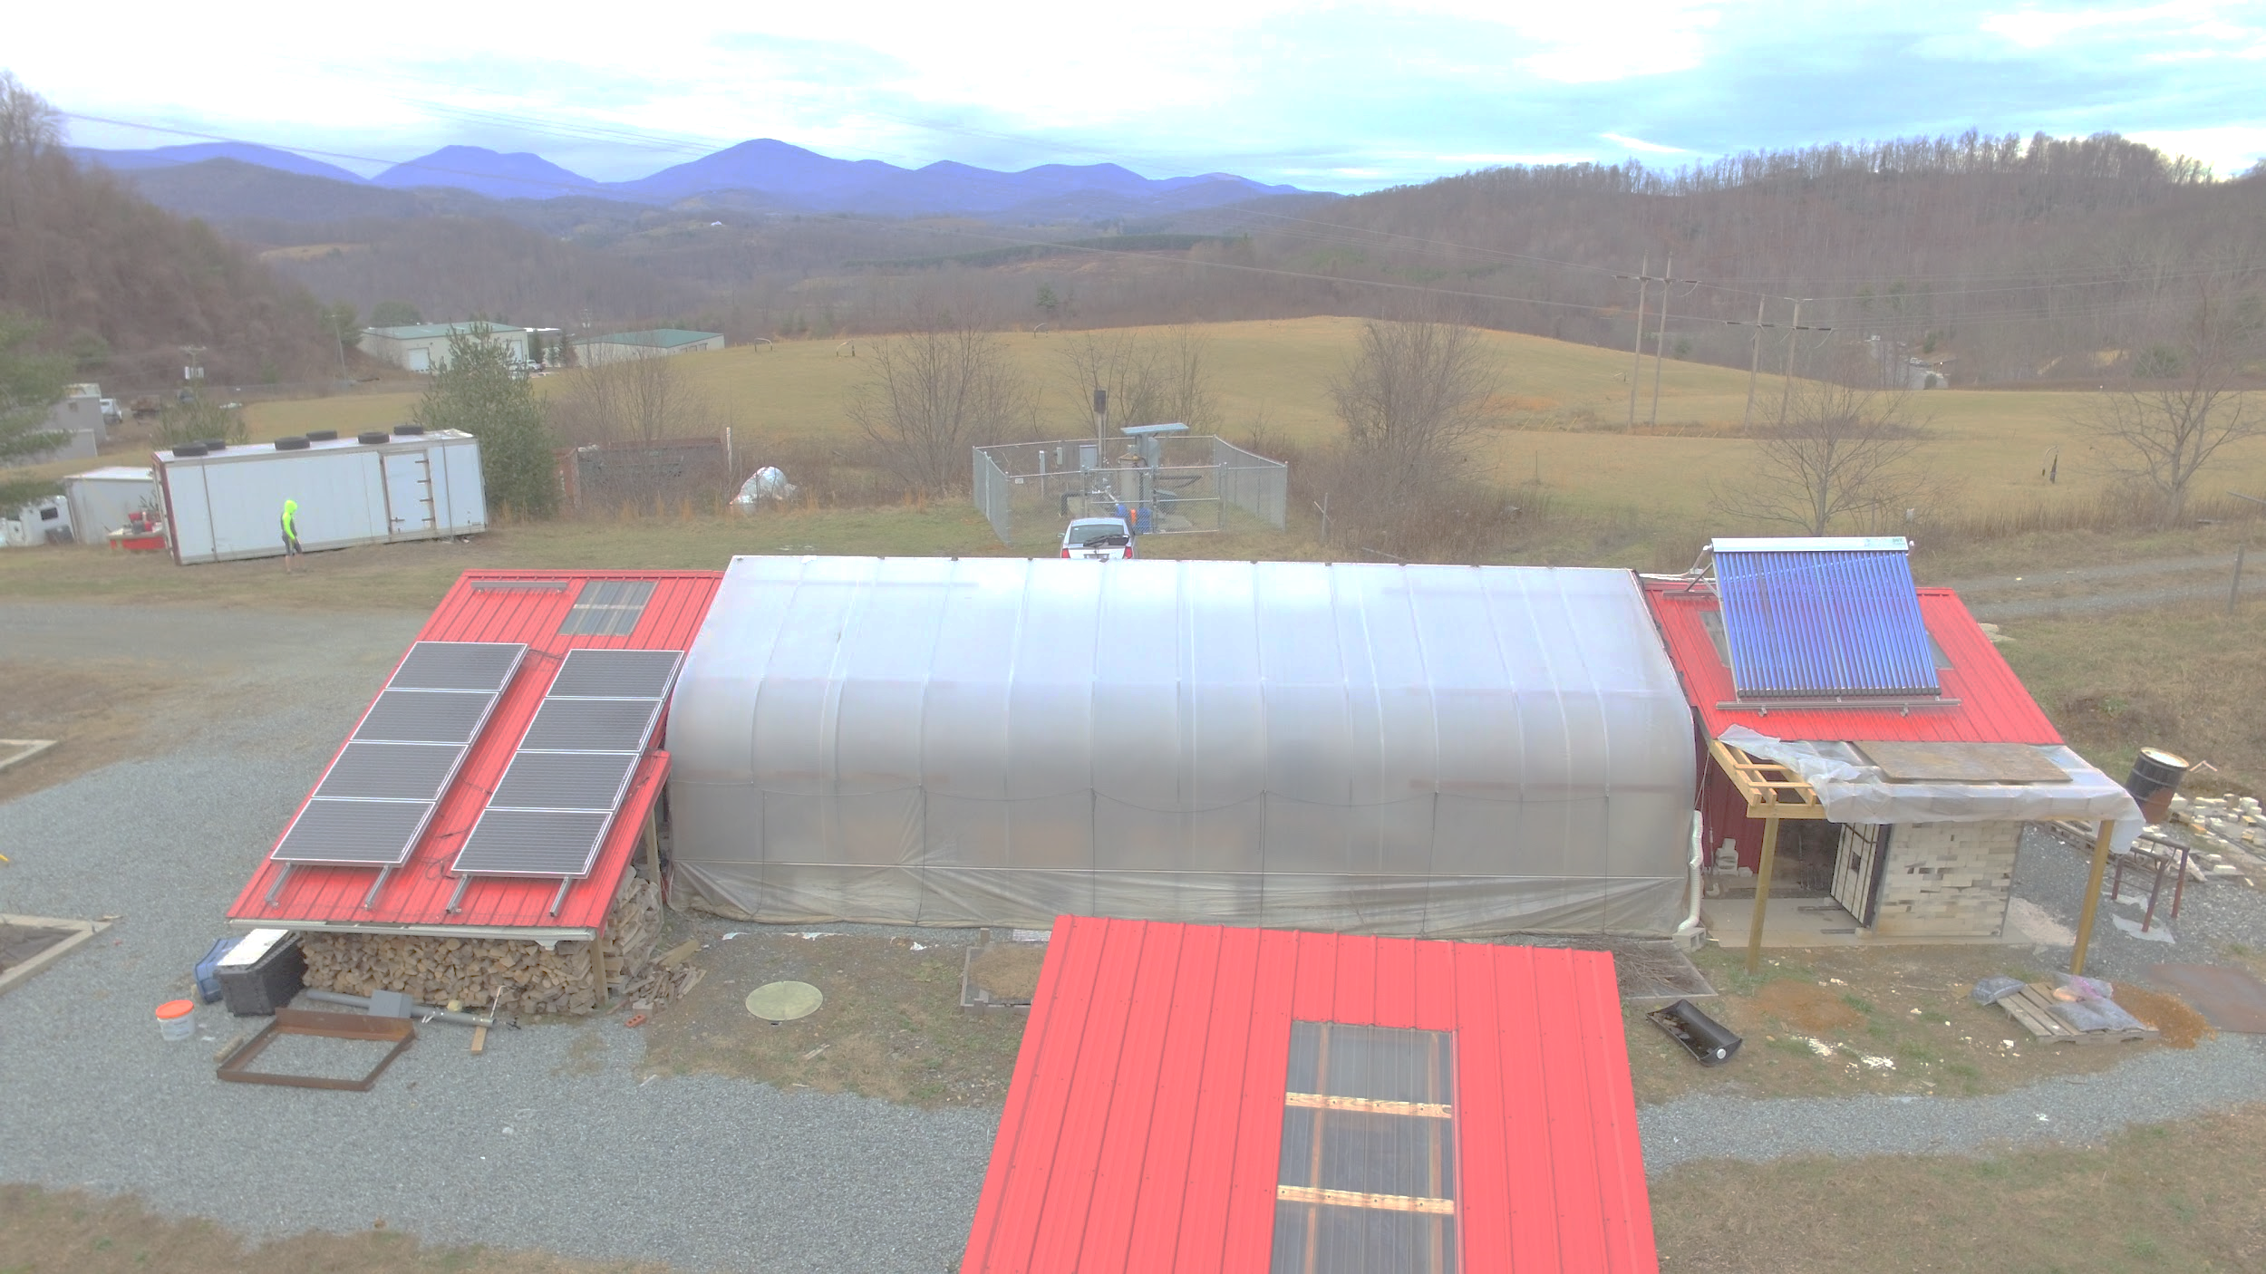
The AppState Nexus Project: Slaughterhouse Waste to Nutrient Recovery BRI: 2024-2026
Jeremy Ferrell, PhD
Associate Professor & Assistant Chair
Department of Sustainable Technology & the Built Environment
Appalachian State University
NCDA & CS – Research Update
March 6, 2025
Notes:
Nexus Project: Integrated Sustainable Energy for Enhancing Farm Productivity
Multidisciplinary research team. On this project: Mike Hambourger- Chemist, Hei-young Kim- Chemical Engineer, Kevin Gamble- Certified Compost Manager, Jeremy Ferrell-Bio & Ag Engineer

Slide 2
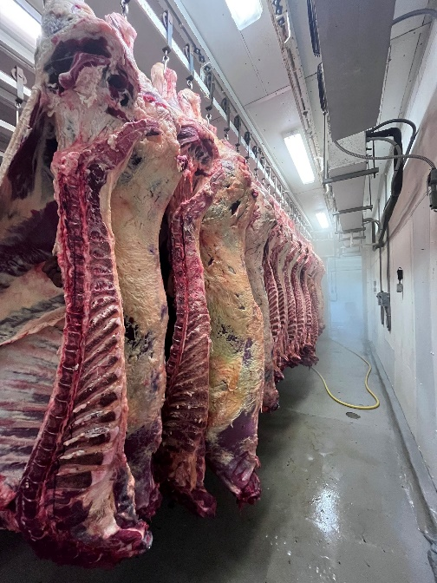
Project Background: Watauga County “Kill & Chill” Facility
PPP model
Watauga County Landfill (2 acre site)
30 beef-head/day capacity
$4.2M (Golden Leaf, Tobacco Trust Fund, ARC, EDA)
“Controversial” project hearing– required Town of Boone water/sewer
Facility Operator selected through Bidding process: Piedmont Custom Meats. Fall-out due to local family-owned business not being selected
General Contractor: DH Griffin – ongoing talks
Notes:
Kill and Chill: animals (beef/pork primarily) killed, dressed, drained, hung for 14 days in a cooler. Then transported to processing into cuts & packaging
The livestock processing center (primarily for beef and pork) is critically needed due to a shortage of local slaughter and processing capacity, with the nearest USDA-inspected slaughter facility a 1-to-2-hour drive from the Watauga County site. Widespread shortages of meat during the COVID-19 shutdown revealed how fragile the meat production system is, even without disruptions to energy and transportation systems

Slide 3
The issue & opportunity
No offal rendering (Darling Ingredients) due to location and scale
Current business plans account for landfilling offal (~$60/ton)
Unsustainable nutrient flow and counter to environmental stewardship of rotational grazing
AND
Additive to the needs of a proposed Watauga County Compost Facility – Commissioned Engineering & Resource Study in 2020 reports Nitrogenous materials would need to come from source separated food waste collection.

Slide 4
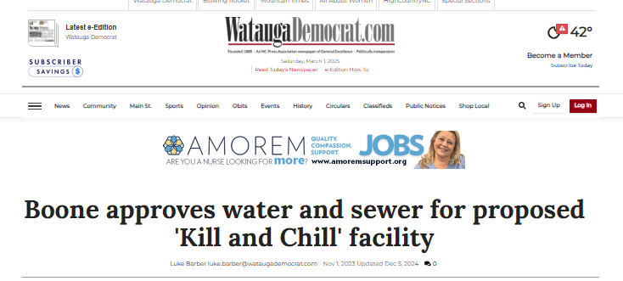
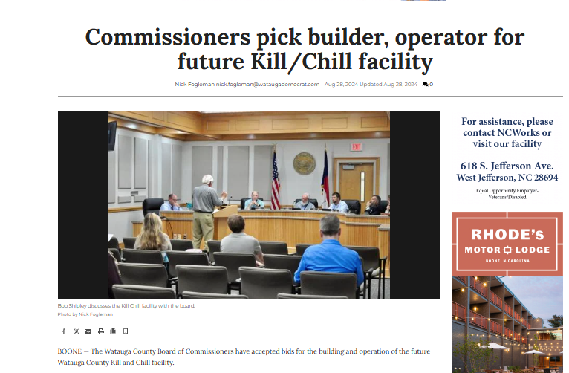
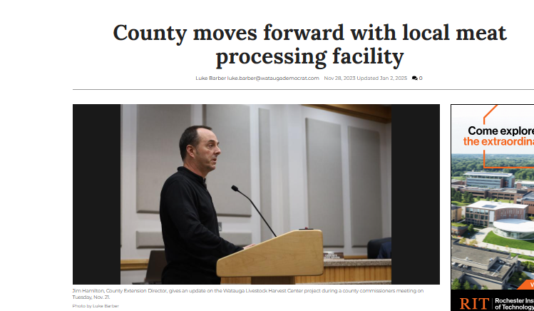
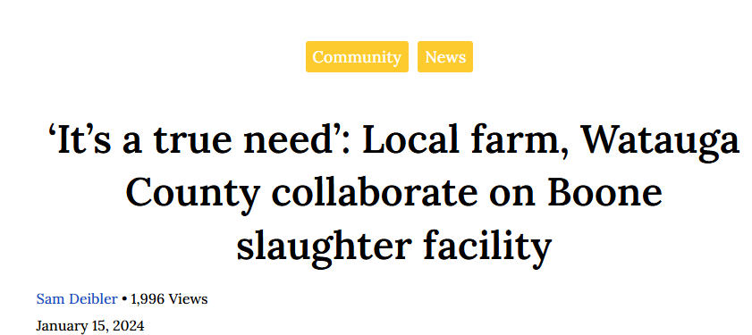

Slide 5
Project Objectives
Lab testing of BCAD with slaughterhouse wastes using the Bioprocess Control AMPTS II
Pilot-scale aerated static compost processing to determine nutrient analysis and compost efficacy
LCA and cost benefit analysis for proposed Watauga County Compost Facility
Outreach and dissemination to project partners

Slide 6
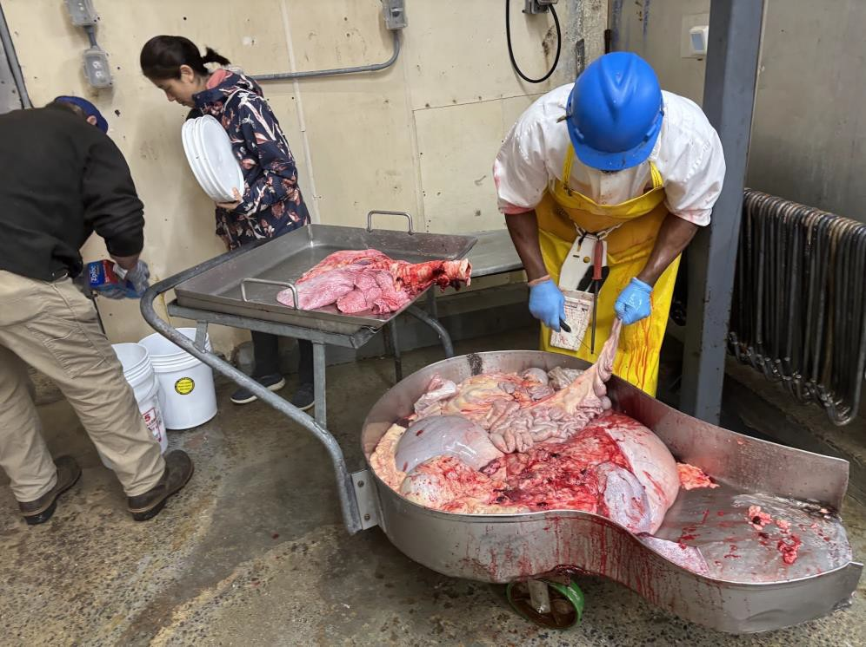
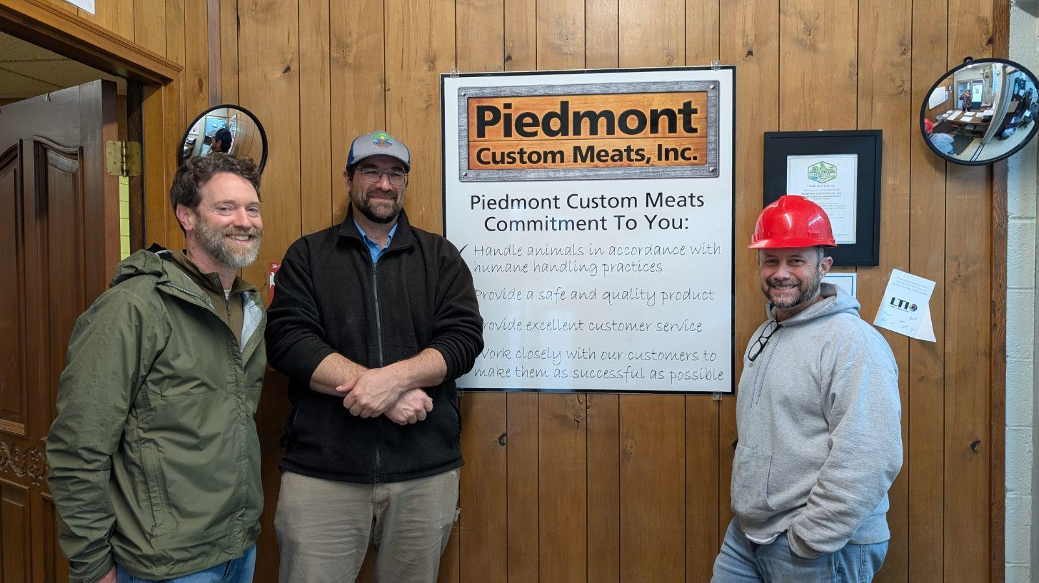
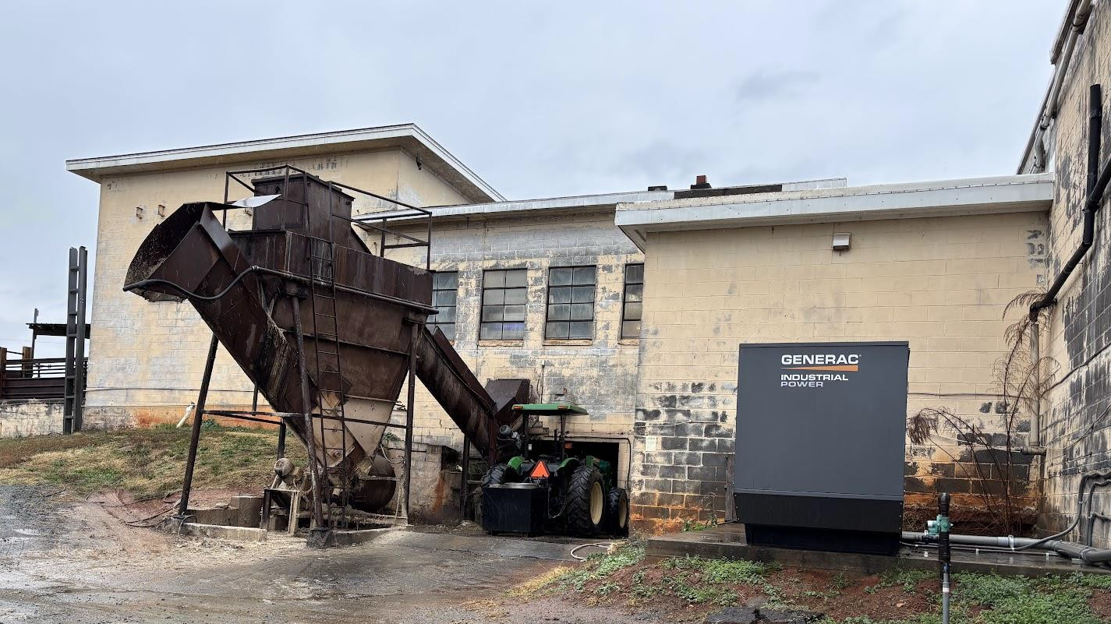
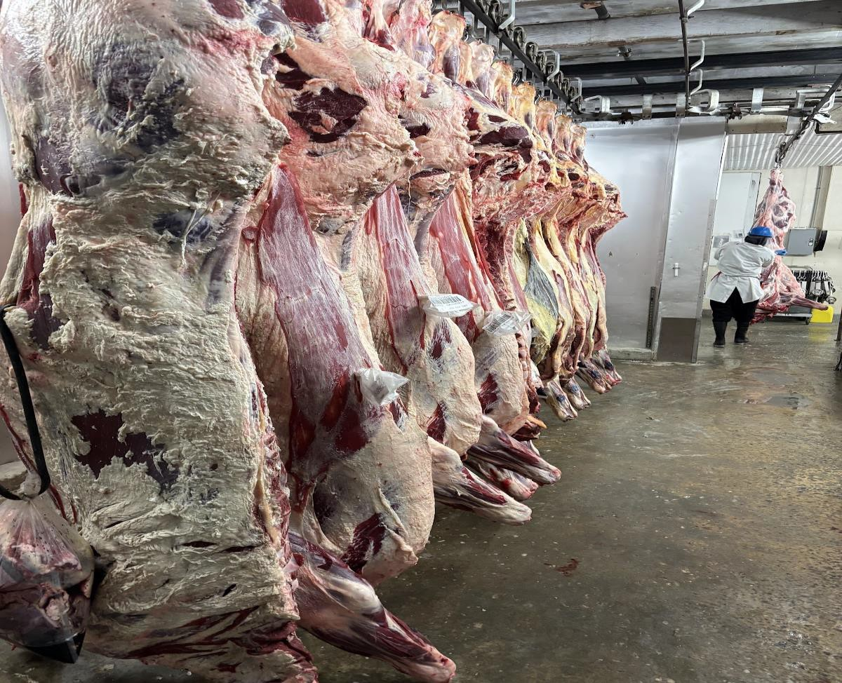
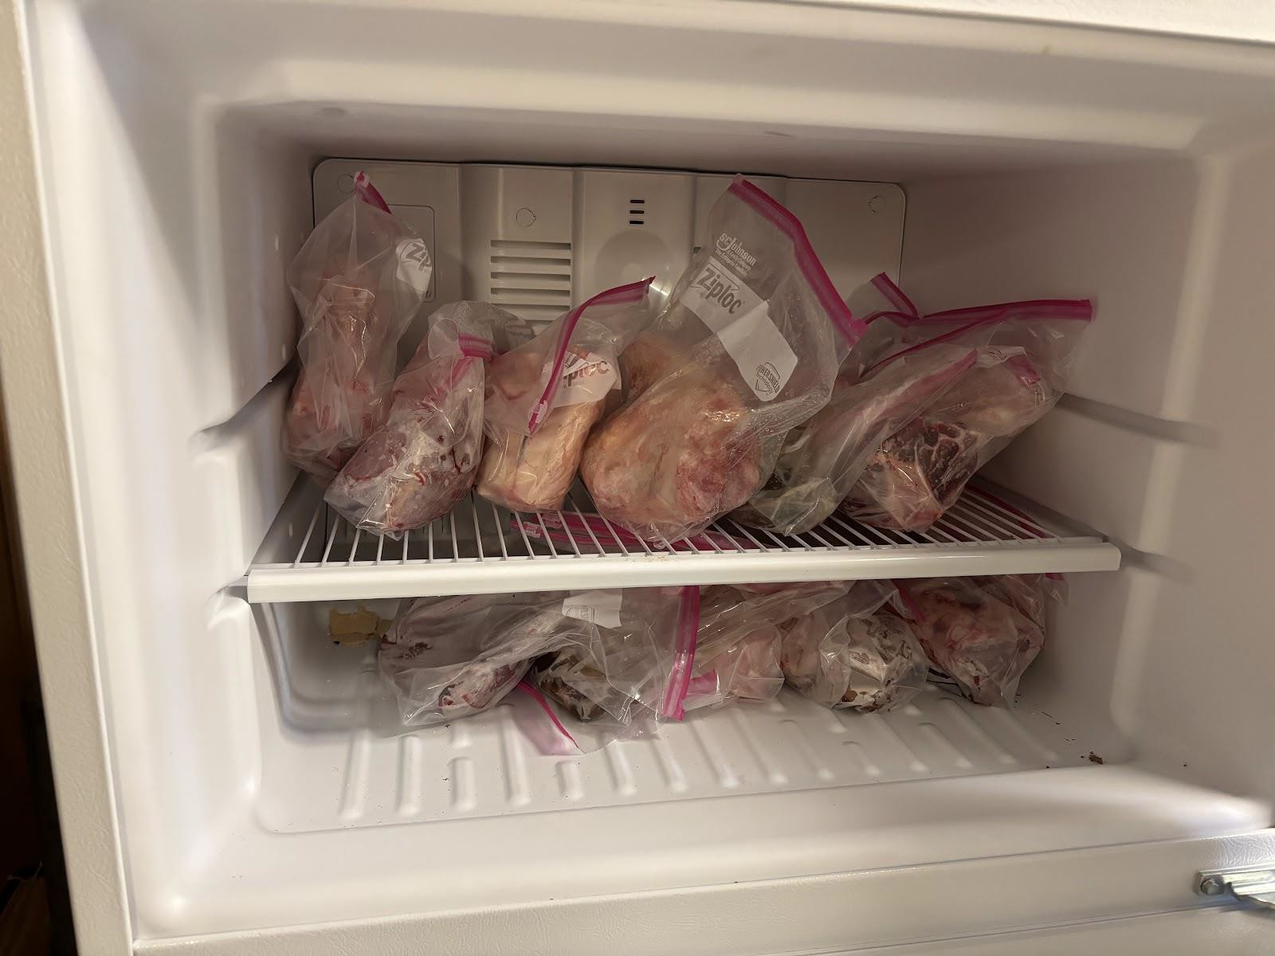
Piedmont Custom Meats Site Visit
Notes:
Similar scale to Watauga facility.
Piedmont Custom meats is interested in a digester

Slide 7
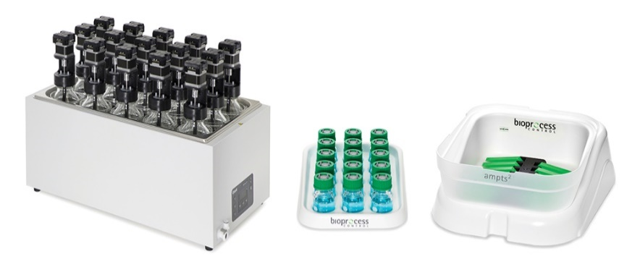
1) Biochar Combined Anaerobic Digestion (BCAD) with food waste: Bioprocess Control AMPTS
y= 14.044*exp^(-1.191x) + 5.8716
R² = 0.9961
Notes:
The chart on the left shows that additional biochar up to 10 g/L improves time to evolve biogas. The difference between 2.5 g/L and 5 or 10 g/L is very small, indicated minimal effect for increased biochar dosing to the slurry.
The chart on the right shows how increases of biochar improve induction time (time to evolve gas). Around 2 g/L appears to be the maximum benefit. The correlation value is excellent, meaning high reproducibility.

Slide 8
1) Biochar Combined Anaerobic Digestion (BCAD) with food waste
The Food waste + biochar yielded 7.8% more cumulative methane over the 4 month experiment
Notes:
NmL is volume in milliliters under standard conditions (0 deg C and 1 atm).

Slide 9
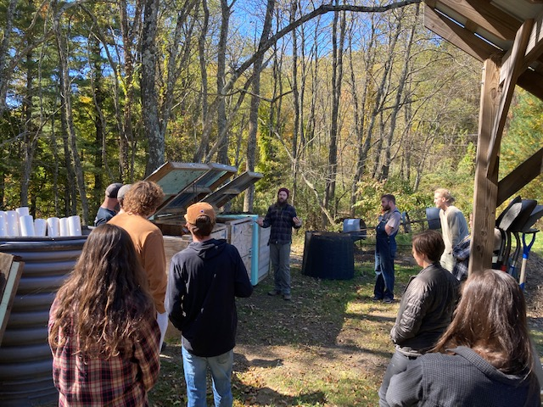
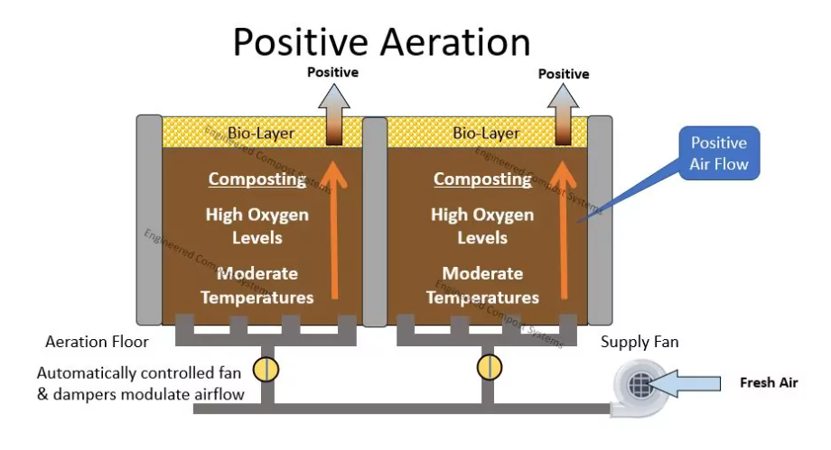
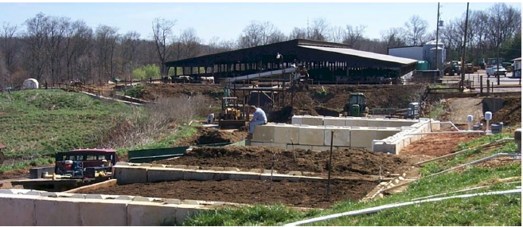
2) Pilot Aerated Static Compost
Watauga “Transfer Station”
“Exploring Organic Composting Options in Watauga County” – July 2020
Baker Advisers & Coker Composting & Consulting
C-based material: LCID (Land Clearing & Inert Debris), 20 Cubic yards/day
N-based materials: Source separated from groceries, restaurants, breweries, etc. ~5 CY/day NEED COLLECTION
Mountain Organic Materials, Buncombe County
https://compostsystems.com/systems/aerated-static-piles/
Notes:
Kevin Gamble- certified composter is leading this effot

Slide 10
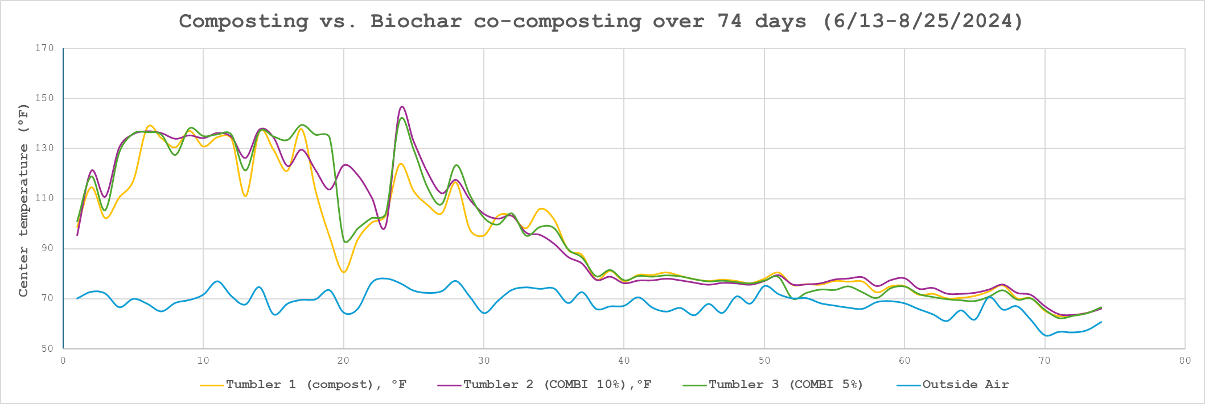
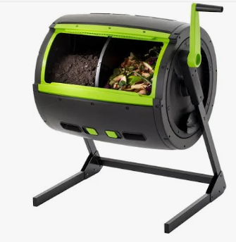
2) Co-compost with Biochar, 5% and 10% by wt.
60 gallon Tumbler
 | Tumbler 1 (compost), °F | Tumbler 2 (COMBI 10%),°F | Tumbler 3 (COMBI 5%) | Outside Air
AVG Temp (F) | 109.6 | 115.3 | 115.3 | 70.7
MAX Temp (F) | 138.4 | 145.5 | 141.5 | 78.1
Biochar additions raise average and maximum internal temperatures
Notes:
Tumbler 1: 189 lbs food waste/wood chips mixed from AppState Compost facility
Tumbler 2: 189 lbs of food waste/wood chips PLUS 21lbs of biochar (hybrid poplar from open pit kiln)
Tumbler 3: 189 lbs of food waste/wood chips PLUS 10 lbs of biochar (hybrid poplar from open pit kiln)
Table data is after 40 days, where compost temps level off.

Slide 11
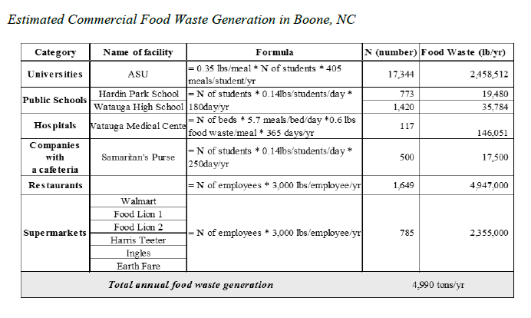
3) LCA & CBA of Commercial Compost Facility
SH offal waste at facility capacity could provide~1/5 of N-based materials as an on-site source
Add SH waste scenarios to existing estimates
Develop CBA based on Capital and O&M costs

Slide 12
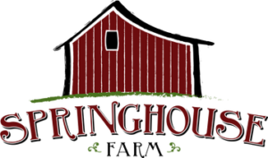
4)Outreach and Dissemination to Project Partners
Notes:
This project stands to advance the bioenergy industry in NC by demonstrating the feasibility of synergetic bioenergy technologies to manage community derived organic waste streams. Biochar coupled with anaerobic digestion and aerated composting create both energy (methane and waste process heat) and soil amendments that stay in the regional community. This project supports the larger efforts in Watauga County that are currently investing in a regional slaughterhouse and have future plans to invest in a compost facility. The LCA and cost benefit analysis produced through this project will directly inform County officials on the use of biochar and anaerobic digestion as tools and techniques for organic waste management. The appropriate partners and interest are in place to make Watauga County a successful model for other rural counties to support the economic viability of their farming communities while reducing the cost and emissions associated with landfilling.

Slide 13
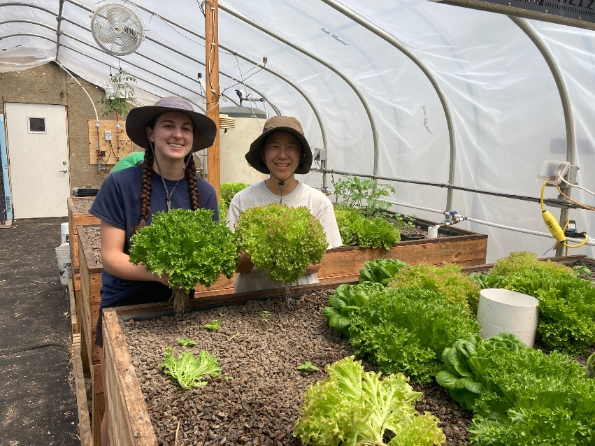
Thank you for your attention! Any questions?

