Slide 1
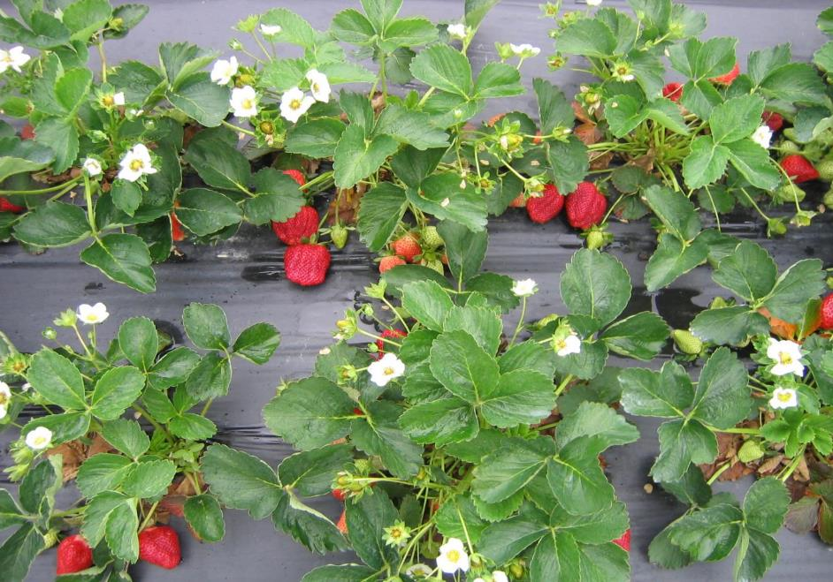
Managing “Neo-P” Neopestalotiopsis on Strawberry
NCDA&CS New and Emerging Crops Program
2025 Research/Industry Update
6 March 2025
Bill Cline, NCSU
Entomology and Plant Pathology
Horticultural Crops Research Station
Castle Hayne, NC

Slide 2
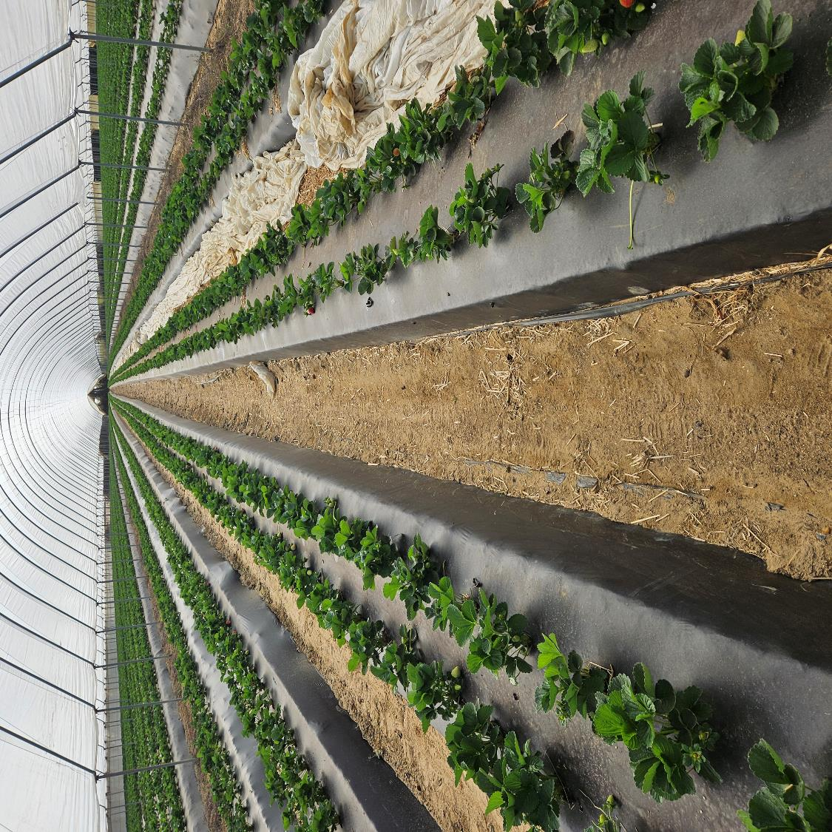
Annual Plasticulture Strawberries in NC
Fumigate/drip/lay plastic in Aug-Sep
Plant Sep-Oct
Harvest Apr-Jun
Mostly open field, PYO or direct marketed
Some commercial shipping, including high tunnel winter production (shown)

Slide 3
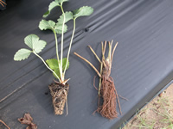
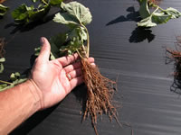
Plants come mostly from US and Canadian nurseries
Cut-off
Plug
Runner tips, i.e,“root your own”
Plug plants
Green-dug plants
Cut-offs (California)
Green-dug

Slide 4
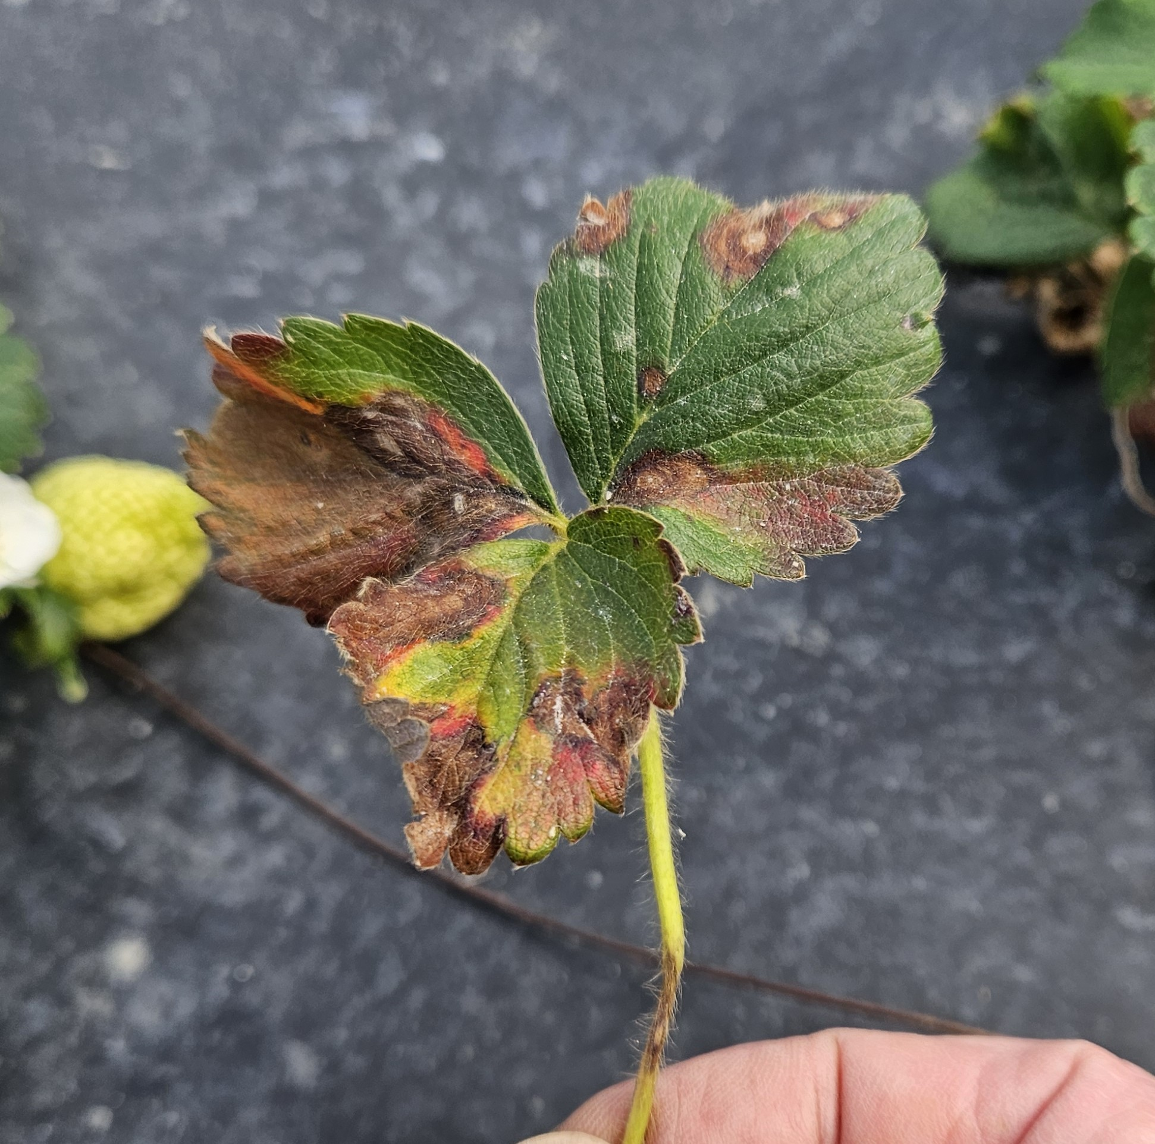
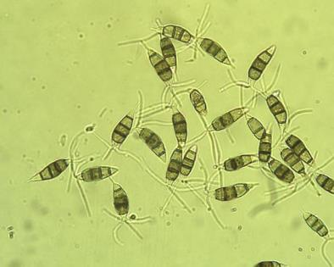
THE PROBLEM – a NEW
and aggressive pathogen
(Neopestalotiopsis spp.)
Has infested nurseries
that supply our growers

Slide 5
Some of what we know…
Species/isolates can vary in aggressiveness
Introduced on infected planting stock
Can persist (over-summer) in plant debris (??)
Infection requires a wetness period (>12 hrs)
Can be spread by wind, rain, equipment, workers
Best labeled fungicides are Thiram, Switch
FRAC 3 products also useful (Orbit, Rhyme, Inspire)

Slide 6
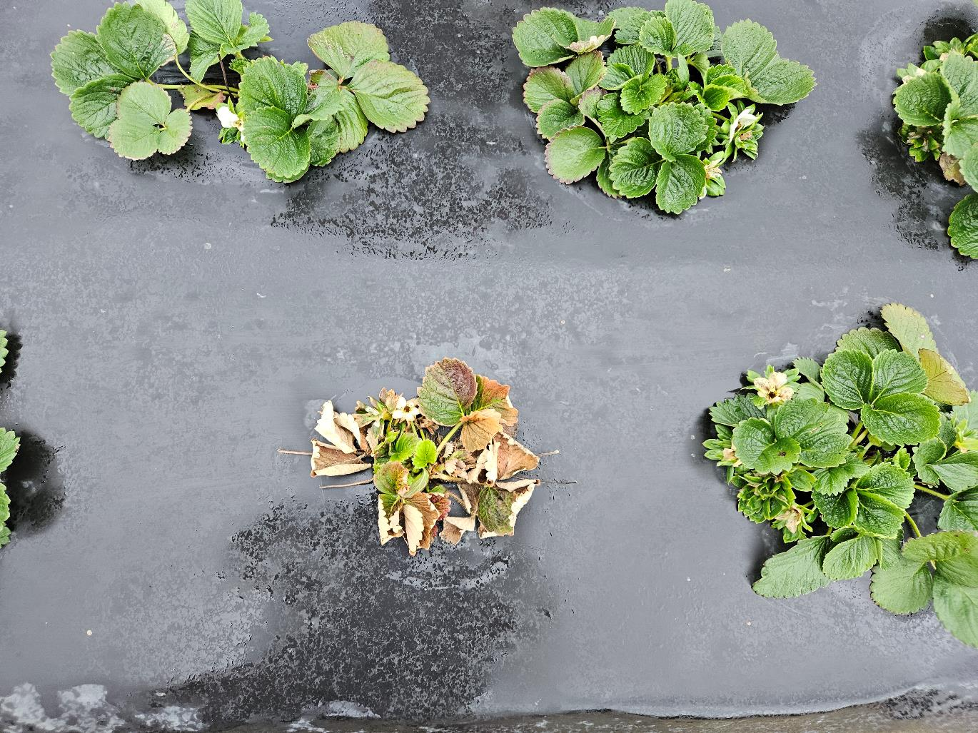
Plant-borne infections produce characteristic stunting and reddening of leaves

Slide 7
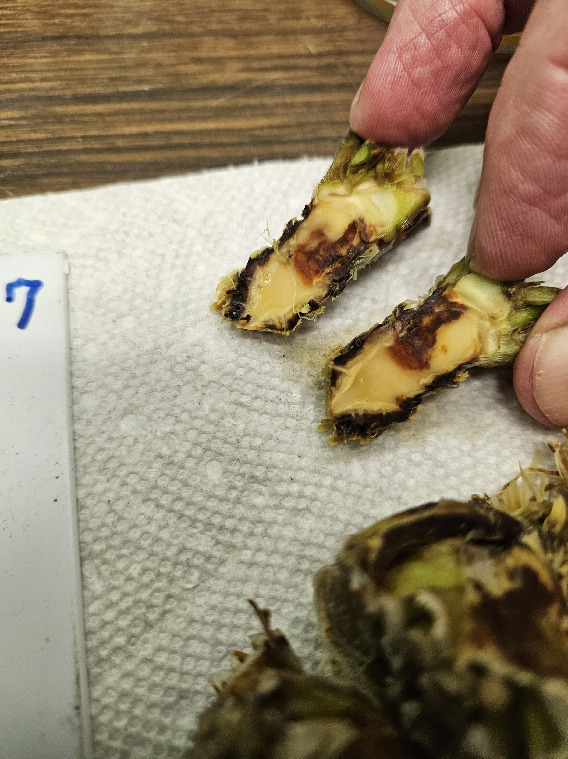
Neopestalotiopsis sp. (Neo-P) can cause crown disease (shown), leaf spots and fruit rot
Introduced on planting stock (many states)
Symptoms similar to other crown rots on strawberry
Report -- submit samples for diagnosis (200+ in 2024)
Crown infection is the most common symptom we see in NC

Slide 8
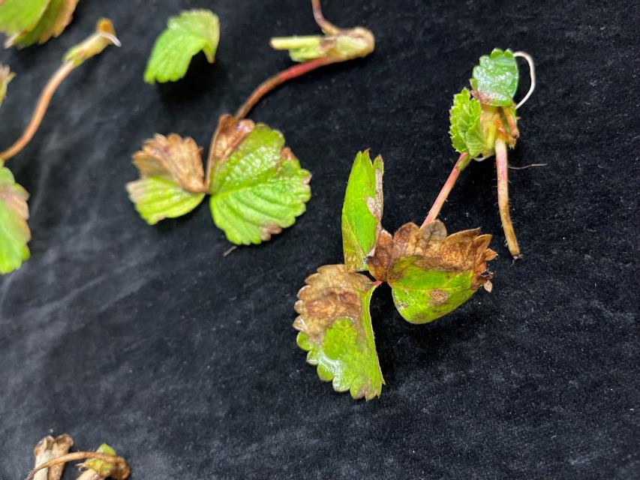
Neop. on infected tips in the rooting bed (PDIC sample)

Slide 9
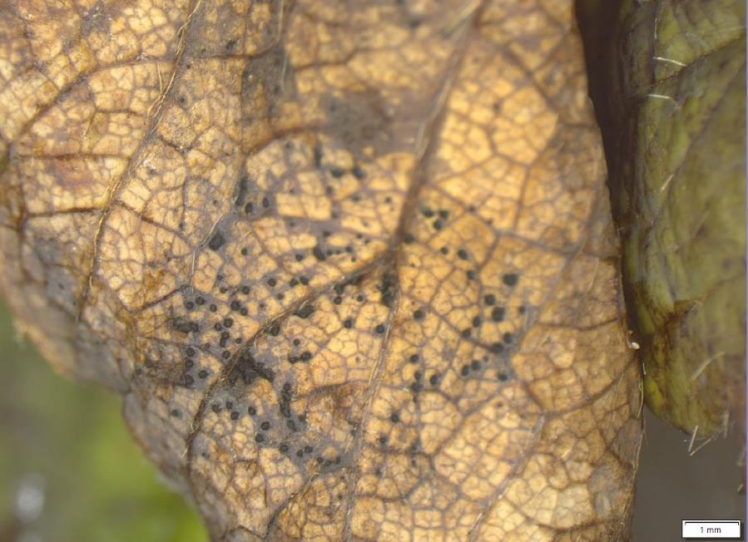
Spore masses on the underside of a leaf following incubation in a moist chamber
Image courtesy of S. Moparthi, PDIC

Slide 10
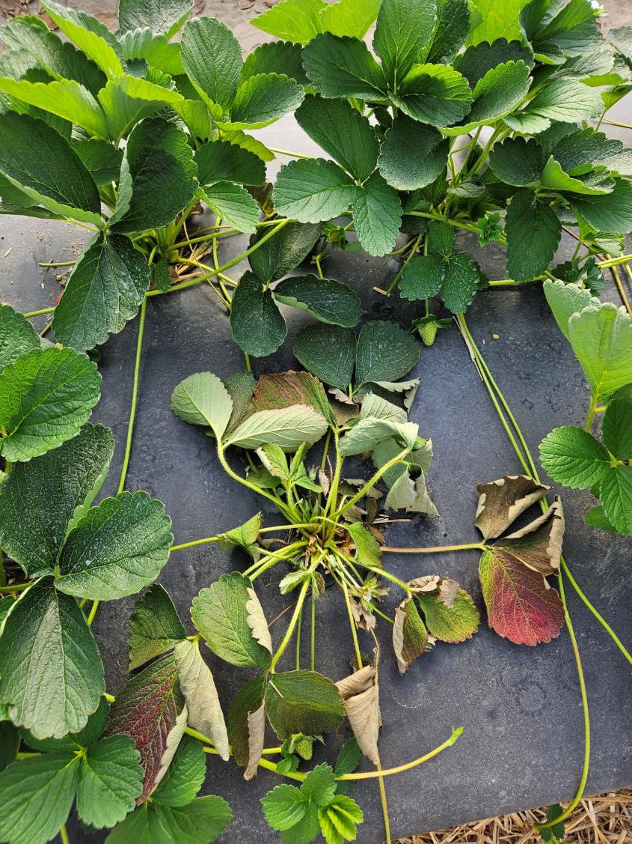
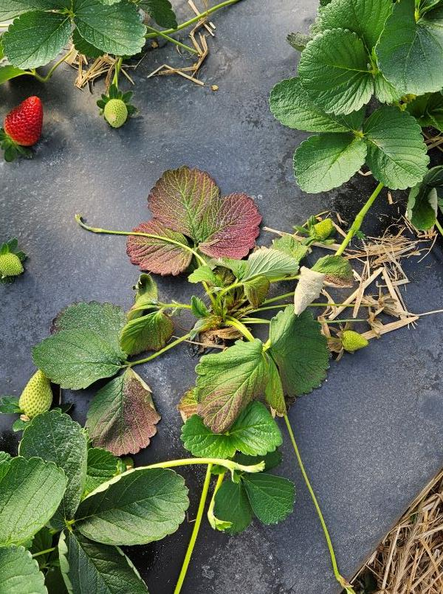

Slide 11
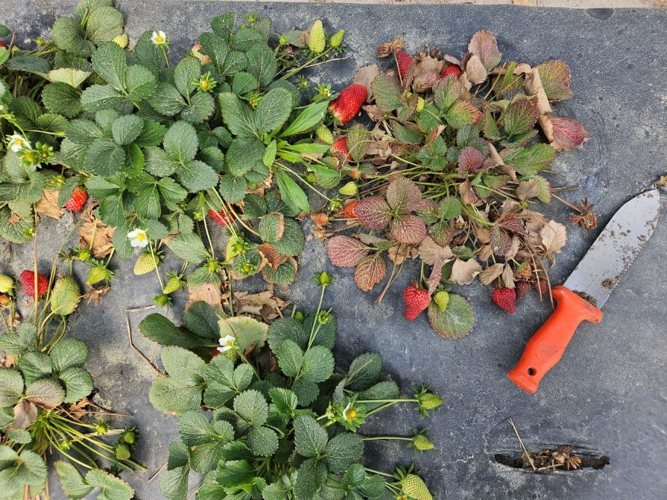

Slide 12

Managing Neopestalotiopsis
Disc harrow, bottom plow to bury debris
Fumigate; Rotate fields if possible
Use disease-free plants
Monitoring and sanitation; handle fruit/plants DRY
Alternating fungicide applications
  Switch (FRAC 9+12)
  Rhyme, Inspire, Tilt, (FRAC 3)
  Thiram (FRAC M03)

Slide 13
Fall/Winter disease management strategy
Diagnosis – Identify the pathogen or abiotic cause before treating with fungicides or other products
Fungicides as needed, based on correct diagnosis
Manage row covers to avoid a “moist chamber” effect that can encourage disease
Remove infected plants as they occur
Use mostly protectant fungicides, saving other fungicide modes of action for Spring disease control during harvest

Slide 14
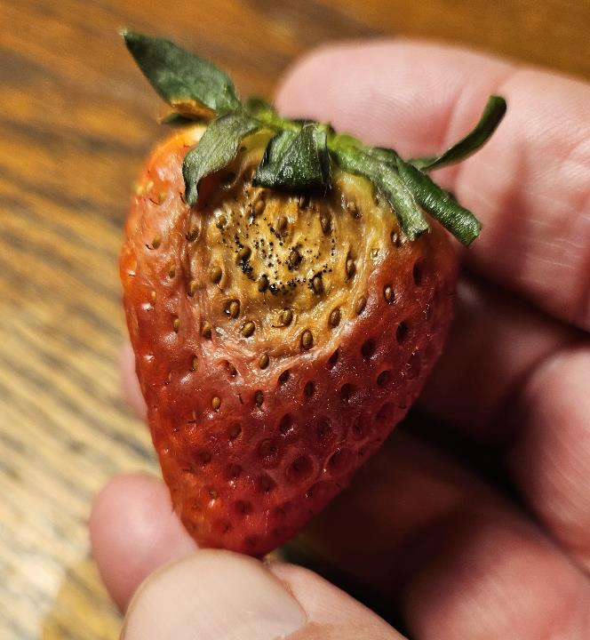
NEOPESTALOTIOPSIS FRUIT ROT

Slide 15
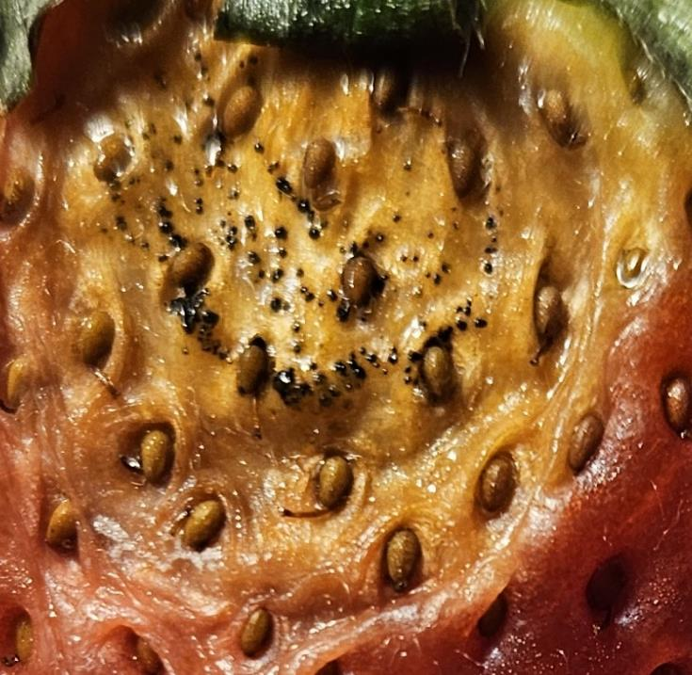
ID: sunken lesions with BLACK spore masses

Slide 16

Gray Mold
(Botrytis)
Anthracnose
(Colletotrichum)
Switch (9+12)
Miravis Prime (7+12)
Pristine (7+11)
Merivon (7+11)
Inspire Super (3+9)
Luna Sensation (7+11)
Polyoxin D, Oso (19)
Captan (M04)
Thiram (M03)
Elevate (17)
Kenja (7)
Fontelis (7)
Scala (9)
Rovral (2)
Luna Tranquility (7+9)
Abound (11)
Cabrio (11)
Flint Extra (11)
Quadris Top (3+11)
Quilt Excel (3+11)
Mode of action
in parentheses ( ).
All products shown are rated “Good” to “Excellent”, see:
https://smallfruits.org/files/2020/12/2021-Strawberry-IPM-Guide.pdf

Slide 17
Gray Mold
(Botrytis)
Anthracnose
(Colletotrichum)
Switch (9+12)
Miravis Prime (7+12)
Pristine (7+11)
Merivon (7+11)
Inspire Super (3+9)
Luna Sensation (7+11)
Polyoxin D, Oso (19)
Captan (M04)
Thiram (M03)
Elevate (17)
Kenja (7)
Fontelis (7)
Scala (9)
Rovral (2)
Luna Tranquility (7+9)
Abound (11)
Cabrio (11)
Flint Extra (11)
Quadris Top (3+11)
Quilt Excel (3+11)
Rhyme (3)
Inspire (3)
Tilt (3)
Mode of action
in parentheses ( ).
Neopestalotiopsis

Slide 18
Year-round Best Management Practices
Limit field operations, such as harvesting and spraying, when plants are wet.
Sanitize hands, shoes, and clothing when moving out of infected fields.
Clean and disinfect equipment when moving out of infected fields.
Remove and destroy symptomatic plants to reduce the spread of disease.
Apply efficacious fungicides in rotation with routine sprays for other diseases.
Use good harvest sanitation practices — avoid overhead watering, cull & destroy infected fruit.

Slide 19
Research Goals/Questions
Identify and characterize isolates in NC.
Find resistant cultivars!!! Inoculated cultivar trials in 2025 to be conducted at Castle Hayne.
Does reinfection occur from plant debris in soil?
Can the pathogen persist in soil without plant debris?
Does reinfection occur through re-use of row covers?
  If so, can row covers be sanitized?
Are other crops, weeds infected/colonized?
Multi-state collaboration (FL, GA and others)
Evaluate fungicides for efficacy/crop safety

Slide 20
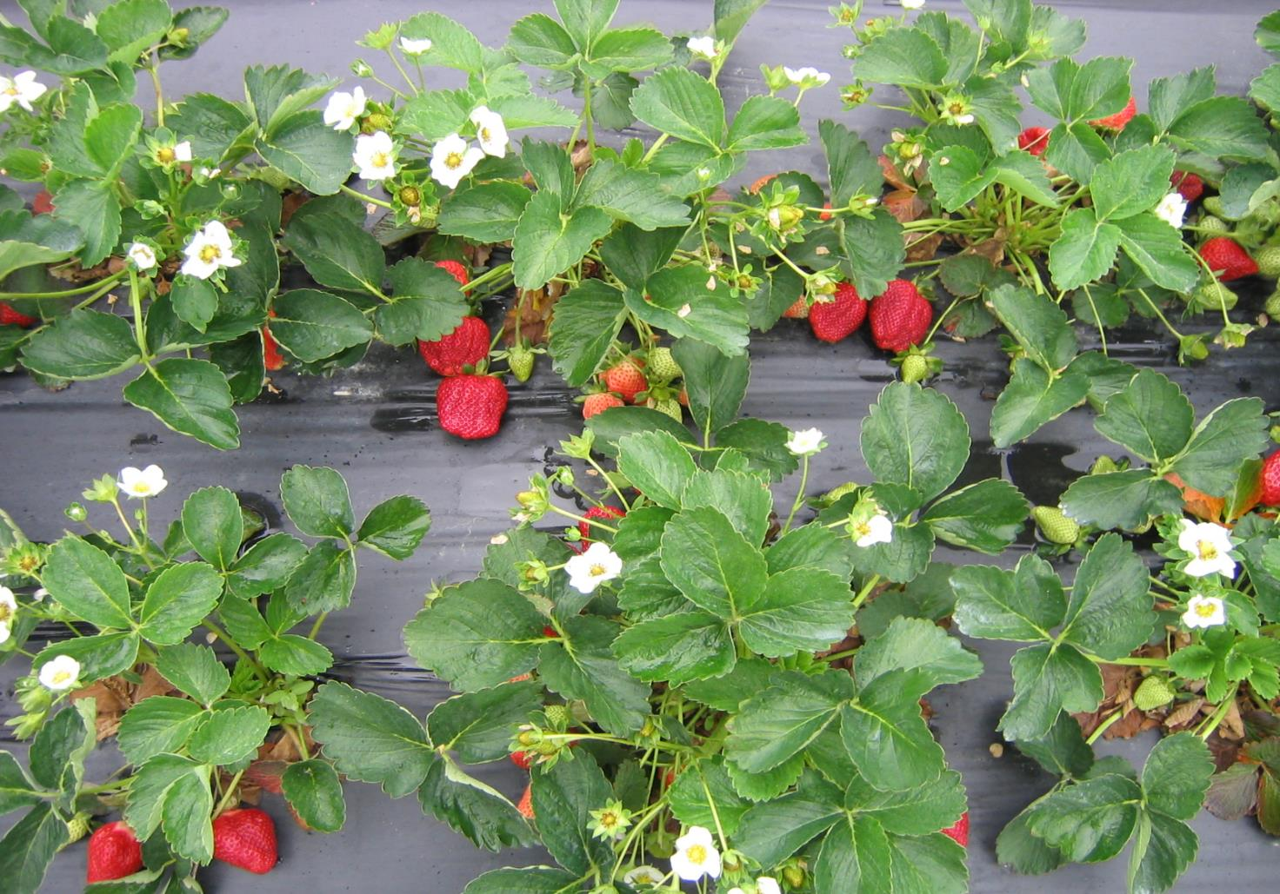
Thank You!
Bill Cline, NCSU
Entomology and Plant Pathology
Horticultural Crops Research Station
3800 Castle Hayne Road
Castle Hayne, NC 28429
910-620-4502
bcline@ncsu.edu

