Slide 1

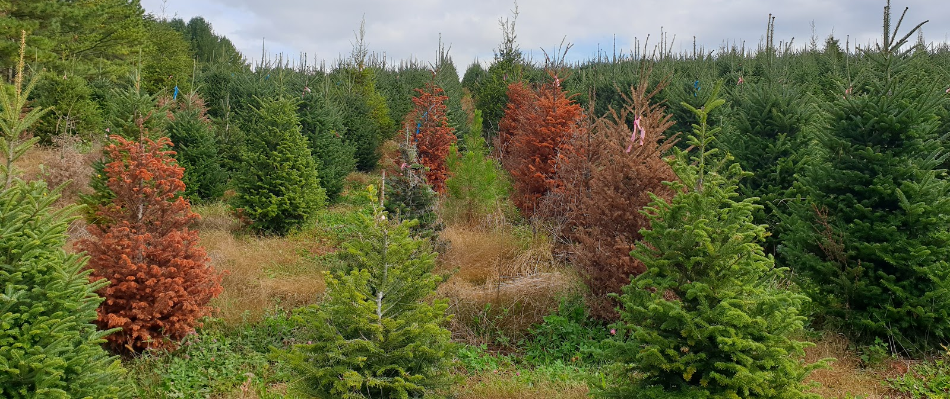
Whitehill Lab – Christmas Tree Genetics Program:
Disease Resistant Exotic Christmas Trees
Justin G. A. Whitehill | Assistant Professor | Dept. of FER
March 6th, 2025
Notes:
`

Slide 2
US Christmas Tree Industry
Fir (Abies spp.) are the premier Christmas trees
The annual value of the US Christmas tree industry is $2.5 billion
  $250 - 400 mil NC annually
Fraser fir accounts for 40% of all trees sold in the US
Fraser fir production is facing serious challenges
40% Fraser fir (Abies fraseri)
2
Percent share of Christmas trees sold annually in the U.S. by genus (USDA 2017)
March 6th, 2025
Notes:
`

Slide 3
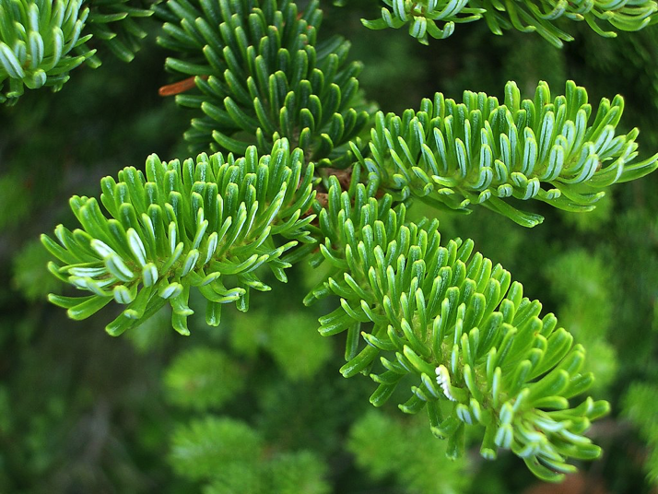
Fraser fir
Fraser fir is native NC
6 naturally occurring island-like populations in the highest peaks of the Southern Appalachian Mountains
  Endangered in the wild
Fraser fir (Abies fraseri)
3
March 6th, 2025
Notes:
`

Slide 4
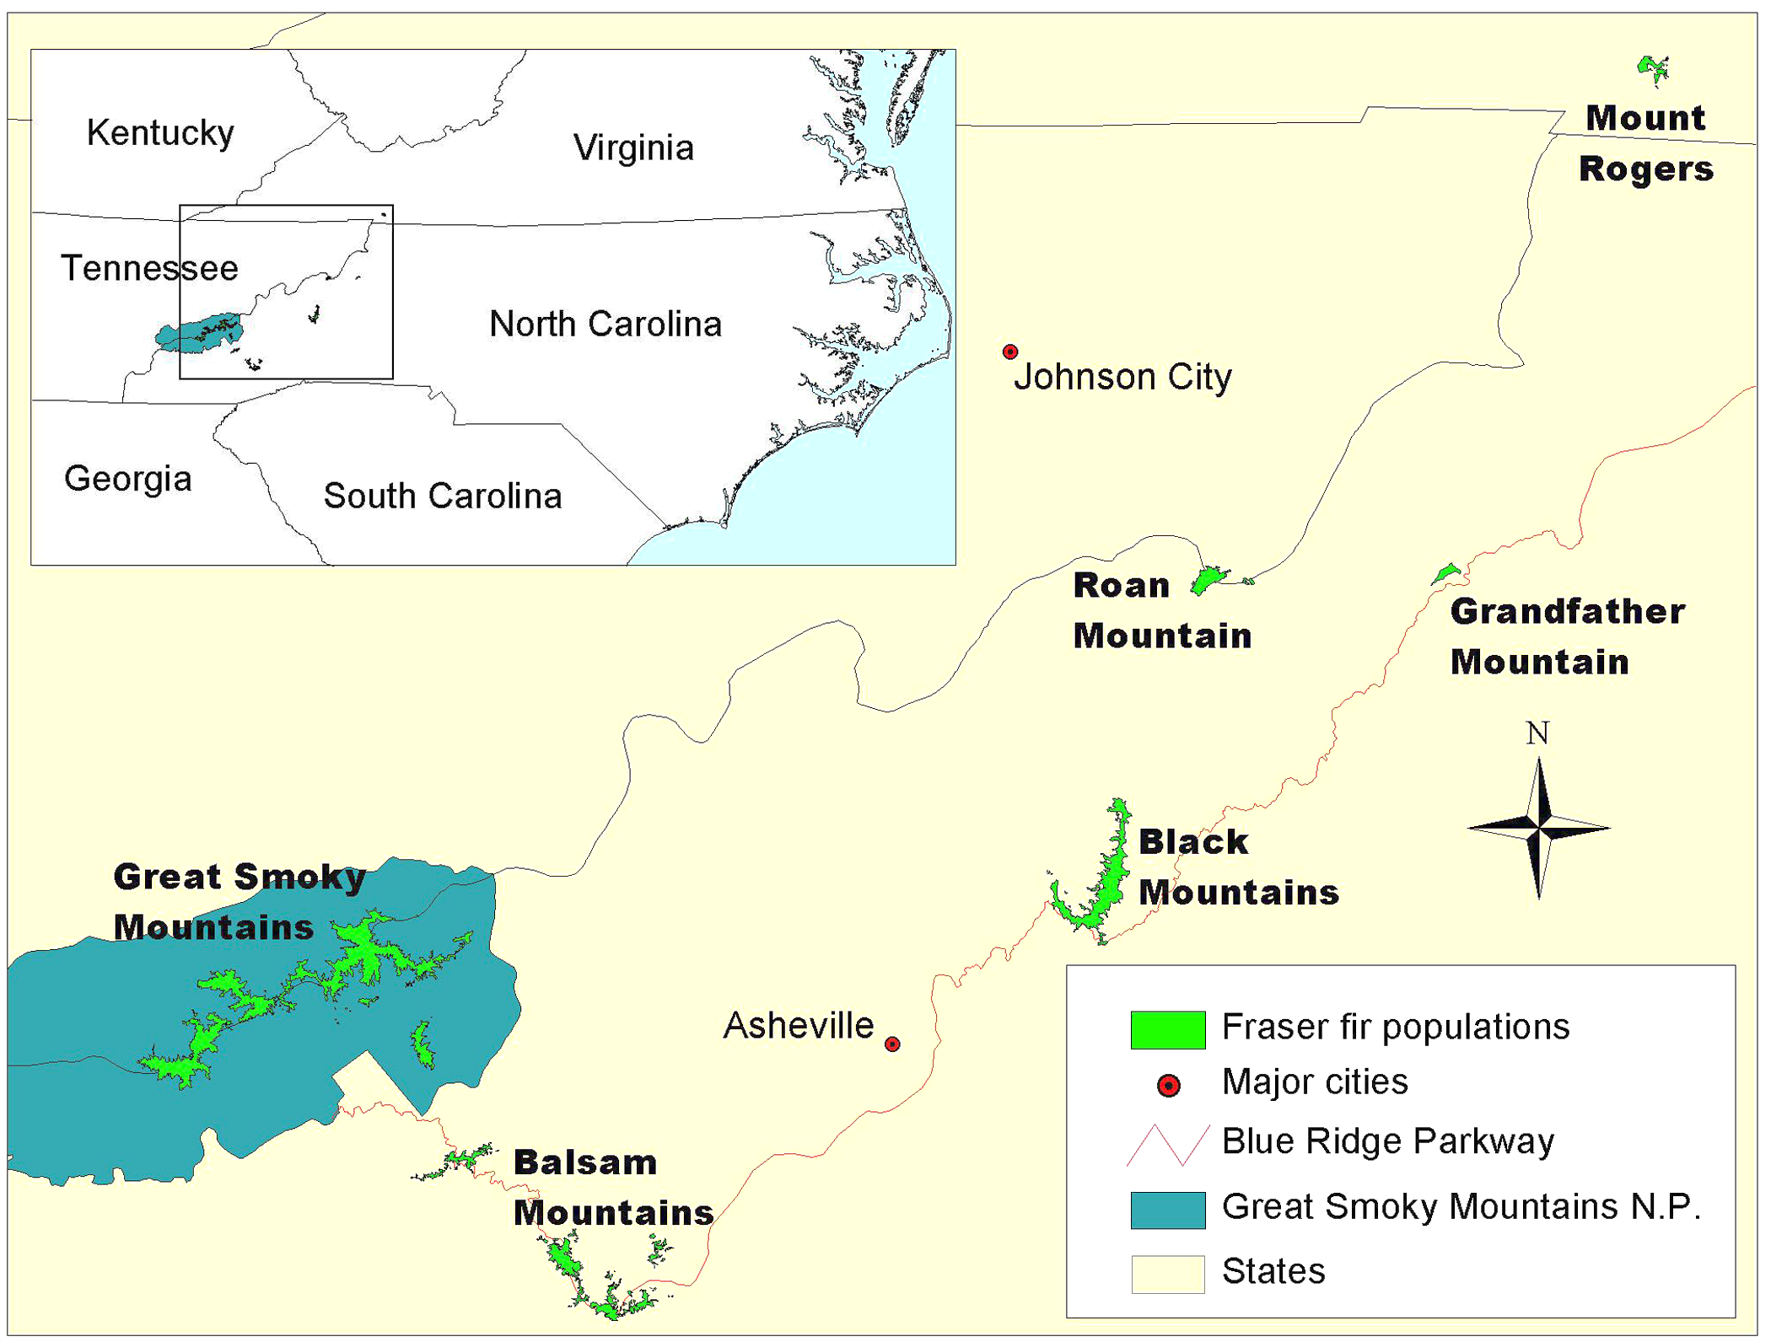
Fraser Fir Natural Distribution
4
Potter et al. 2008.
March 6th, 2025
Notes:
`

Slide 5

Fraser fir
Fraser fir is native NC
6 naturally occurring island-like populations in the highest peaks of the Southern Appalachian Mountains
  Endangered in the wild
Fraser fir known as the “Perfect Christmas Tree” or the “Cadillac of Christmas Trees”
Elite Fraser fir traits include:
  Soft needles
  Post-harvest needle retention
  Long lasting aroma
  Pliable yet strong branches
Fraser fir faces significant problems
Fraser fir (Abies fraseri)
5
March 6th, 2025
Notes:
`

Slide 6
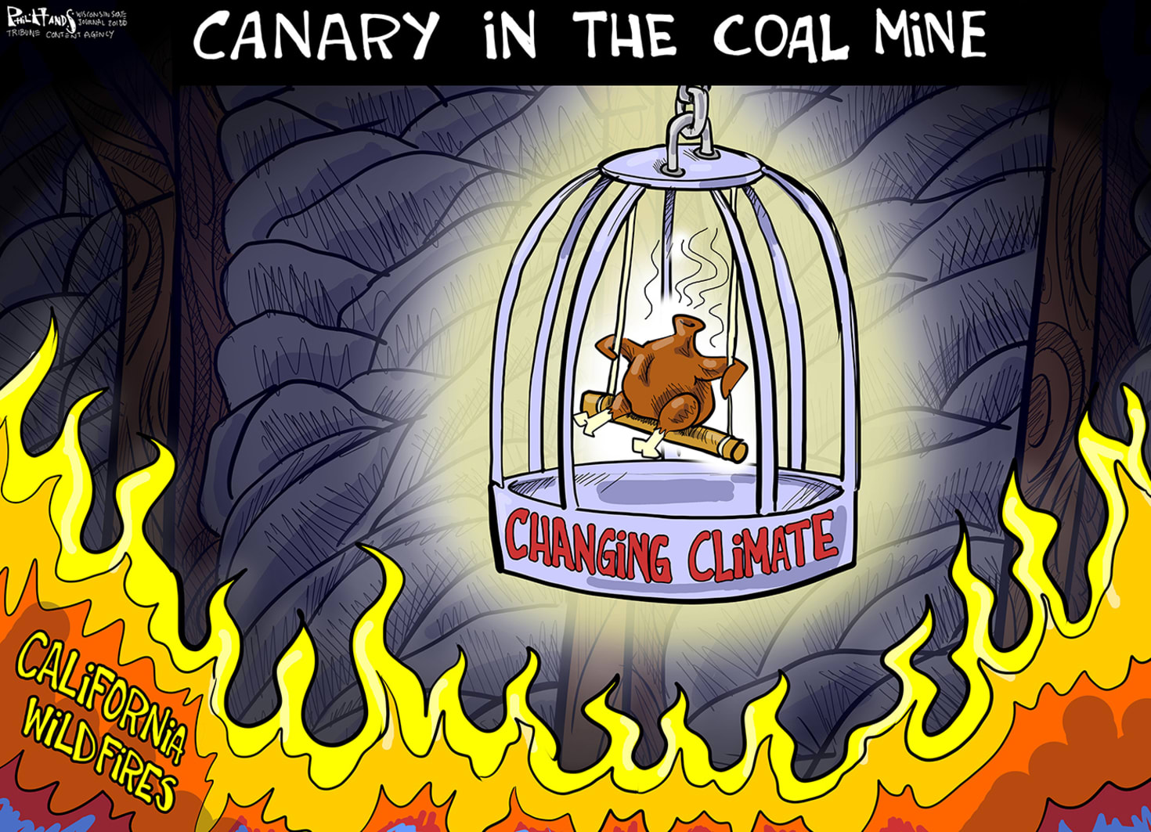

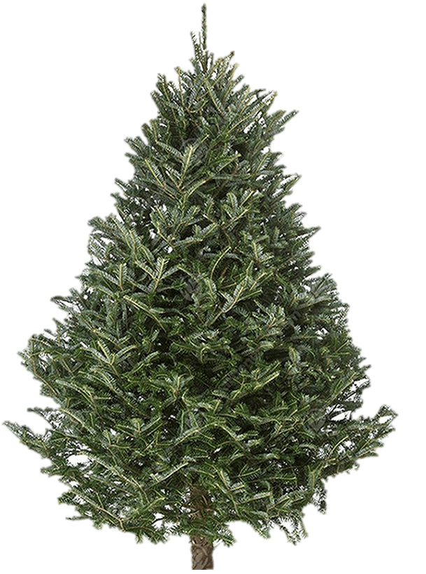




Fraser fir and Climate Change
PRR
Needle Retention
Climate Change
Phytophthora root rot
Increased pest pressure
Insects
Needle retention
Deer Browse
Drought
Elongate Hemlock Scale
6
March 6th, 2025
Notes:
`

Slide 7
Fraser fir and Climate Change
PRR
Phytophthora root rot
Increased pest pressure
Needle retention
Drought
Elongate Hemlock Scale
7
March 6th, 2025
Notes:
`

Slide 8
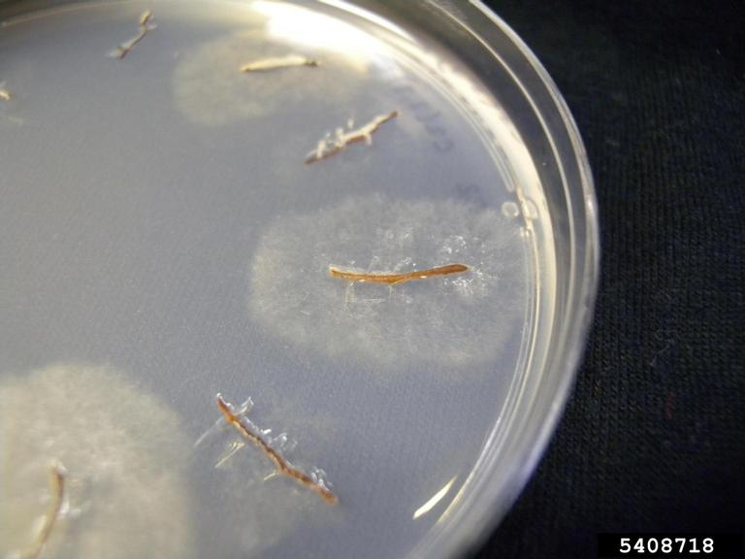
Phytophthora Root Rot (PRR)
Phytophthora: Genus of oomycetes
  Over 200 species
Phytophthora (Greek):
  phytón = “Plant”
  phthorá = “Destruction”, “plant-destroyer”
Likely introduced to the Americas in the 18th century
First reported on Christmas trees in the 1960’s
Phytophthora cinnamomi growing from Fraser fir root samples on PARPH-V8 agar Brantlee Spakes Richter, University of Florida, Bugwood.org
8
March 6th, 2025
Notes:
`

Slide 9
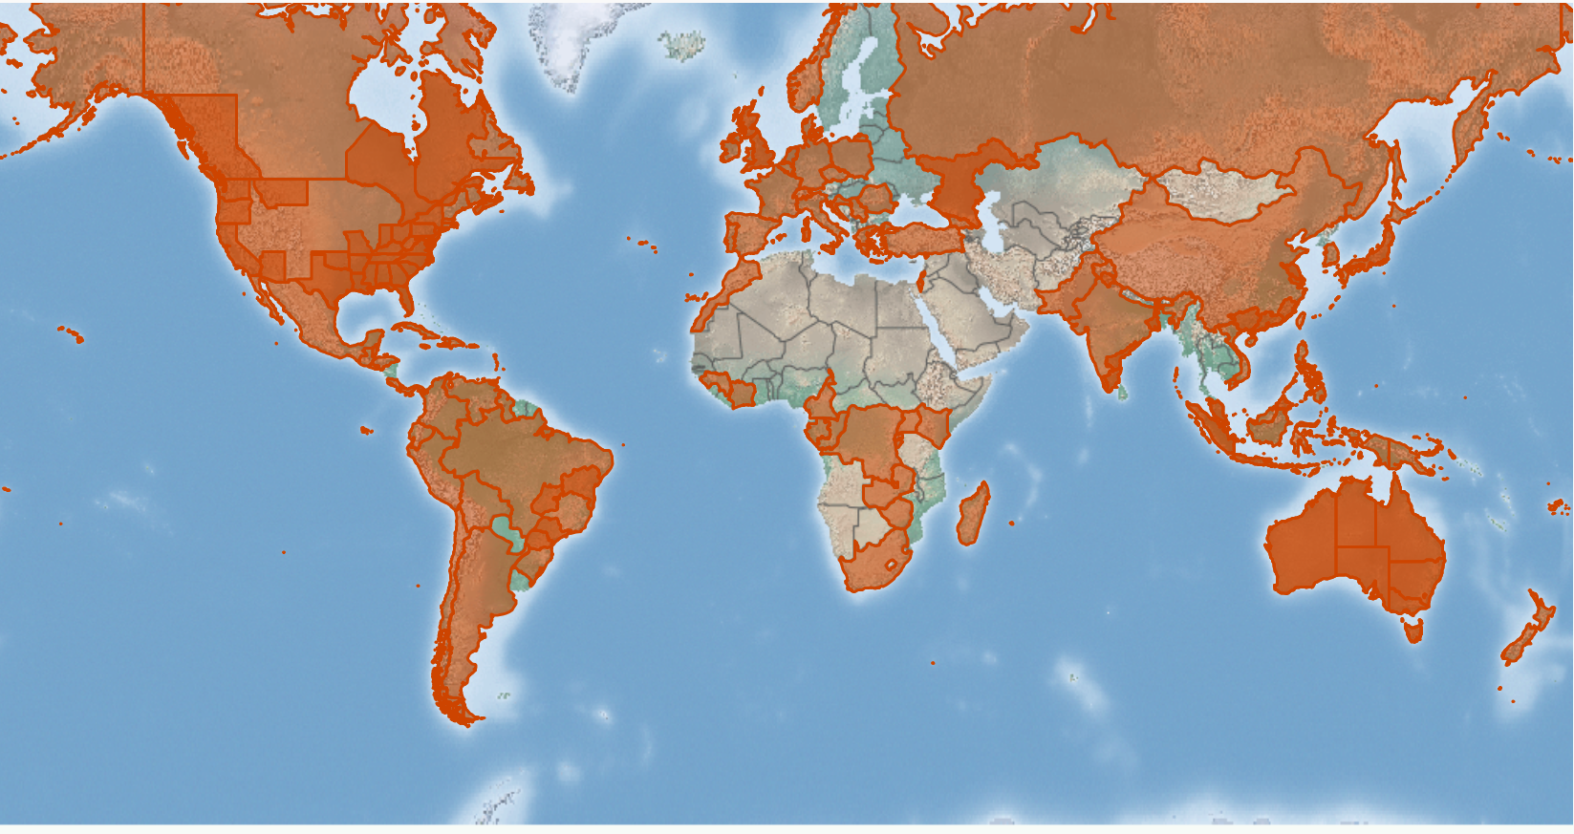
PRR worldwide distribution
9
March 6th, 2025
Notes:
`

Slide 10
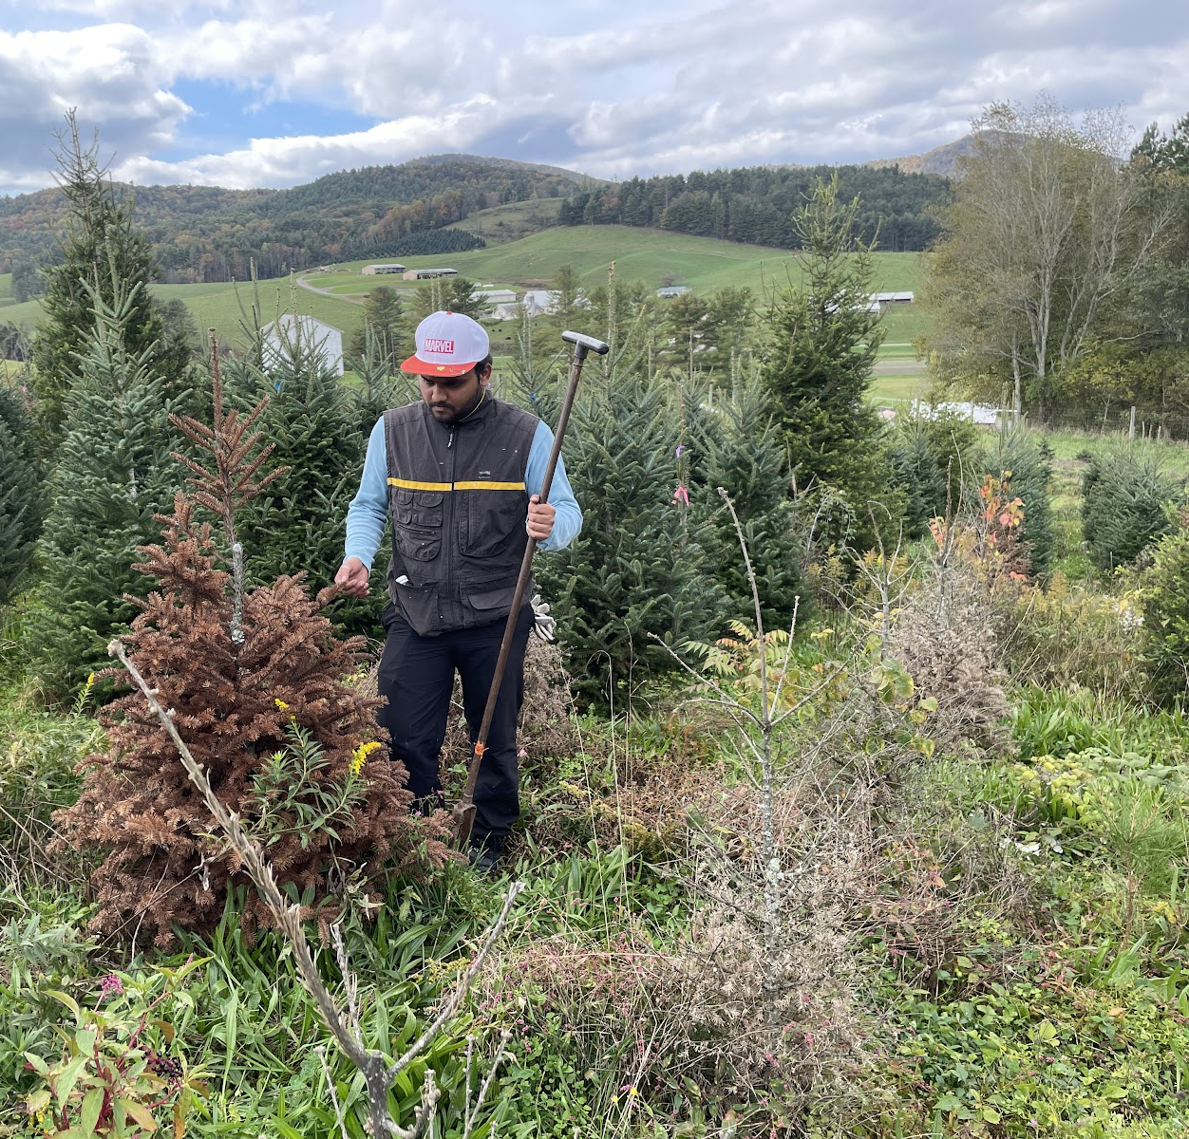
Fraser fir is 100% susceptible to PRR
Resistant fir species exist
Resistance is more durable closer to the historical origin of the disease
Abies spp. with natural resistance include:
  Momi (A. firma)
    – 100% resistance
  Turkish (A. bormuelleriana)
    – 50 - 80% resistance
  Trojan (A. equi-trojani)
  – 45 – 40% resistance
Is there genetic resistance to PRR in fir?
CTG PhD student Adarsha Devihalli collects infected Fraser fir roots
10
March 6th, 2025
Notes:
`

Slide 11
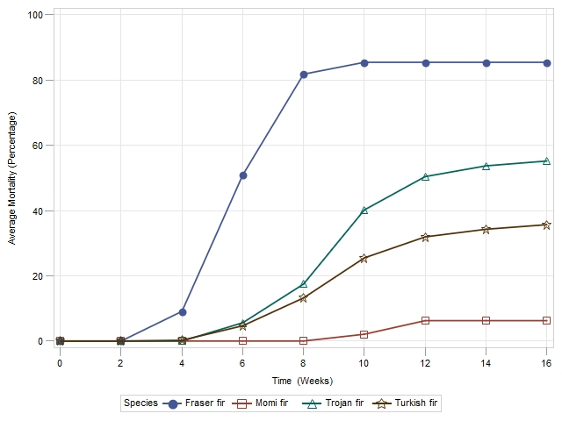
Fir (Abies spp.) Resistance to PRR
Low Resistance
Fraser fir
Trojan fir
Turkish fir
Momi fir
Average mortality over time
High Resistance
Kohlway et al. 2017.
11
March 6th, 2025
Notes:
`

Slide 12
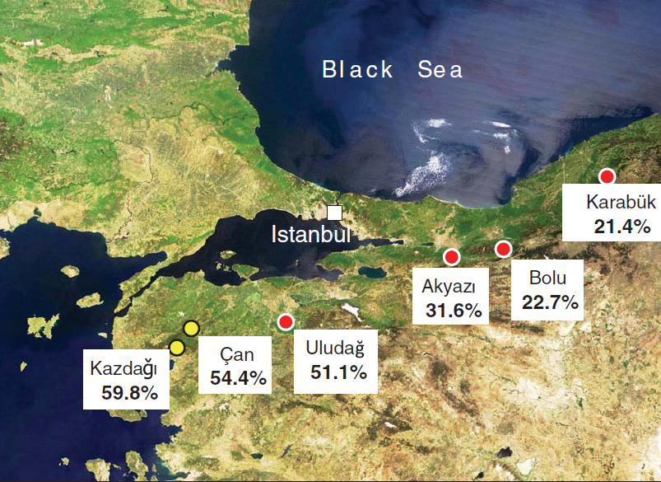
Worldwide resistance gradient in Abies spp.
Low Resistance
High Resistance
Turkish fir
Momi fir
Fraser fir
Trojan fir
Turkish fir
Trojan fir
Origin of P. cinnamomi
12
Gradient of Abies spp. resistance to P. cinnamomi
March 6th, 2025
Notes:
`

Slide 13
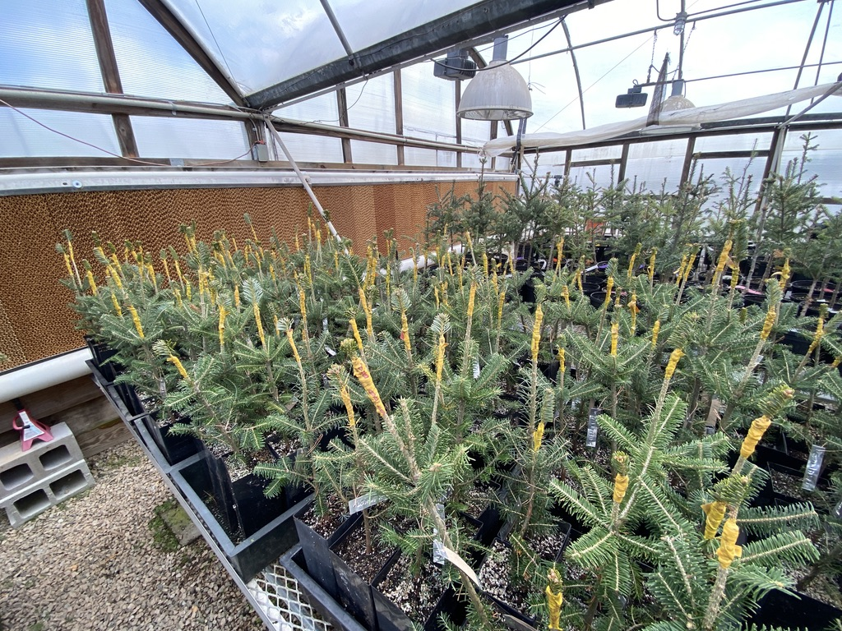


Current and Future Genetic Solutions to manage PRR
Current Genetic Solutions
- Plant FF grafted onto resistant/tolerant rootstock
- Plant resistant exotic species
Future Genetic Solutions
- Develop resistant Fraser fir clonal material
Grafted Fraser fir seedlings
13
March 6th, 2025
Notes:
`

Slide 14
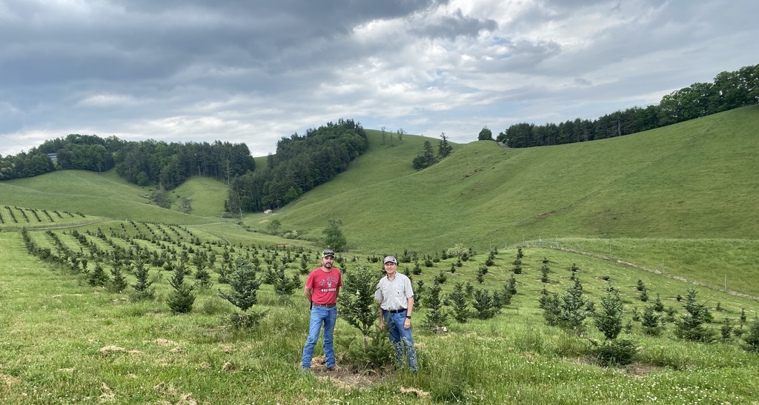
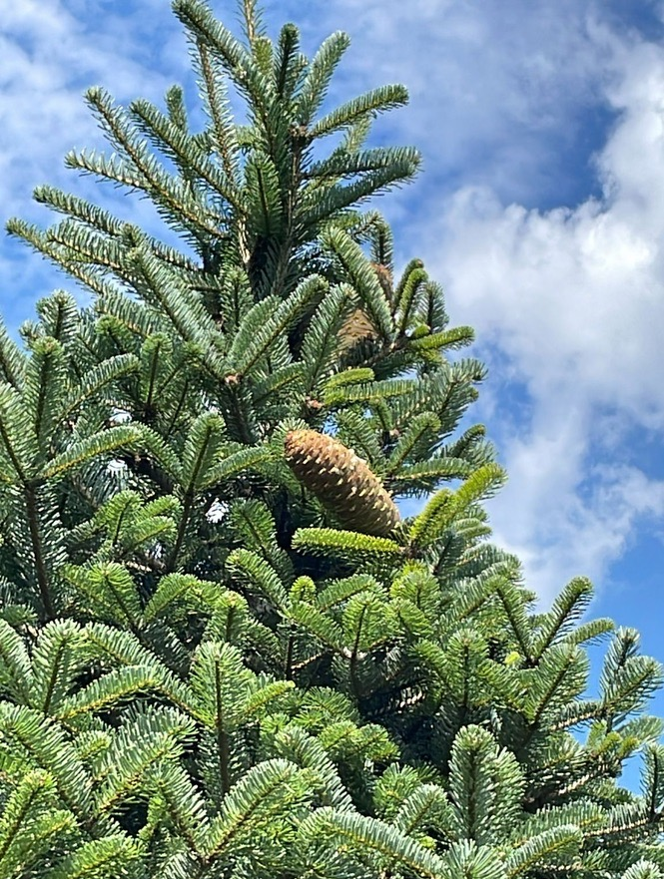
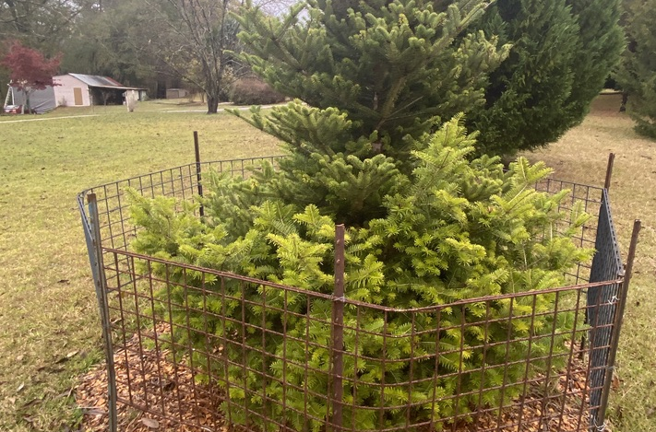
NCSU CTG Program
Fraser Fir
Turkish and Trojan Fir
Momi fir
14
March 6th, 2025
Notes:
`

Slide 15
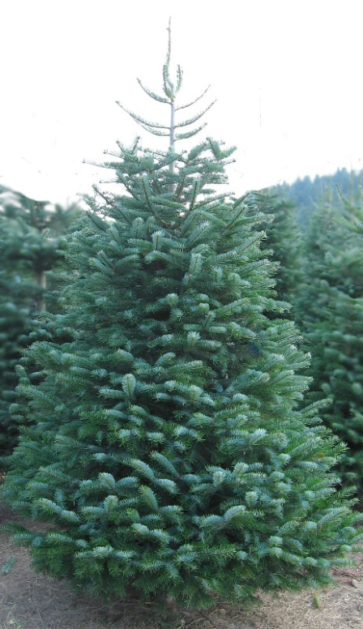
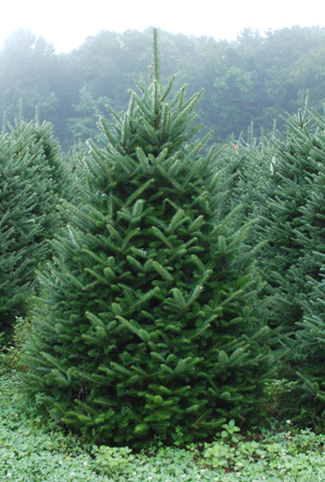
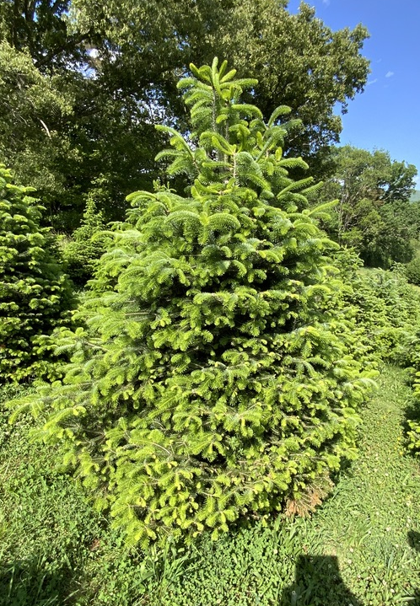
Why Turkish and Trojan fir?
Turkish fir
Fraser fir
Trojan fir
15
March 6th, 2025
Notes:
`

Slide 16
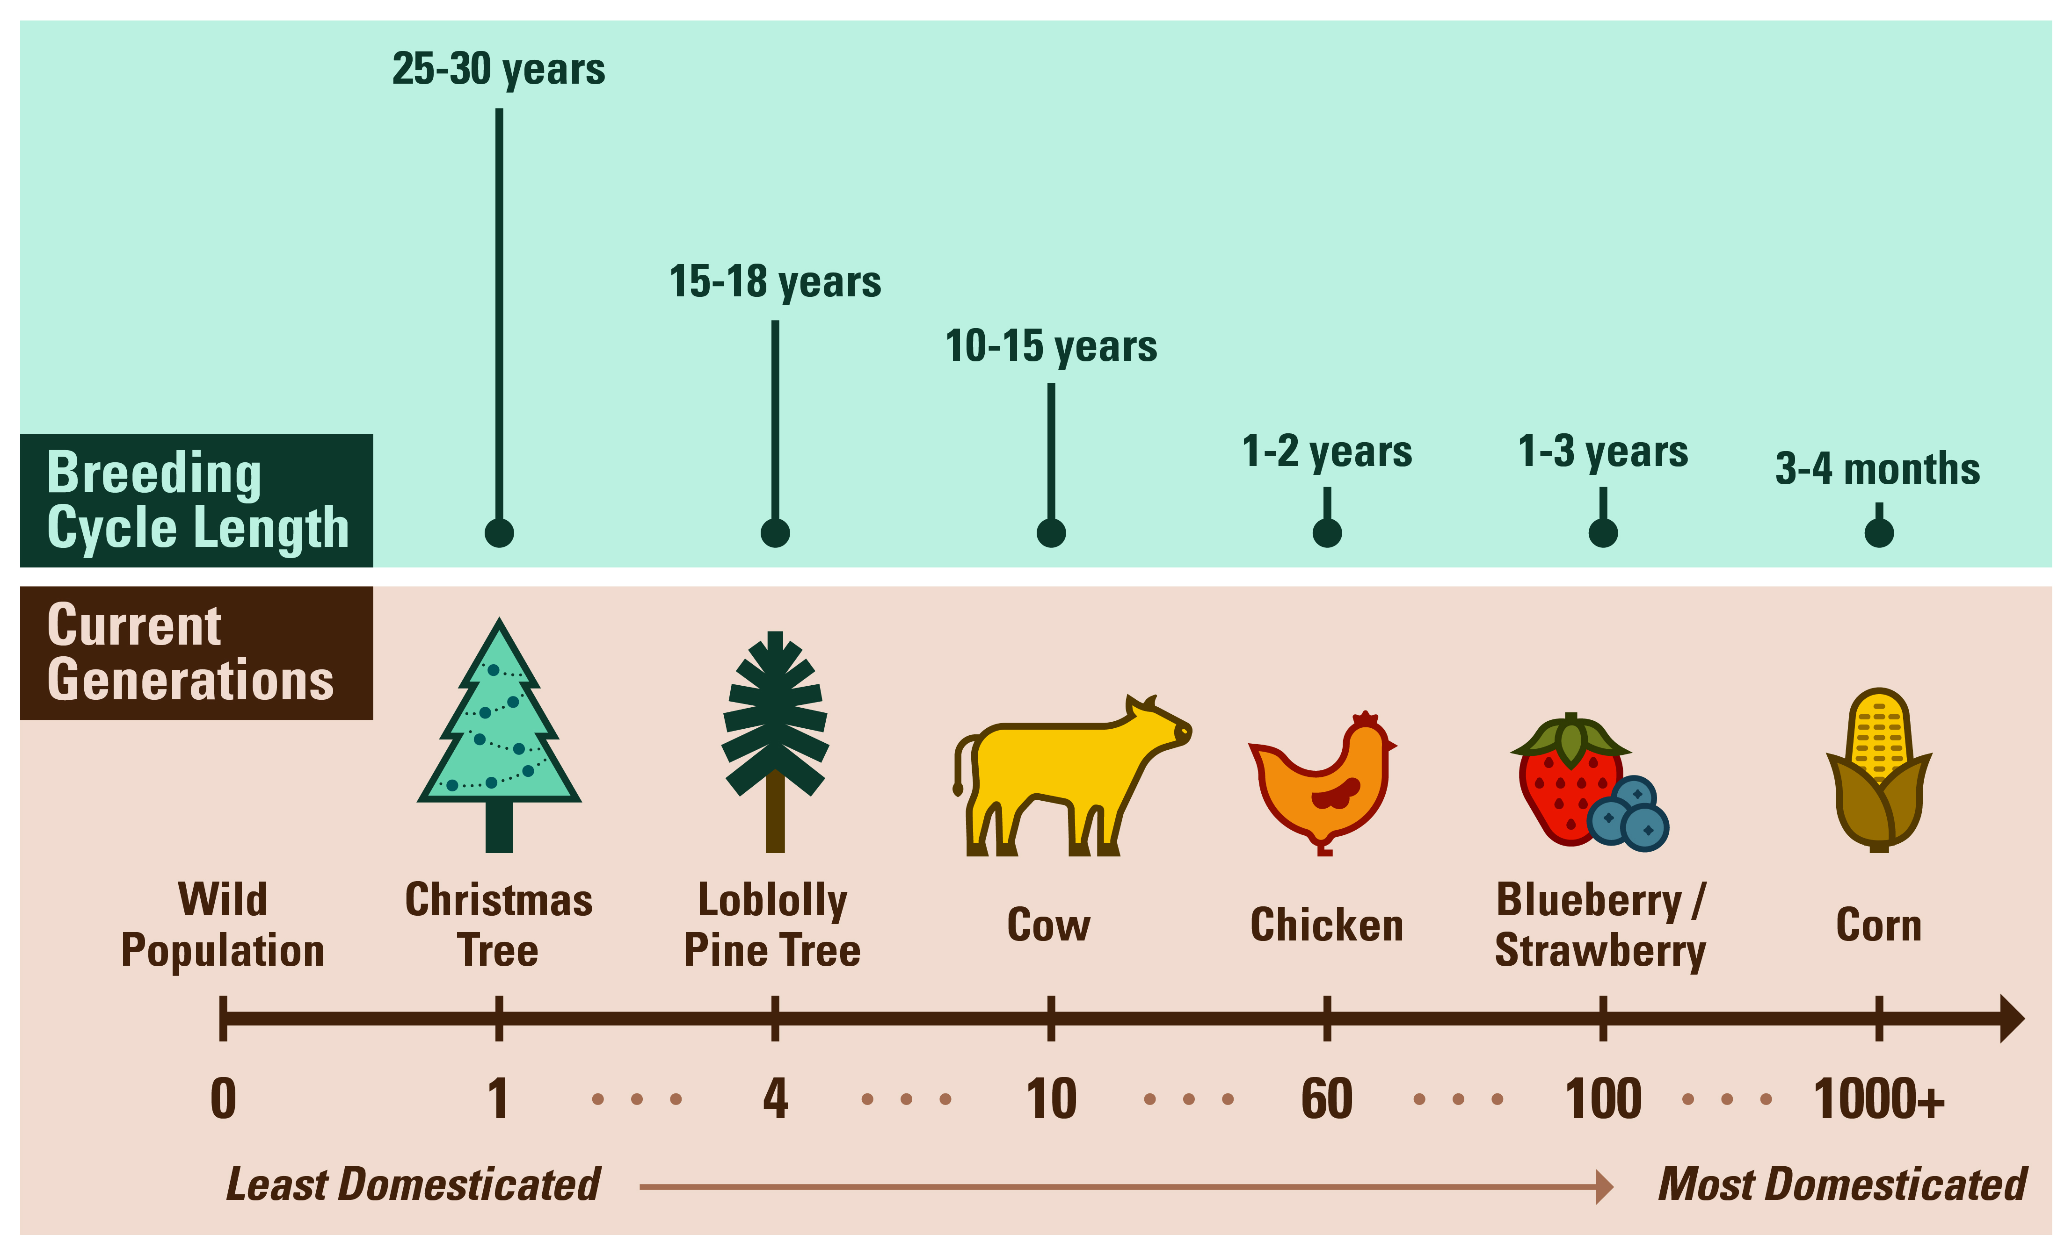
Plant Domestication
Figure 2. Current cycle/generation of genetic improvement for important crop species. The average length of time required to complete a generation is highlighted above each commodity.
16
March 6th, 2025
Notes:
`

Slide 17


Advancing Christmas Tree Research takes a village
17
March 6th, 2025
Notes:
`

Slide 18
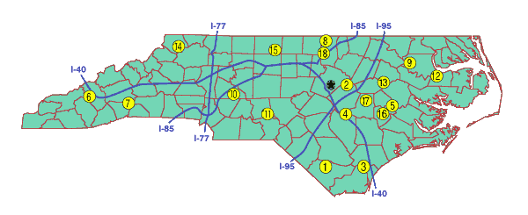
NC State Christmas Tree Genetics program resources
Upper Mountain Research Station
Mountain Research Station
NCDA Research Stations
Mountain Hort. Crops
Research & Extension Center
Piedmont Research Station
18
March 6th, 2025
Notes:
`

Slide 19

Our ultimate goal
Improve economic outcomes through better access to elite Christmas tree genetic materials and disrupt entrenched supply chains to ensure the long-term survival of the NC Christmas tree industry.
19
March 6th, 2025
Notes:
`

Slide 20

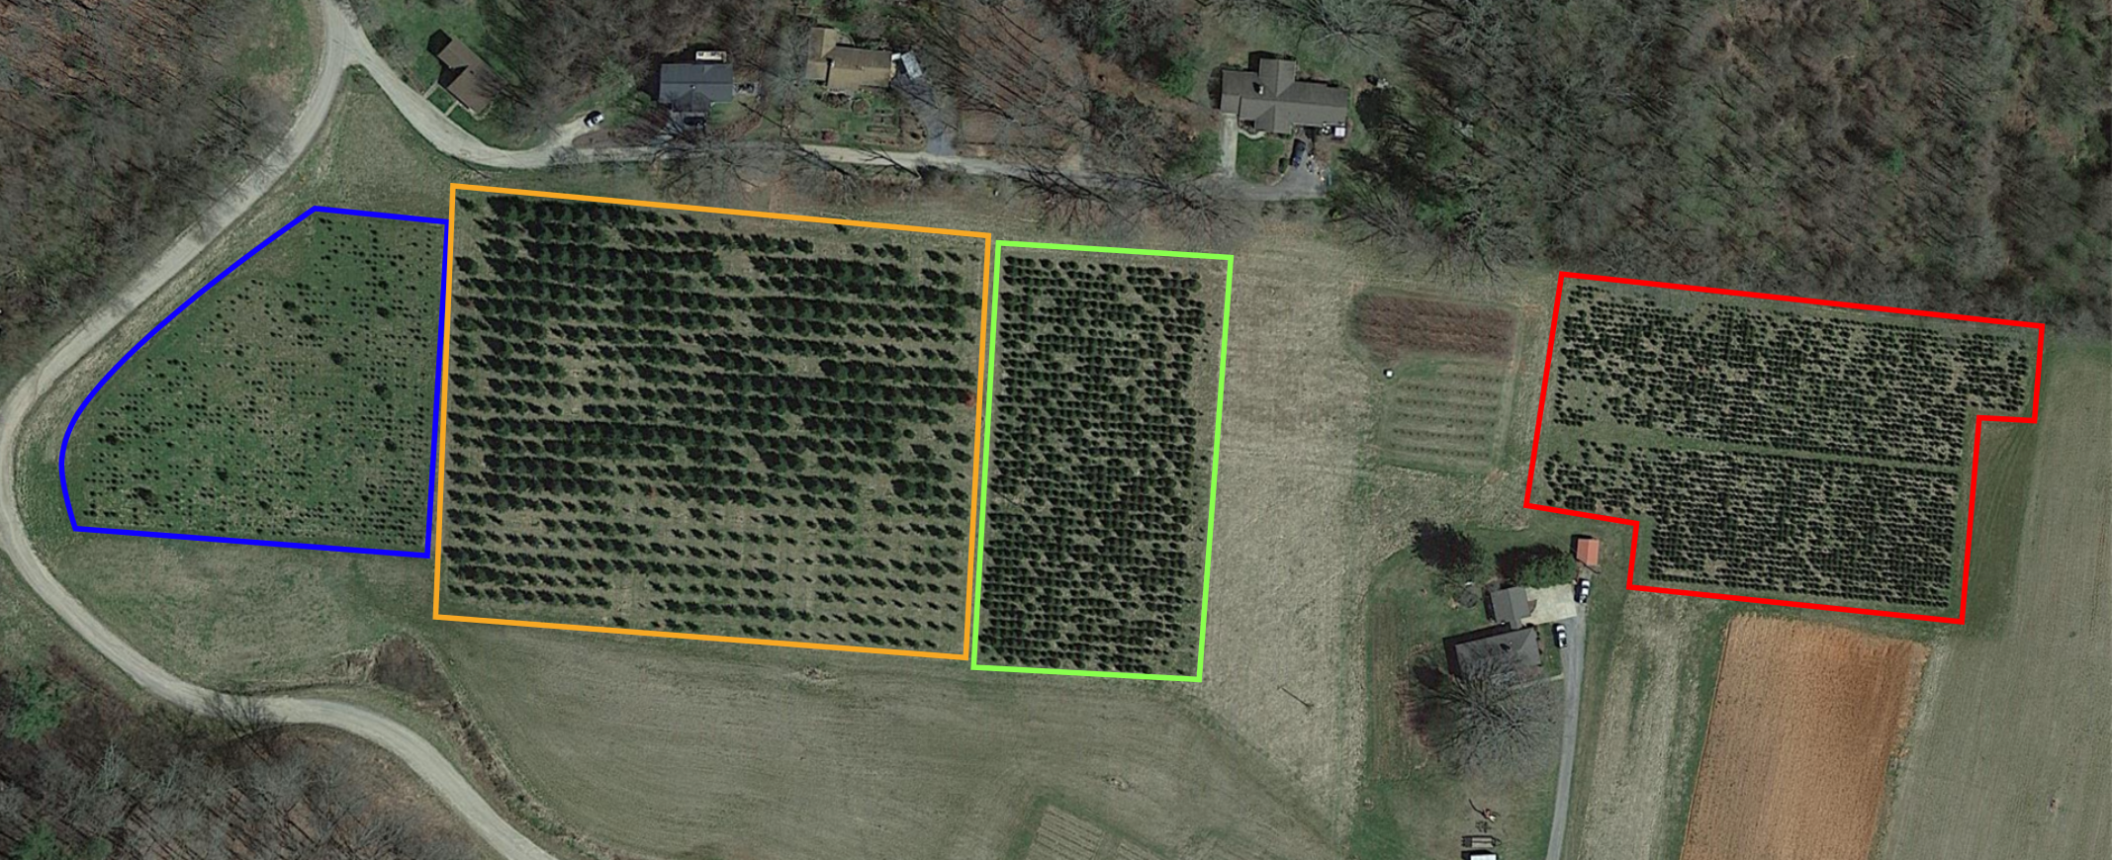
Whitehill Lab – Christmas Tree Genetics Program:
Mountain Research Station
Waynesville, NC
Justin G. A. Whitehill | Assistant Professor | Dept. of FER
1
4
2
3
20
March 6th, 2025
Notes:
`

Slide 21

Whitehill Lab – Christmas Tree Genetics Program:
Resources
#3 – Turkish and Trojan Fir PRR Survivors - MRS
1
4
2
3
21
March 6th, 2025
Notes:
`

Slide 22
Turkish and Trojan Fir PRR Survivors
#3 – Turkish and Trojan Fir PRR Survivors – MRS
Planted in 2011
~1027 trees of Turkish/Trojan
We will be working to evaluate and inventory in 2025
Survivors of PRR inoculations
Pre-dates CoFirGE
One-of-a-kind resource
Next steps: Make selections, graft into seed orchard
Need more data before selections can be made
Trees are now 16-17 years old
Need to be developed for direct use as Christmas trees
22
Turkish and Trojan Fir PRR Survivors - MRS
March 6th, 2025
Notes:
`

Slide 23
Project Goal
The overall goal of the project is to comprehensively evaluate the North Carolina Turkish and Trojan fir CoFirGE replicated field trials and PRR Survivor Trees. Identification of genetically superior Turkish and Trojan fir trees will then be used for clonebank and seed orchard establishment. To achieve this goal, we propose three major project objectives:
23
March 6th, 2025
Notes:
`

Slide 24
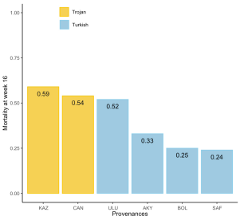
Project Objectives
Objective 1: Evaluate post-harvest needle retention and insect tolerance of existing CoFirGE progeny tests and PRR survivor trees.
Objective 2: Analyze and compare seed sources (i.e. provenance) and predict breeding values of families and individual trees for selection of elite Turkish and Trojan fir genotypes for use in clonebank and seed orchard establishment.
Objective 3: Establish elite Turkish and Trojan fir clonebanks and seed orchards in collaboration with NCDA research stations.
Mortality of four Turkish fir (blue bars) and Trojan fir (yellow bars) seed sources to Phytophthora root rot disease after inoculation over a 16-week time-period
24
March 6th, 2025
Notes:
`

Slide 25
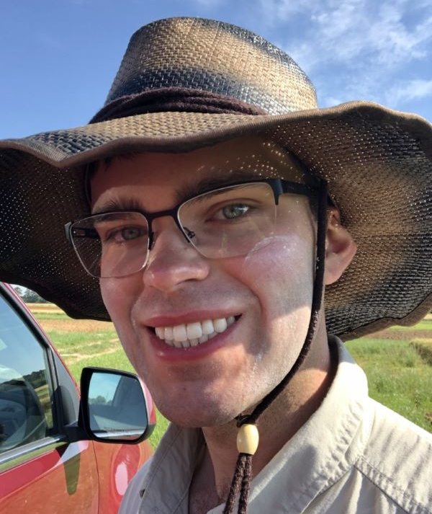

NECP supports training the next generation of scientists
Dr. John Bagwell
Christmas Tree Genetics Program
Breeding Program Manager, Post-Doc
Jesse Hickman
PhD Student
Environmental stress on Fraser fir
25
March 6th, 2025
Notes:
`

Slide 26
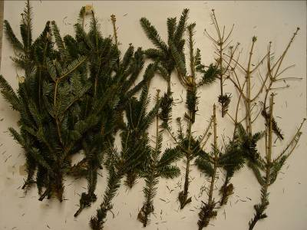
Needle Retention of Turkish and Trojan fir
0
1
2
3
4
5
6
7
26
March 6th, 2025
Notes:
`

Slide 27
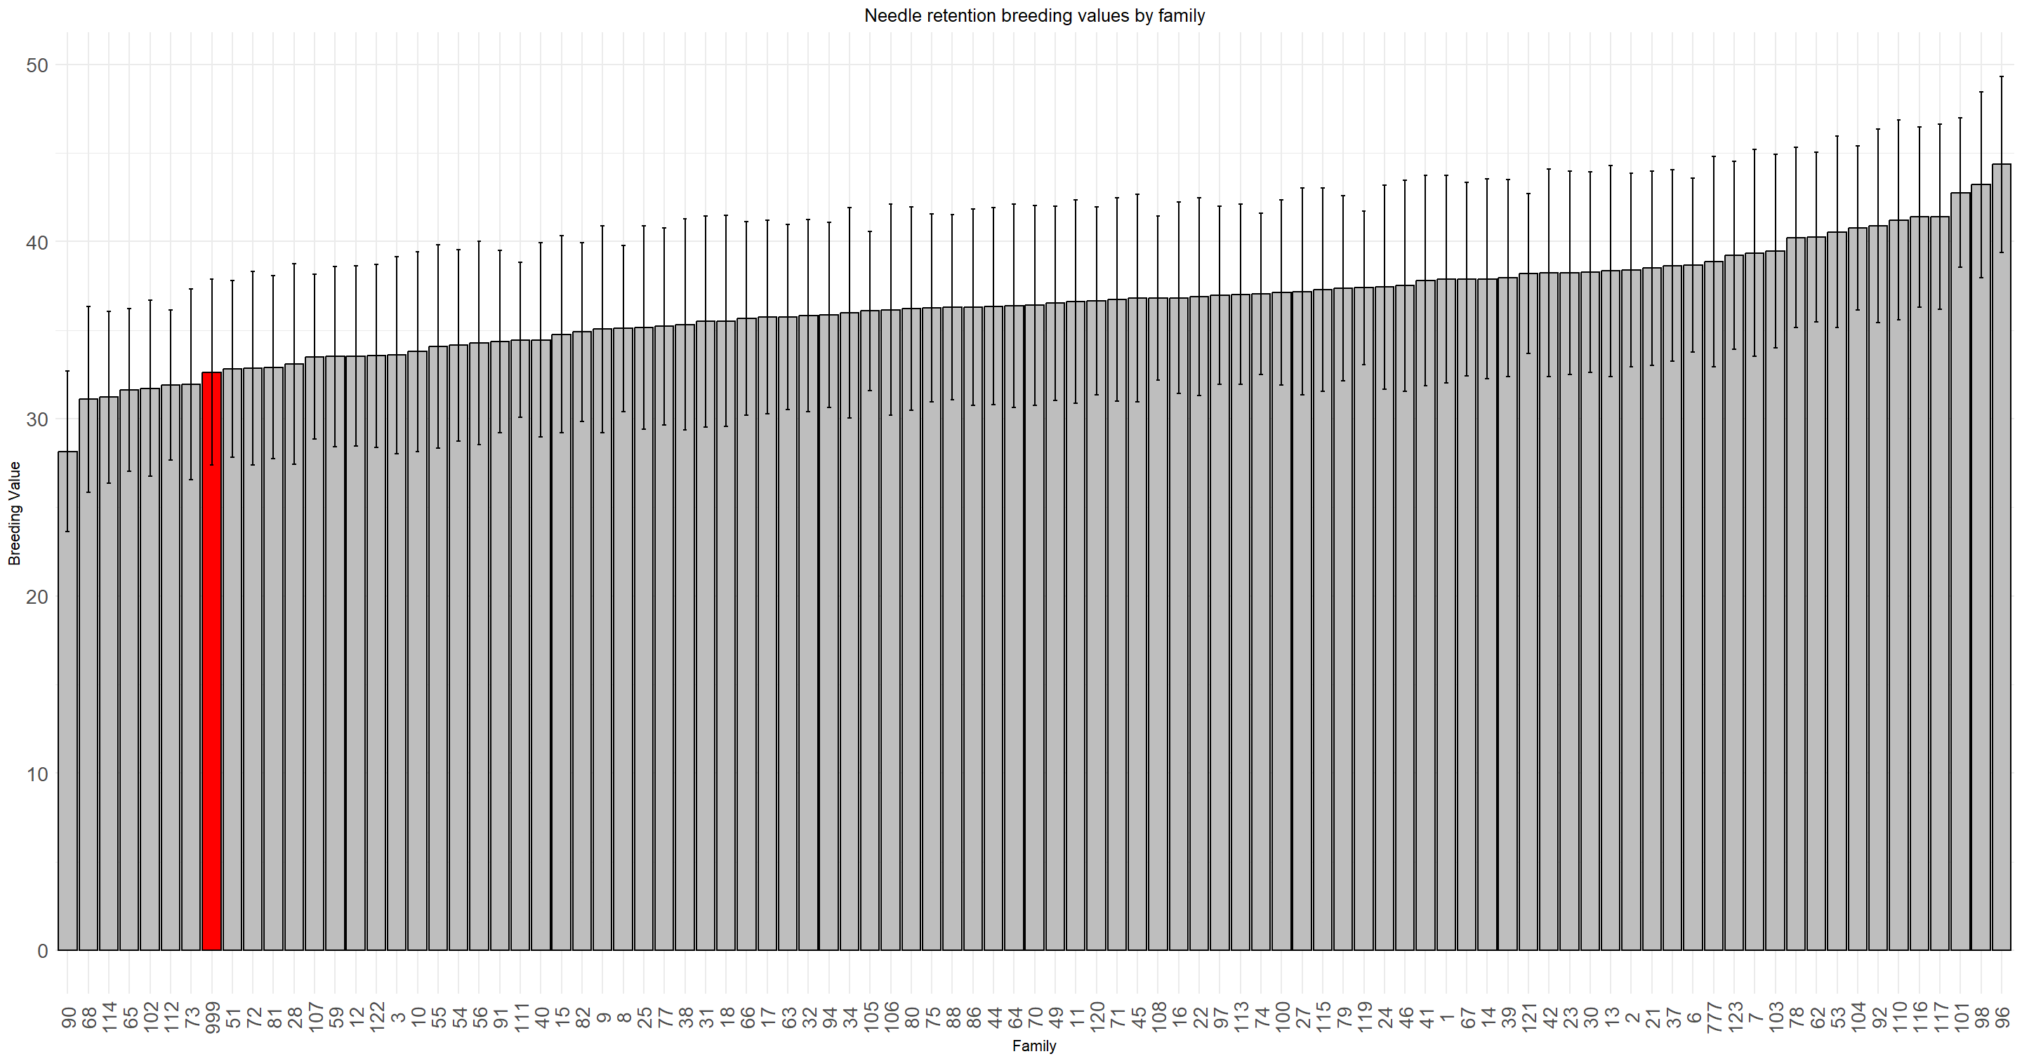
Turkish and Trojan fir Needle Retention by Family
H₂ = 0.14
h₂ = 0.04
Turkish fir Bolu
Turkish fir
Bolu & Akyazi
Fraser fir
27
March 6th, 2025
September 9th, 2023
Notes:
`

Slide 28
Turkish and Trojan fir range
Turkish fir
Trojan fir
28
March 6th, 2025
Notes:
`

Slide 29
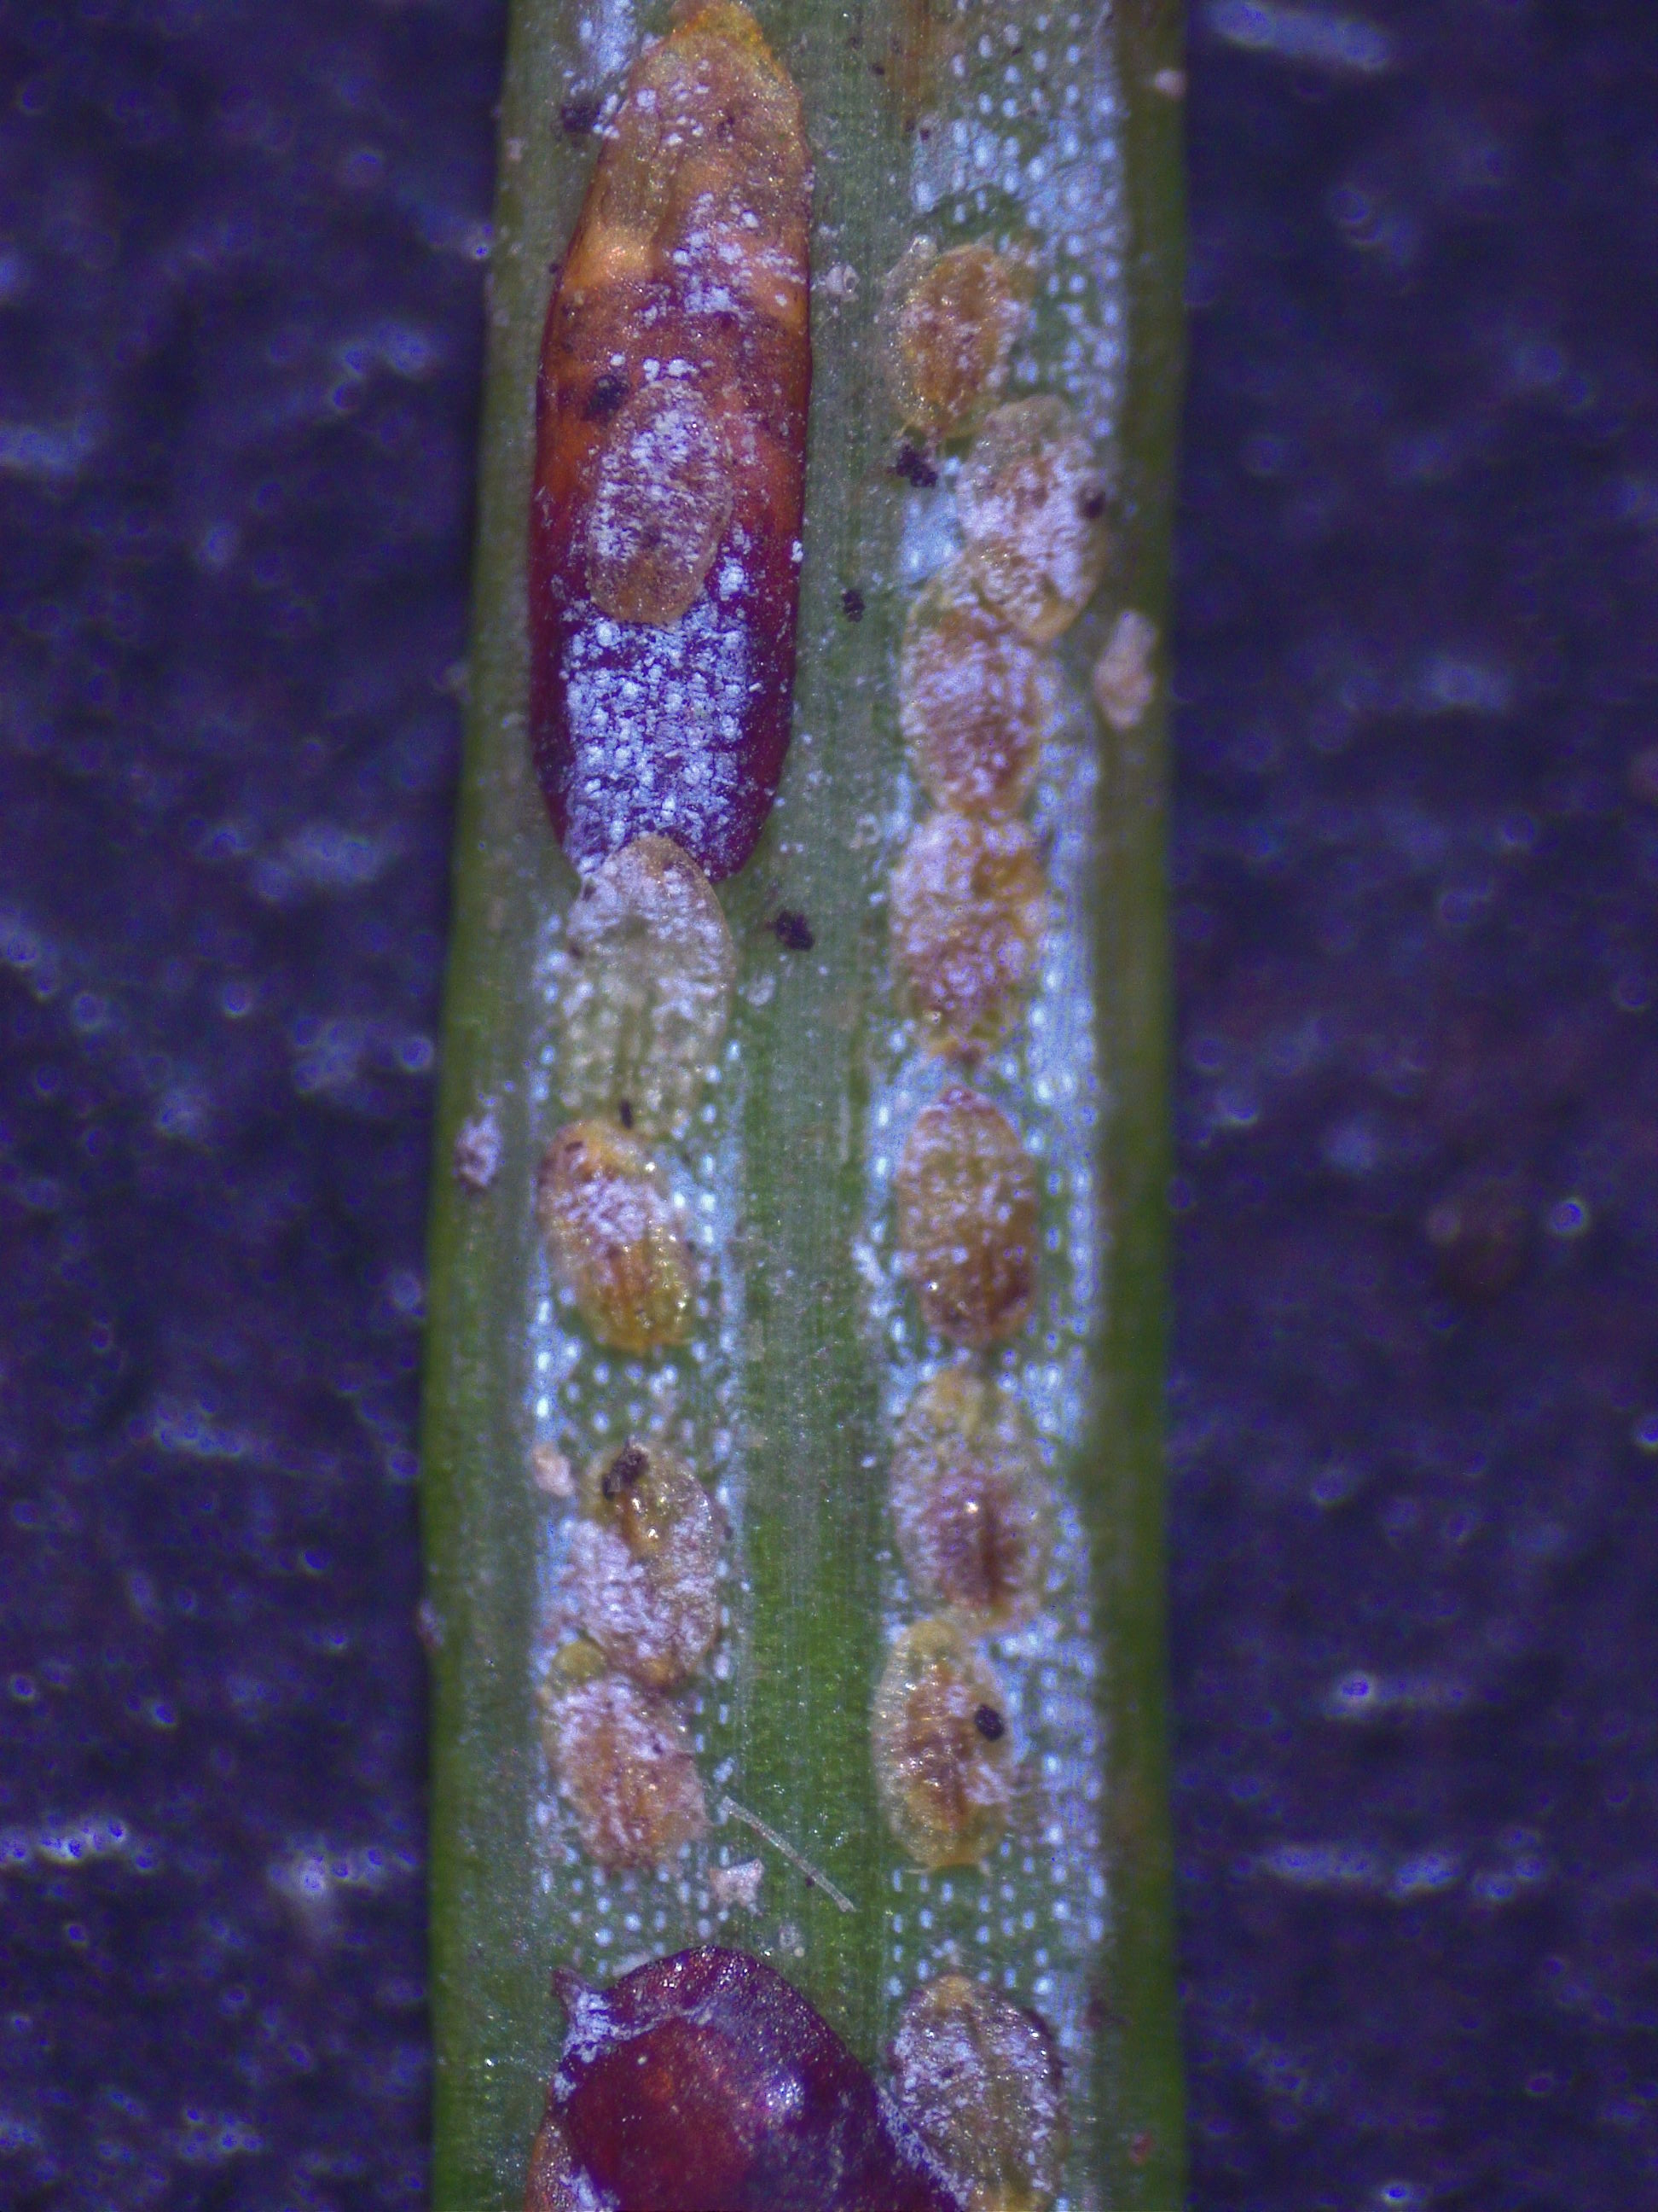
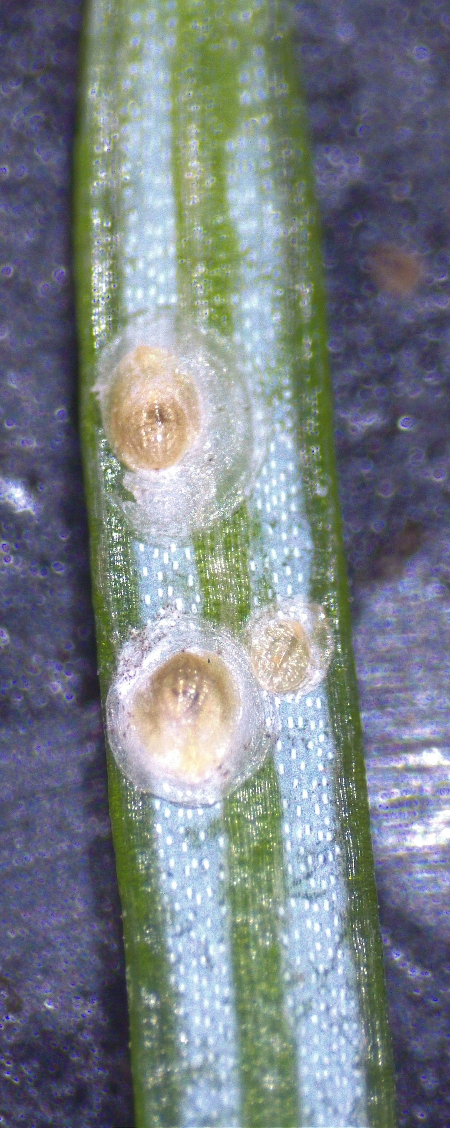
Insect tolerance of Turkish and Trojan fir
a)
b)
  Balsam twig aphid
  Spruce spider mite
  Balsam woolly adelgid
  White grubs feeding on roots
  Cinara aphid
  Hemlock rust mite
  Rosette bud mite
  Elongate hemlock scale (a)
  Cryptomeria scale (b)
29
March 6th, 2025
Notes:
`

Slide 30
Project Objectives
Objective 1: Evaluate post-harvest needle retention and insect tolerance of existing CoFirGE progeny tests and PRR survivor trees.
Objective 2: Analyze and compare seed sources (i.e. provenance) and predict breeding values of families and individual trees for selection of elite Turkish and Trojan fir genotypes for use in clonebank and seed orchard establishment.
Objective 3: Establish elite Turkish and Trojan fir clonebanks and seed orchards in collaboration with NCDA research stations.
Mortality of four Turkish fir (blue bars) and Trojan fir (yellow bars) seed sources to Phytophthora root rot disease after inoculation over a 16-week time-period
30
March 6th, 2025
Notes:
`

Slide 31
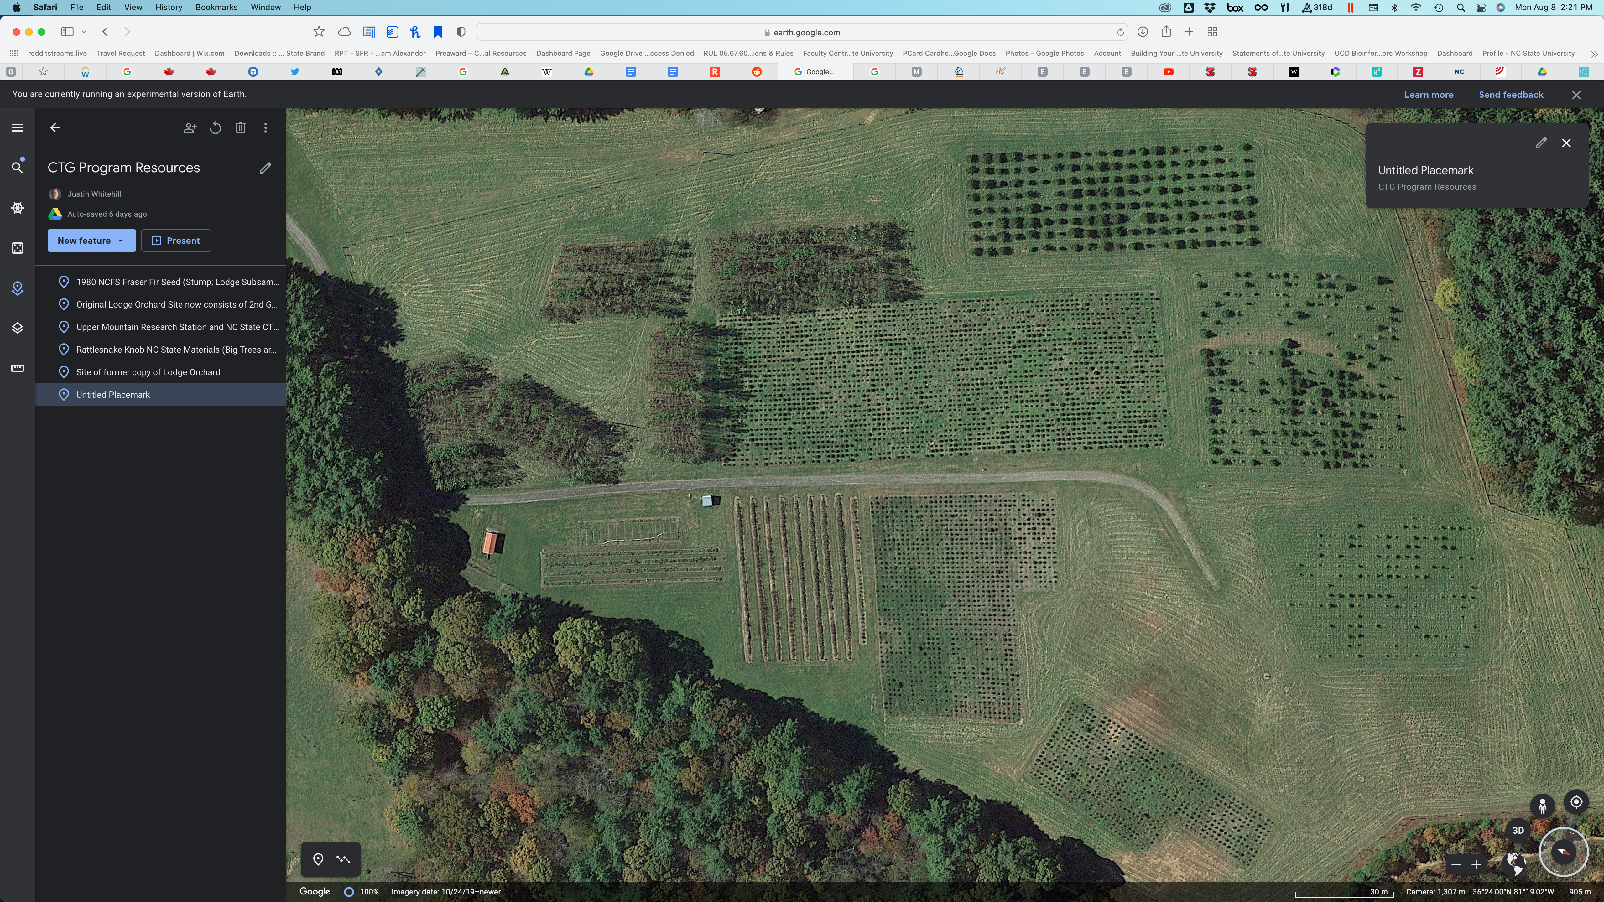
Establishing Elite Turkish and Trojan fir seed orchards
UMRS CoFirGE Test
Establish 2 elite seed orchards
#1: Elite Turkish fir seed orchard
#2: Elite Trojan fir seed orchard
Location: UMRS and MRS on existing CoFirGE trial trees
MRS Turkish/Trojan fir
Top 20-25 Turkish or Trojan fir top-grafted onto existing CoFirGE trees
31
March 6th, 2025
Notes:
`

Slide 32
Establishing Elite Turkish and Trojan fir seed orchards
UMRS CoFirGE Test
32
March 6th, 2025
Notes:
`

Slide 33
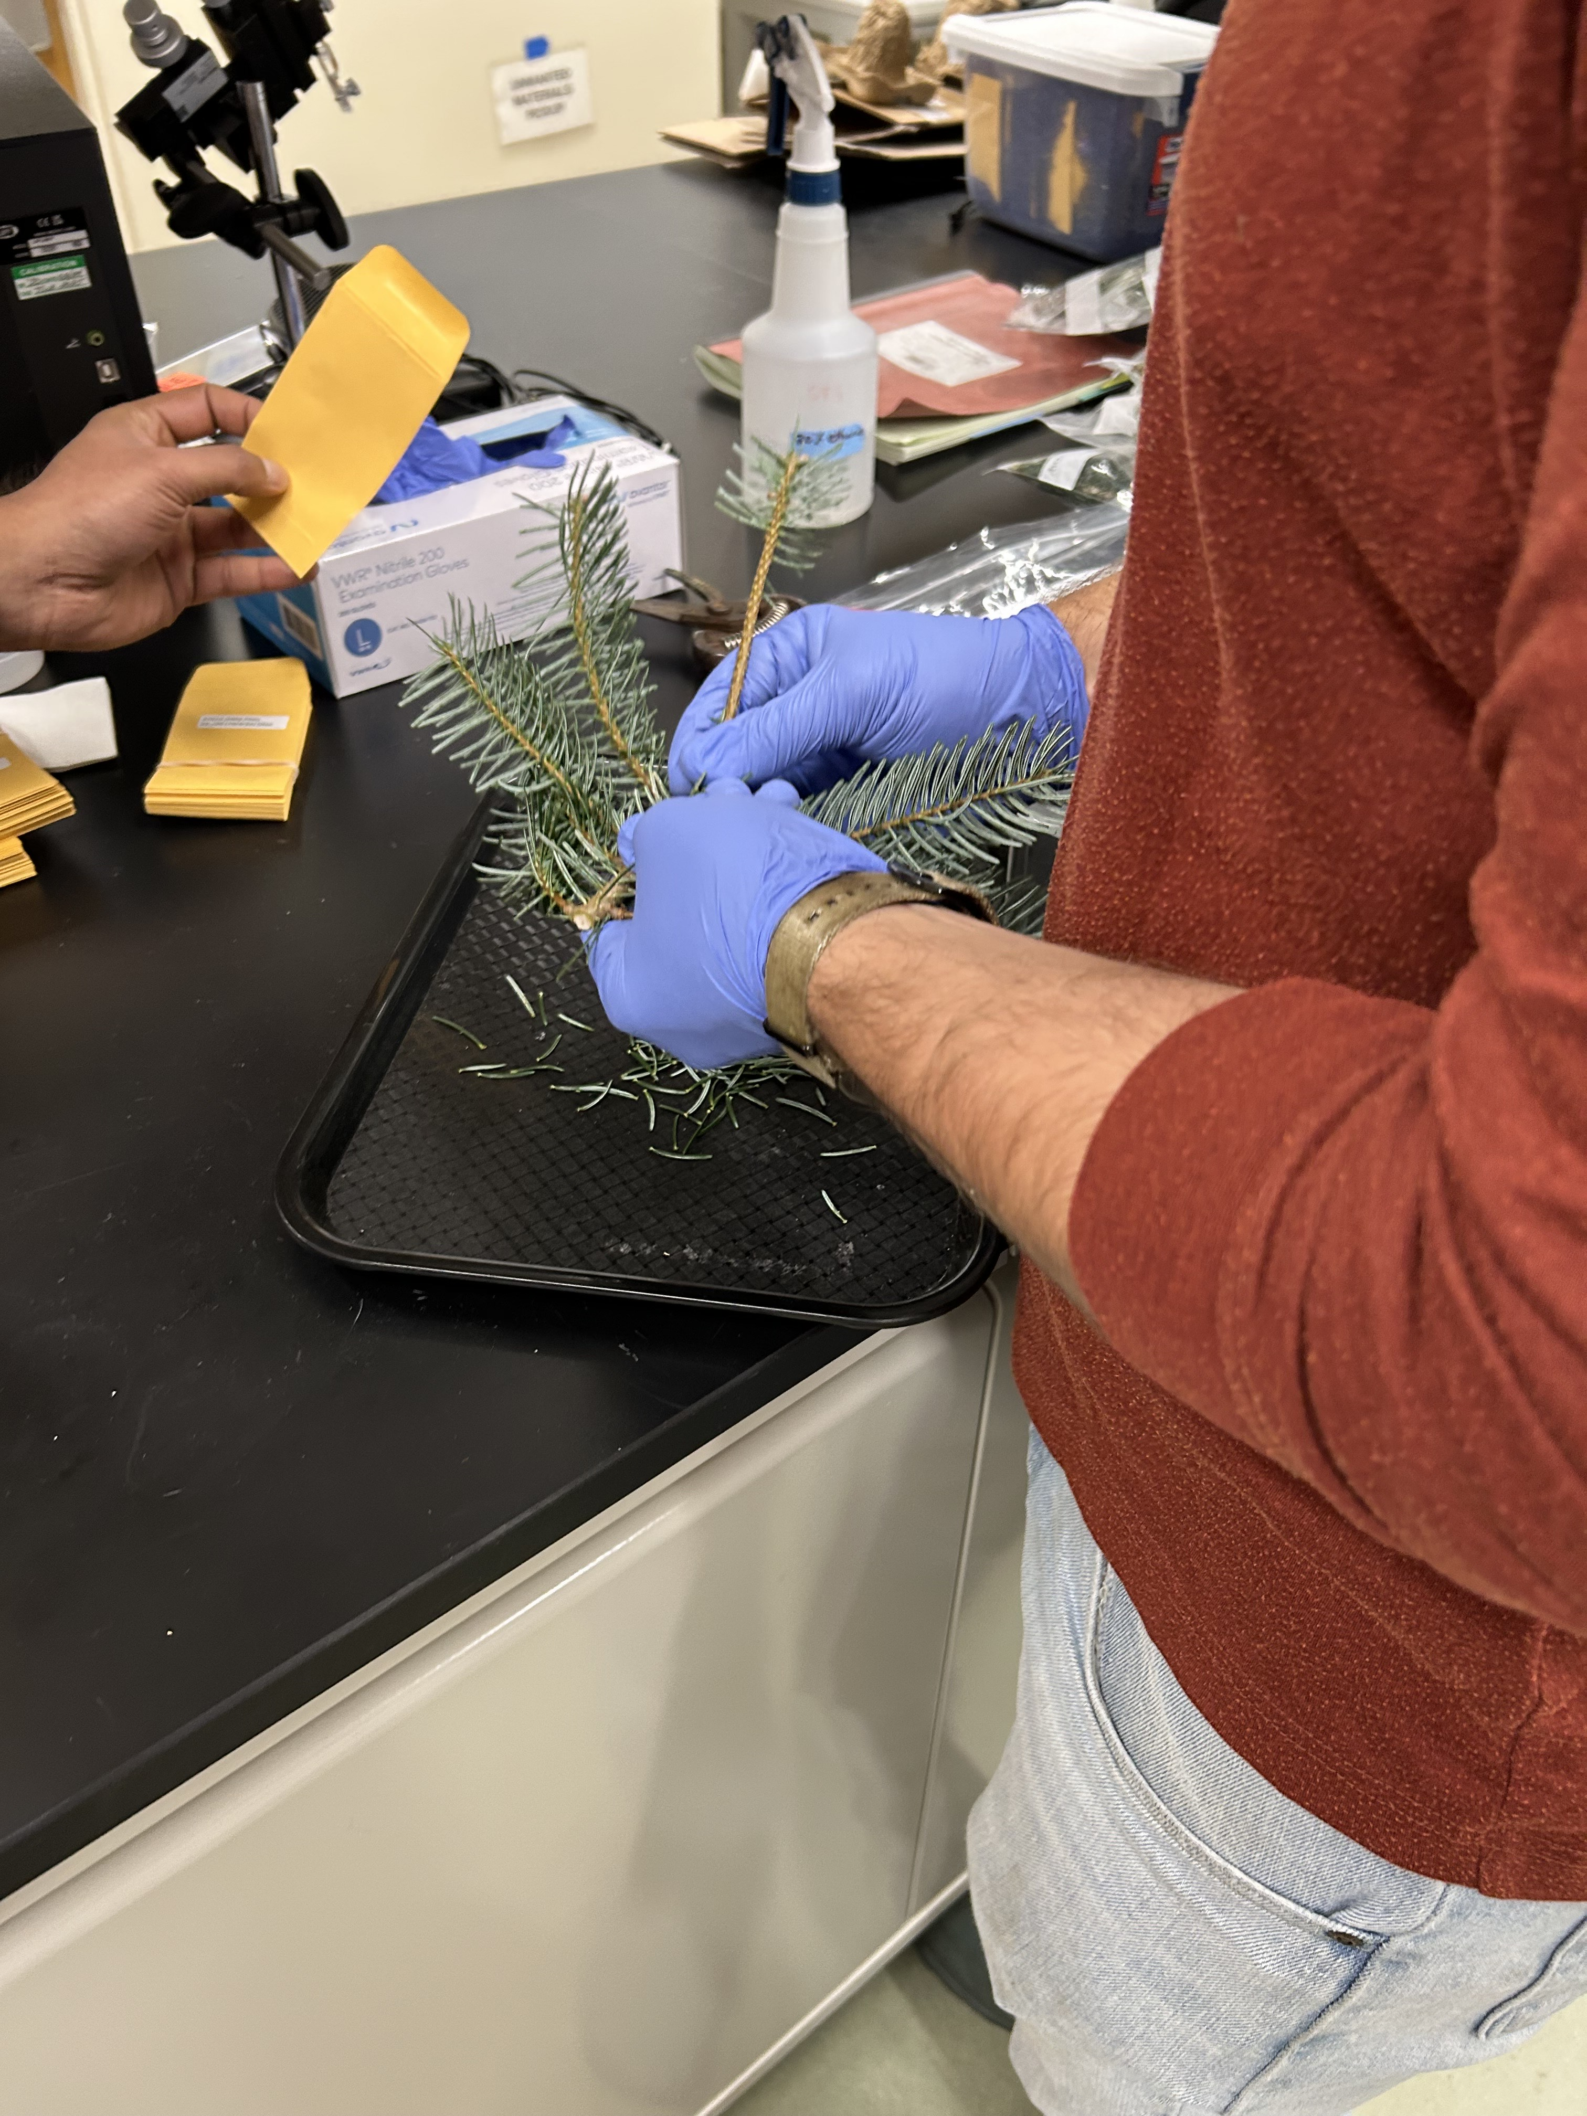
Take home message!
PRR resistant exotic Turkish and Trojan fir have been identified with PRR resistance (previous), improved NR (NECP), late budbreak (not shown), and quality (not shown)
Insect tolerance/resilience will be evaluated in spring 2025
Identification and selection of elite trees is ongoing
  Next step is to use a weighted selection index to identify the best trees for seed orchard use
Summer 2026 establish seed orchards
Continue to collect seed from PRR survivors
Whitehill CTG lab students and postdocs processing needles from PRR Turkish and Trojan fir survivors for NR study
33
March 6th, 2025
Notes:
`

Slide 34
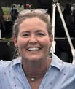
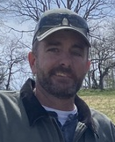
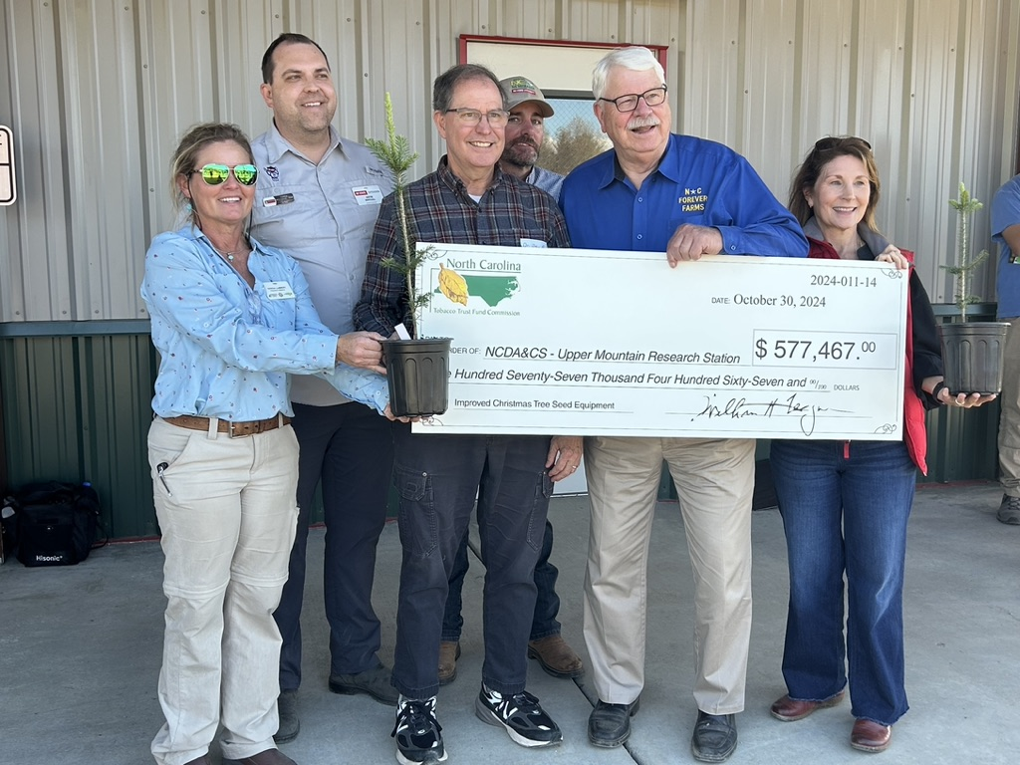

Thanks!
Teresa Lambert
NCDA Research Station Director
Tracy Taylor
UMRS Superintendent
Tobacco Trust Fund Christmas Tree Seed Center of Excellence
34
March 6th, 2025
Notes:
`

Slide 35
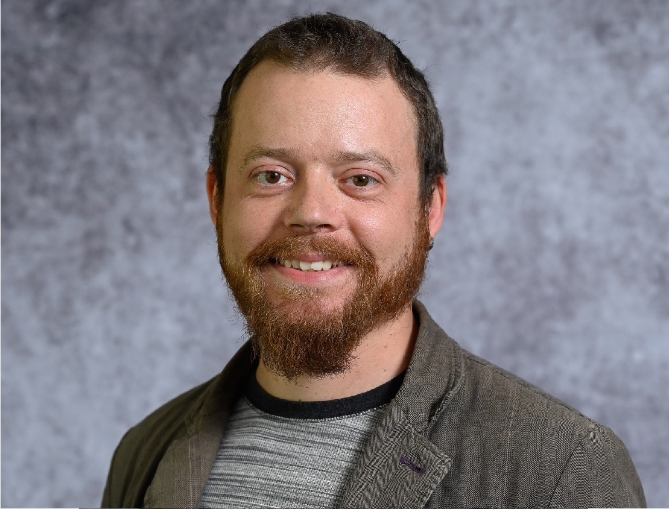

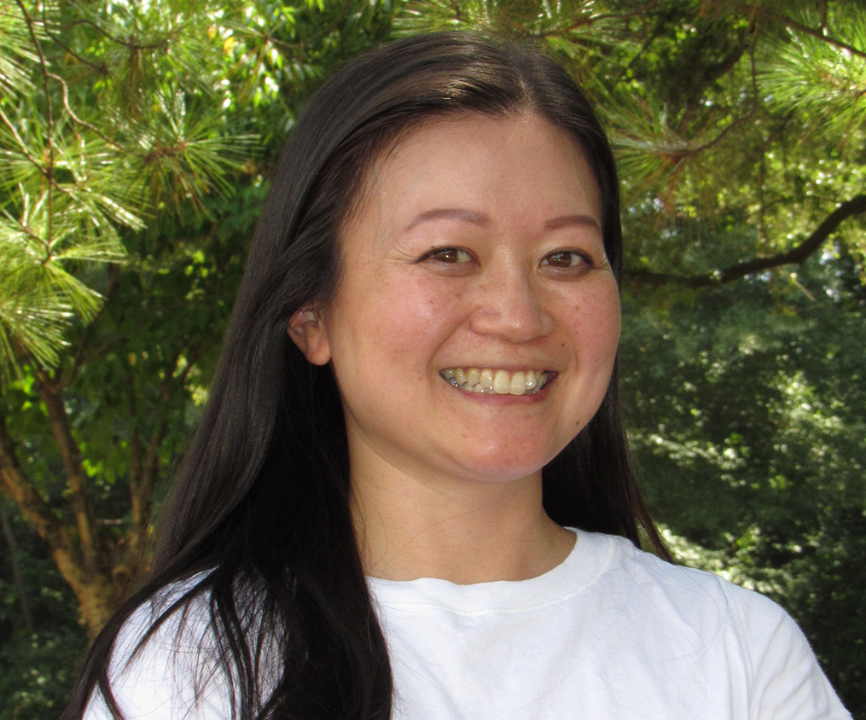




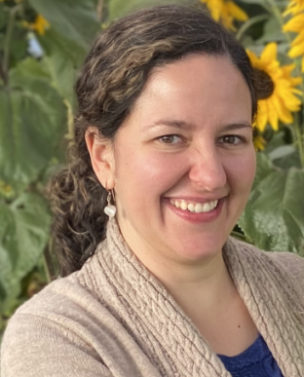
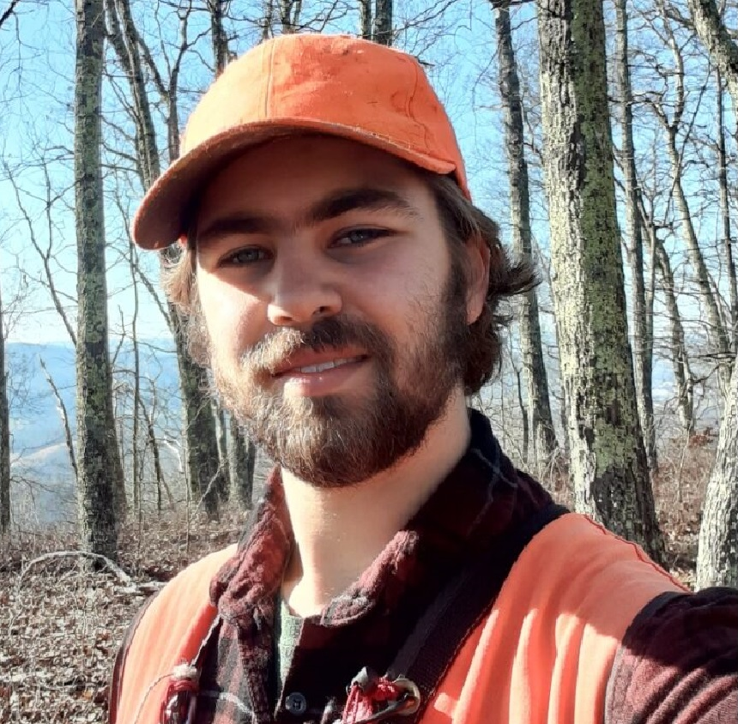
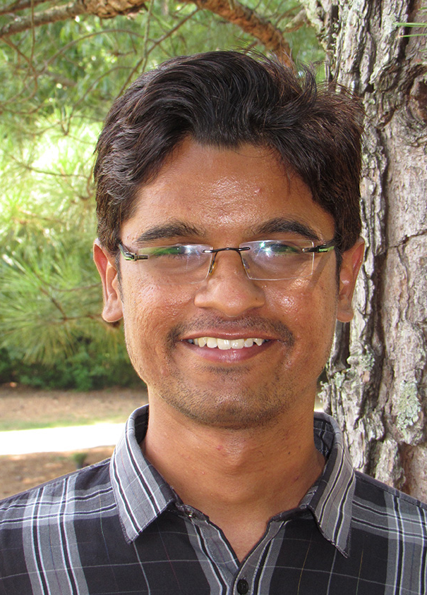
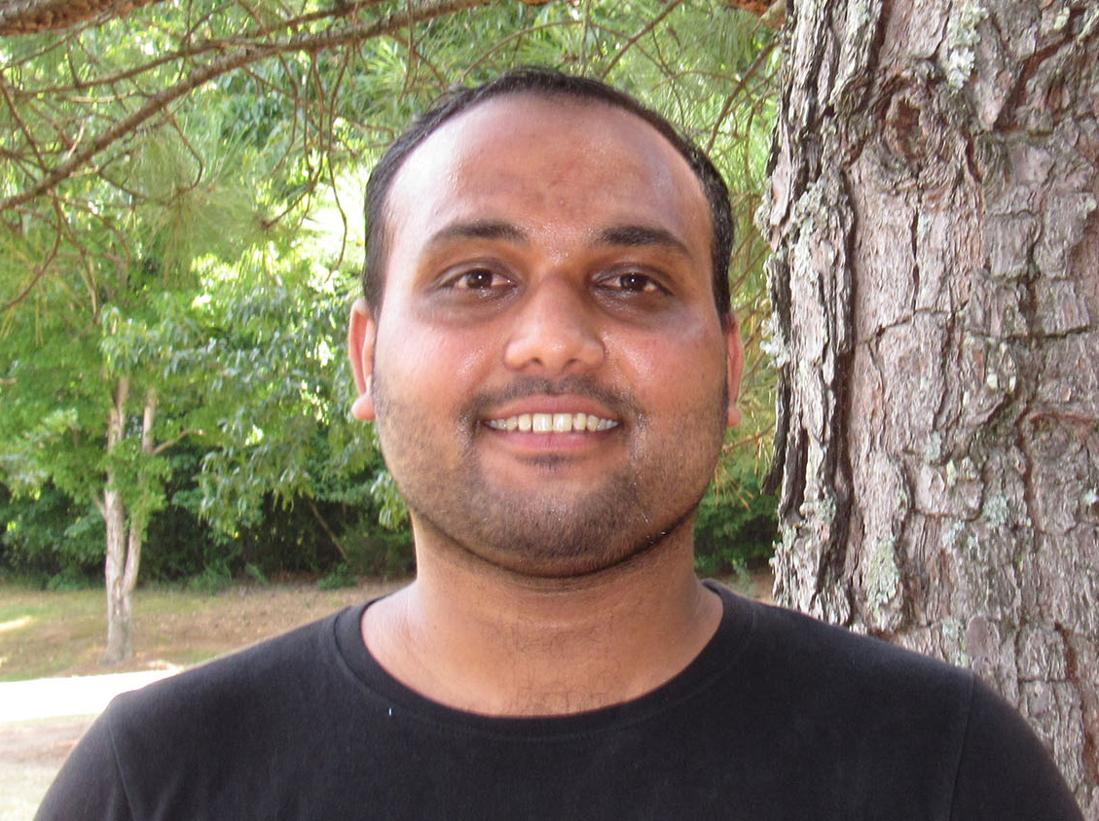


Whitehill Lab Members
STAFF
POST-DOCS
PI Whitehill
Chiang
Lab/Project Manager
Whetten
Professor Emeritus
Molecular Breeding
Barampuram
Tissue Culture
Yuen
Bioinformatics Support
TBD
Tissue Culture
Elorriaga
Bagwell
GRADUATE STUDENTS
MS Cothron
PhD Gade
PhD Devihalli
PhD Hickman
PhD Patton
MS Williams
35
March 6th, 2025
Notes:
`

Slide 36
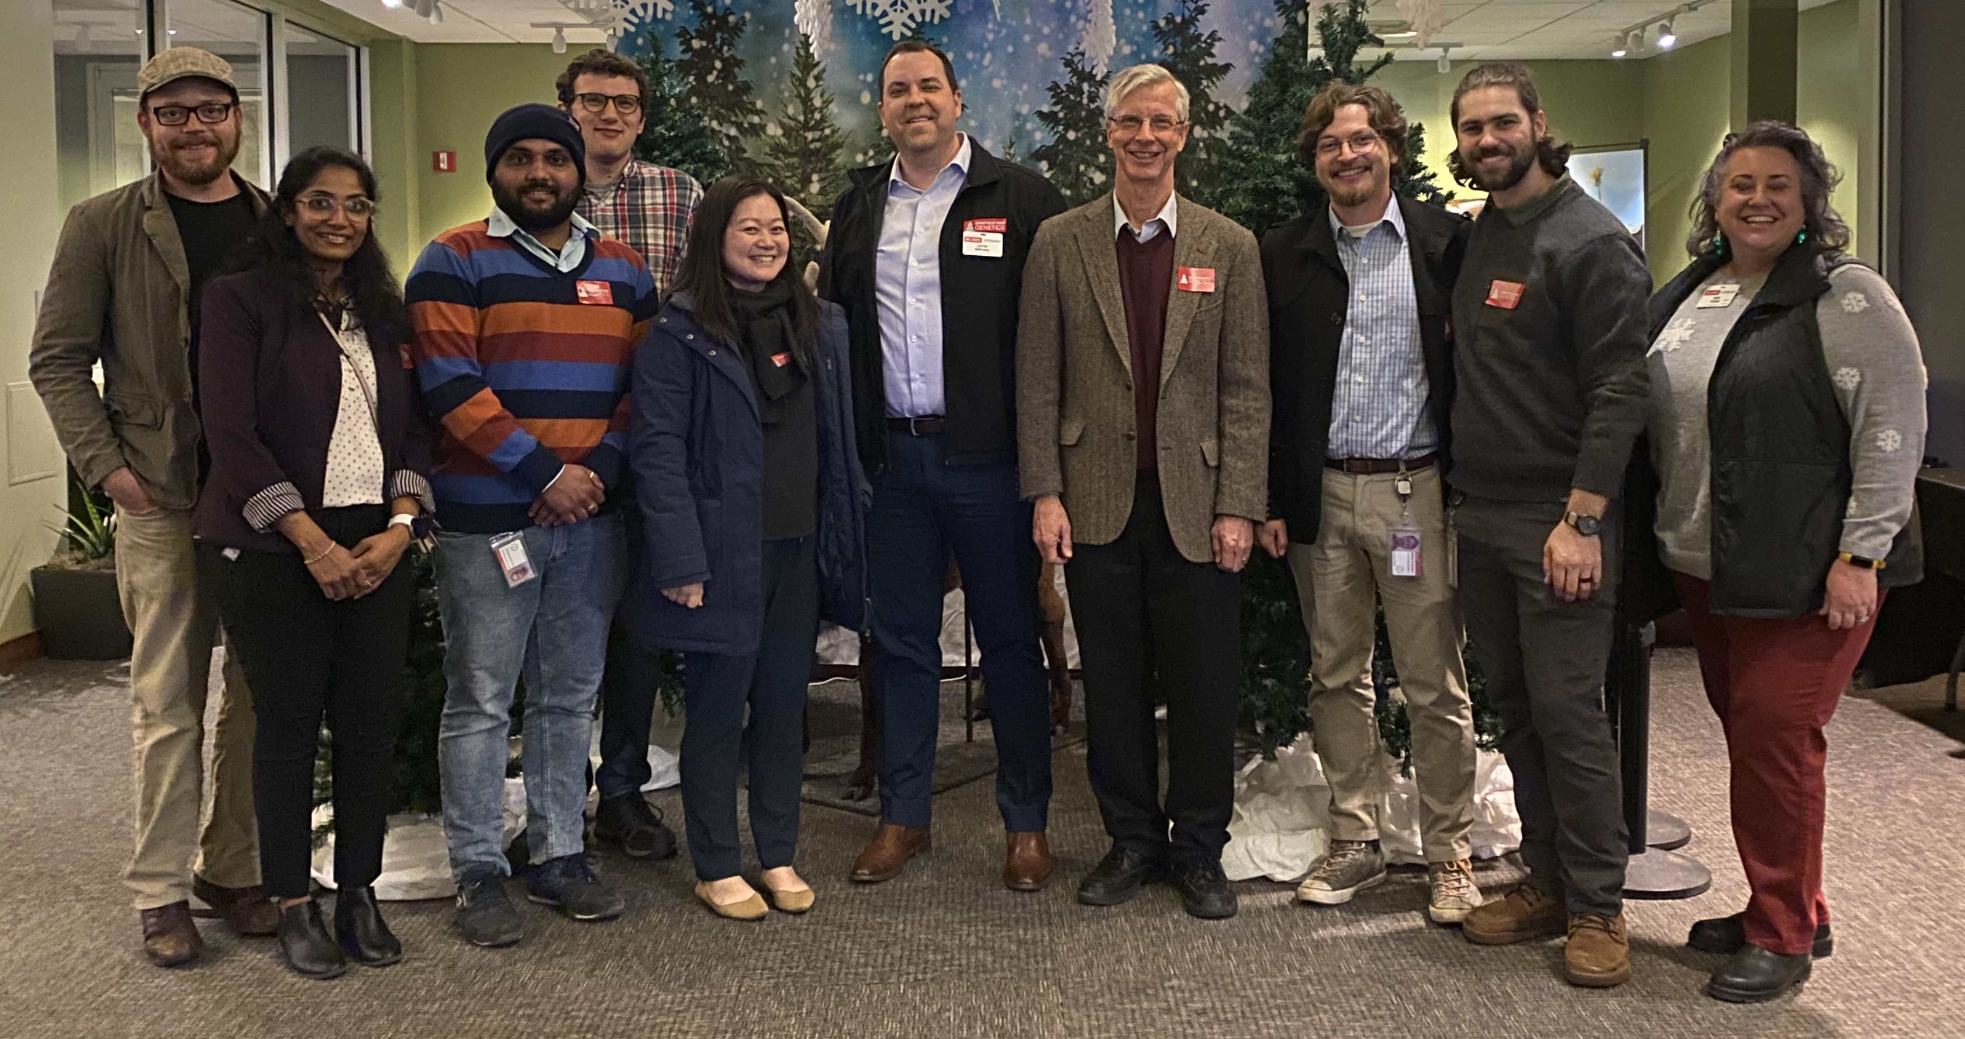









Acknowledgements
Whitehill Lab: Twitter (@WhitehillLab)
Collaborators
Jeff Owen
Tracy Taylor
Teresa Lambert
John Council
Rusty Barr
Travis Birdsell
Dr. Ross Whetten
Dr. Elizabeth Nichols
Dr. Jack Wang
Dr. Fikret Isik
Dr. Jean Ristaino
Dr. Charles Sims
Dr. Robert Jetton
Dr. Solomon Ghezehei
Funding
36
March 6th, 2025
Notes:
`

Slide 37
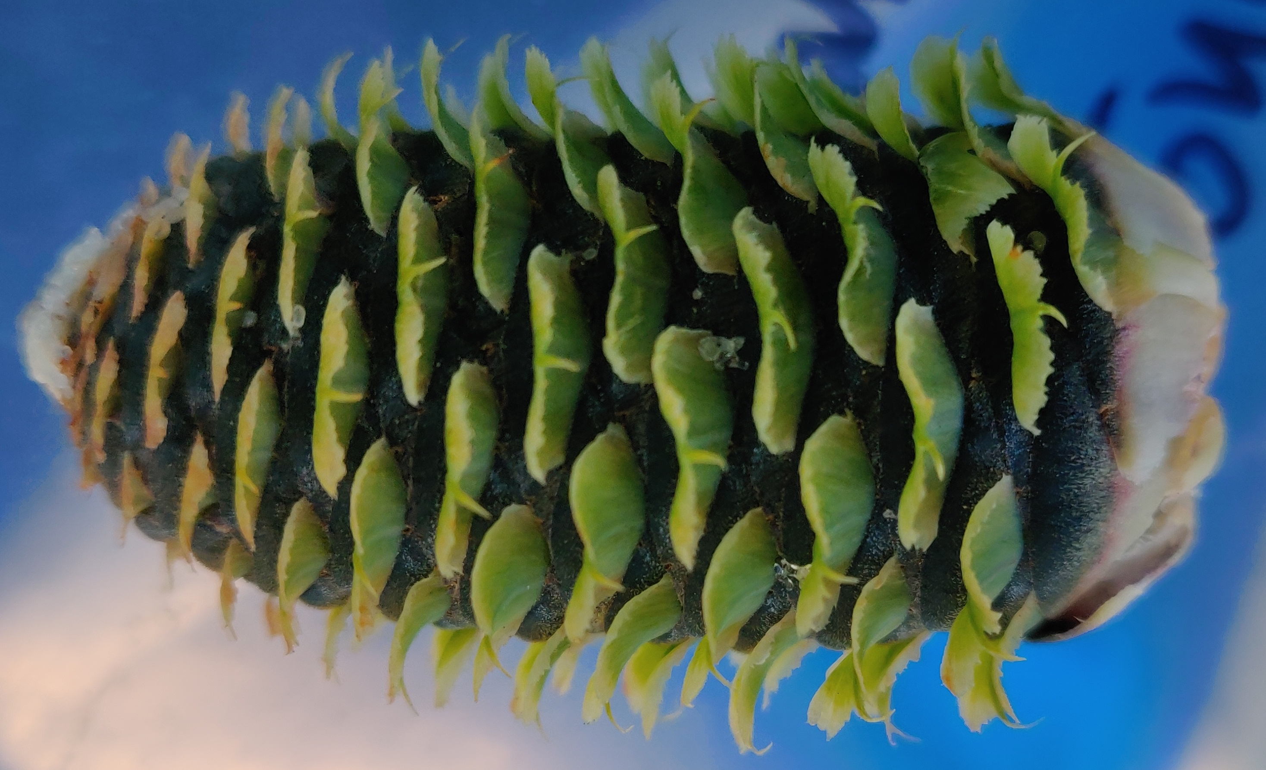
QUESTIONS?
37
March 6th, 2025
Notes:
`

