Slide 1
Carbon-neutral Energy and Nutrient Recovery from Solid Manures
Wayne Yuan, Dwi Cahyani
Dept. of Bio. and Ag. Engineering
NC State University

Slide 2
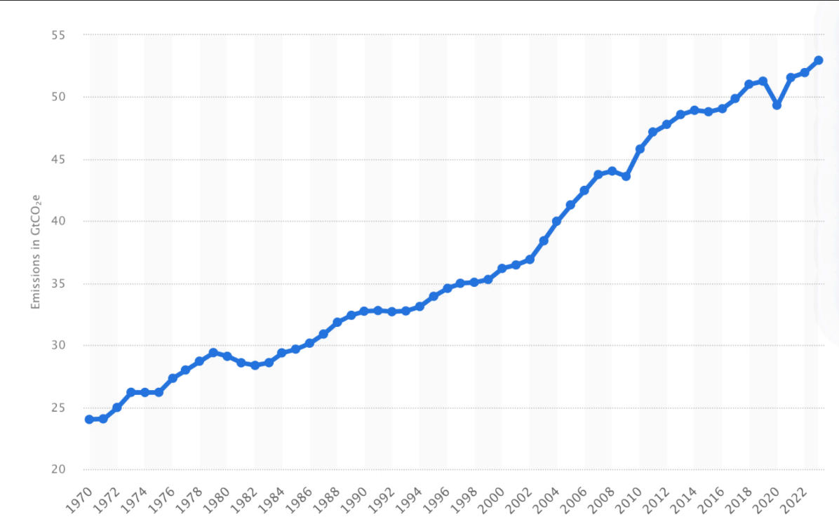
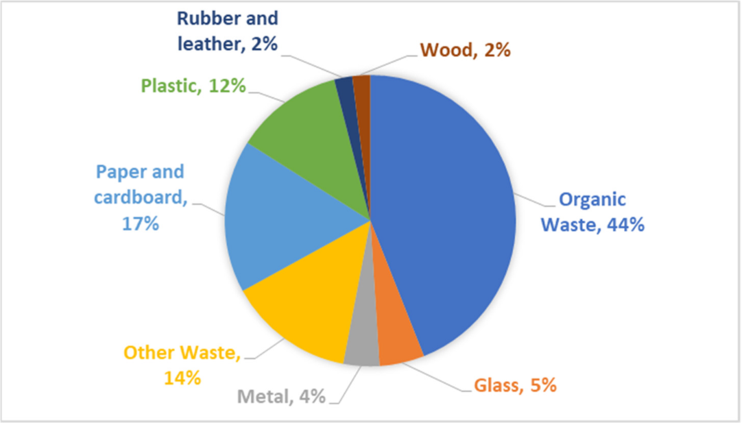
The Challenge: GHG, Waste, Fertilizer Shortage
Greenhouse gas emissions
Waste management
Global waste composition. Obtained from Sustainability.
Global CO2e emissions. Obtained from Statista.

Slide 3
Project Purpose
Project Goals and Objectives
Manure collection, separation, drying, and characterization
Syngas production from TLUD gasification of dried solid manure
Nutrient analysis of ash-biochar blends from TLUD gasification

Slide 4
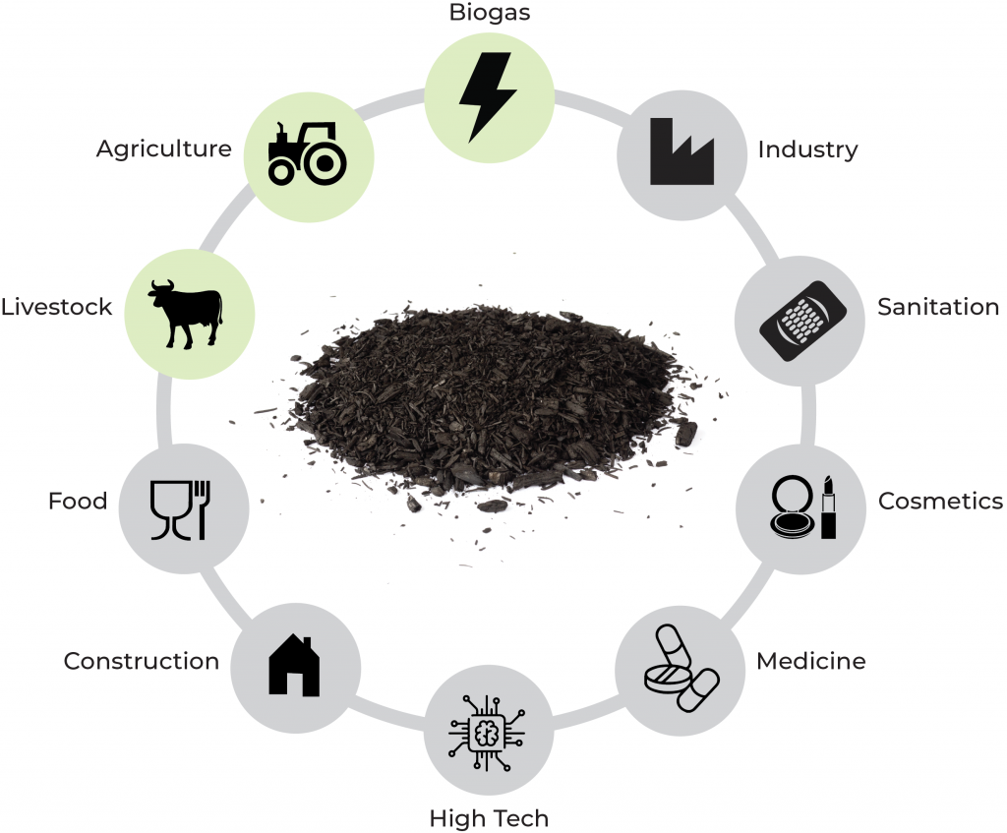
Biochar
What is it?
Carbon-rich material produced from organic waste or biomass
Produced via thermochemical conversion
What it is used for?
Enhances soil fertility
Stable form of long-term carbon storage
Precursor for high-value products
Potential applications of biochar. (Biochar Industry, 2023)
Notes:
heating biomass in a low-oxygen environment

Slide 5
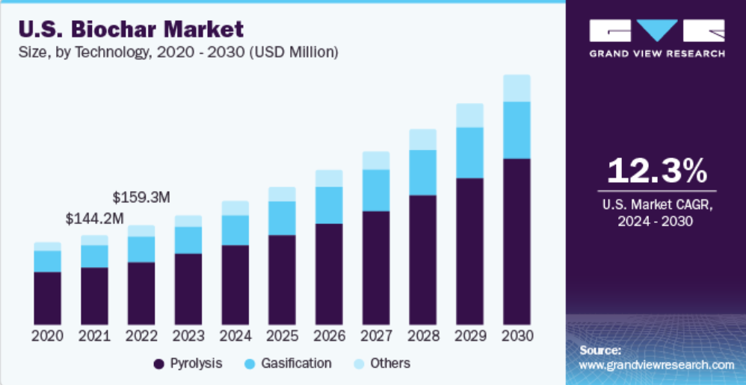
Market of Biochar
Market Analysis Report 2023
$1.35B
$541.8M
Biochar Market Size, Share and Growth Analysis Report (Grand View Research Biochar, 2023)
Notes:
Historical Range: 2018-2022
Forecast Period: 2024 - 2030
Since the process does not yield stable biochar that can be used in agricultural applications,
Increasing product consumption in producing organic food and its ability to enhance soil fertility & plant growth are expected to be key factors driving market growth

Slide 6
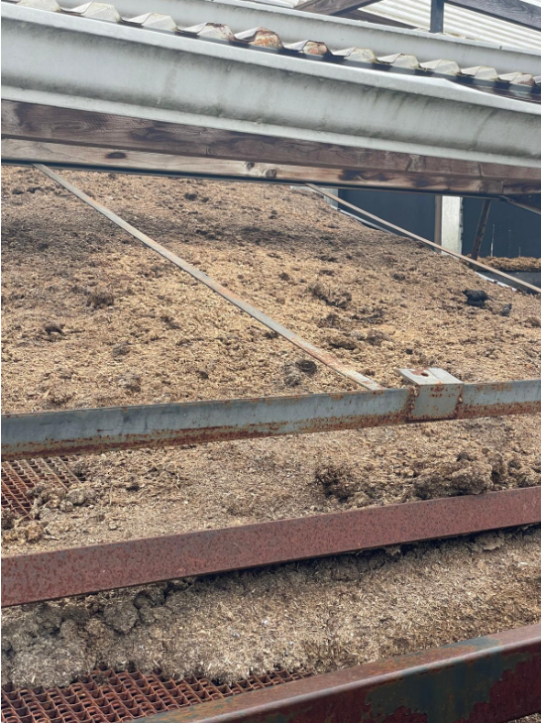
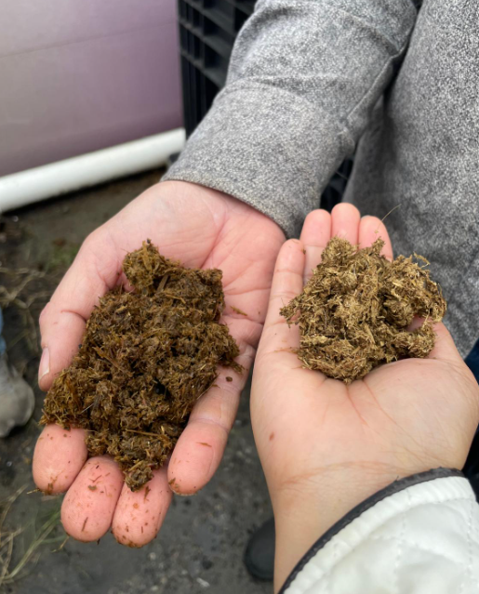
Manure sourcing and processing
Table 1. Farm/Source of Manure
Manure type | Farm/Source
Poultry | Pray to Lay Poultry, LLC 4591 N Nc Highway Seven Springs, NC 28578
Dairy | Kooba Dairy Inc 1719 Penny Tew Mill RD, Roseboro, NC 28382
Swine | Montauk Energy 1362 Blind Bridge Road Duplin County, NC
Woodchips | Veneer Technologies, Newport, NC
A
B
Figure 1. Manure drying process (A), wet (left) and dry (right) dairy manure (B).

Slide 7
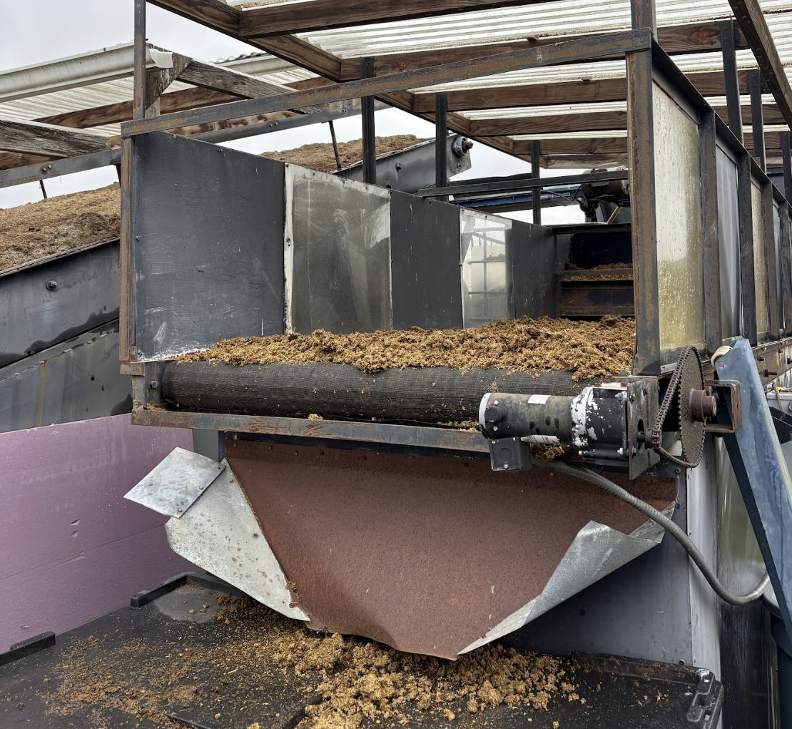
Animal Manure Pretreatment
Animal waste
Lake Wheeler Field Laboratories
Dried Manure
High Moisture Content
Layer Poultry Litter = 75%
Dairy Manure = 87%
(ASABE Standard)
Belt Dryer, 24+ hr
Lower Moisture Content (< 30%)

Slide 8
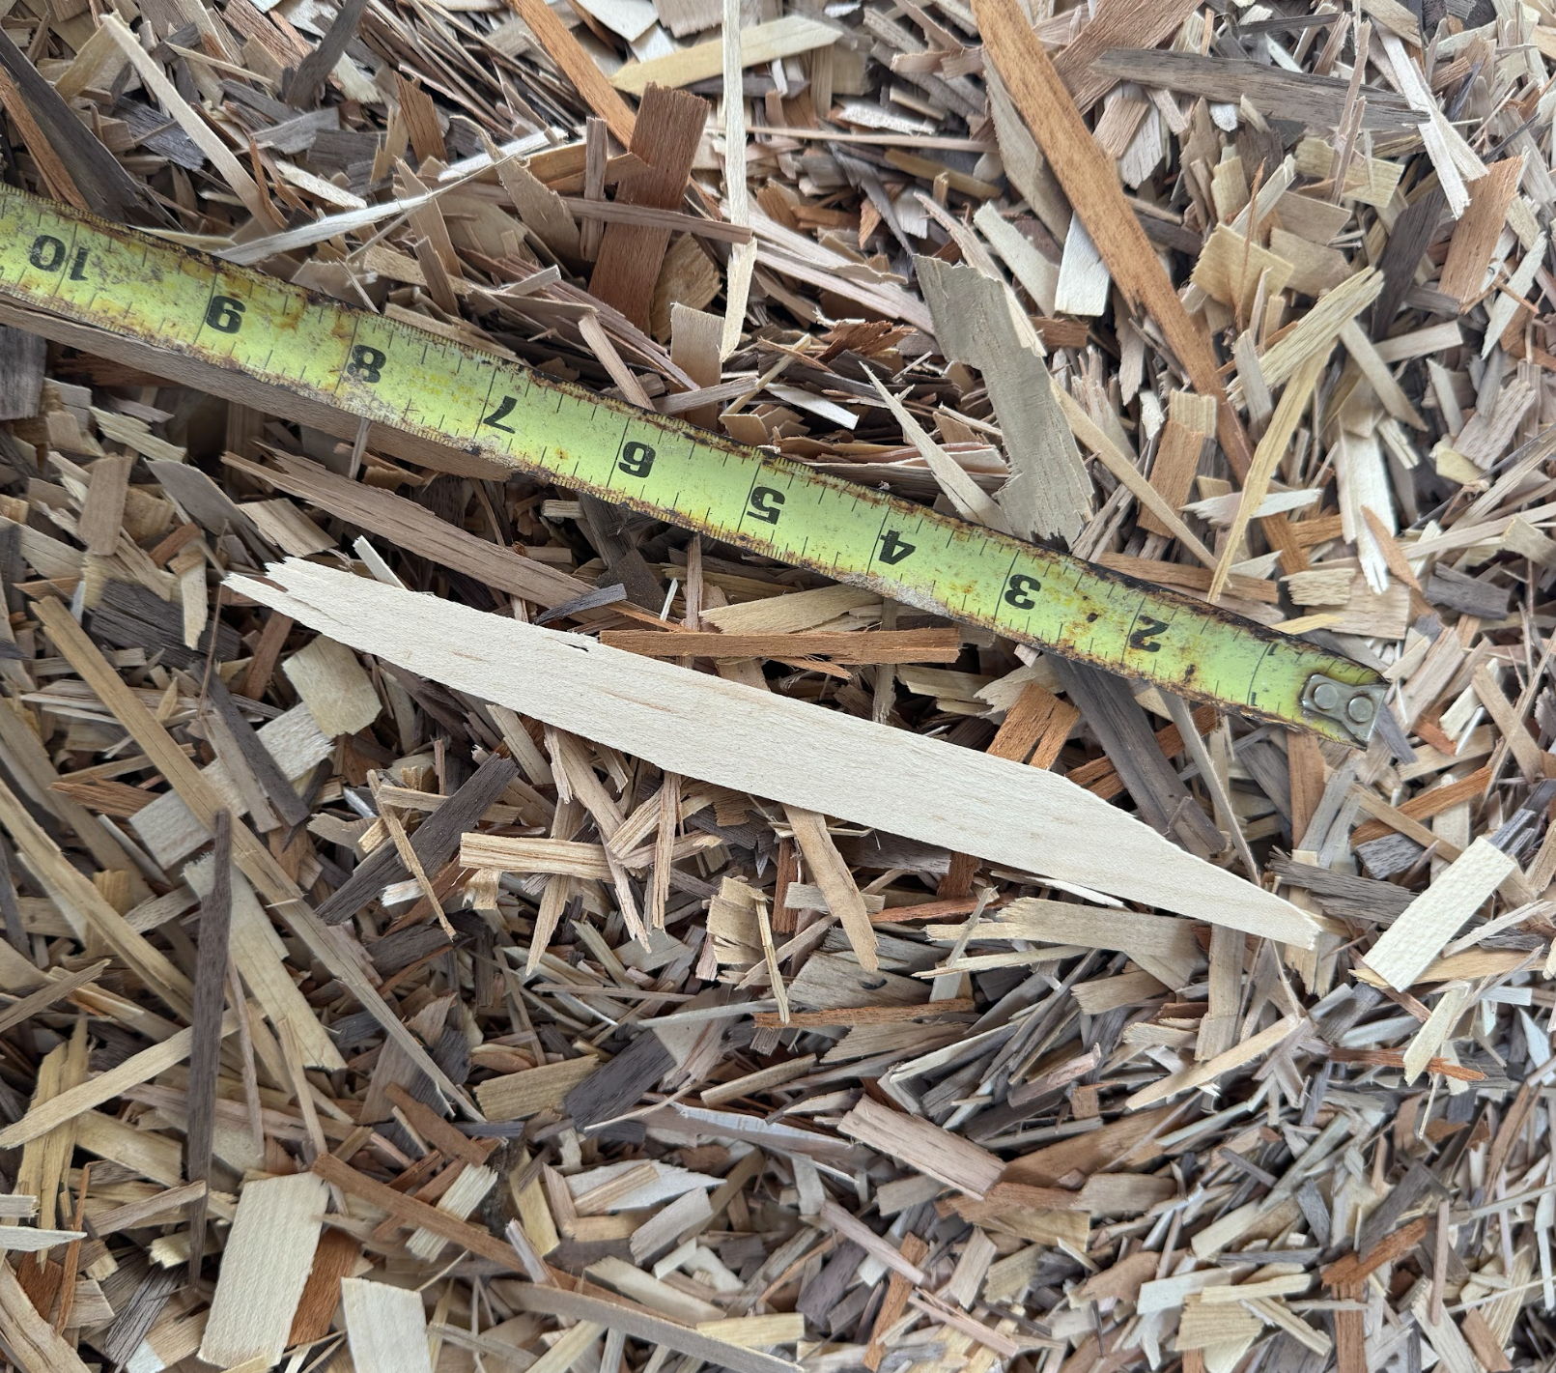
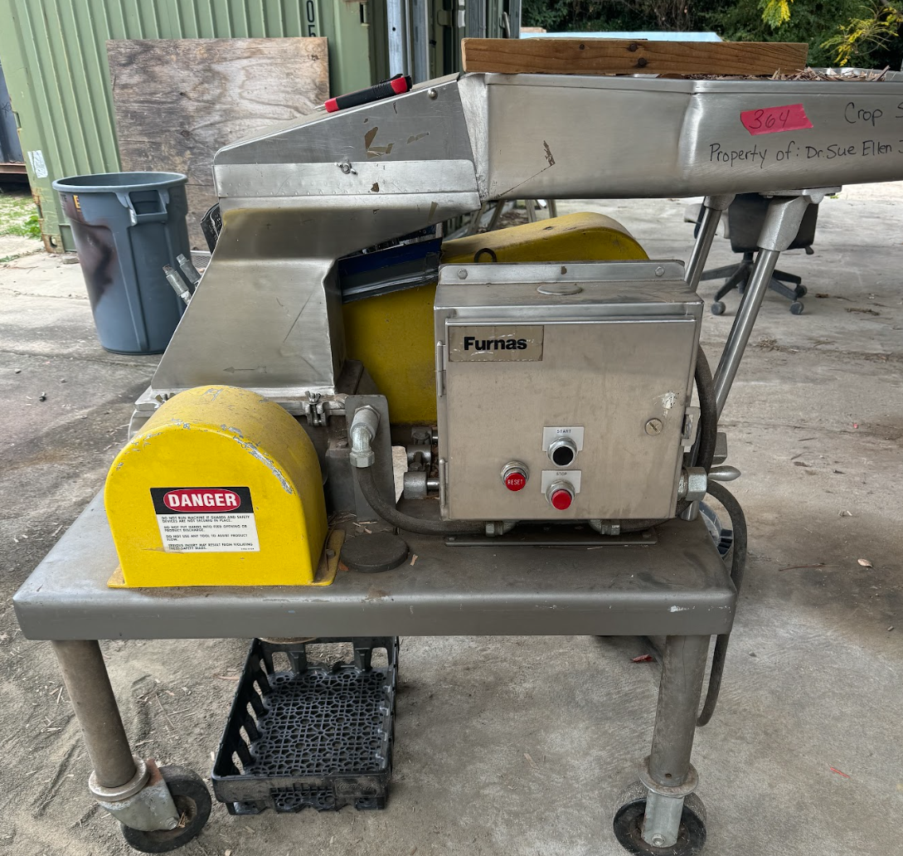
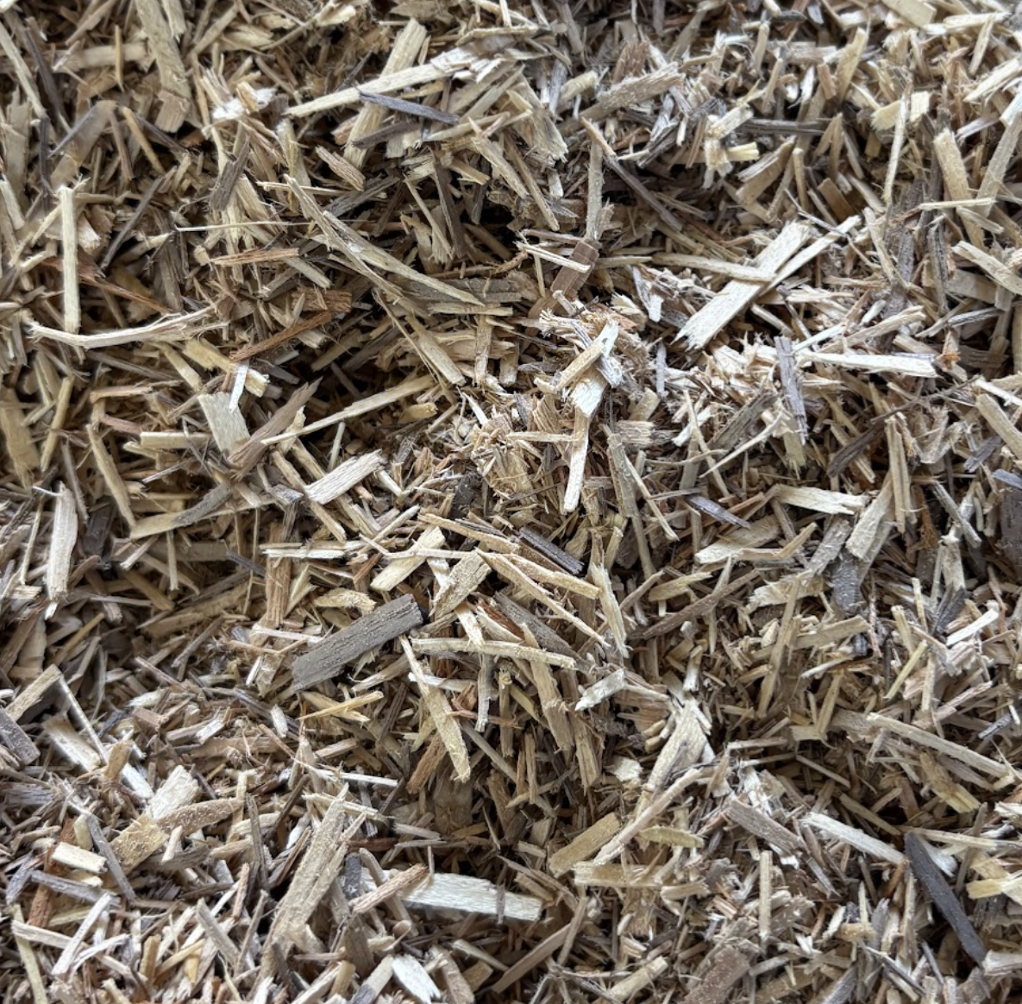
Wood Veneer Waste Pretreatment
Starting Material
Mill
Ending material
Non-uniform particles sizes
Reduces wood chips to uniform size
Uniform Particle Size

Slide 9
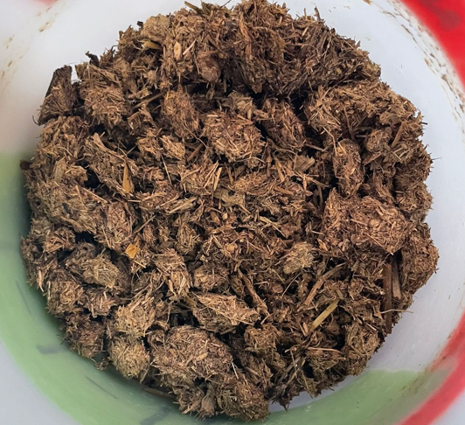
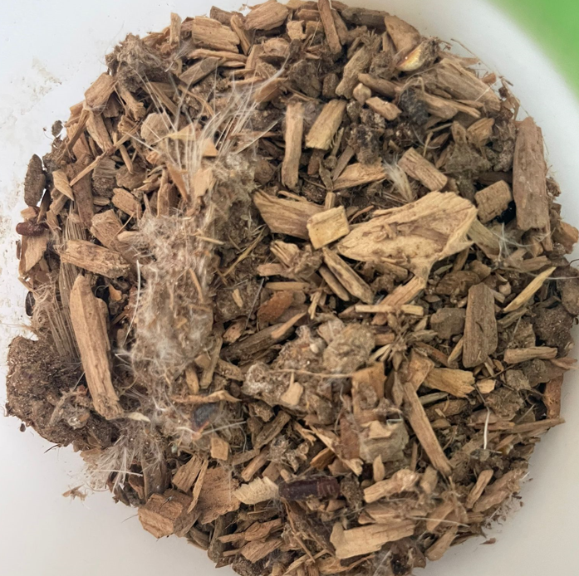
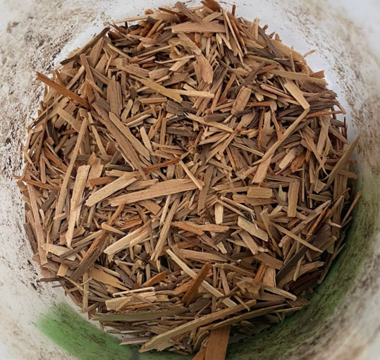
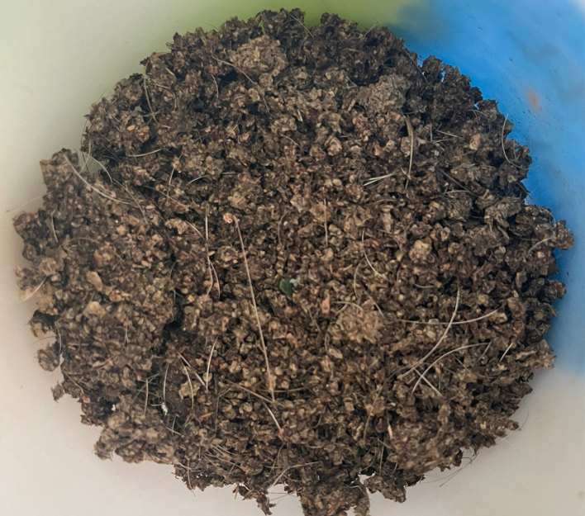
Raw
Biomass
Feedstock
Dried Dairy manure
Dried Poultry litter
Wood Veneer Waste
Dried Swine manure

Slide 10
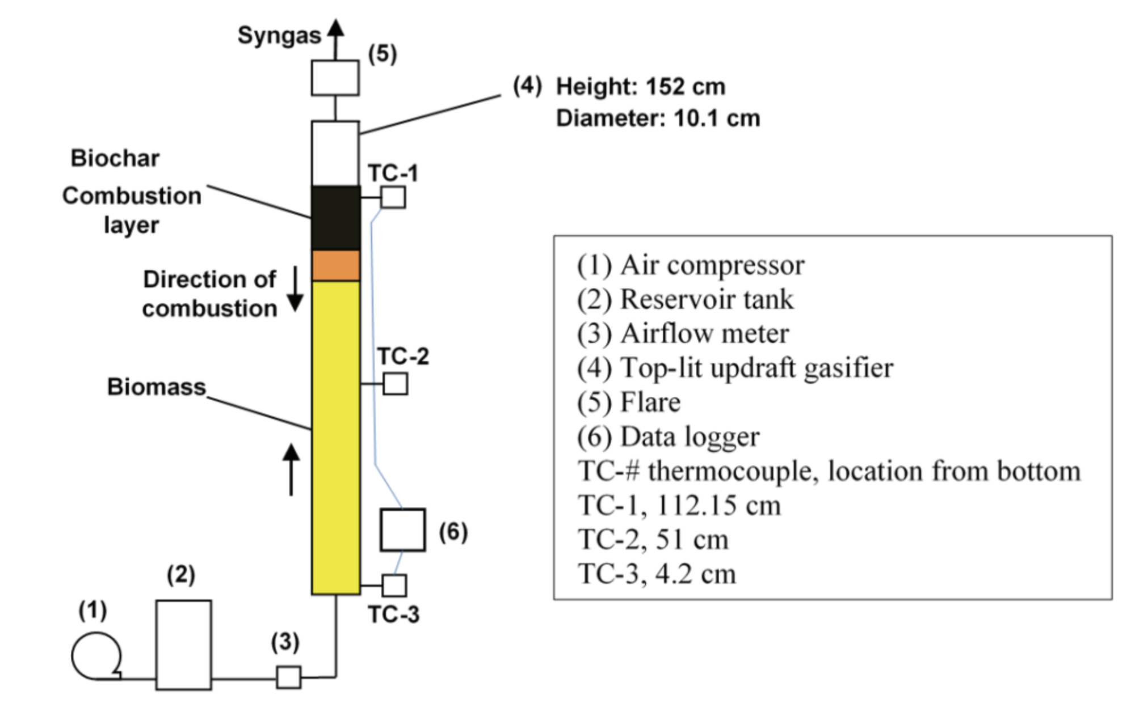
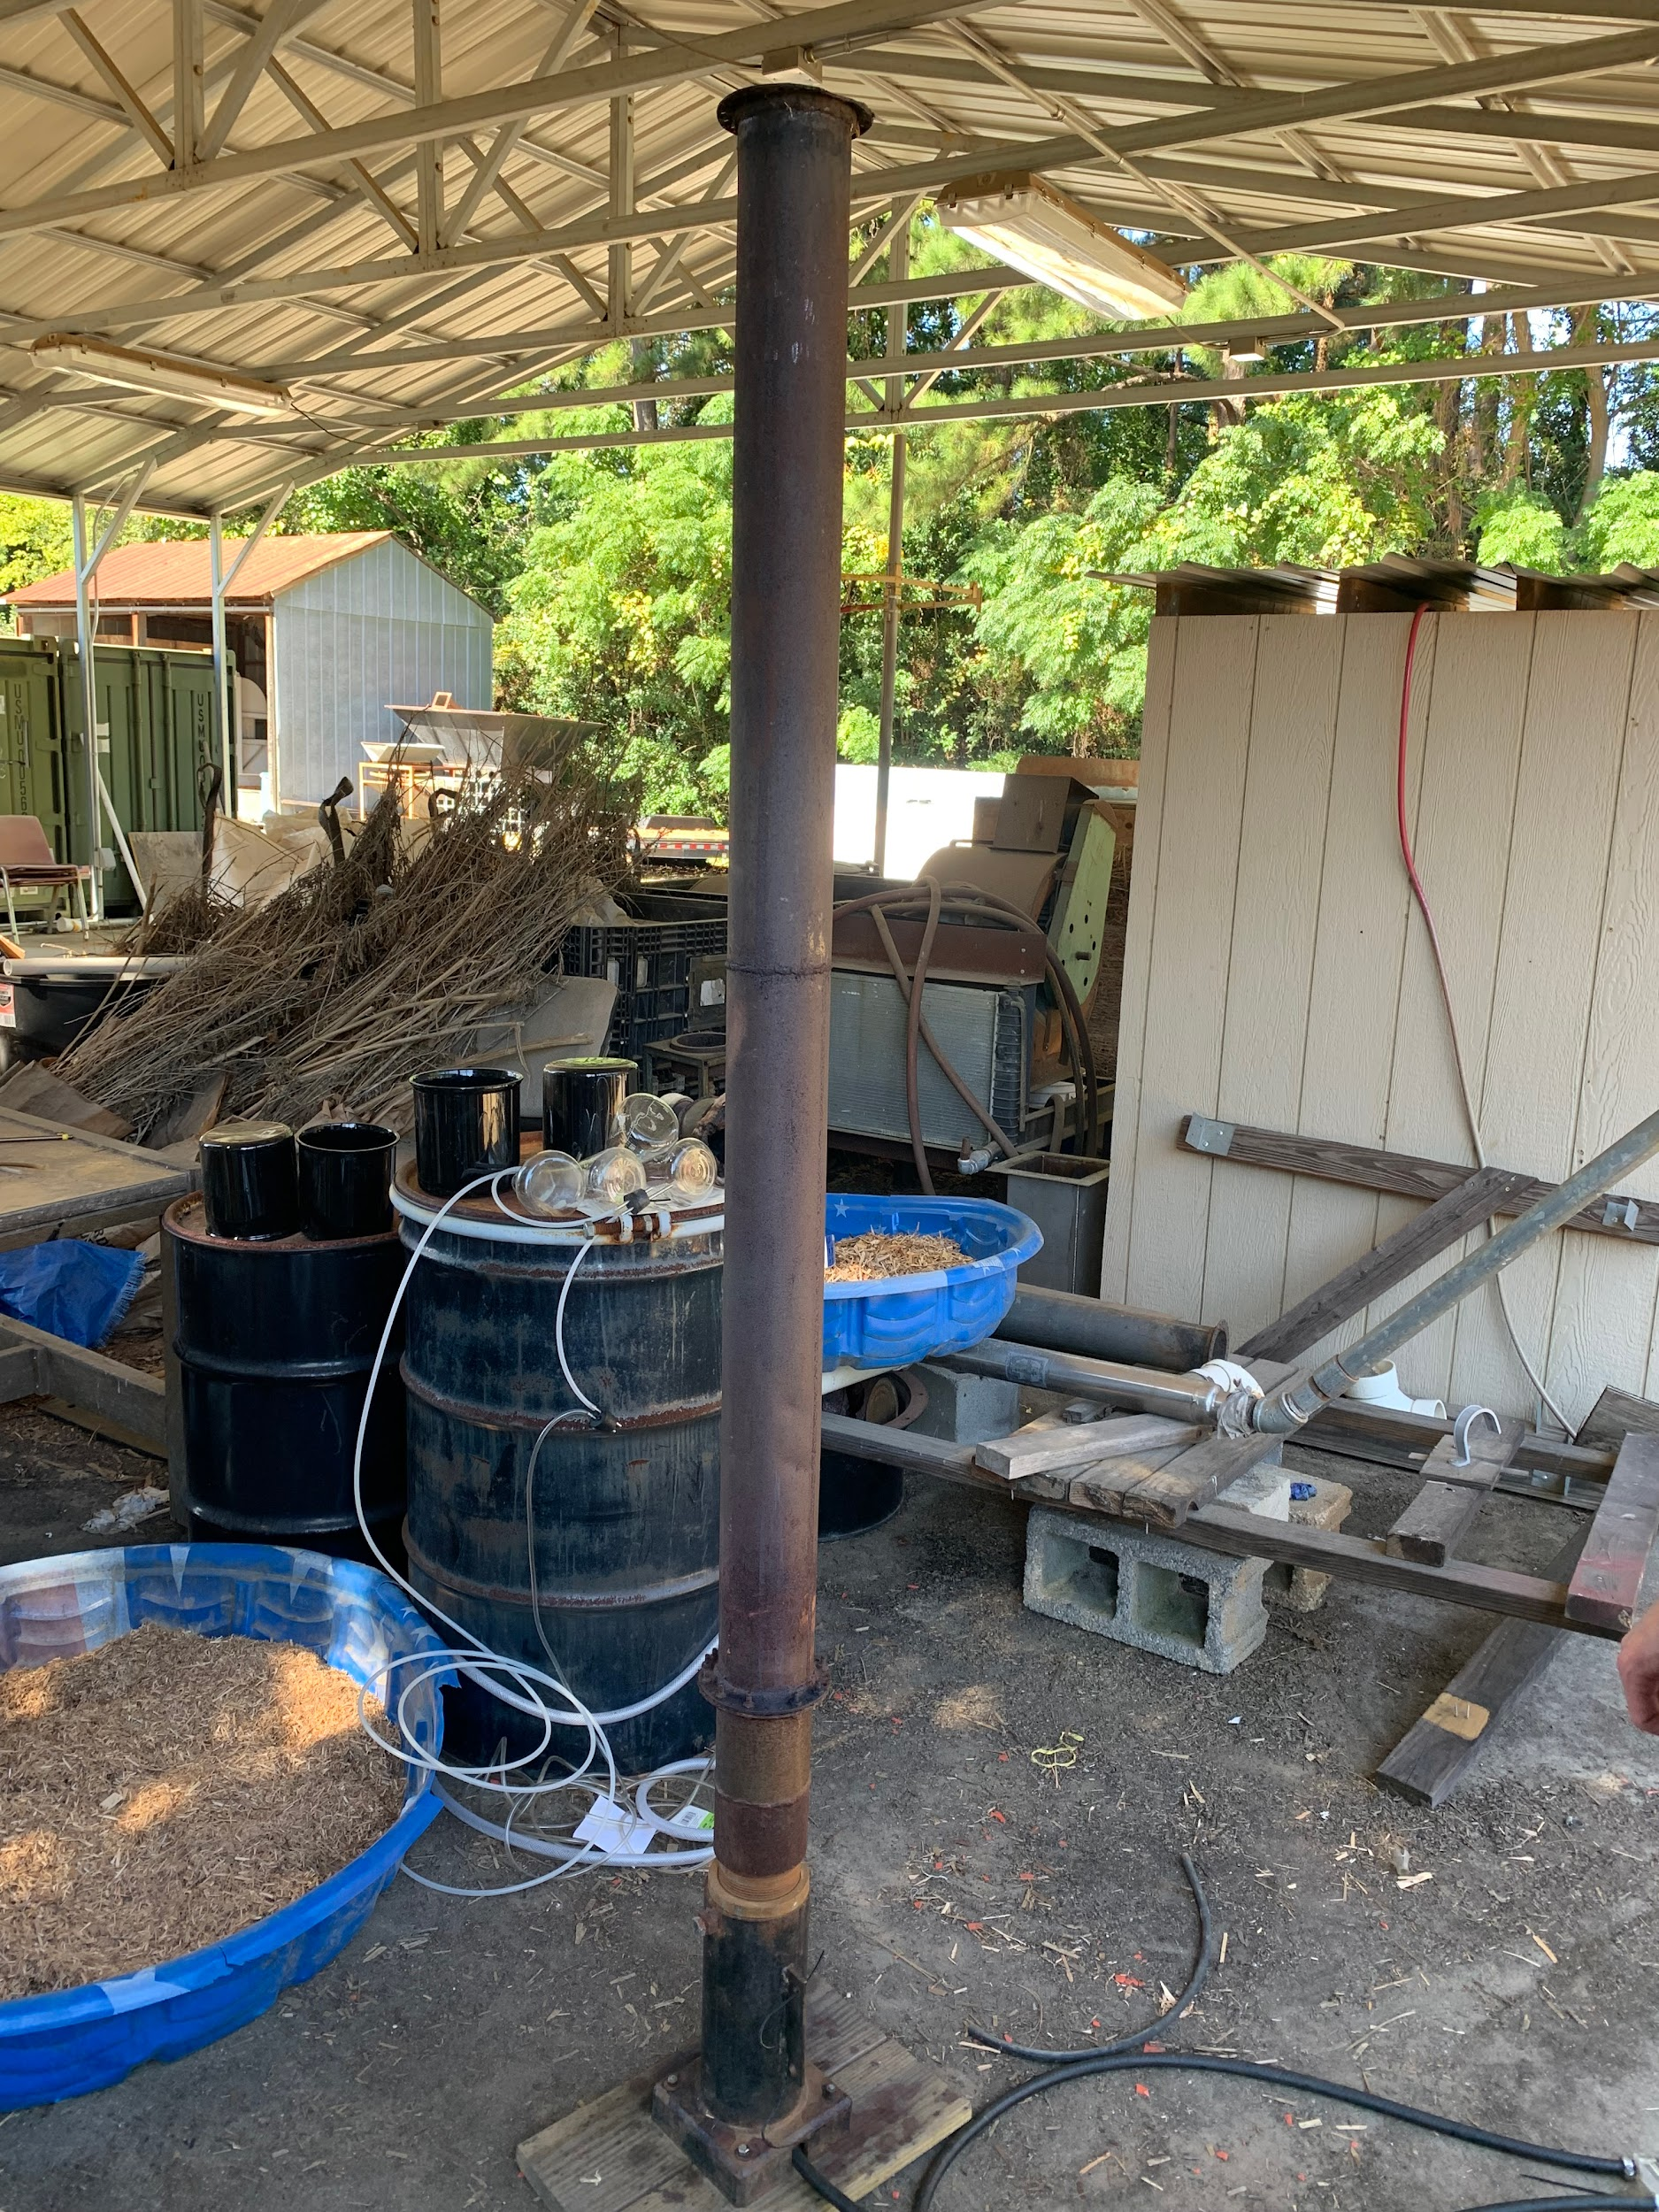
Top Lit Updraft (TLUD) Gasification Unit
Volume: .012 m^3
James, A. M., Yuan, W., Boyette, M. D., Wang, D., & Kumae, A. (2016). Characterization of Biochar from Rice Hulls and Woodchips Produced in a Top-Lit Updraft Biomass Gasifier . 2016 American Society of Agricultural and Biological Engineers, 59(3).

Slide 11
Top Lit Updraft (TLUD) Gasification Unit
Pressure: 50-60 psi
James, A. M., Yuan, W., Boyette, M. D., Wang, D., & Kumae, A. (2016). Characterization of Biochar from Rice Hulls and Woodchips Produced in a Top-Lit Updraft Biomass Gasifier . 2016 American Society of Agricultural and Biological Engineers, 59(3).

Slide 12
Top Lit Updraft (TLUD) Gasification Unit
Adjust Airflow
James, A. M., Yuan, W., Boyette, M. D., Wang, D., & Kumae, A. (2016). Characterization of Biochar from Rice Hulls and Woodchips Produced in a Top-Lit Updraft Biomass Gasifier . 2016 American Society of Agricultural and Biological Engineers, 59(3).

Slide 13
Top Lit Updraft (TLUD) Gasification Unit
Add feed,
Ignite with torch
James, A. M., Yuan, W., Boyette, M. D., Wang, D., & Kumae, A. (2016). Characterization of Biochar from Rice Hulls and Woodchips Produced in a Top-Lit Updraft Biomass Gasifier . 2016 American Society of Agricultural and Biological Engineers, 59(3).

Slide 14
Top Lit Updraft (TLUD) Gasification Unit
Thermocouples track temperature with datalogger
James, A. M., Yuan, W., Boyette, M. D., Wang, D., & Kumae, A. (2016). Characterization of Biochar from Rice Hulls and Woodchips Produced in a Top-Lit Updraft Biomass Gasifier . 2016 American Society of Agricultural and Biological Engineers, 59(3).

Slide 15
Top Lit Updraft (TLUD) Gasification Unit
Capture Syngas
James, A. M., Yuan, W., Boyette, M. D., Wang, D., & Kumae, A. (2016). Characterization of Biochar from Rice Hulls and Woodchips Produced in a Top-Lit Updraft Biomass Gasifier . 2016 American Society of Agricultural and Biological Engineers, 59(3).

Slide 16
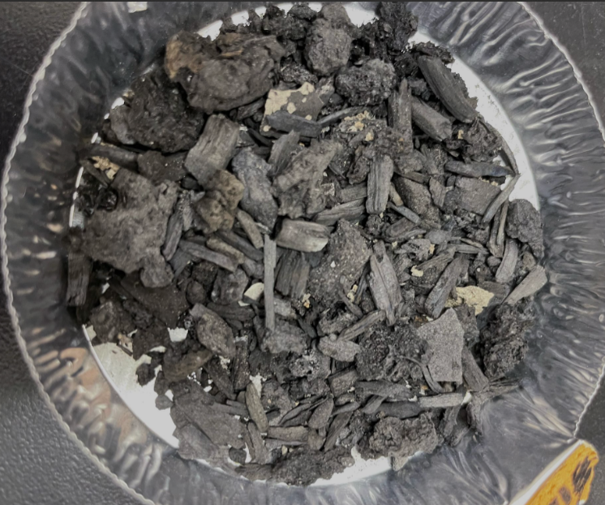
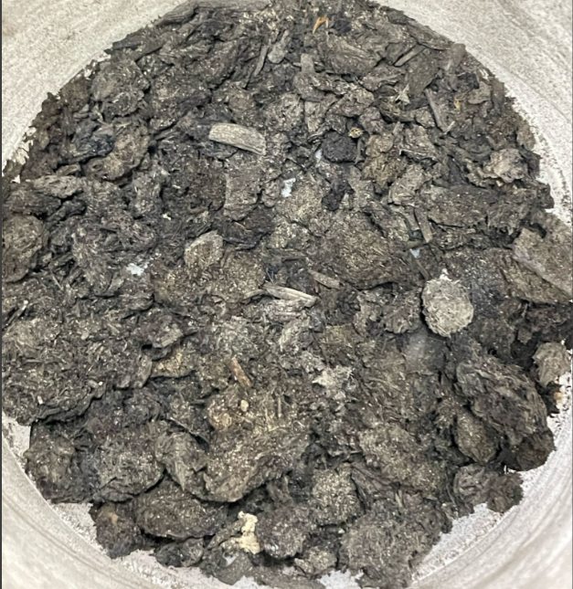
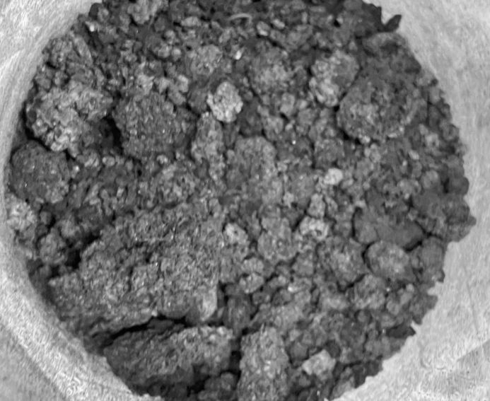
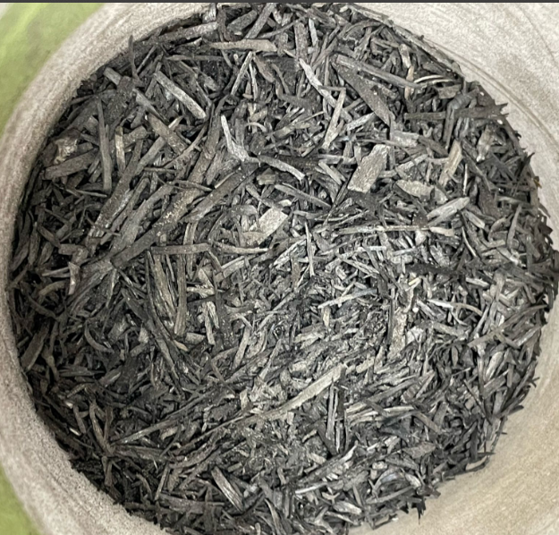
Biochars
produced
Biochar Dairy manure
Biochar Poultry litter
Biochar Wood Vaneer
Biochar Swine manure

Slide 17
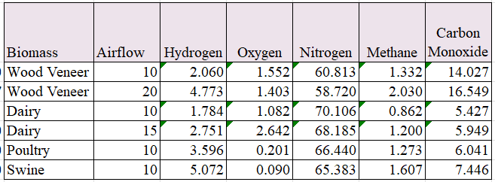
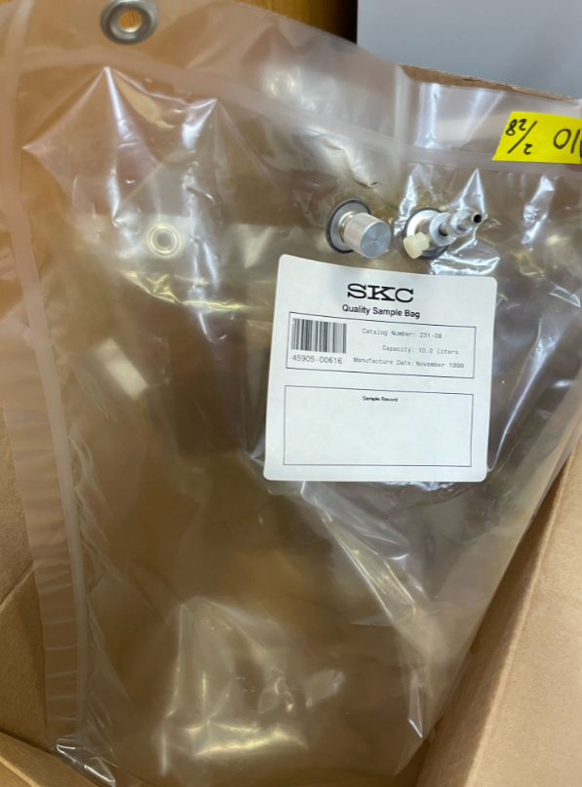
Syngas compositions
Syngas composition
Figure 4. Syngas of Dairy Manure
The chemical composition of syngas was measured by Gas
Chromatography, SRI 8610 with TCD and Argon carrier gas.
Syngas was captured using 10 L Tedlar bag.

Slide 18
Average Biochar yield, Moisture content and Max gasifier Temperature.
Biomass | Airflow | Feedstock Moisture content (%) | Average Biochar Yield (%) | Max Temperature (Celcius)
Wood Veneer | 10 | 10.2 | 10.07
Wood Veneer | 20 | 10.04 | 11.88
Dairy | 10 | 14.58 | 19.37
Dairy | 15 | - | 26.94
Poultry | 10 | 16.33 | 31.18
Swine | 10 | - | 22.97

Slide 19
Acknowledgement
Dr. Mahmoud Sharara
Mr. Chris Hopkins
NCSU Animal and Poultry Waste Processing Facility
NCDA&CS for funding support
Veneer Technologies

Slide 20
Thank you!

