Slide 1
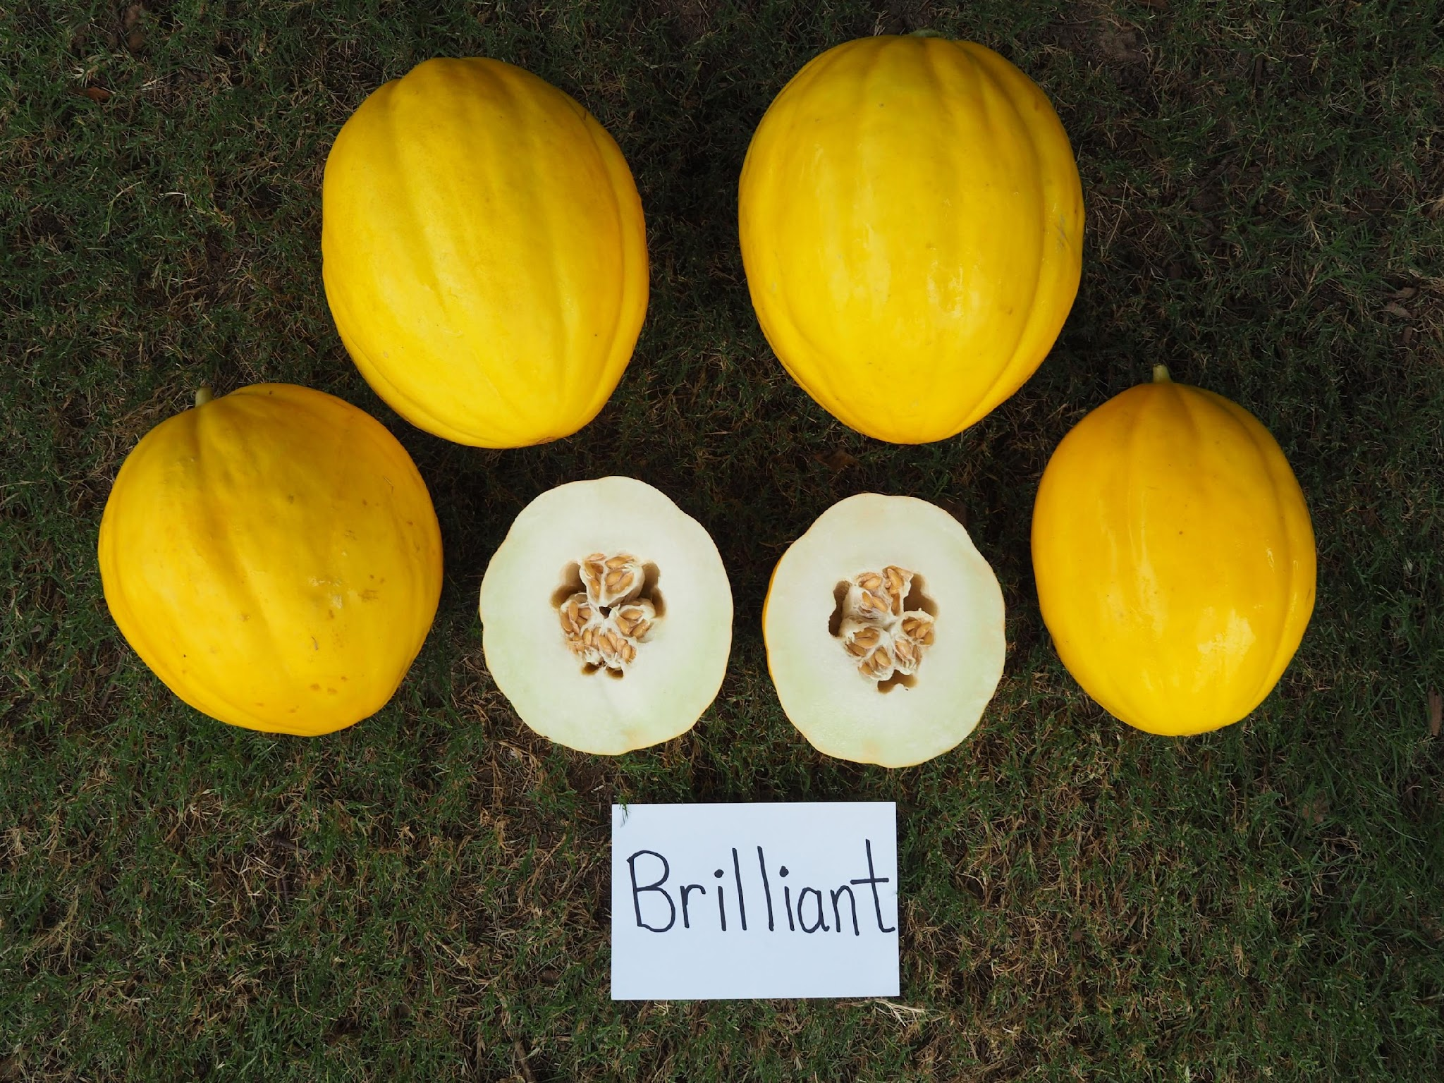
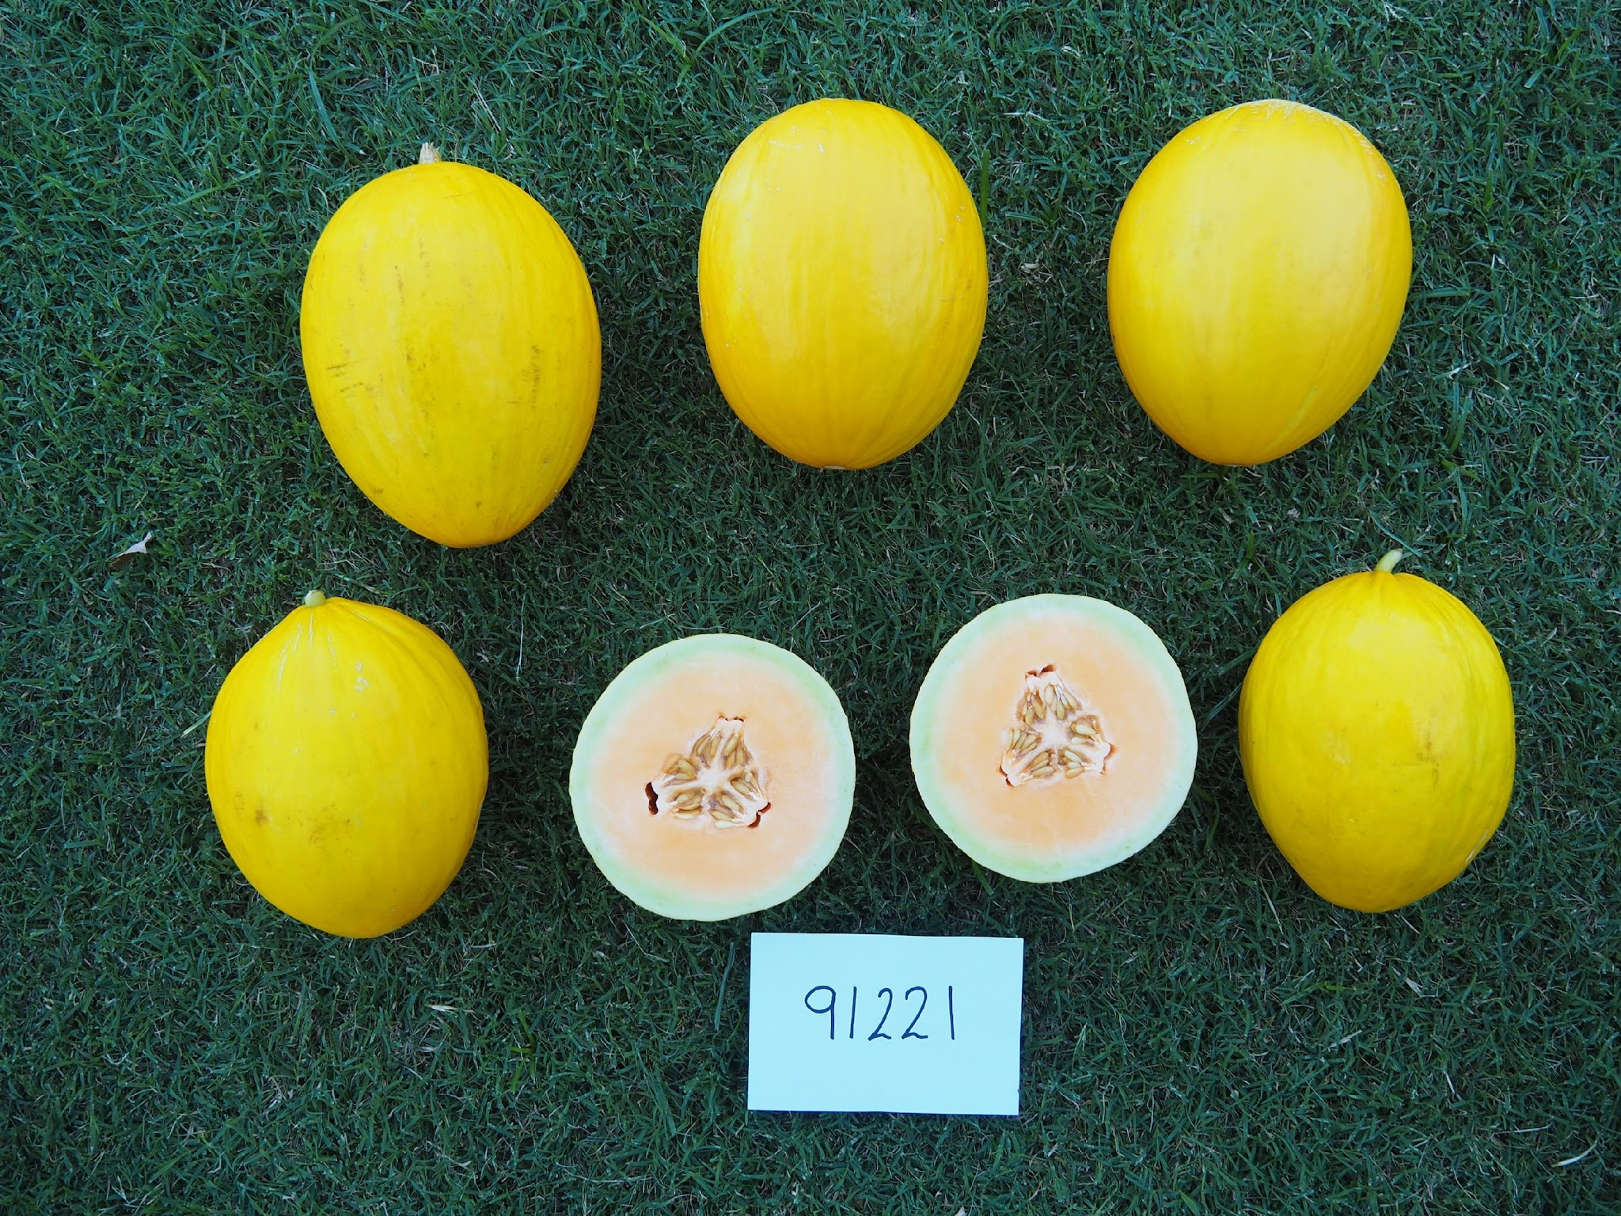
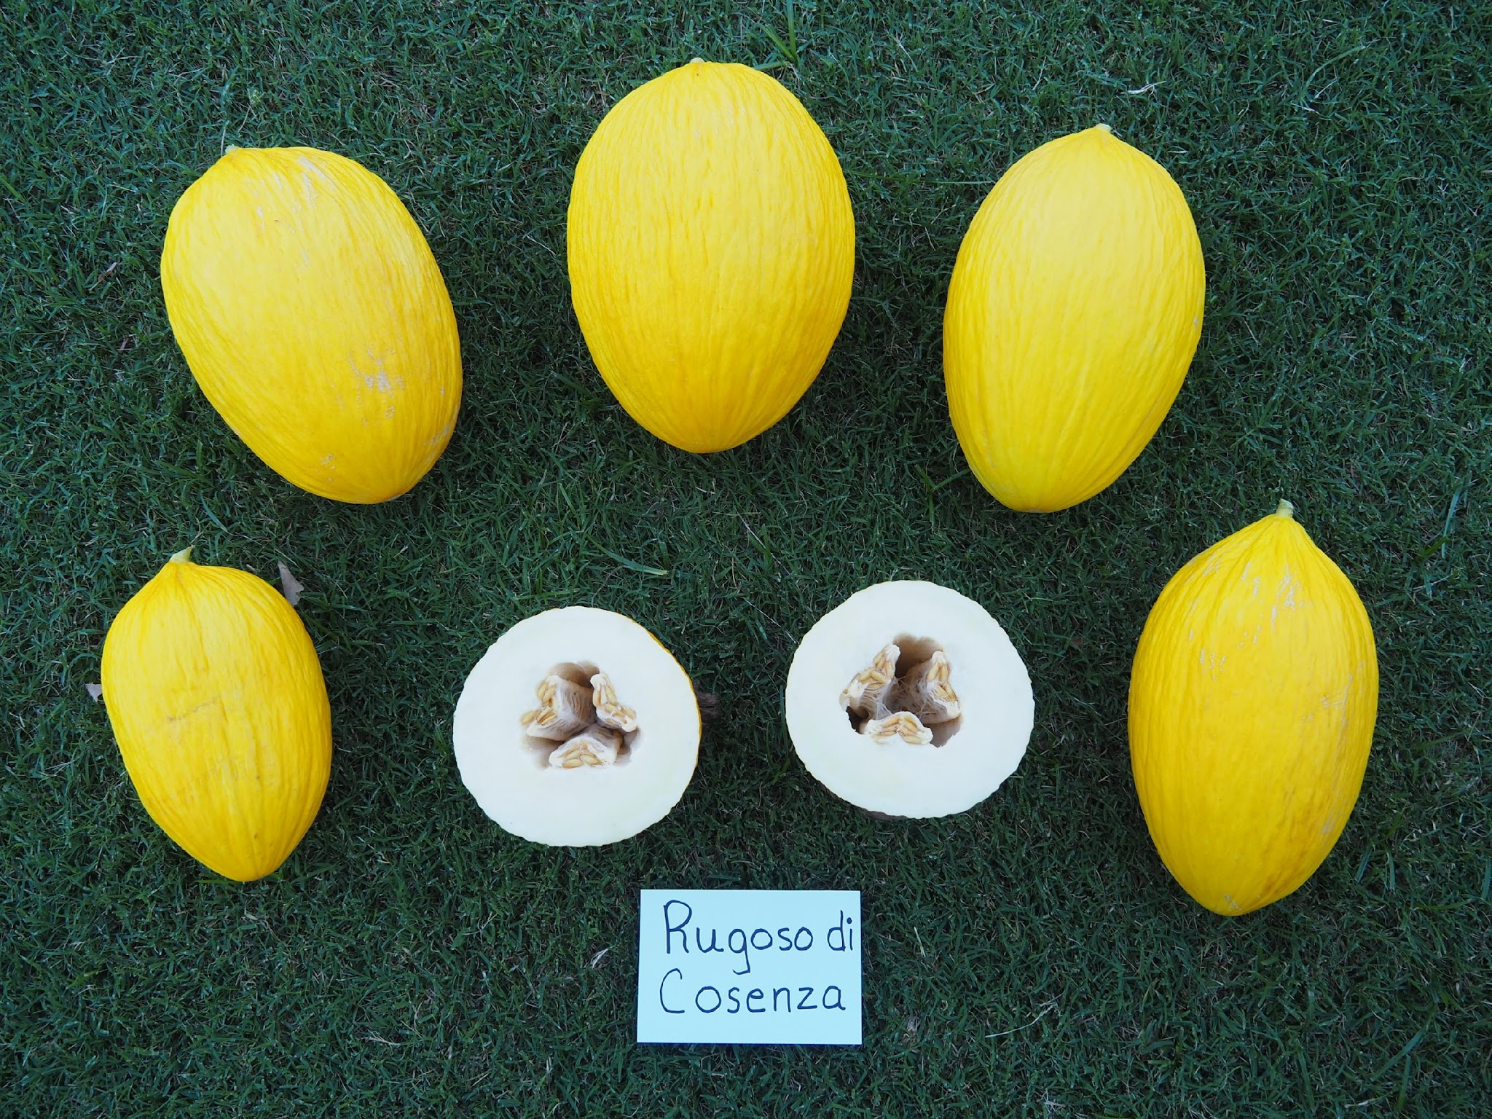
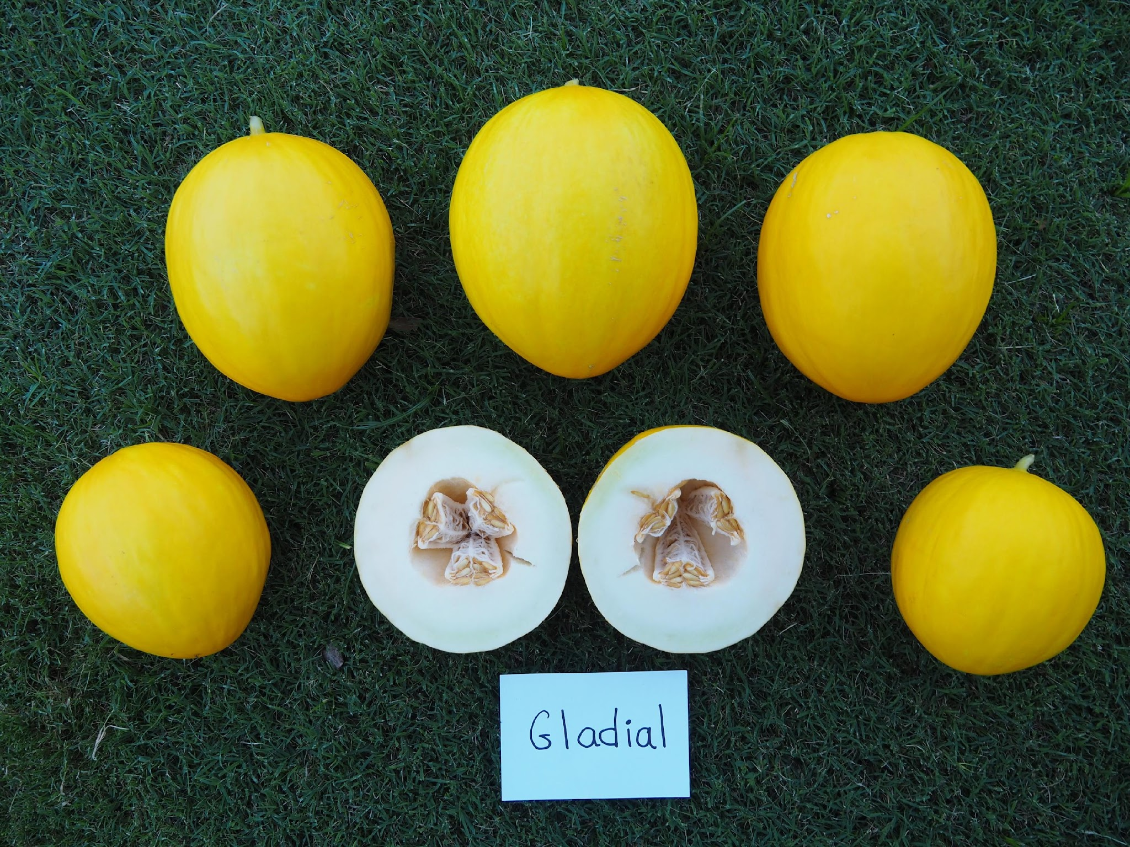
2025 Research & Industry Update
Canary Melon, a NC Crop Option
Jonathan Schultheis¹, Suzanne Johanningsmeier², Penelope Perkins-Veazie³
Department of Horticultural Science, North Carolina State University, Raleigh, NC 27695-7609; ² USDA Agricultural Research Service, Food Service and Market Quality and Handling Research Unit, North Carolina State University, Raleigh, NC 27695; ³Department of Horticultural Science, Plants for Human Health Institute, NC Research Campus, Kannapolis, NC 28081

Slide 2


Background
Scientifically known as Cucumis melo var. inodorus. (lacks musk-like odor).)Classified as a winter melon.
Believed to have originated from the Middle East.
Thrives in warm, temperate climates with well-drained soil.
Takes about 80 to 90 days to develop from seed to mature fruit.

Slide 3




Current Markets
Primary countries that produce and market canary melons are
Algeria, Morocco, Tunisia, Spain, and Brazil.
Brazil presently in the largest producer.
United States produces canary melons, yet lags considerably
behind the production of cantaloupes and honeydew melons.
Most acreage produced in CA and AZ.
No statistics are specifically gathered by USDA on canary melons
as this type melon is truly a specialty melon.

Slide 4
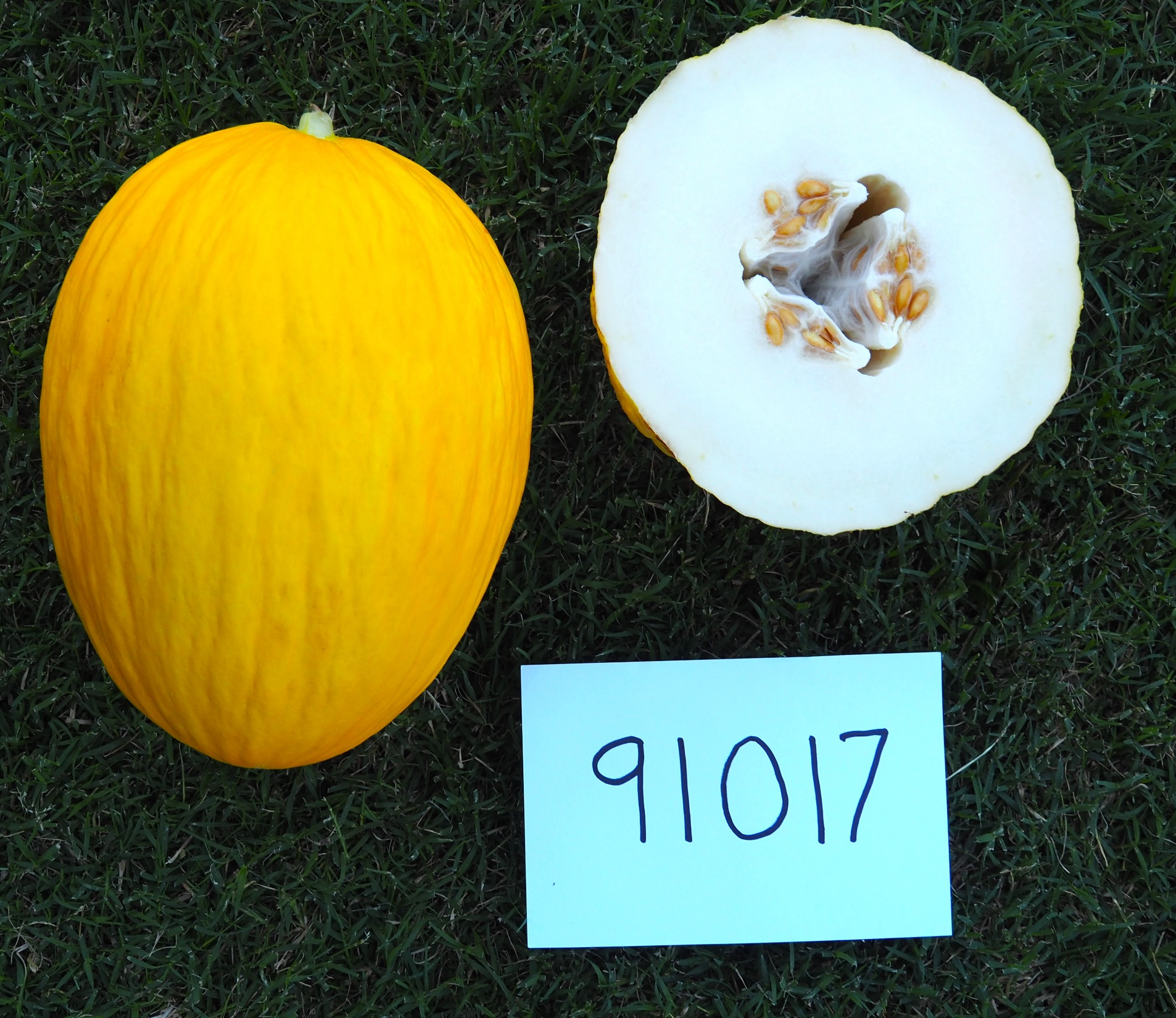
Fruit Profile
Vibrant golden-yellow rind.
Oblong / Oval shape (Spheroid)
Average fruit weight 3.7 – 6.6 lb.
Mainly ivory or light green flesh
Some orange flesh
Typical
Canary Melon

Slide 5
Project Objectives
Evaluate range of canary melon genetics and determine adaptation to NC growing conditions.
Select cultivars for advanced testing based of field and laboratory results, and sensory evaluations.
Conduct sensory evaluations; trained and consumer.
Selected cultivars to farmers for grow out and evaluation.
Adoption: Will growers grow canary melons in 2026.

Slide 6



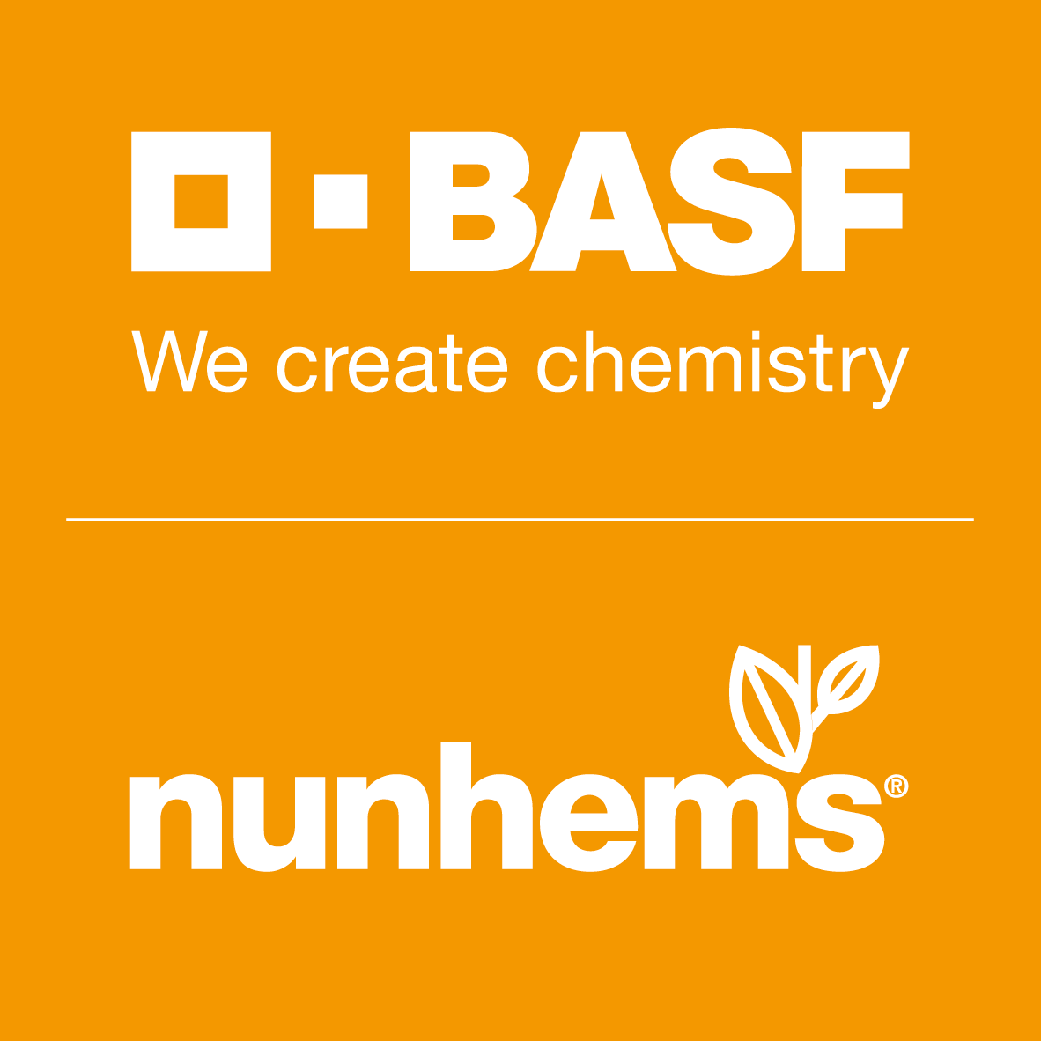






Cultigens

Slide 7
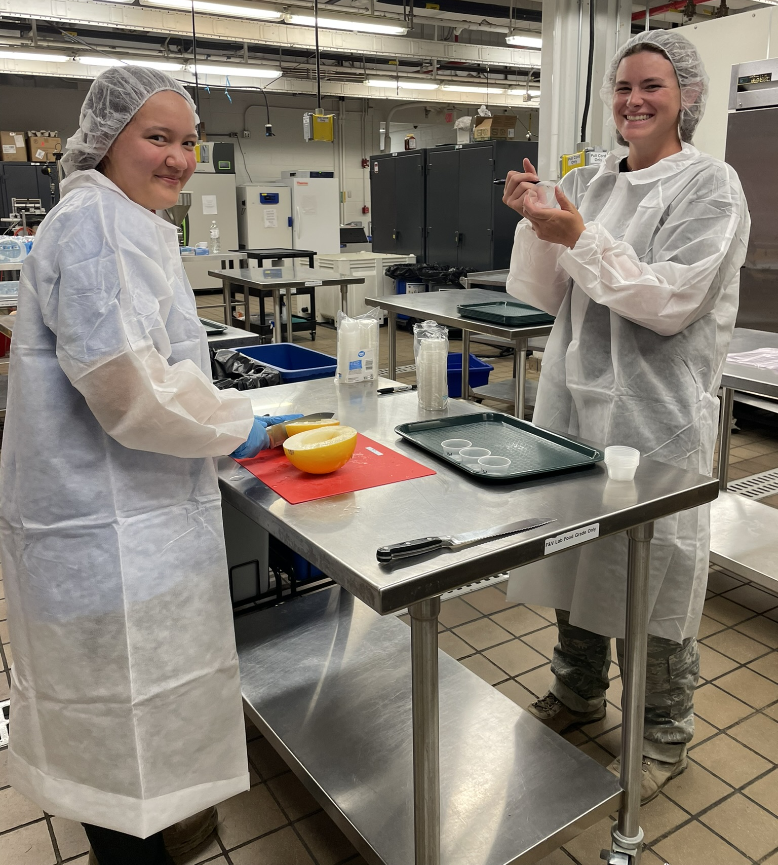
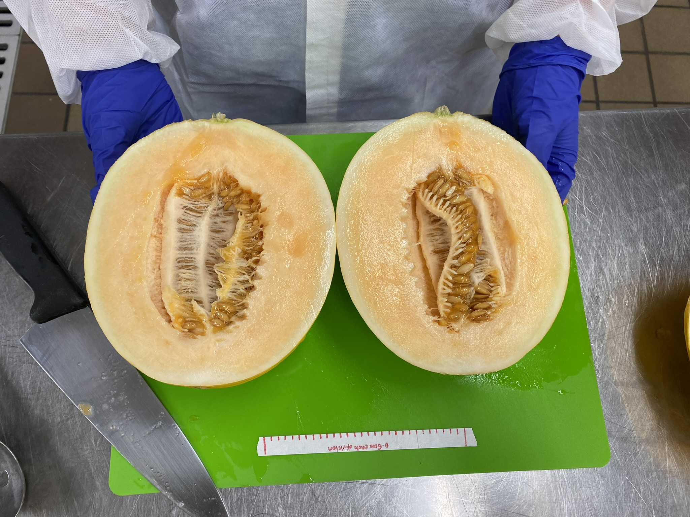
Sensory Profiling Methods Overview
Descriptive Analysis
18 untrained panelists
Generated terms for: aroma, flavor, texture
797 unique descriptors
Merged to 189 common terms
Sweet reported 228 times, main descriptor

Slide 8
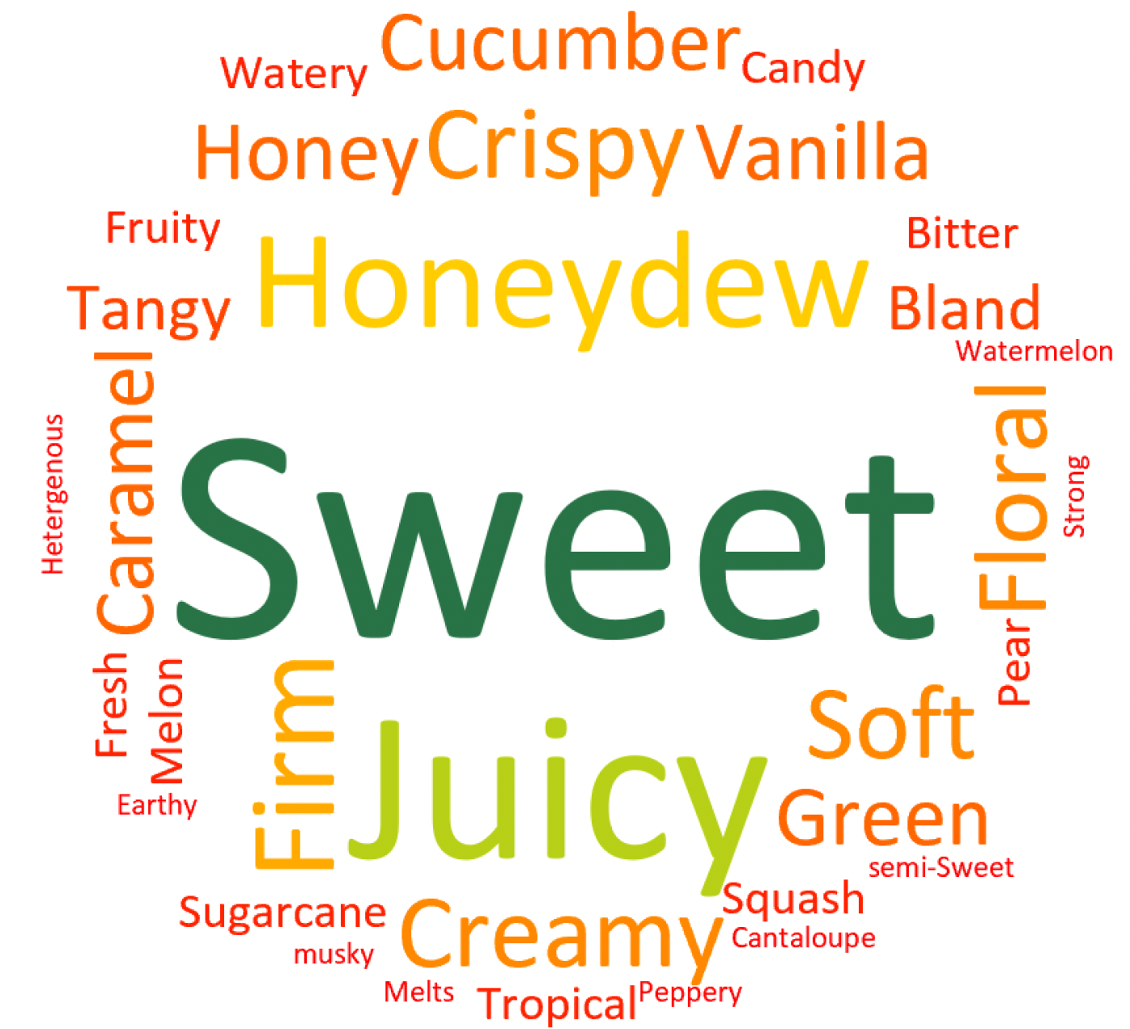
Sensory
Word Cloud
Gladial

Slide 9
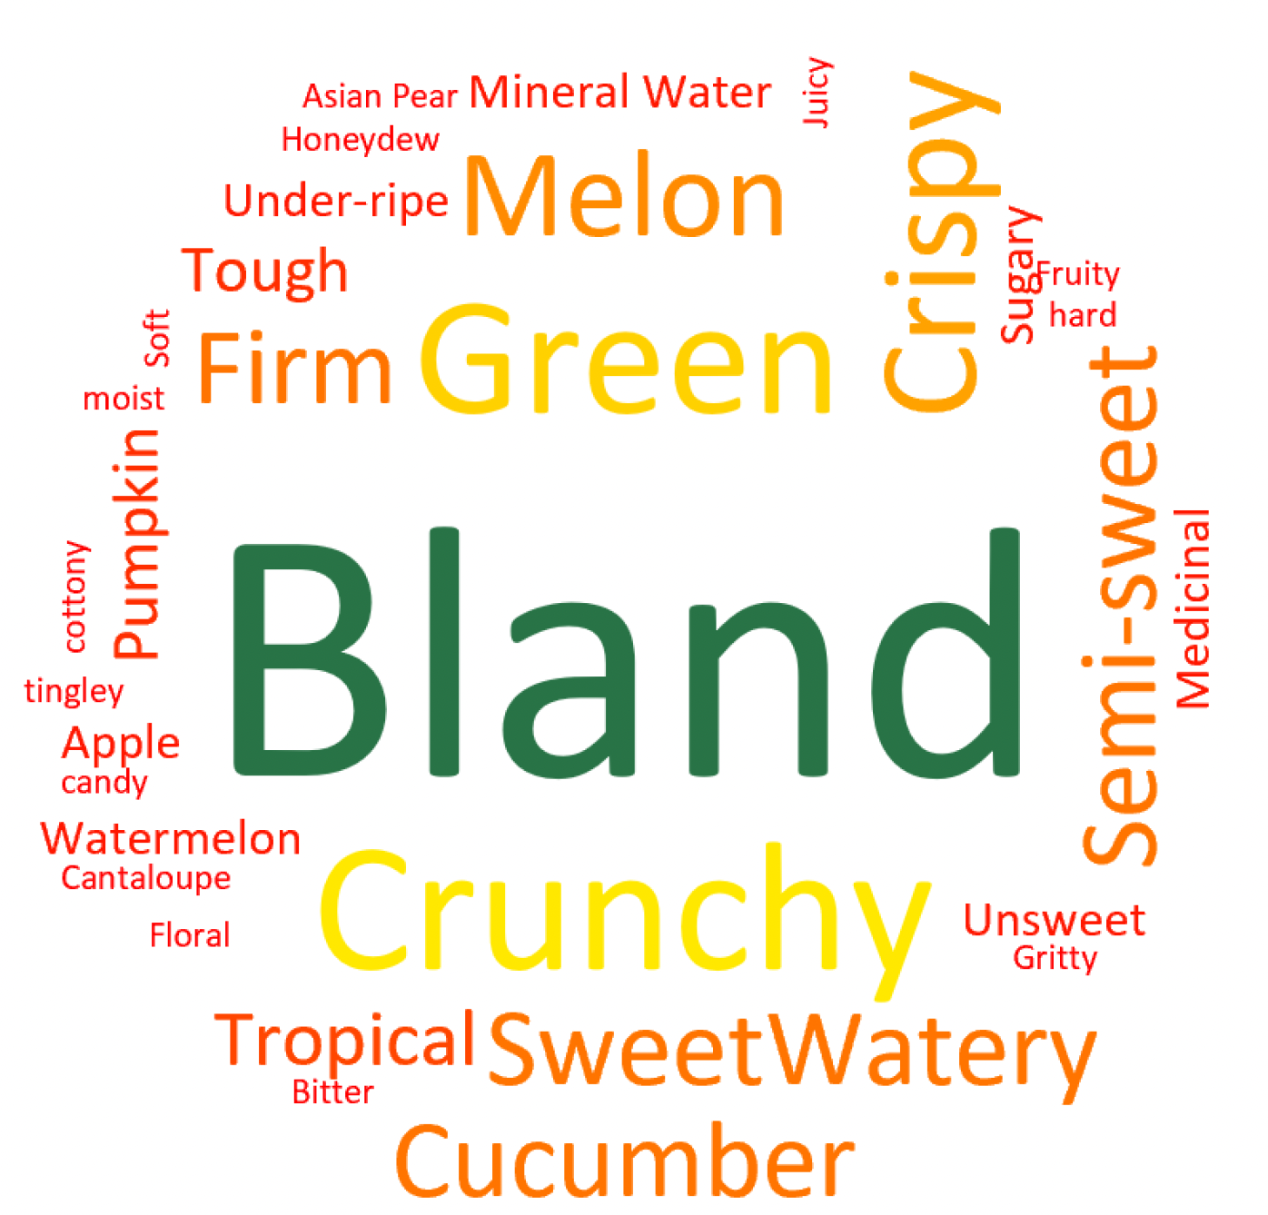
Sensory
Word Cloud
Crispy Pear

Slide 10
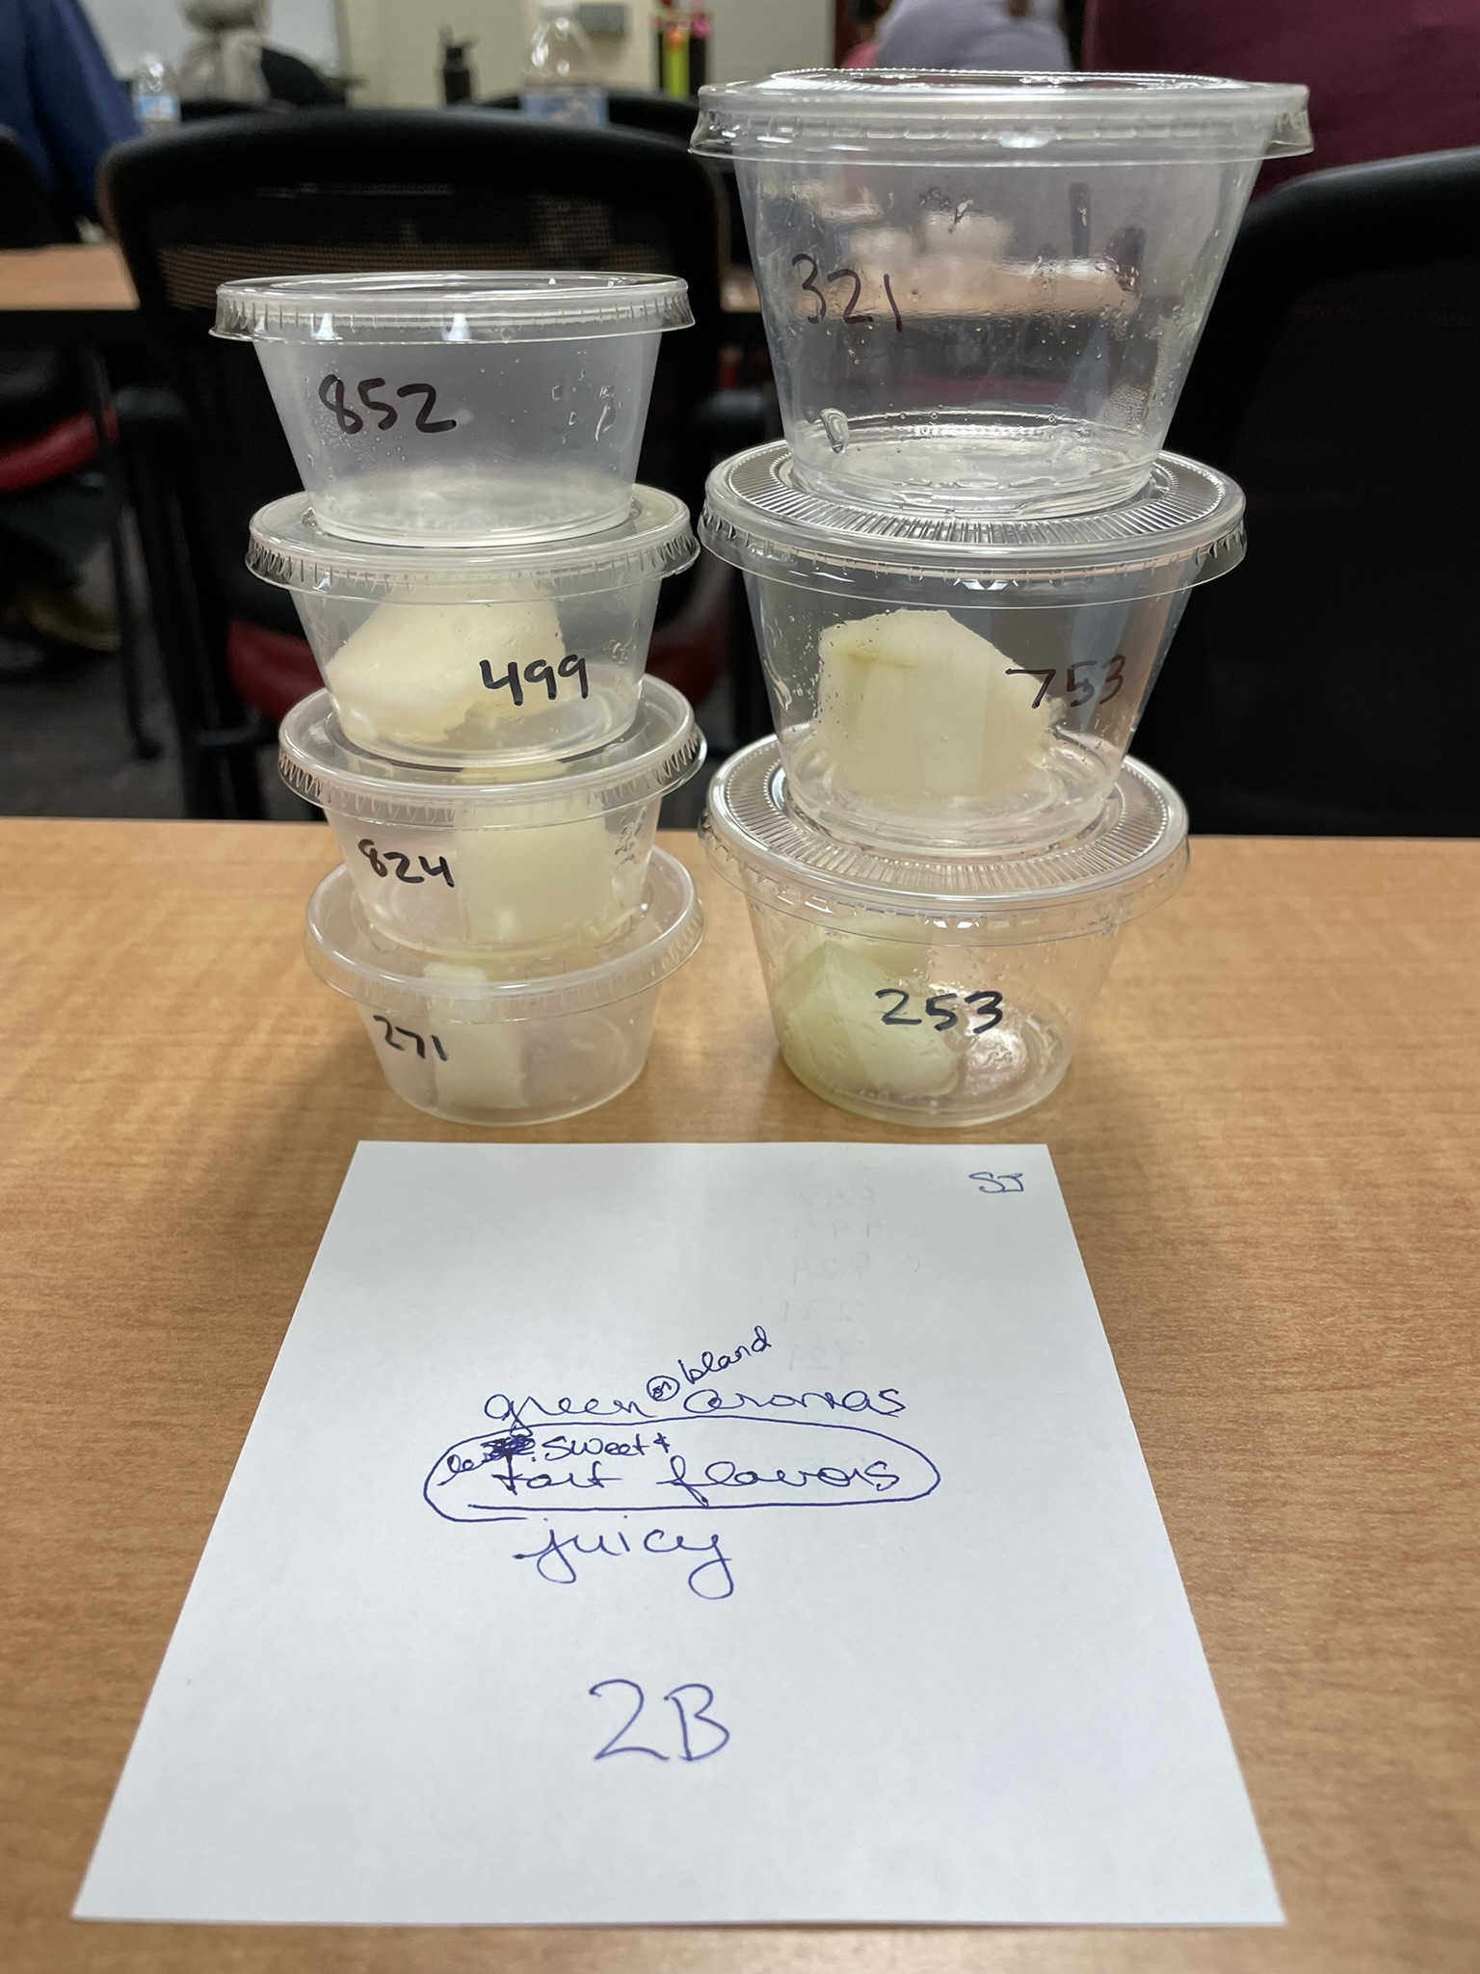
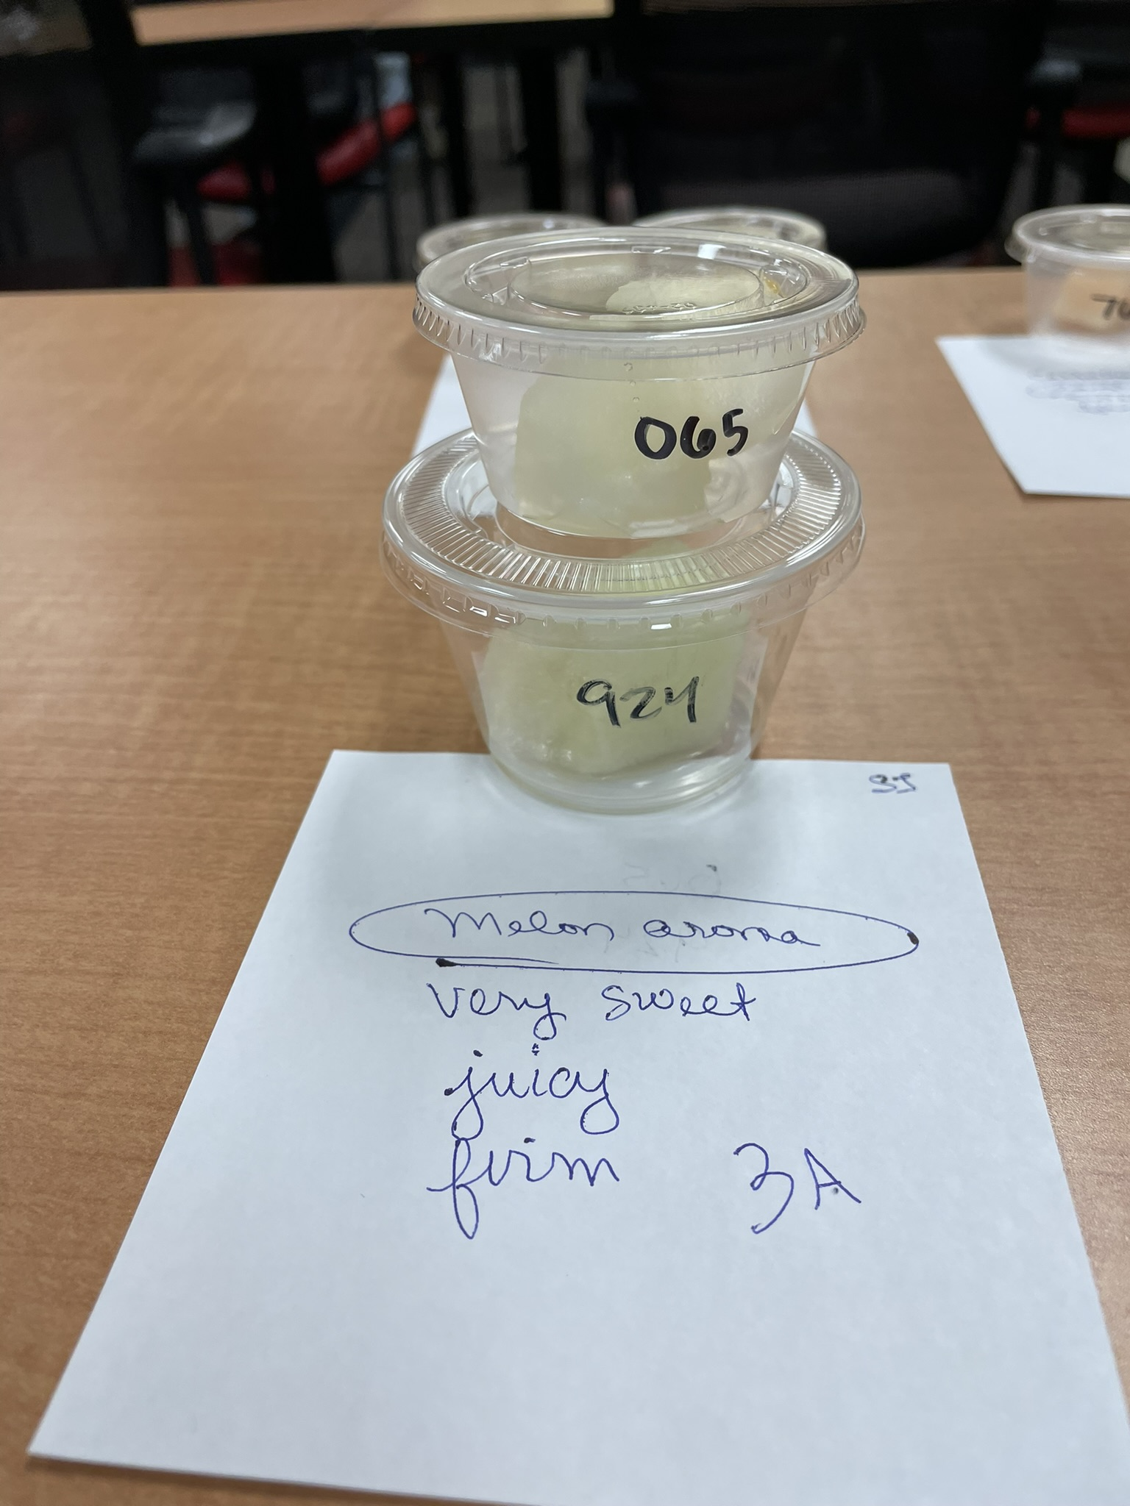
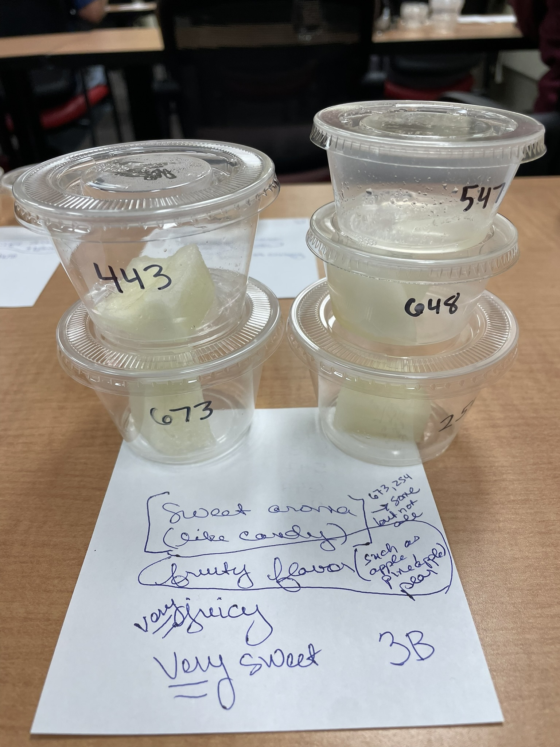
Free Sorting Activity
Free Sorting Basics
16 untrained panelists
All 20 entries presented simultaneously
Panelists sorted based on own criteria and perception
Rapid sensory profiling method

Slide 11
Free Sorting Activity
Free Sorting Basics
16 untrained panelists
All 20 entries presented simultaneously
Panelists sorted based on own criteria and perception
Rapid sensory profiling method

Slide 12
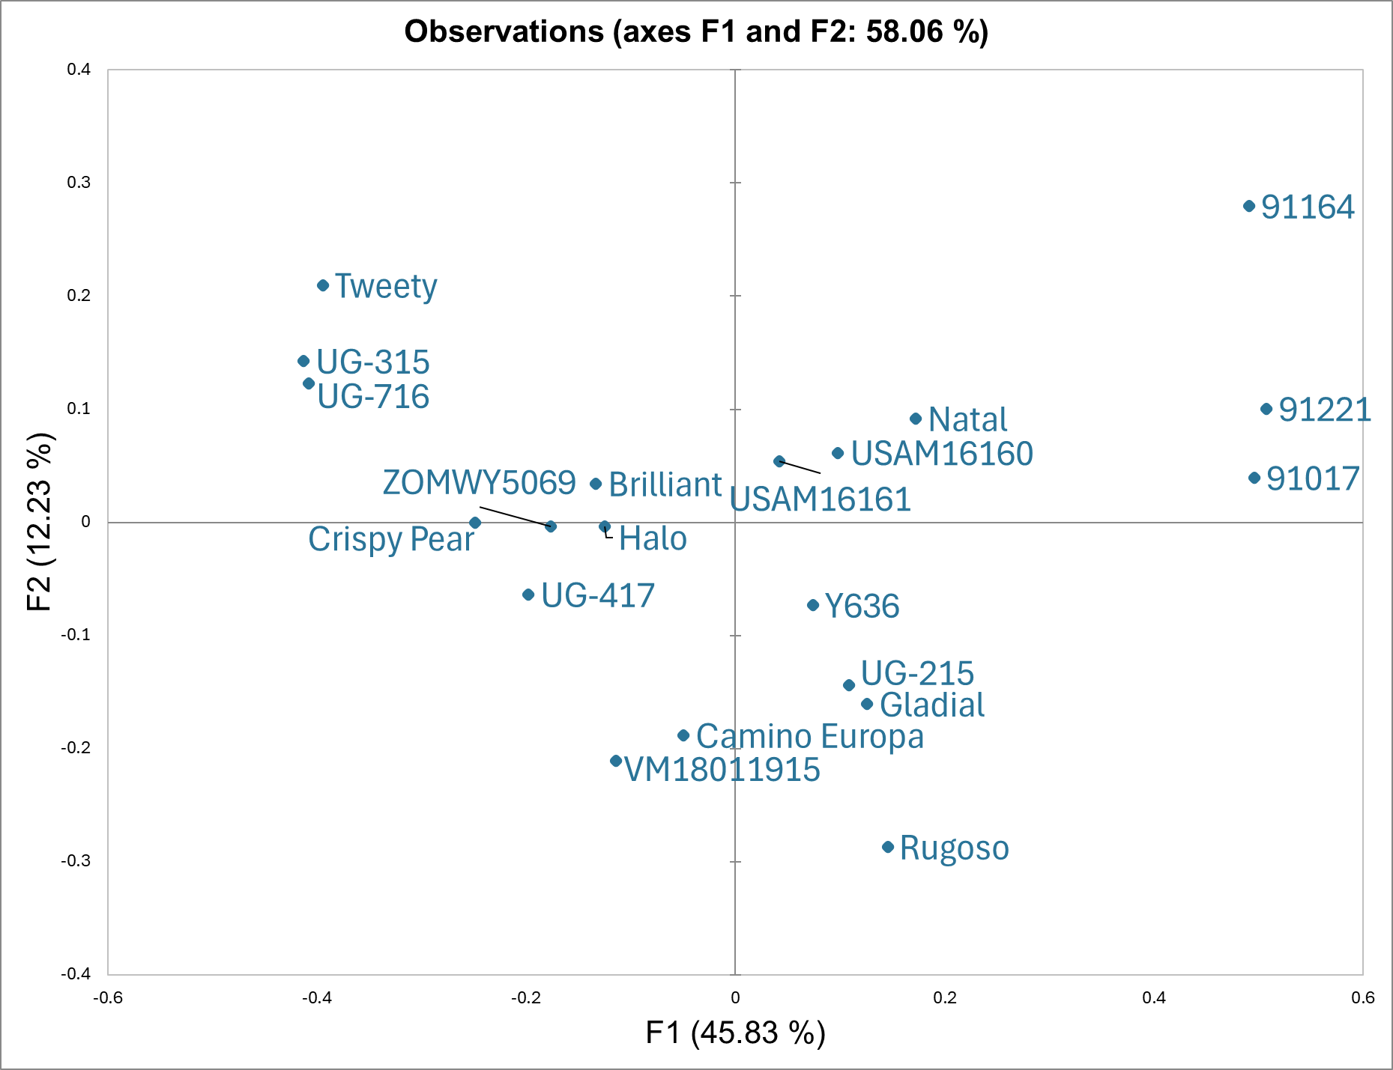
Free Sorting
Results
Consensus Plot:
Generated from Statistical analysis of free sorting data
Visually represents perceived similarities between cultigens

Slide 13
Clustering
Generated from free sorting data
Depicts similarly perceived cultigens as clusters

Slide 14
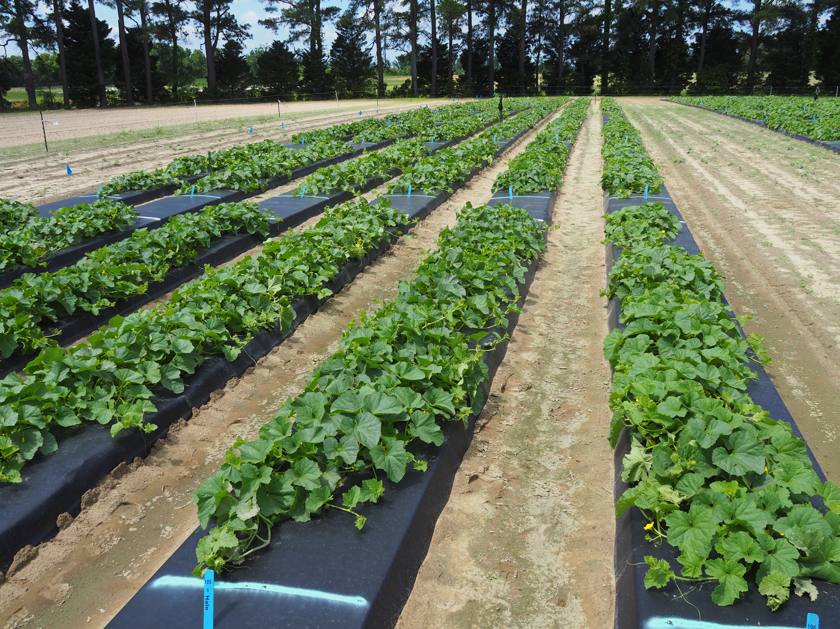
2024 Field Studyd
Central Crops Research Station, Clayton; 14 harvests

Slide 15
Measures
Evaluate Yield – Quantity & Weight (lb.)
Exterior Qualities
Length & Diameter (in)
Average Fruit Weight
Fruit Shape
Sutures Severity
Netting Density / Type
Foliage Cover
Interior Qualities
Flesh Color
Cavity Size
Pressure (lb) Top & Bottom of Fruit
Soluble Solids (Brix)
Flavor Profile / Description

Slide 16
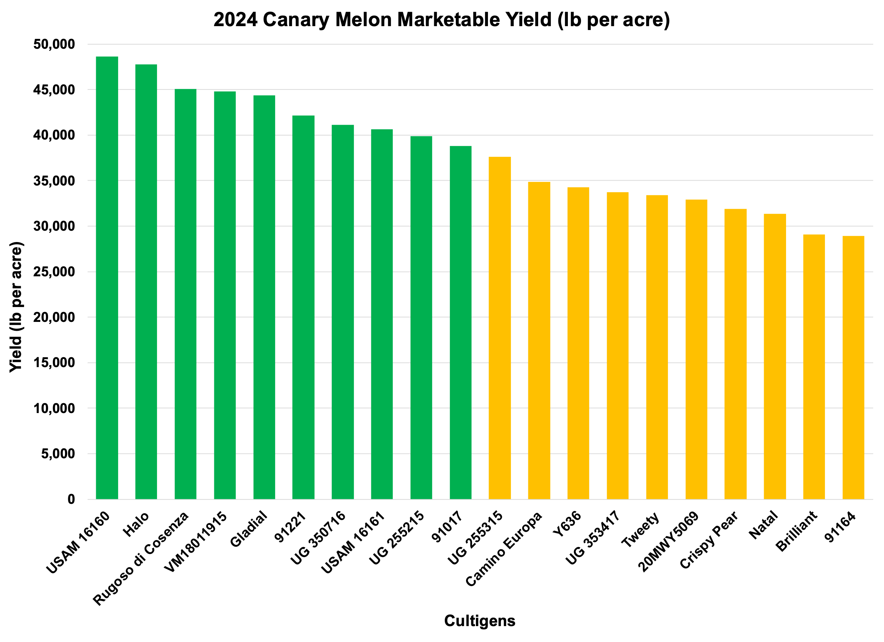
1. USAM 16160 – 48,686
2. Halo – 47,780
3. Rugoso di Cosenza – 45,052
4. VW18011915 – 44,818
5. Gladial - 44,377
6. 91221 - 42,128
7. UG 350716 – 41,099
8. USAM 16161 – 40,663
9. UG 255215 – 39,868
10. 91017 – 38,796

Slide 17
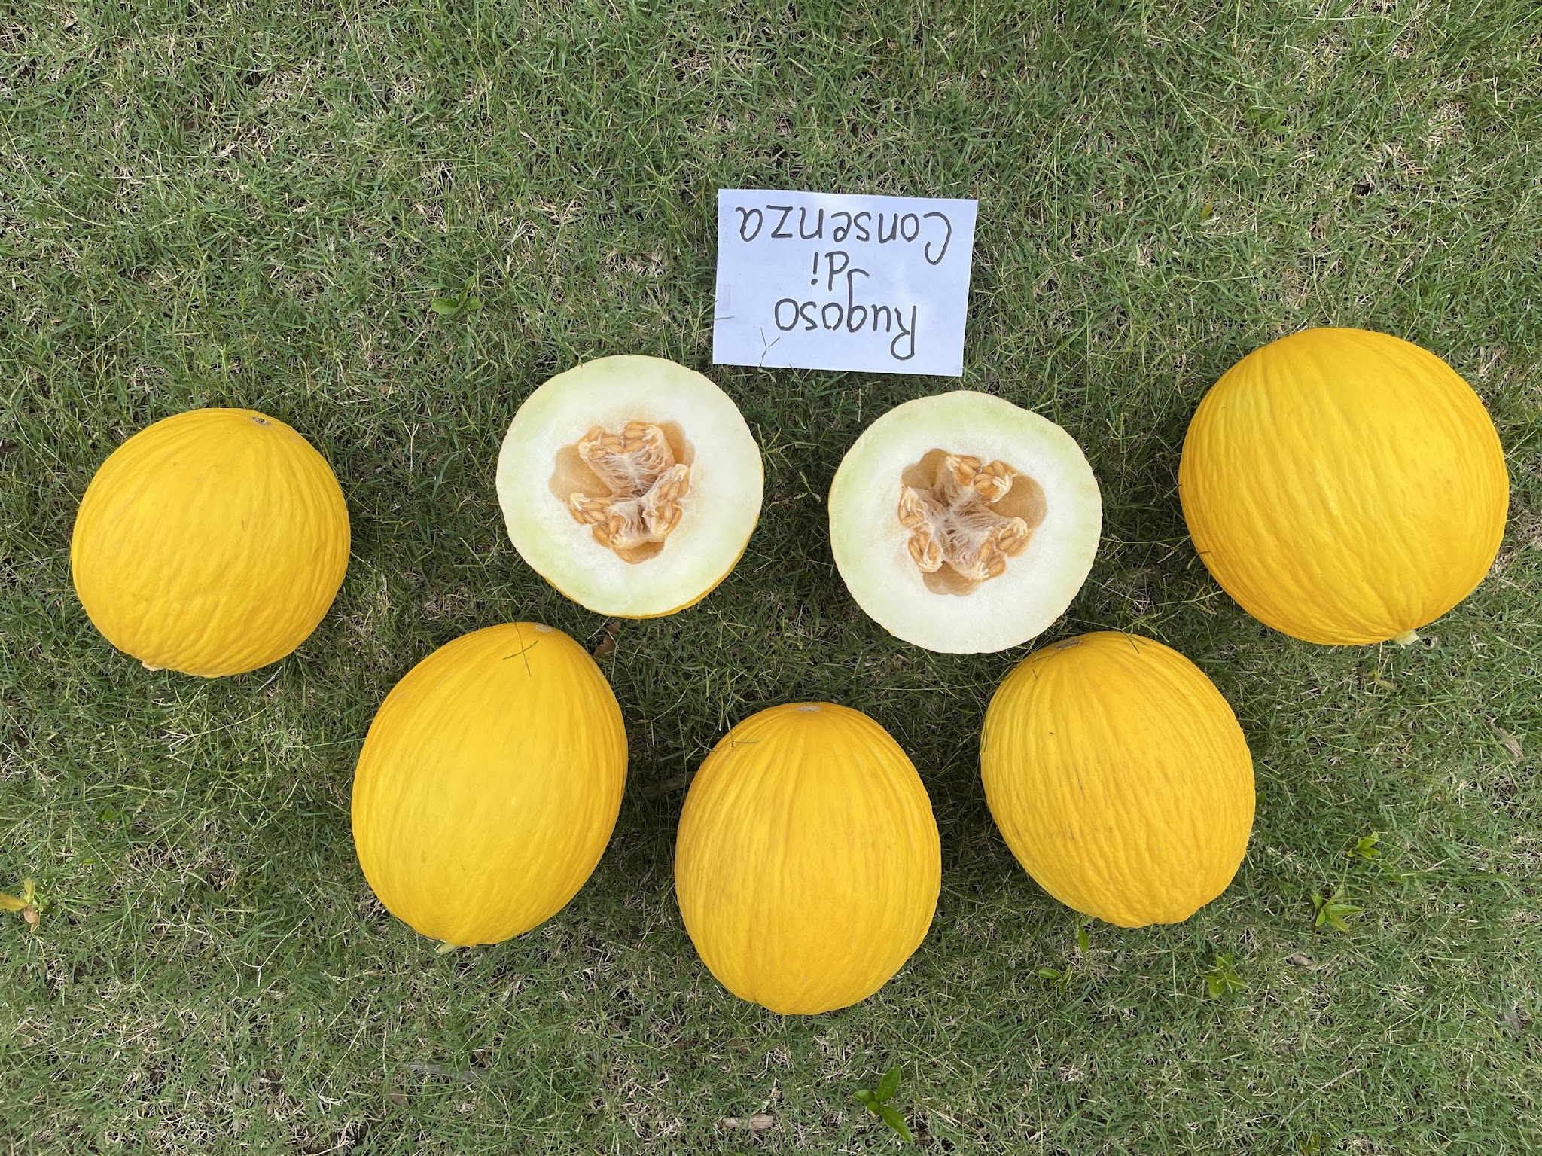
2023
2024

Slide 18
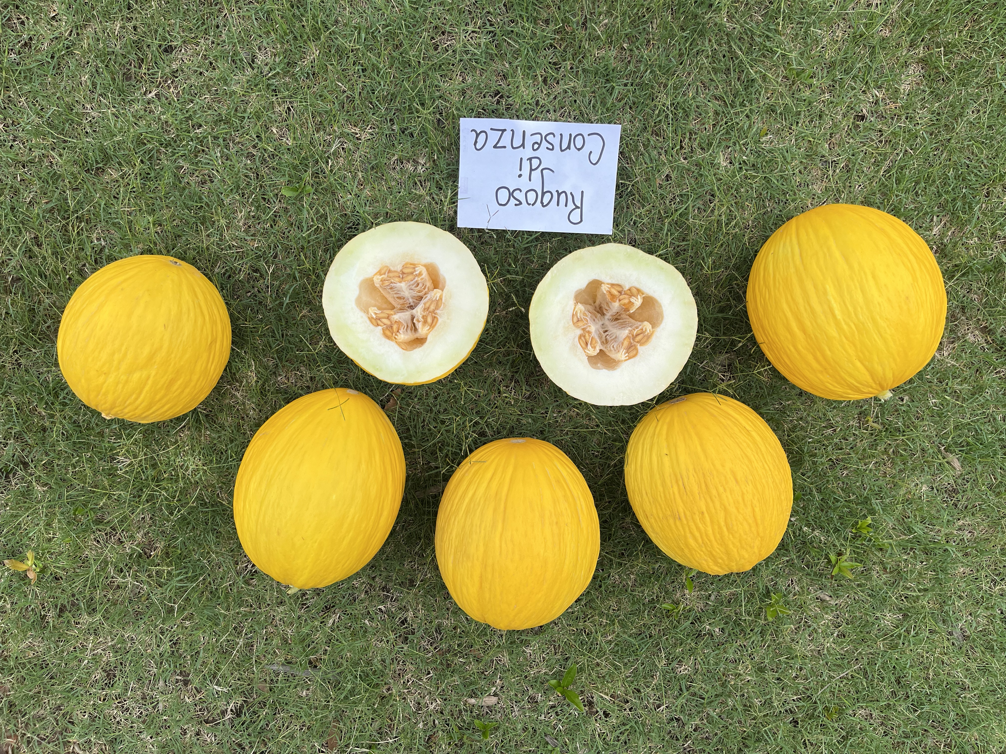
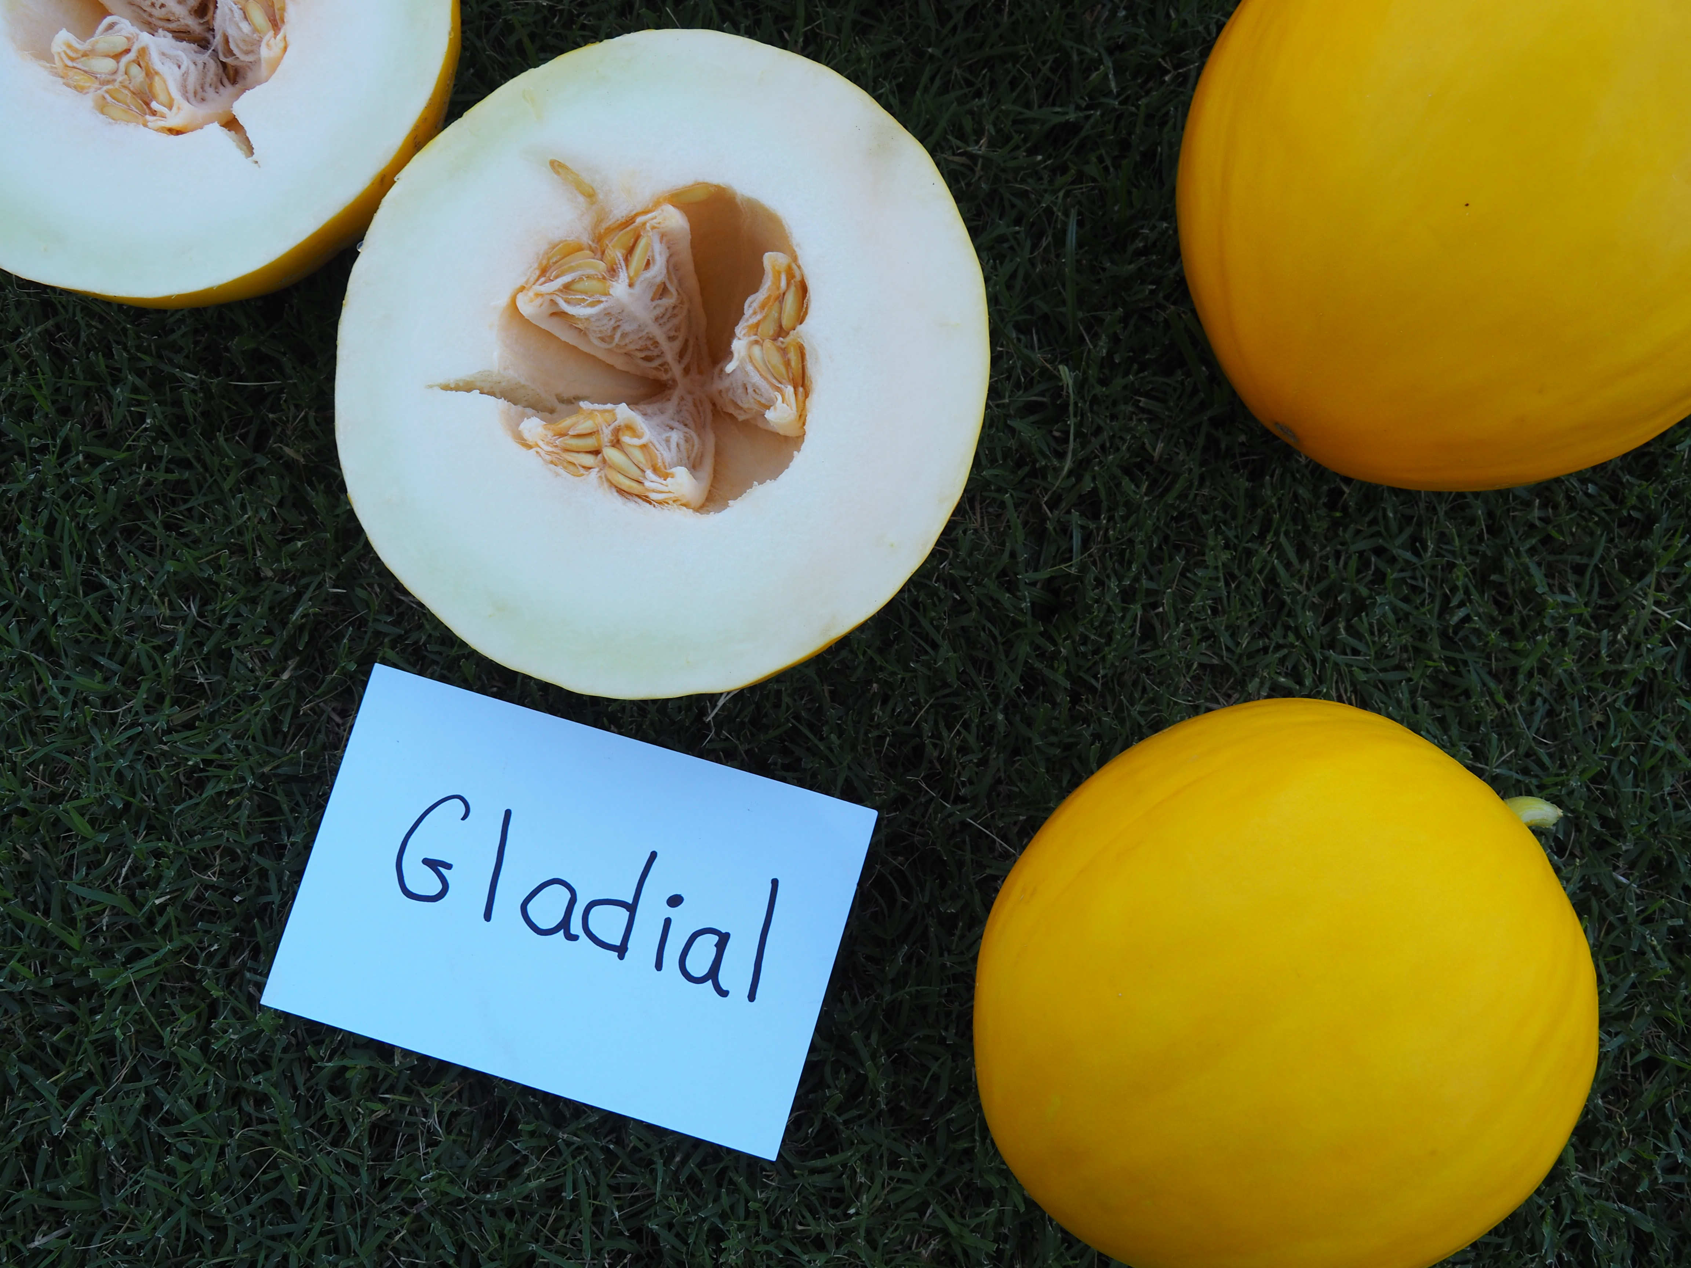
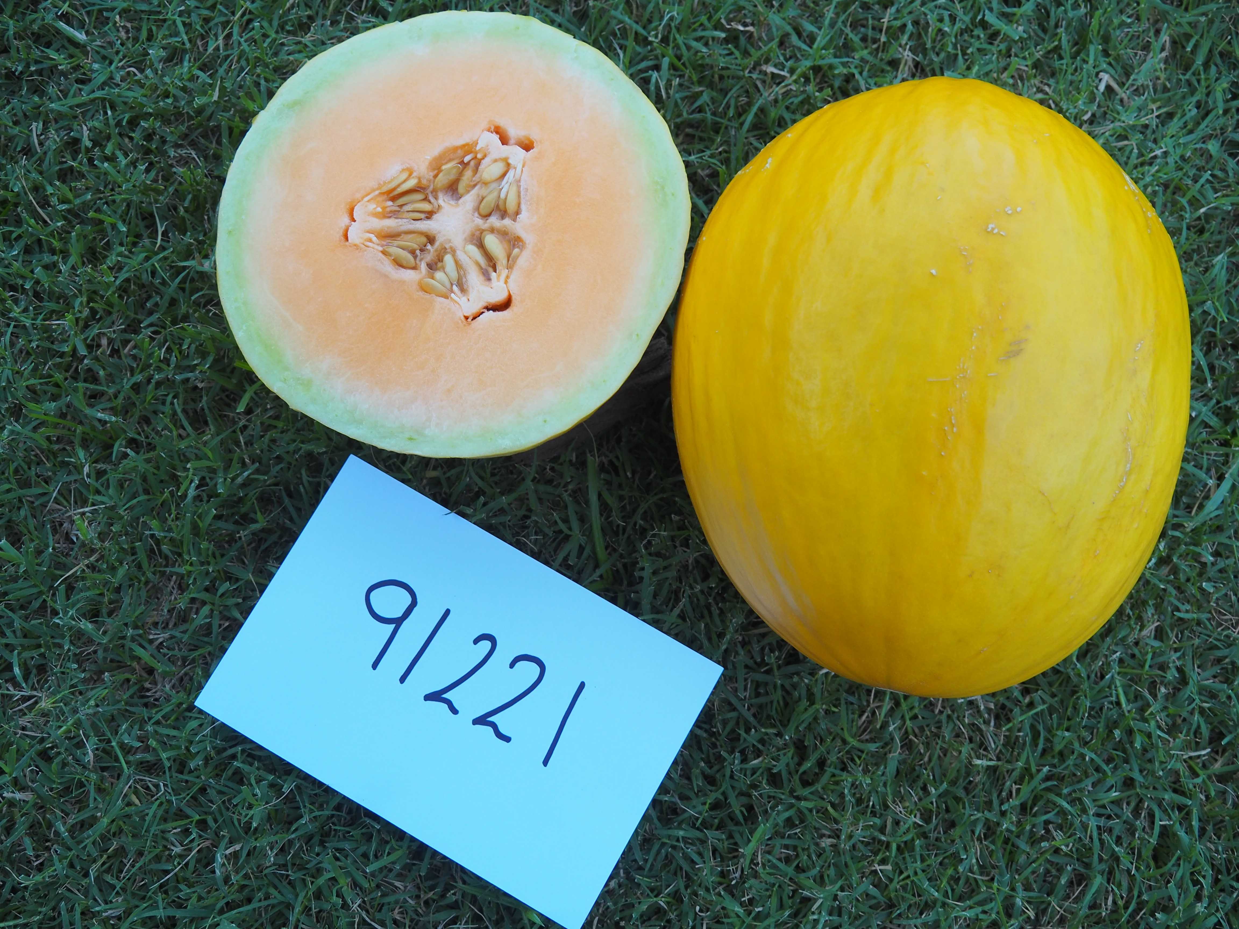
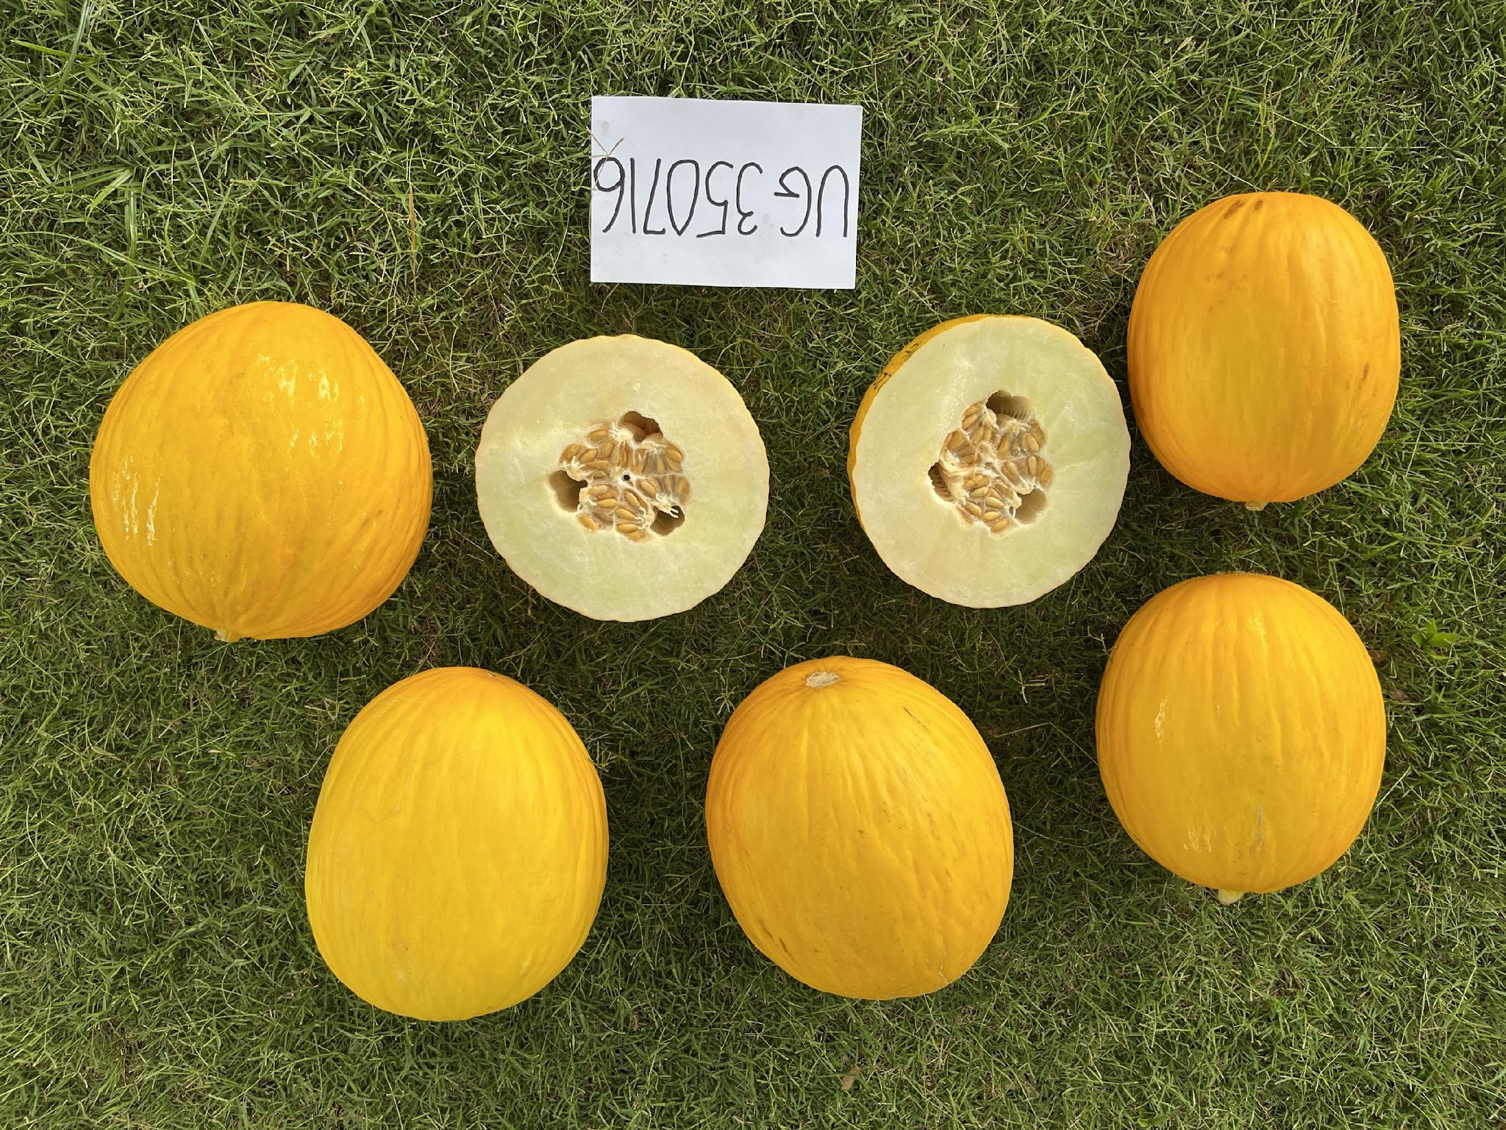
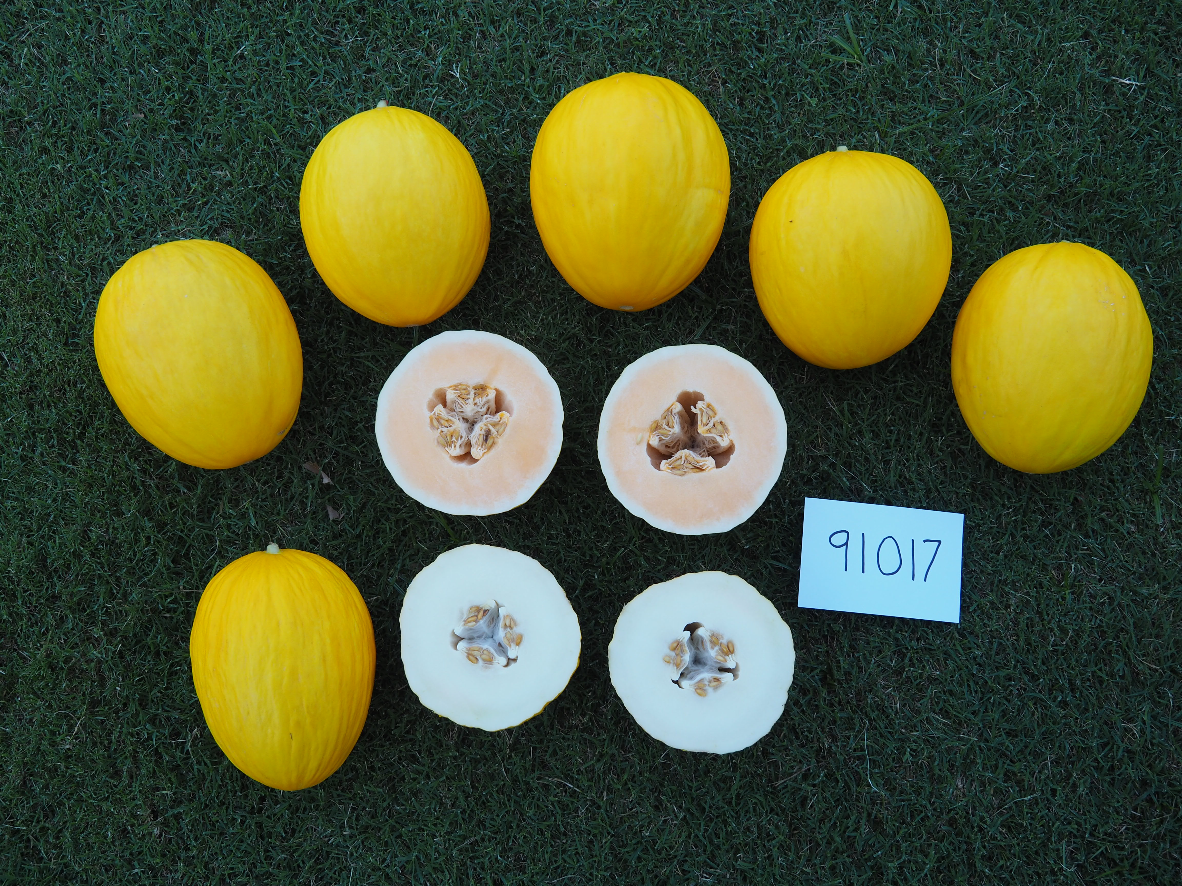
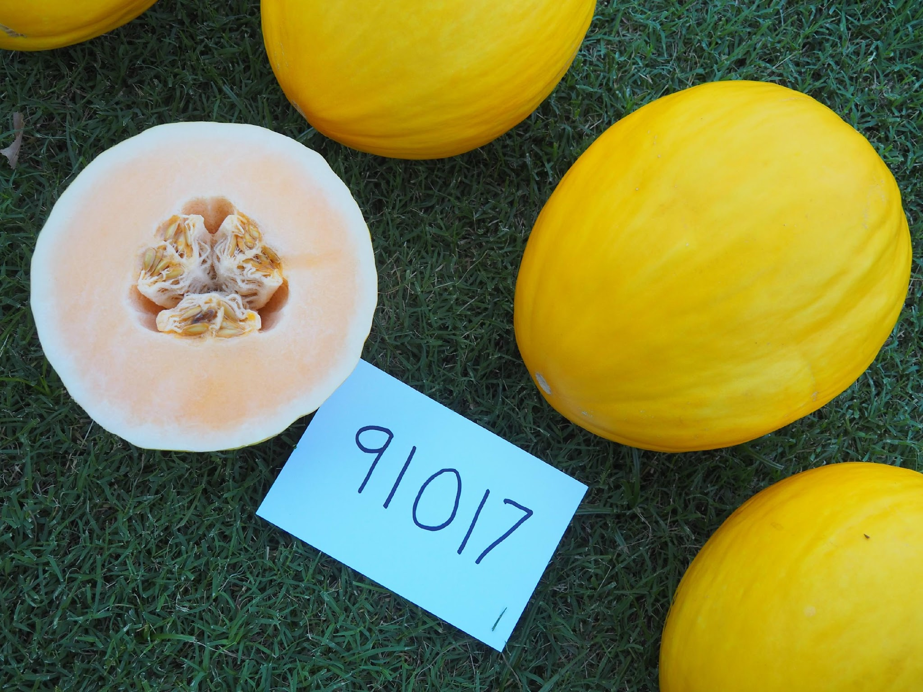

Slide 19
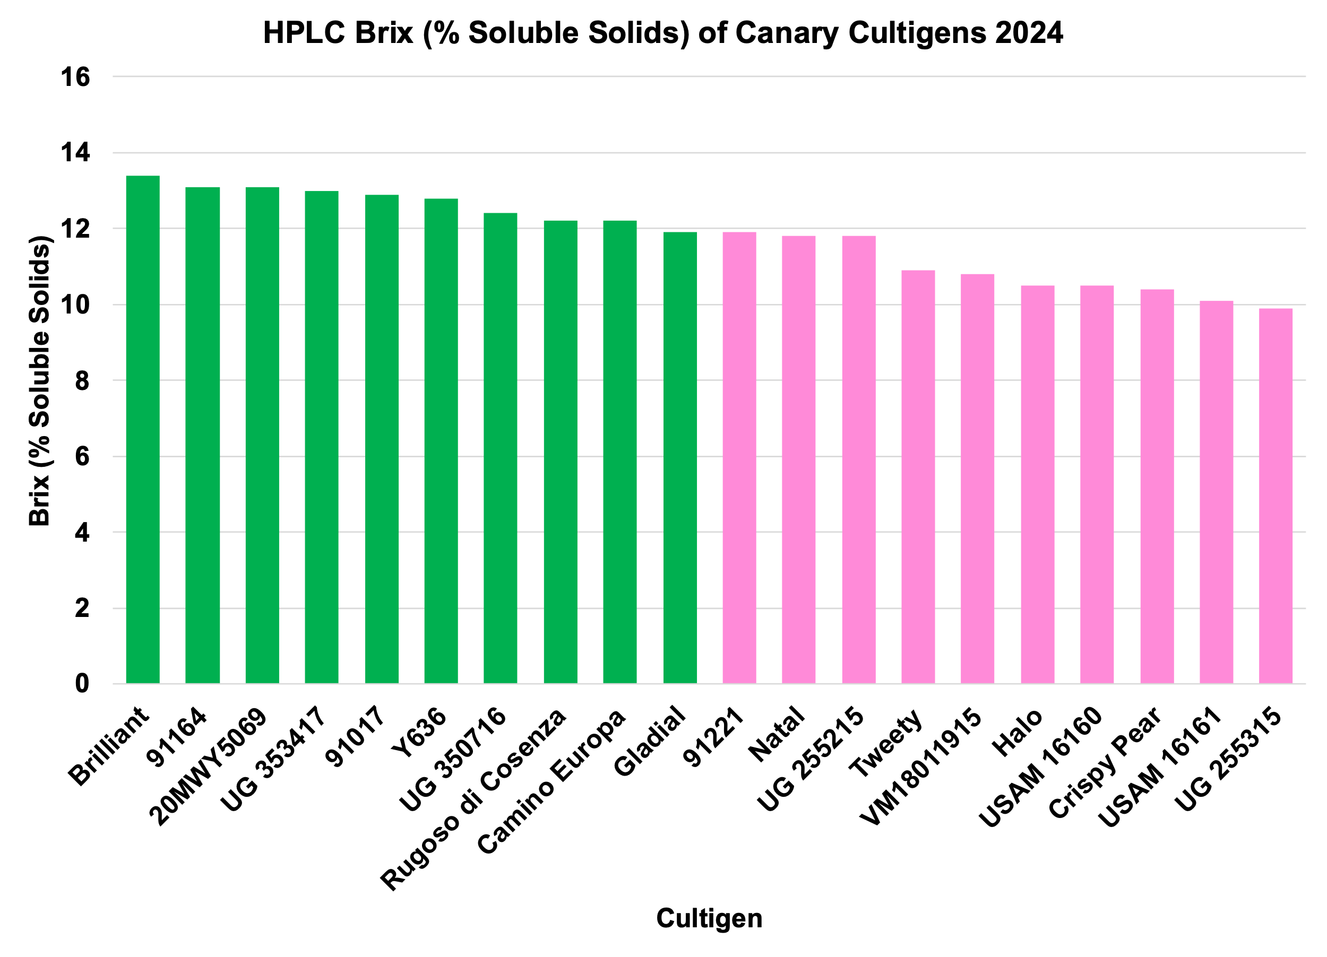
1. Brilliant – 13.40
2. 91164 – 13.14
3. 20MWY5069 – 13.08
4. UG 353417 – 13.00
5. 91017 – 12.88
6. Y636 – 12.83
7. UG 350716 – 12.43
8. Rugoso di Cosenza– 12.23
9. Camino Europa– 12.17
10. Gladial – 11.92

Slide 20
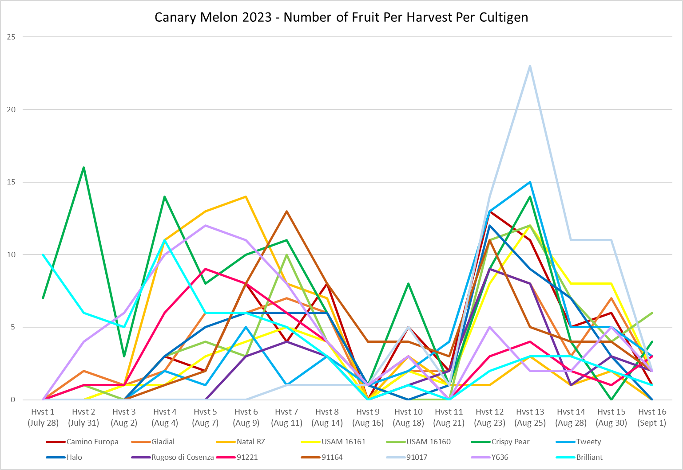
Cultigen
Camino Europa
Gladial
Natal
USAM 16161
USAM 116160
Crispy Pear
Tweety
Halo
Rugoso di Con.
91221
91164
91017
Y626
Brilliant
AVG
% Early
7.4
17.5
39.7
8.5
12.1
42.2
5.1
13.6
0
32.7
4.4
0
42.7
61.3
21
Brilliant 2024 – % Early = 58.8 %

Slide 21
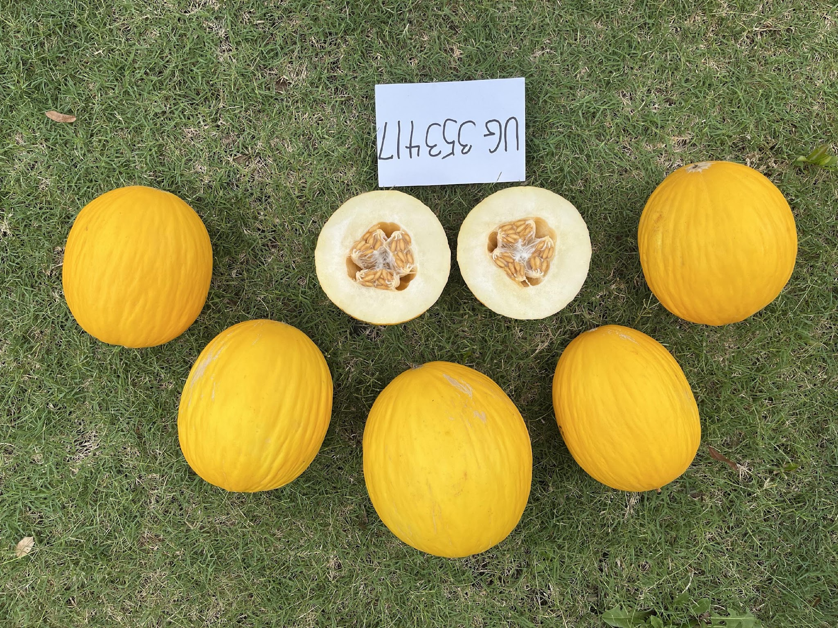

Slide 22
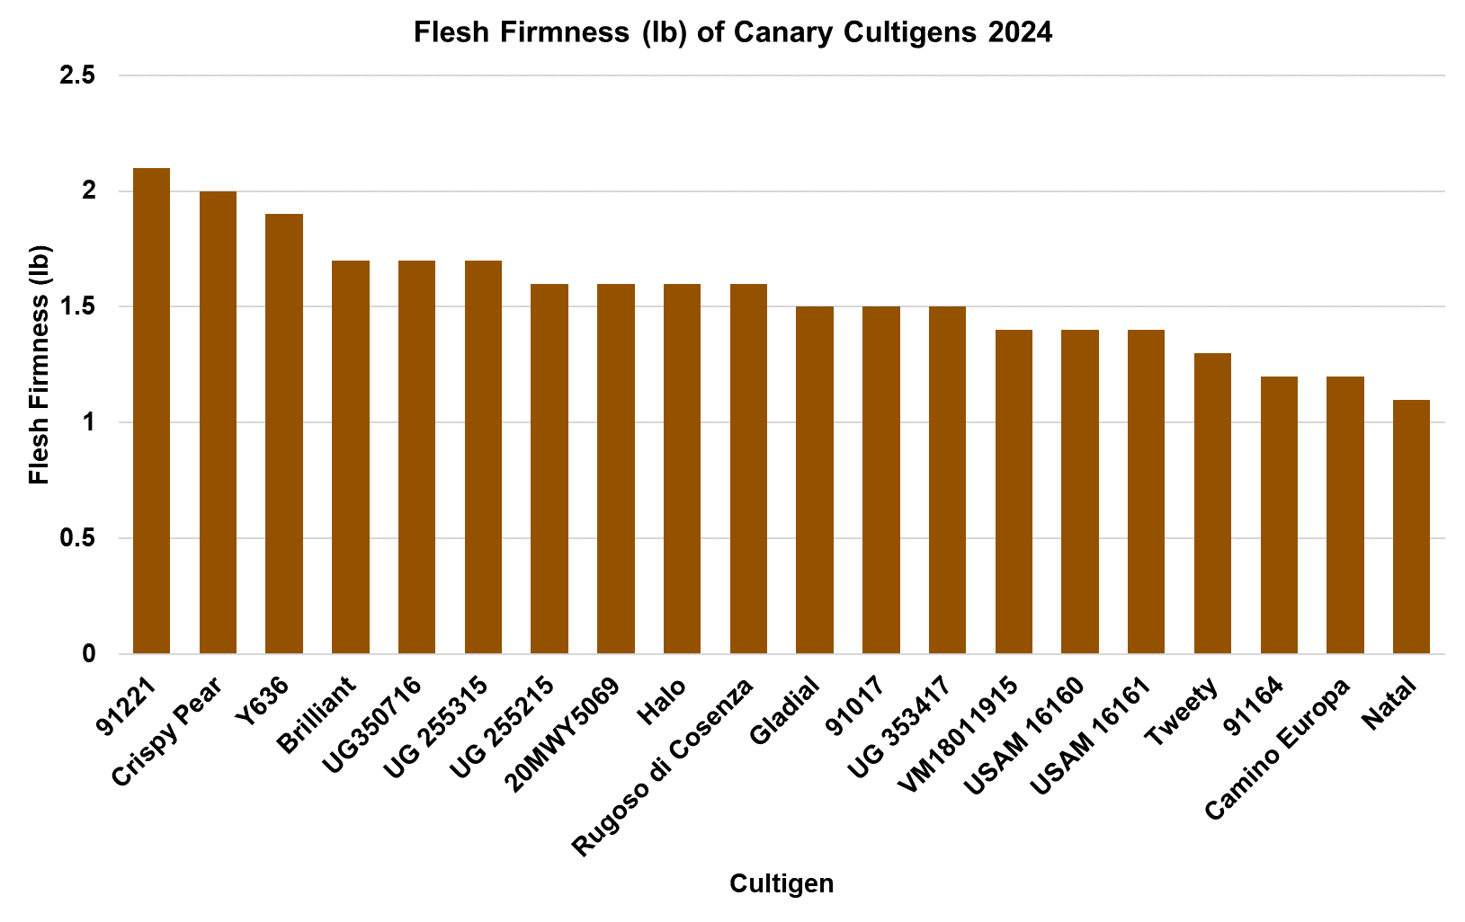

Slide 23
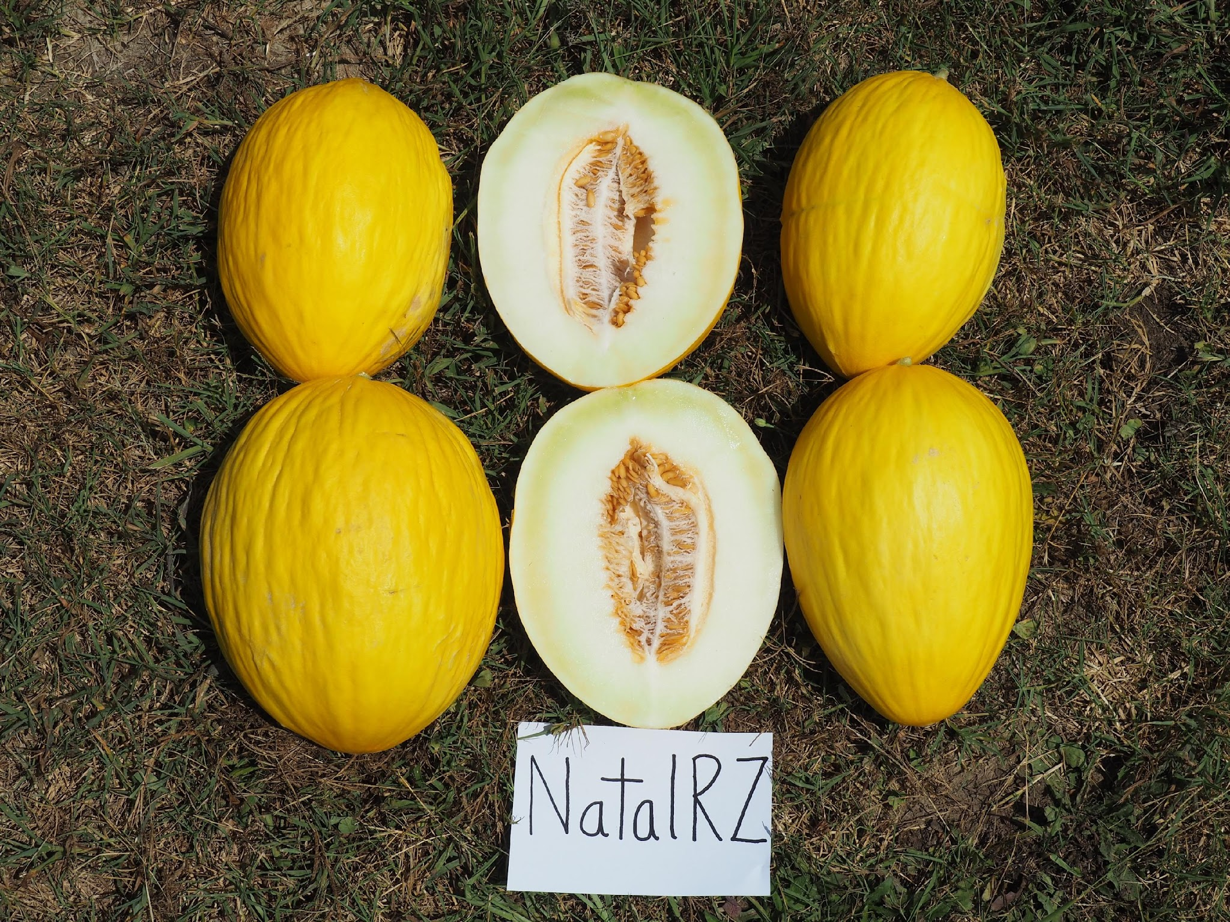

Slide 24
Project Objectives
Evaluate range of canary melon genetics and determine adaptation to NC growing conditions.
Select cultivars for advanced testing based of field and laboratory results, and sensory evaluations.
Conduct sensory evaluations; trained and consumer.
Selected cultivars to farmers for grow out and evaluation.
Adoption: Will growers grow canary melons in 2026.

Slide 25
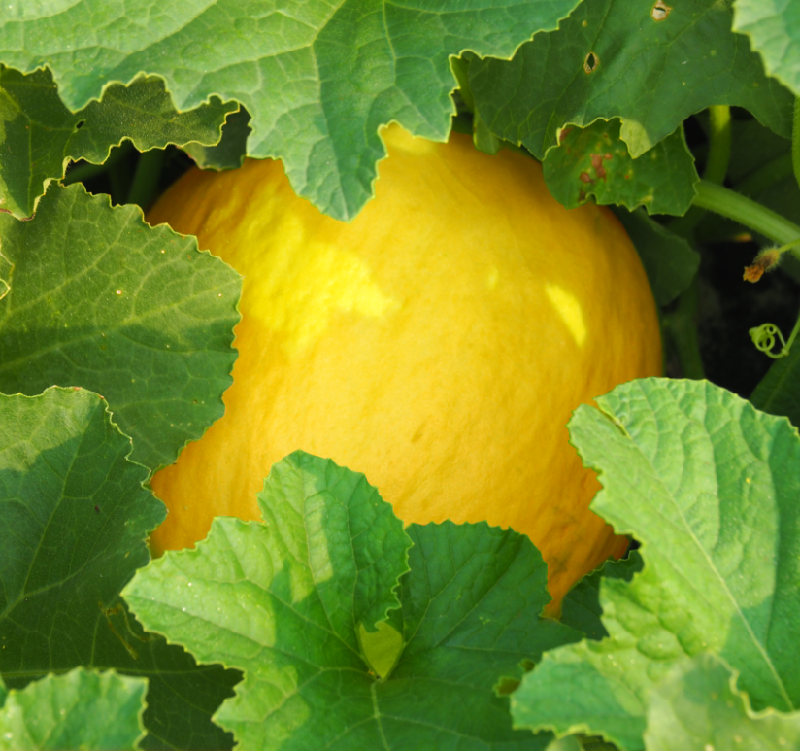


Acknowledgements
Stuart Michel, Baker Stickley, Brandon Parker, Jessie Poe, Matthew Allan
Seed companies
Central Crops Res. Sta.
Joy Smith, Statistics
Summer employees Daphne Meyer, Lia Hunt, Cameron Roberts, Nate Wyschka
New and Emerging Crops grant, award # 24-048-4007
Notes:
Would like to analyze the studies differently with statistics, maybe analyze rates within each clone block

Slide 26
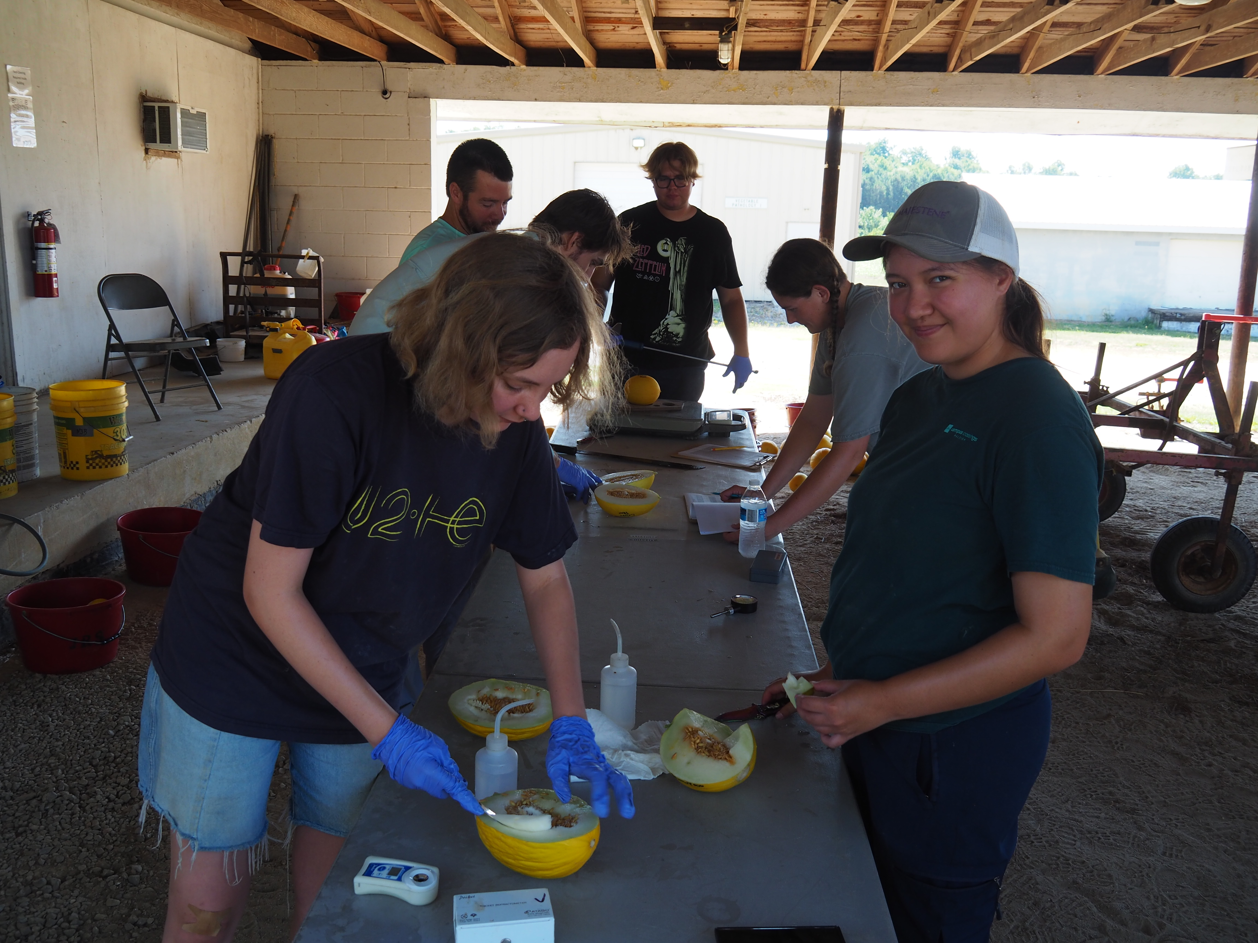

Slide 27
Sensory Profiles
Rugoso
45,052 lb/ac
9.5% sugar
Natal
31,352 lb/ac
9.5% sugar

Slide 28
Sensory Profiles
Gladial
44,377 lb/ac
9.2% sugar
UG-417
33,732 lb/ac
10.0% sugar

Slide 29
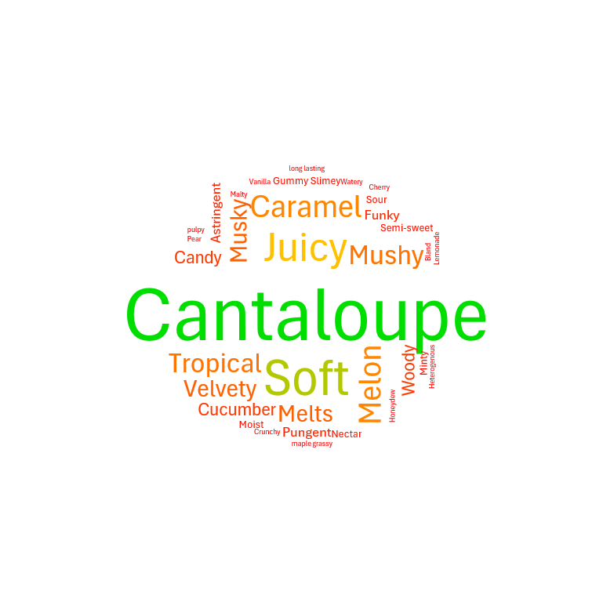

Slide 30
Sensory Profile
91017
38,796 lb/ac
12.9% SS/sugar

Slide 31
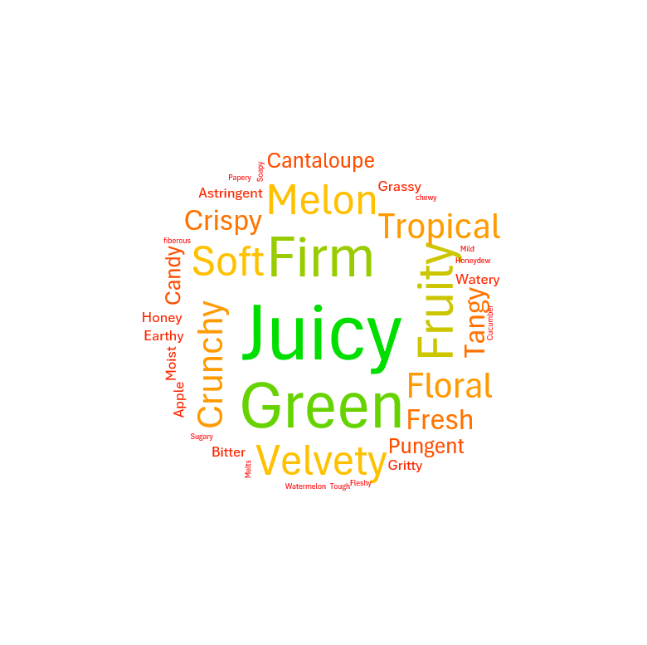
Sensory Profile
Brilliant
29,098 lb/ac
13.4% SS/sugar

Slide 34
Current Markets
Brazil presently the largest producer.
United States produces canary melons, yet considerably lags behind the production of muskmelons/cantaloupes and honeydew melons. Most acreage is produced in CA and AZ
No statistics are specifically gathered by USDA on canary melons as this type melon is truly a specialty melon.
Primary countries that produce and market canary melons are Algeria, Morocco, Tunisia, Spain, and Brazil.

Slide 35
Methods
20 canary melon entries evaluated in 2024
10 participating seed companies
Grown on CCRS, Clayton using plasticulture
14 harvests (28 June through 29 July).

Slide 36
Clustering
Generated from free sorting data
Depicts similarly perceived cultigens as clusters

Slide 37
Clustering
Generated from free sorting data
Depicts similarly perceived cultigens as clusters

Slide 39
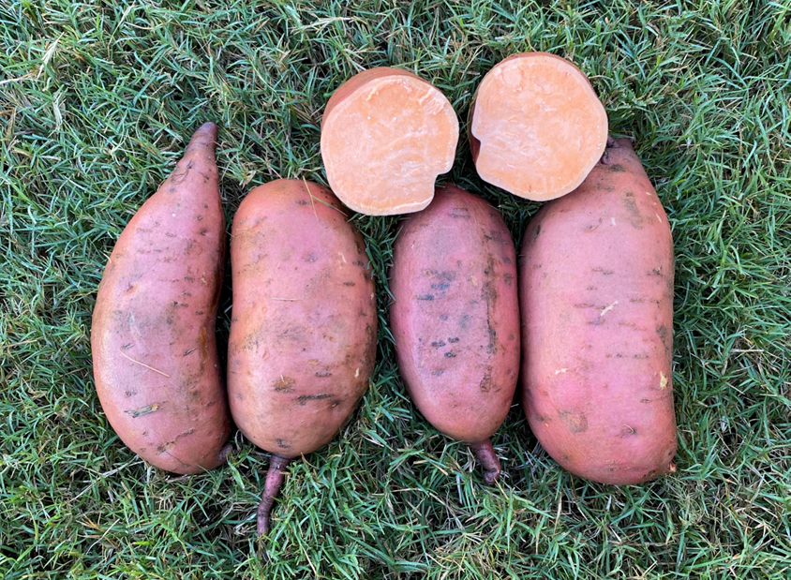
Covington
Orange-fleshed industry standard for NC sweetpotato growers
  Comprises over 85-90% of acreage grown in NC
Comparison check to other two varieties
High yield, high pack-out, stores up to 12 months
Susceptible to GRKN

Slide 40
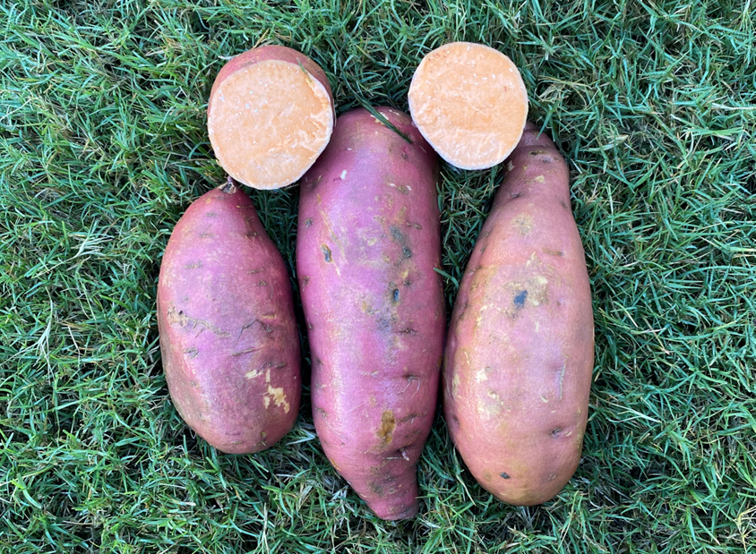
NC09-1105
Orange-fleshed tablestock clone with GRKN resistance
  Invasive RKN species of significance to NC sweetpotato growers
Bred and selected in 2009 but cut due to concerns in long-term storage in initial tests
  “Resurrected” after screening identified it as resistant to GRKN
Good yield but long term storage may be a concern
  Short-term variety for growers with GRKN-infested fields
Likely to be released Fall 2025
Notes:
Color variation, can look very similar to Cov, can be more reddish

Slide 41
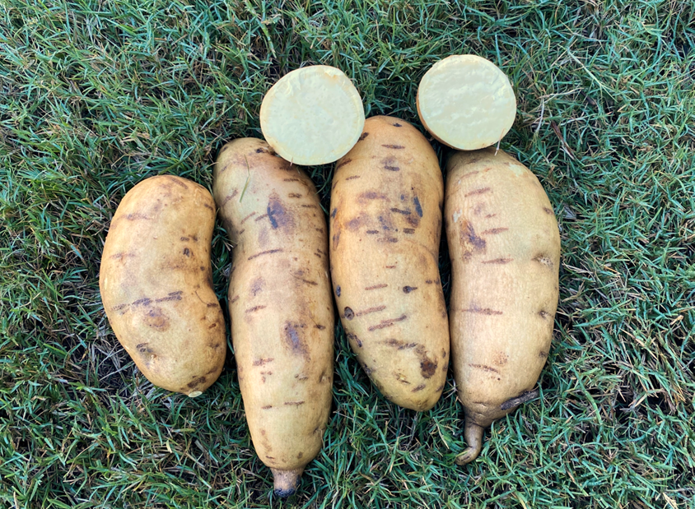
NC15-0728
Yellow-fleshed specialty-type clone bred in 2015
  Progeny of Covington (orange-fleshed) and a purple-fleshed clone
Alternative to traditional orange-fleshed and anthocyanin-rich purple-fleshed varieties
Fair disease resistance, excellent culinary quality
  Susceptible to GRKN
Likely to be released Fall 2025
Notes:
Emphasize it is yellow, looks more white in this picture

Slide 42
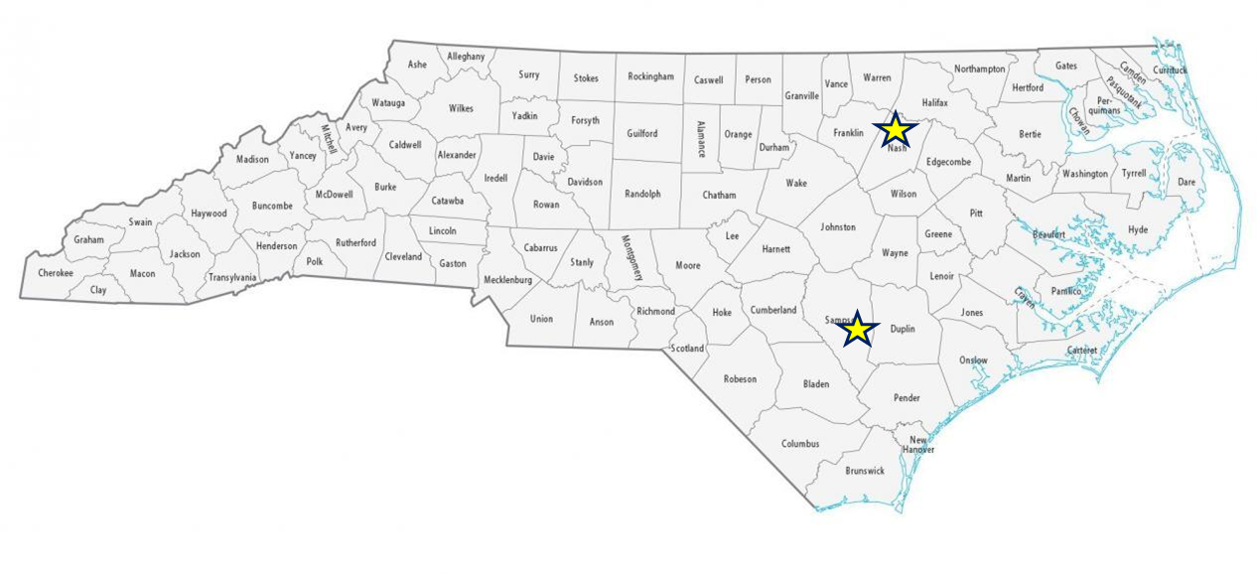
Study Objective
Optimize nitrogen rate that produces the greatest yield and quality for two sweetpotato clones near release compared with Covington
2 locations
  Horticultural Crops Research Station (HCRS) in Clinton, NC
  On-farm location with grower cooperator Leggett Farming Partnership near Nashville, NC
Notes:
Soil type at both locations is a loamy sand, slightly sandier at Clinton compared to on-farm site

Slide 43
Methods
5 fertilizer rate treatments randomized within 4 replications
  0, 40, 80, 120, and 160 lb N/ac
4 row plots, data collected on one of the two inner rows
Nitrogen fertilizer treatments were calcium nitrate (15.5-0-0) split into 2 or 3 applications, side-dressed by hand then cultivated in
  Note: an additional 24 lb N/ac was applied by mistake to the HCRS location during routine fertilization on the research station
Notes:
NCDA recommended rate is 80 lb/ac for Covington, so we went on lower and upper range of that
1st N application is 1 week after planting, 2nd is 3 weeks after planting, 3rd is for the 120 and 160 lb/ac treatments only 5 weeks after planting
Split plot design – easier to compare fertilizer treatments within clone than across clones

Slide 44
Results
Large differences between 2 study locations
On-farm location Covington 80 lb/ac yield: 35,393 lbs/ac
HCRS location Covington 80 lb/ac yield: 9,671 lbs/ac
Why?
  Planting time
    On-Farm: planted 6/11/24
    HCRS: planted 6/27/24
  Consistency of rainfall
Notes:
Having enough NC09-1105 plants available was a limiting factor to planting both studies at more similar times

Slide 45
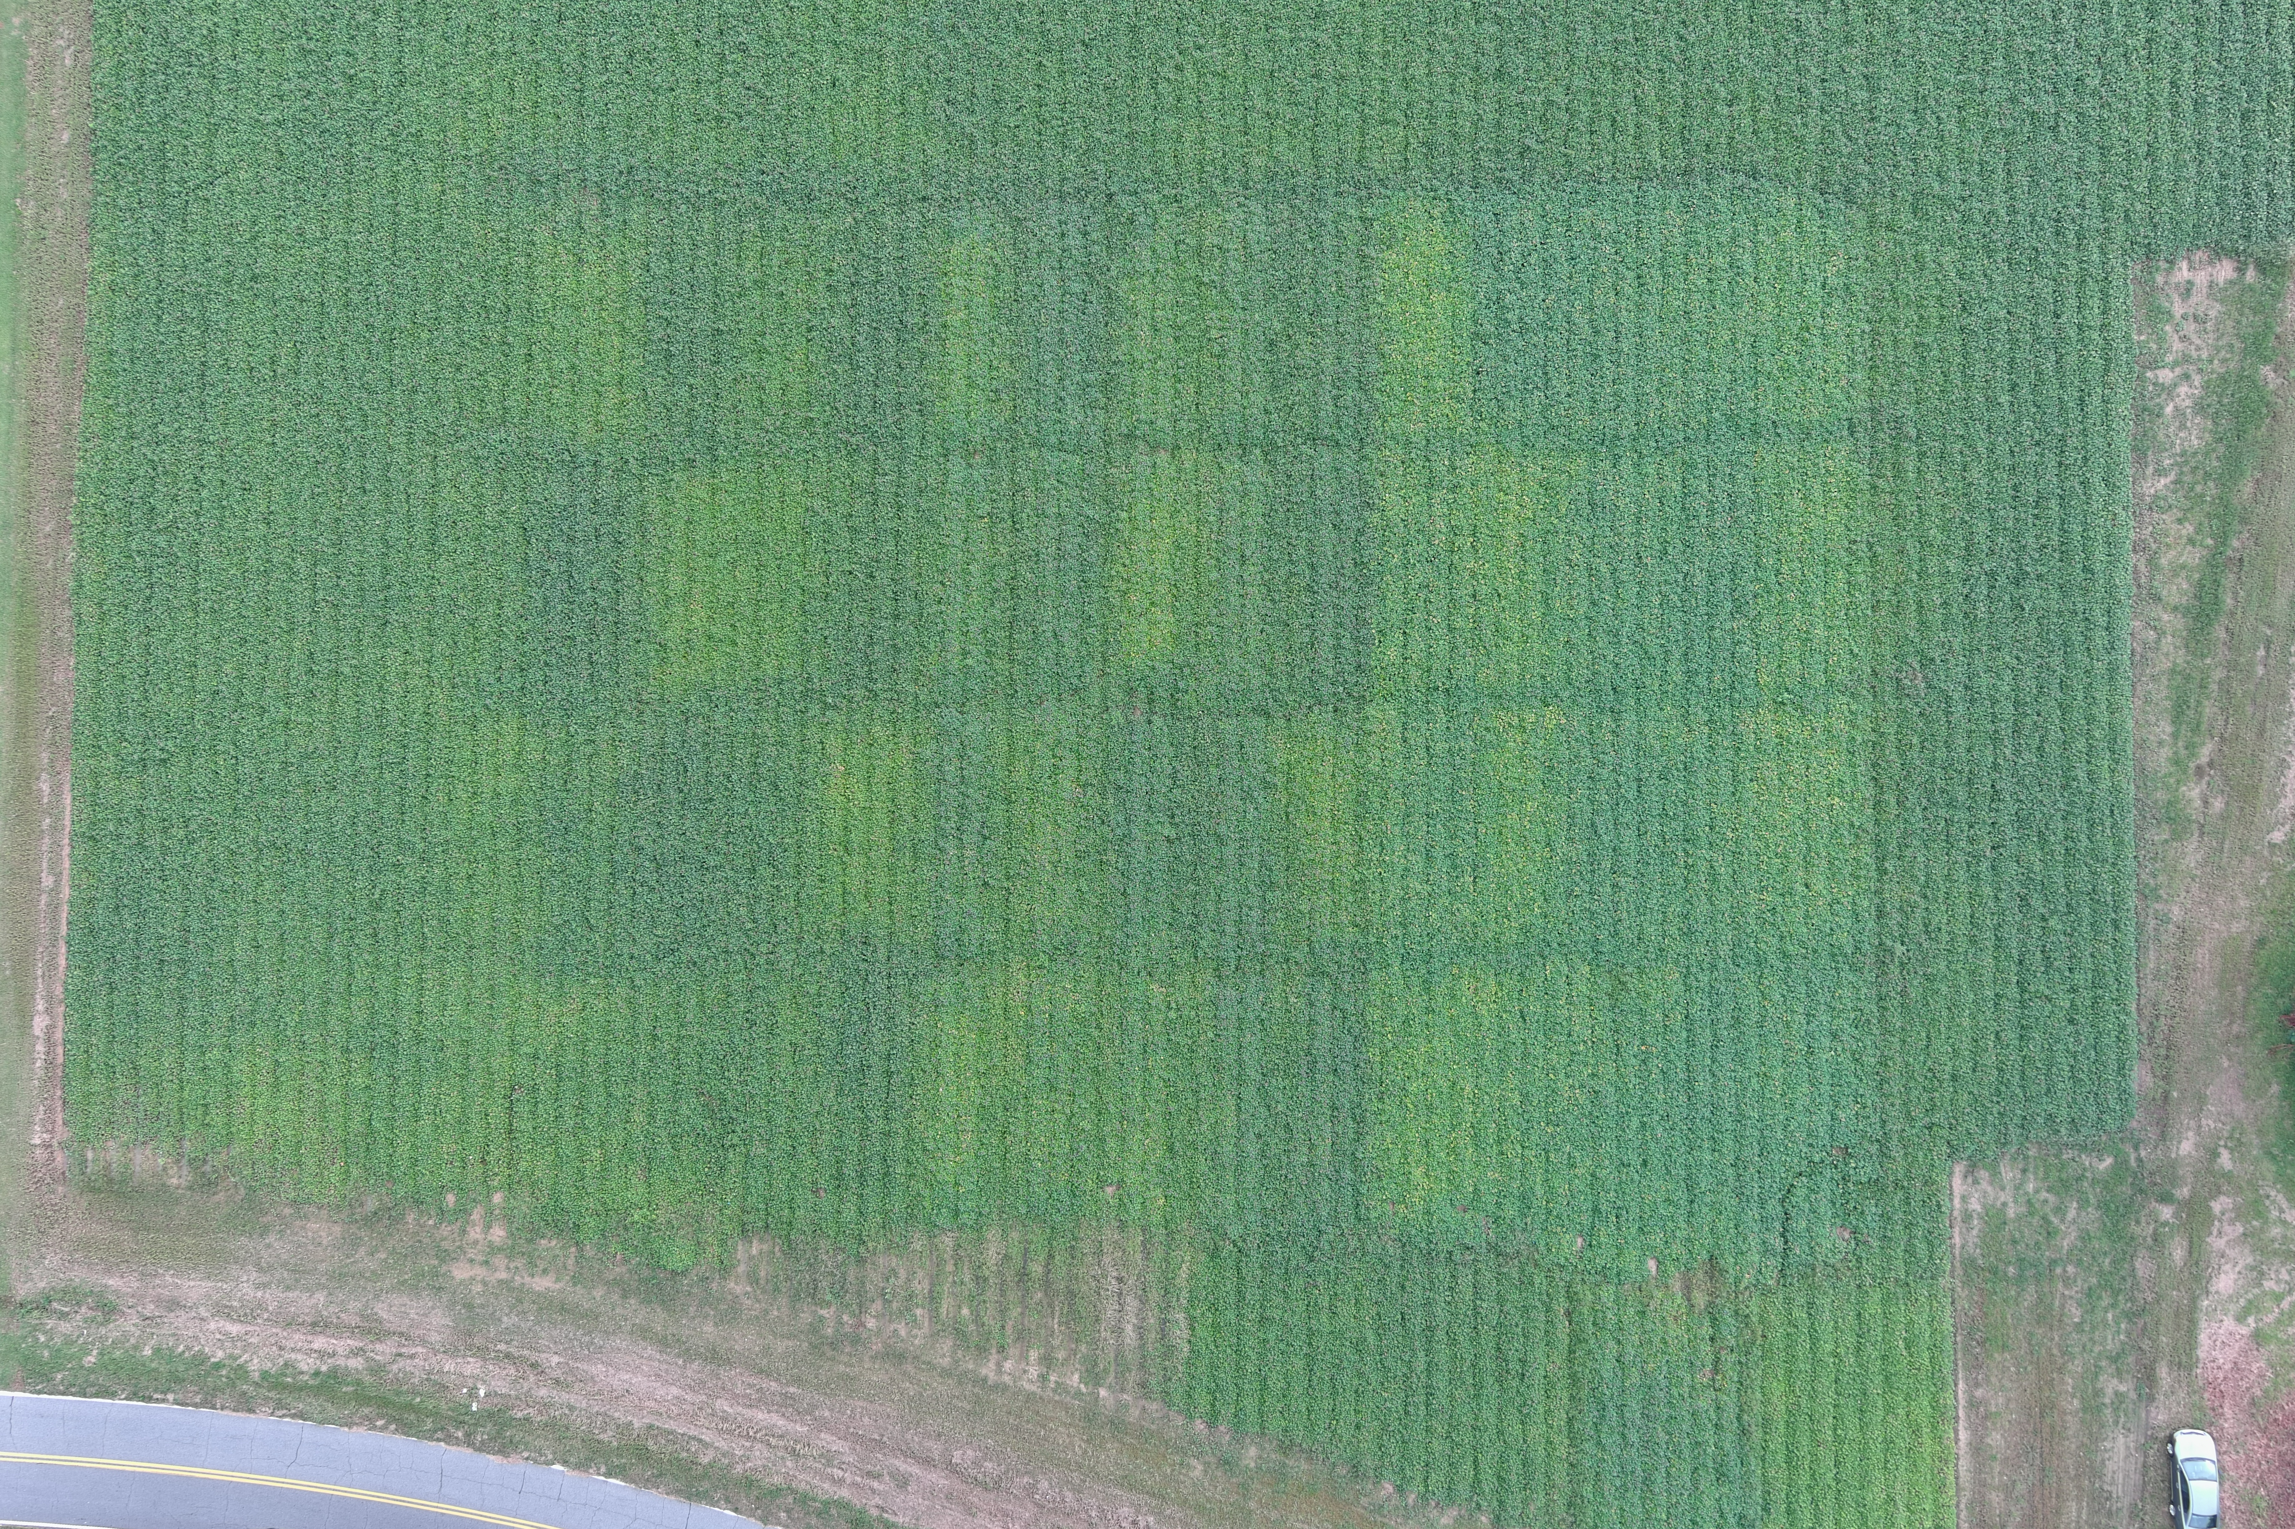
On-Farm location, photo courtesy of Dusten Jolly
9/26/24
108 DAP
Notes:
Vines are vigorous, good vegetative cover, 3 weeks before harvest
Highlight 0s

Slide 46
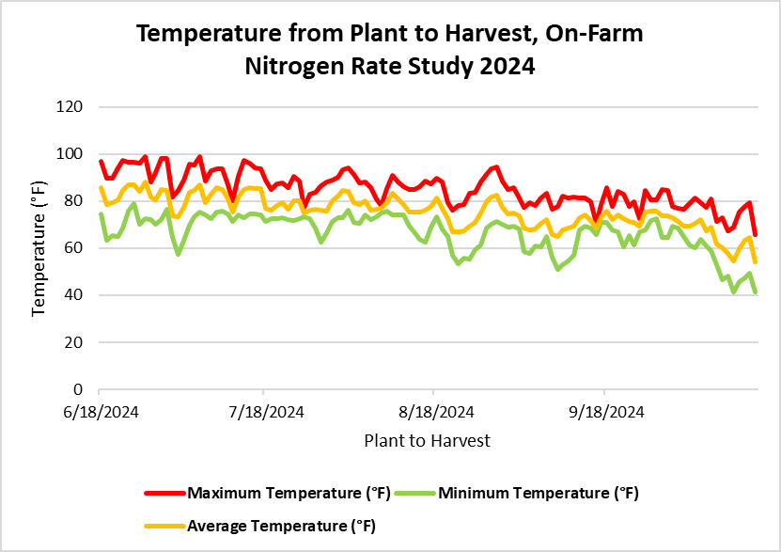
Date Recorded | Precipitation (in)
7/1/24 | 0.78
7/8/24 | 1.8
7/16/24 | 3.0
7/23/24 | 1.5
7/30/24 | 3.25
8/29/24 | 3.1
9/26/24 | 5.2
10/15/24 | 6.0 (full)
24.63 inches total precipitation
Notes:
Temperature and relative humidity data loggers were used to monitor temperature at the on-farm location, these are averaged between 2 loggers. Rain gauge was used to collect precipitation data, monitored by the local county extension agent. Due to the earlier planting, the on-farm study had additional time to grow before the heavy rains from Hurricane Debby set in, allowing better root set. Additionally, on-farm study had an additional 6 inches of rain occur between late September and harvest, when the HCRS location had no rain during the same period.

Slide 47
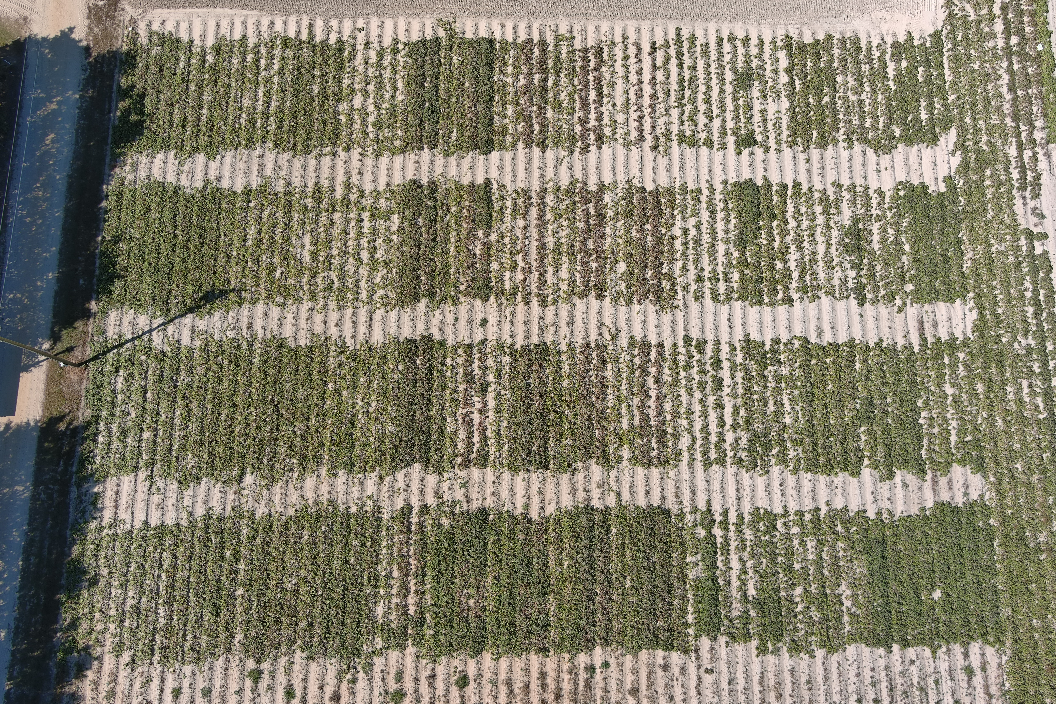
HCRS location, photo courtesy of Dusten Jolly
10/23/24
119 DAP
Notes:
October 2024, lack of irrigation may have been an issue, also right after a period of cold (dropped below 40), 119 DAP

Slide 48
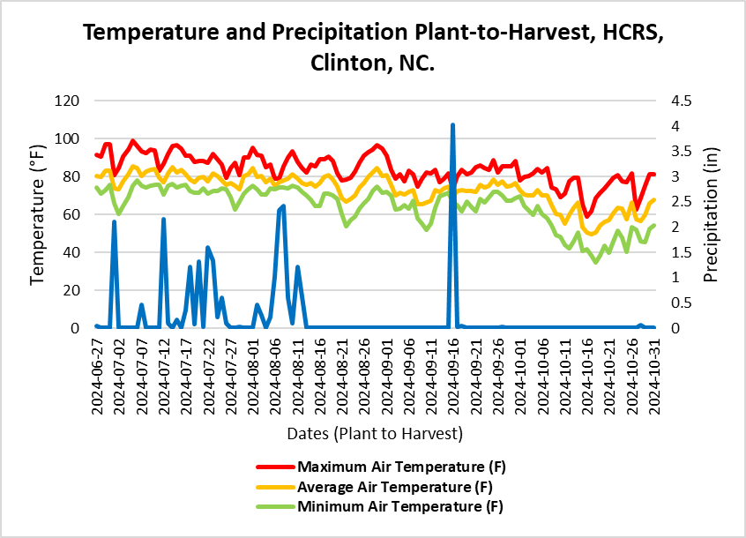
Light frost ~2 weeks before harvest
Heavy rains for over a month immediately after planting
Dry period, only one major rain event within 2 months of harvest
25.0 total inches of precipitation
Notes:
HCRS precipitation total: 25 inches – concentrated at beginning of season besides September 16 rain event
On-Farm precipitation total: 24.6 inches – more spread out throughout season
Heavy rains right after planting reduced storage root set, then dry period that followed prevented the roots that were there from sizing. While on-farm was set earlier and had more time for growth and root set before the heavy rains from Hurricane Debby, as well as more consistent rain throughout the season.
Sweetpotatoes don’t tolerate cold temperatures; frost may injure vines, freeze will kill plants

Slide 49
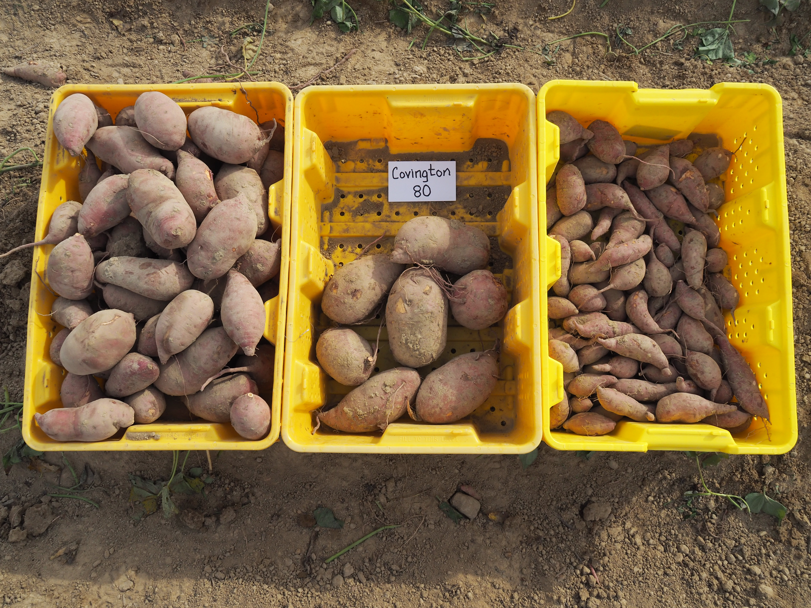
On-Farm Results
No differences in this location, but yields were fairly good overall
SAS, Tukey-Kramer method at P < 0.05, Effect: Clone*Rate | p-value: 0.8931 (ns)

Slide 50
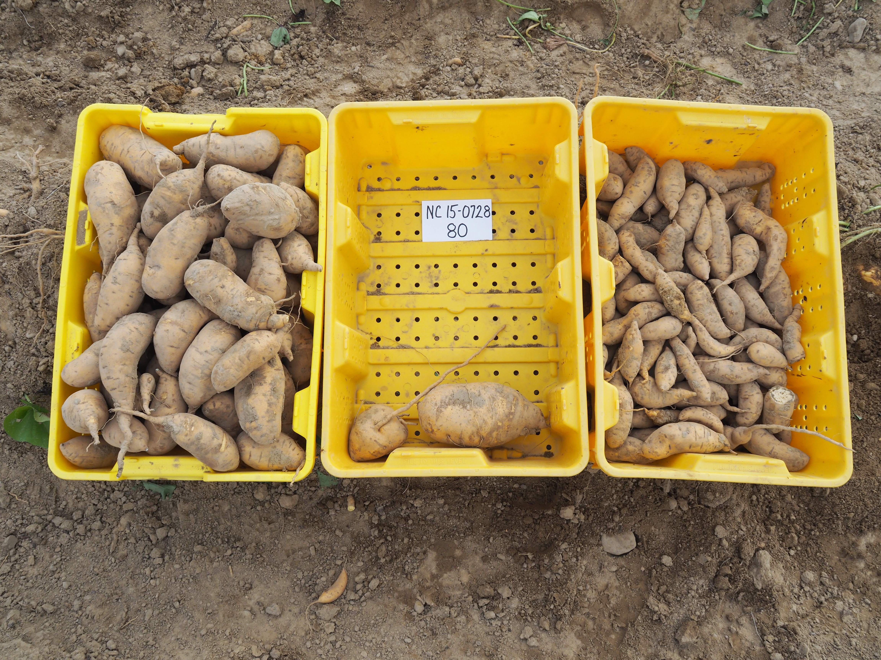
On-Farm Results
Covington was the highest yielding clone at this location
A
B
AB
SAS, Tukey-Kramer method at P < 0.05, Effect: Clone | p-value: 0.0218
Notes:
This is the effect of clone on marketable yield – why lbs are so low
Uniform distribution of moisture throughout the season

Slide 51
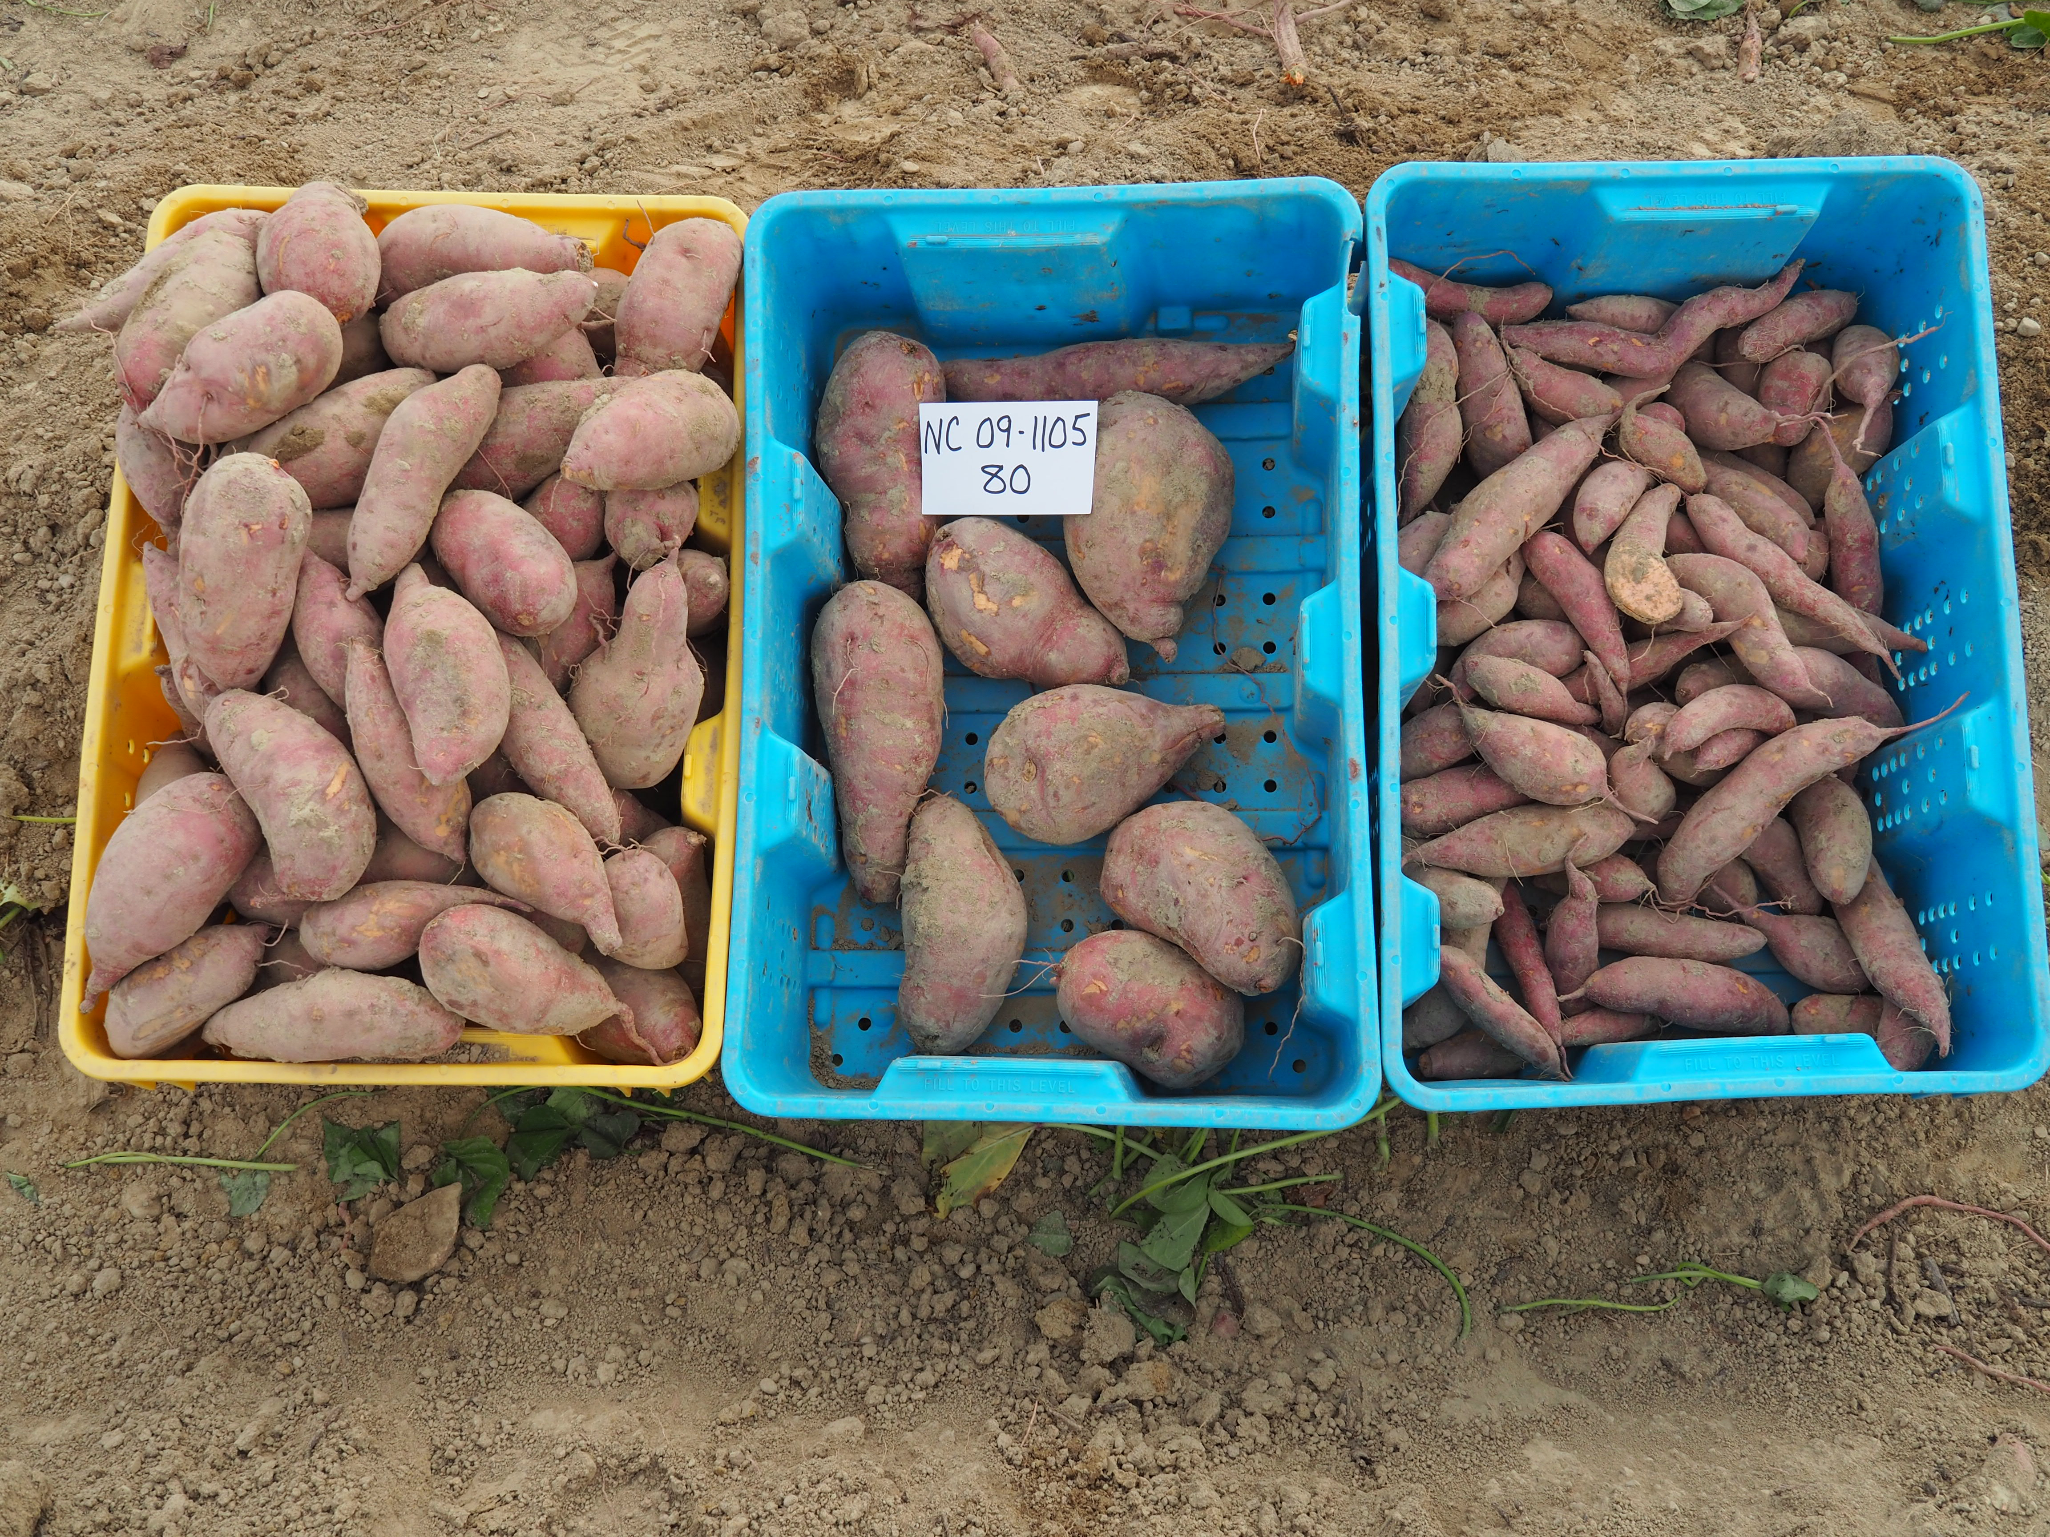
On-Farm Results
No differences between rates
80 lb N/ac numerically the highest
SAS, Tukey-Kramer method at P < 0.05, Effect: Rate | p-value: 0.1145 (ns)

Slide 52
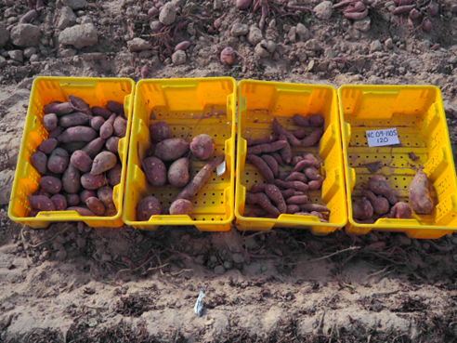
HCRS Results
Statistical separation at this location
AB
ABC
D
SAS, Tukey-Kramer method at P < 0.05, Effect: Clone*Rate | p-value: 0.0451
Notes:
Can’t present effect of clone and rate separately bc interaction is significant
120 and 160 rates had a later application, after the heavy rains, wasn’t leached away as quick

Slide 53
Nitrogen Rate Results - Summary
There were no differences between rates at the on-farm location, but Covington had overall greater marketable yields compared to NC09-1105 and NC15-0728.
Yields were much lower at the HCRS location compared to the on-farm location, but there was statistical separation among treatments.
  Covington and NC15-0728: no differences between rates, but numerical increases with increasing rate
  NC09-1105 – 120 and 160 lb N/ac rates resulted in the highest marketable yields
These studies need to be repeated.
  Planting time and weather resulted in large differences between the locations.
Notes:
Would like to analyze the studies differently with statistics, maybe analyze rates within each clone block

Slide 54
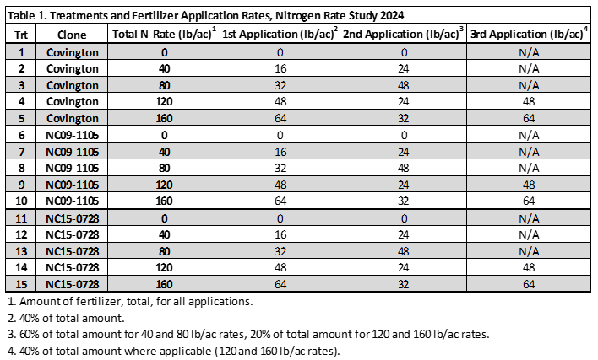
Notes:
Would like to analyze the studies differently with statistics, maybe analyze rates within each clone block

Slide 55
Nitrogen Rate Effects on Three Sweetpotato Clones and the Amounts of Free Asparagine in the Root Tissue
Free asparagine is a major nitrogen transport molecule in plants and has been strongly correlated with the formation of acrylamide, a carcinogen, in fried sweetpotato products
Evaluated the correlation of free asparagine and Nitrogen rate
Measured sweetpotato free asparagine contents for the three clones at the five nitrogen rates
Notes:
Would like to analyze the studies differently with statistics, maybe analyze rates within each clone block

Slide 56
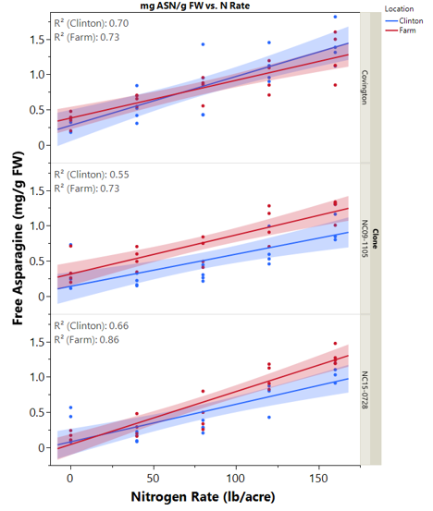
Free asparagine and nitrogen rate correlations, Nitrogen Rate Study, 2024.
Source Matthew Allan
Notes:
Would like to analyze the studies differently with statistics, maybe analyze rates within each clone block

Slide 57
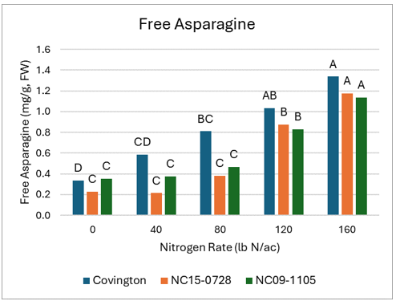
Sweetpotato free asparagine contents. Shared capital letters within a clone indicate no significant difference. Nitrogen Rate Study, 2024. Source Matthew Allan
Notes:
Would like to analyze the studies differently with statistics, maybe analyze rates within each clone block

Slide 58
Free Asparagine Response to Nitrogen - Summary
There were positive correlations between increased nitrogen rate application and free asparagine content in sweetpotato.
Some clones appear to uptake nitrogen more than other clones (i.e. Covington).
It was plausible that the strong free asparagine response with respect to nitrogen rates was due to the unfavorable growing conditions, because free asparagine increases with plant stress.
We propose to continue the collaboration with Matthew Allan to better understand the relationship between excess nitrogen application and free asparagine in sweetpotato flesh.
Notes:
Would like to analyze the studies differently with statistics, maybe analyze rates within each clone block

Slide 59
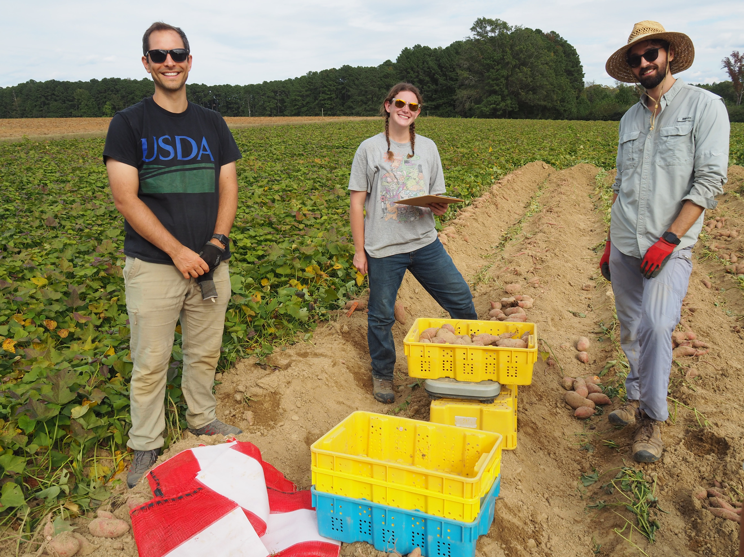

Acknowledgements
Thank you to our grower cooperator for the on-farm location, Leggett Farming Partnership of Nashville, NC, as well as Colby Griffin, Nash Co. Extension Agent, for their cooperation and assistance in the set-up, planting, maintenance, and communication of the on-farm study.
Thank you to the research station staff at the Horticultural Crops Research Station in Clinton, NC for their assistance in the HCRS study location, and to Dusten Jolly for obtaining the drone photos of both study locations.
An additional thank you for the Cultural Management team under Dr. Schultheis including summer employees, as well as Matthew Allan of USDA-ARS who assisted with fertilizer applications, tissue sampling, harvest, and processing samples.
Funding for this research was in part by a North Carolina Sweetpotato Commission award (24-06).

Slide 60
Background – Sweetpotatoes in NC
North Carolina is the top sweetpotato-producing state, averaging 60% of US production and 70% of global sweetpotato exports
Sweetpotato Breeding Program at NC State selects new clones each year which undergo extensive screening
  Disease resistance, culinary/eating quality
Advanced clones are tested further by the Cultural Management Program at NC State
  Fertilizer requirements, spacing, storage
  Nitrogen rate evaluations crucial in release of ‘Covington’ (Yencho et al., 2008)
  Managing internal necrosis after the release of ‘Covington’
Notes:
Breeding program led by Dr. Craig Yencho
Cultural management program led by Dr. Jonathan Schultheis

Slide 61
Methods
Split plot design: 20 row blocks of each clone, 5 fertilizer rate treatments randomized within
  0, 40, 80, 120, and 160 lb N/ac
4 row plots, data collected on one of the two inner rows
  HCRS Plot Size: 30 ft long, 42 in wide, 30 plants per row (11.75” in-row spacing)
  On-Farm Plot Size: 30 ft long, 44 in wide, 36 plants per row (10” in-row spacing)
Nitrogen fertilizer treatments were calcium nitrate (15.5-0-0) split into 2 or 3 applications, side-dressed by hand then cultivated in
  Note: an additional 24 lb N/ac was applied by mistake to the HCRS location during routine fertilization on the research station
Notes:
NCDA recommended rate is 80 lb/ac for Covington, so we went on lower and upper range of that
1st N application is 1 week after planting, 2nd is 3 weeks after planting, 3rd is for the 120 and 160 lb/ac treatments only 5 weeks after planting
Split plot design – easier to compare fertilizer treatments within clone than across clones

Slide 62
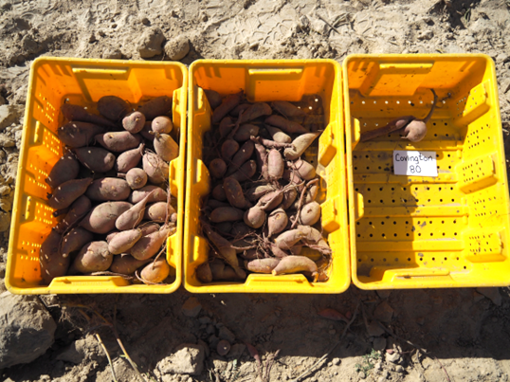
HCRS Results
Covington had numerical yield increases as N rate increased
SAS, Tukey-Kramer method at P < 0.05, Effect: Clone*Rate | p-value: 0.0451
Notes:
Can’t present effect of clone and rate separately bc interaction is significant

Slide 63
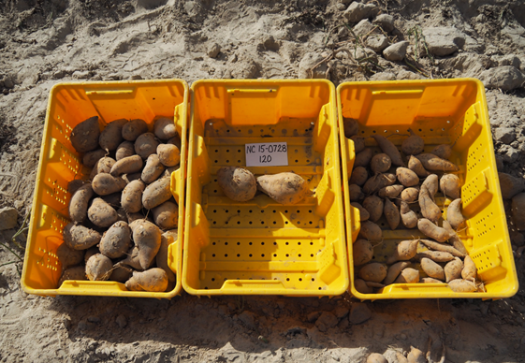
HCRS Results
NC15-0728 also had numerical yield increases as N rate increased.
SAS, Tukey-Kramer method at P < 0.05, Effect: Clone*Rate | p-value: 0.0451
Notes:
Can’t present effect of clone and rate separately bc interaction is significant

Slide 64
HCRS Results
NC09-1105 had a drastic yield increase between the 80 and 120 lb N/ac rates
Increased jumbos for 120 and 160 lb N/ac rates
SAS, Tukey-Kramer method at P < 0.05, Effect: Clone*Rate | p-value: 0.0451
Notes:
Can’t present effect of clone and rate separately bc interaction is significant
Star 120 and 160, better than 0, 40, and 80

Slide 65
Notes:
Would like to analyze the studies differently with statistics, maybe analyze rates within each clone block

Slide 66
Notes:
Would like to analyze the studies differently with statistics, maybe analyze rates within each clone block

Slide 67
Notes:
Would like to analyze the studies differently with statistics, maybe analyze rates within each clone block

Slide 68
Notes:
Would like to analyze the studies differently with statistics, maybe analyze rates within each clone block

Slide 69

Notes:
Would like to analyze the studies differently with statistics, maybe analyze rates within each clone block

Slide 70

Notes:
Would like to analyze the studies differently with statistics, maybe analyze rates within each clone block

Slide 71
Notes:
Would like to analyze the studies differently with statistics, maybe analyze rates within each clone block

Slide 72
Notes:
Would like to analyze the studies differently with statistics, maybe analyze rates within each clone block

Slide 73
Notes:
Would like to analyze the studies differently with statistics, maybe analyze rates within each clone block

Slide 74

Includes all 4 reps

Slide 75
Notes:
Would like to analyze the studies differently with statistics, maybe analyze rates within each clone block

Slide 76
Number of fruit per harvest per cultigen includes all 4 reps.

