Slide 1
Civil Rights Compliance
The North Carolina Department of Agriculture
and Consumer Services
Food Distribution Division
Notes:
We designed this template so that each member of the project team has a set of slides with its own theme. Members, here’s how you add a new slide to just your set:
Mark where you want to add the slide: Select an existing one in the Thumbnails pane, click the New Slide button, then choose a layout. The new slide gets the same theme as the other slides in your set.
Careful! Don’t annoy your fellow presenters by accidentally changing their themes. That can happen if you choose a different theme from the Design tab, which changes all of the slides in the presentation to that look.

Slide 2
FNS Instruction 113-1
https://www.fns.usda.gov/fns-instruction-113-1
The purpose of FNS Instruction 113-1 is to:
Establish and convey policy
Provide guidance and direction
Ensure compliance with and enforcement of the prohibition against discrimination

Slide 3
What is discrimination?
Simple Definition:
the unfair or prejudicial treatment of different categories of people and groups based on characteristics

Slide 4
Why Civil Rights Training?
Training is required so that people involved in all levels of administration of programs that receive Federal financial assistance understand civil rights related laws, regulations, procedures and directives
Local agencies are responsible for training their managers and staff who interact with applicants or participants on an annual basis
New staff must receive Civil Rights training before participating in TEFAP/CSFP activities
Volunteers must also receive training appropriate for their roles and responsibilities

Slide 5
Civil Rights Training for Volunteers
Frontline volunteers, such as individuals who regularly interact with applicants and participants, determine eligibility, or handle personal information must receive full Civil Rights training on an annual basis
Volunteers who do not handle personal information and who may infrequently interact with program applicants, participants, or frontline staff must receive, at a minimum, limited Civil Rights training, which covers customer service and any other subject matter applicable to each volunteer’s role and responsibilities
Volunteers who do not interact in any way with program applicants and participants and who do not handle personal information are not required to complete Civil Rights training

Slide 6
Training Content
The annual training must include, but not be limited to, the following topics in the FNS Instruction 113-1:
Collection and use of data
Effective public notification systems
Complaint procedures
Compliance review techniques
Resolution of non-compliance
Requirements for reasonable accommodation of persons with disabilities
Requirements for language assistance
Conflict resolution
Customer service

Slide 7
Collection and Use of Data
State and local agencies are required to obtain data by race and ethnicity
Form FNS-191 (CSFP)
Data should be collected at point of application
Self-identification or self-reporting is preferred method of obtaining data

Slide 8
Collection and Use of Data
Applicants/Participants cannot be required to furnish information regarding their race or ethnicity
Applicants shall be assured that the information is required and used for statistical purposes only and has no impact on eligibility criteria
Where an applicant/participant does not provide this information, the collector shall through visual observation secure and record the data

Slide 9
Effective Public Notification Systems
Inform applicants, participants and potentially eligible persons of their program rights, responsibilities and the steps necessary for participation
Must advise applicants and participants at the service delivery point of their right to file a complaint, how to file a complaint, and the complaint procedures
All information materials and sources, including websites, must contain a non-discrimination statement. The statement is not required to be included on every page of the program website, but at least on the home page.

Slide 10
Notification Methods
Display
Prominently display the USDA “And Justice For All” non-discrimination poster
Inform
Inform potentially eligible people, applicants, participants, and grassroots organizations of the program and its requirements
Provide
Provide appropriate information in alternative formats for people with disabilities
Include
Include the nondiscrimination statement on all appropriate program materials provided to the public
Convey
Convey the message of equal opportunity in all photographic and other graphics that are used to provide program-related information to the public
Share
Share program-related information materials in languages other than English, if the need exists

Slide 11
Civil Rights Complaint Procedures
Right to File
Anyone alleging discrimination has the right to file a complaint within 180 days of the alleged discriminatory action
Acceptance
Complaints, written or verbal, must be forwarded to the appropriate Office of Civil Rights (OCR) Director. Anonymous complaints will be handled as any other to the extent feasible on available information.
Forms
Any OCR (Office for Civil Rights) may develop complaint forms, but the use of such forms must not be a prerequisite for acceptance of a complaint

Slide 12
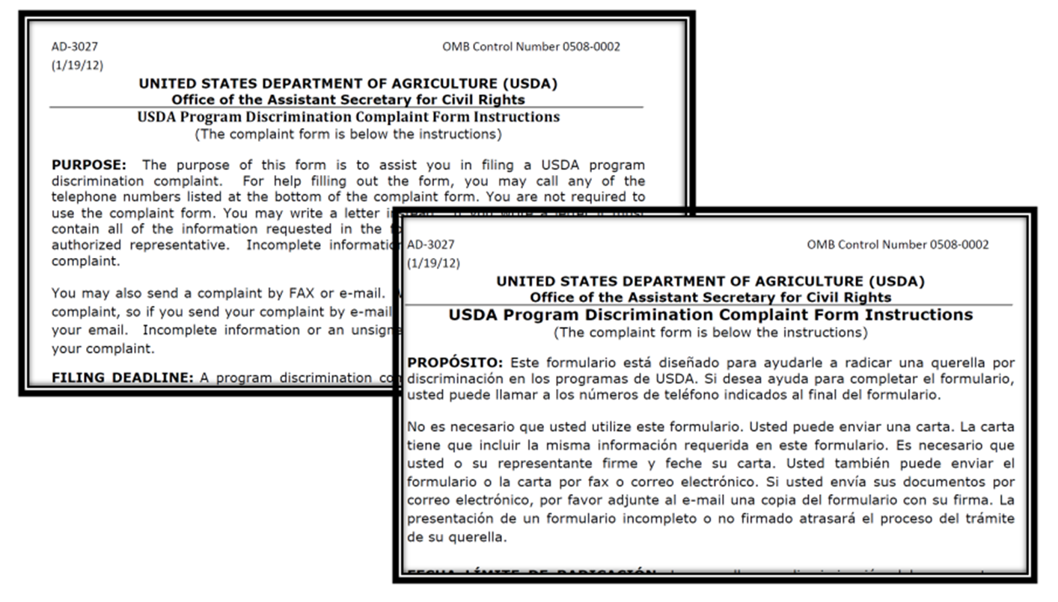
Complaints of Discrimination
Verbal, written or anonymous
Can be made by any person at any level
Civil Rights complaint is based on 6 protected classes
Have specific processes in place for your agency

Slide 13
Verbal Complaints
The person to whom the allegations are made must write up the elements of the complaint for the complainant.

Slide 14
Verbal Complaints Content
Complainant name, address & phone, email or other contact
Specific location and name of agency delivering the service or benefit
Nature of the incident or action that led the complainant to feel discriminated
What protected base (class) the complainant feels discriminated against
Names, phone numbers, titles, addresses or people who may have knowledge of the discriminatory action
The date(s) which the alleged discriminatory actions occurred or duration of such actions

Slide 15
Compliance Reviews
Must advise the reviewed entity in writing of findings and recommendations
Federal or state reviewer must secure information as necessary to make the determination of compliance
Routine reviews conducted as required by program regulations. Selection criteria:
Unusual fluctuations of racial/ethnic groups in service area
Number of discrimination complaints filed against the agency
Unresolved findings from previous reviews
Information from grassroots organizations, state officials, etc…

Slide 16
Resolution of Noncompliance
Noncompliance – factual finding that a Civil Rights requirement is not being adhered to
Achieving Voluntary Compliance – if found noncompliant, immediate steps to become compliant must be taken
Termination / Suspension of Assistance – any action must be limited to the agency found noncompliant and limited to a particular program which noncompliance was found

Slide 17
What is a Protected Class?
Any person or group of people who have characteristics for which discrimination is prohibited based on a law, regulation, or executive order

Slide 18
What is a Protected Class?
Any person or group of people who have characteristics for which discrimination is prohibited based on a law, regulation, or executive order
FNS PROGRAMS
PROTECTED CLASSES
POLITICAL AFFILIATION (CSFP & FDPIR)
RELIGION (CSFP & FDPIR)
NATIONAL ORIGIN
SEX
(including gender identity and sexual orientation)
RACE
AGE
COLOR
DISABILITY

Slide 19
Full Non-Discrimination Statement
In accordance with federal civil rights law and U.S. Department of Agriculture (USDA) civil rights regulations and policies, this institution is prohibited from discriminating on the basis of race, color, national origin, sex (including gender identity and sexual orientation), disability, age, or reprisal or retaliation for prior civil rights activity.
Program information may be made available in languages other than English. Persons with disabilities who require alternative means of communication to obtain program information (e.g., Braille, large print, audiotape, American Sign Language), should contact the responsible state or local agency that administers the program or USDA’s TARGET Center at (202) 720-2600 (voice and TTY) or contact USDA through the Federal Relay Service at (800) 877-8339.
To file a program discrimination complaint, a Complainant should complete a Form AD-3027, USDA Program Discrimination Complaint Form which can be obtained online at: https://www.usda.gov/sites/default/files/documents/USDA-OASCR%20P-Complaint-Form-0508-0002-508-11-28-17Fax2Mail.pdf, from any USDA office, by calling (866) 632-9992, or by writing a letter addressed to USDA. The letter must contain the complainant’s name, address, telephone number, and a written description of the alleged discriminatory action in sufficient detail to inform the Assistant Secretary for Civil Rights (ASCR) about the nature and date of an alleged civil rights violation. The completed AD-3027 form or letter must be submitted to USDA by:
mail: U.S. Department of Agriculture Office of the Assistant Secretary for Civil Rights 1400 Independence Avenue, SW Washington, D.C. 20250-9410; or
fax: (833) 256-1665 or (202) 690-7442; or
email: program.intake@usda.gov
This institution is an equal opportunity provider.
https://www.fns.usda.gov/cr/fns-nondiscrimination-statement

Slide 20
Short Non-Discrimination Statement
“This institution is an equal opportunity provider.”
“Esta institución es un proveedor que ofrece igualdad de oportunidades.” (Spanish)
https://www.fns.usda.gov/cr/fns-nondiscrimination-statement

Slide 21
Requirements for Reasonable Accommodation of People with Disabilities
The Americans with Disabilities Act of 1990 (ADA) prohibits discrimination and ensures equal opportunity for people with disabilities in employment, state and local government services, public accommodations, commercial facilities, and transportation.
https://www.ada.gov/index.html

Slide 22
Reasonable Accommodations for People with Disabilities
Reasonable accommodations that do not cause undue hardship must be provided
Accommodating facilities consider:
Parking lot
Entrances
Exits
Hallways
Elevators
Restrooms
Braille signage

Slide 23
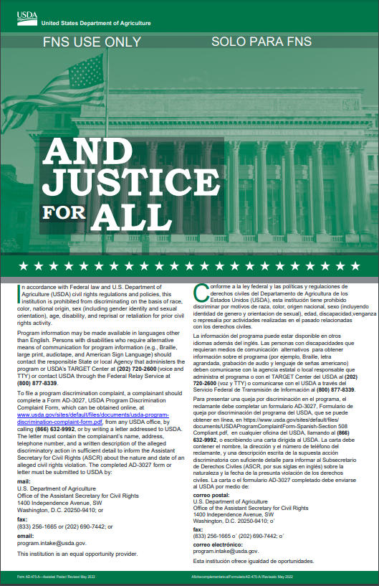
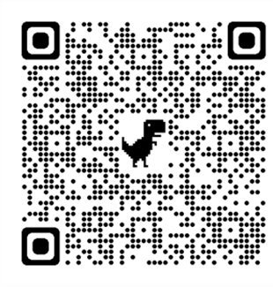
“And Justice For All” Poster
AD-475A is the required version for TEFAP and CSFP
Display in a prominent location for all to view
For AJFA posters, contact your NCDA&CS FDD Field Services Representative
https://www.ncagr.gov/fooddist/FieldServices.html

Slide 24
Requirements for Language Assistance
Title VI and its regulations require state agencies, local agencies, or other sub-recipients to take reasonable steps to assure “meaningful” access to information and services they provide.
https://www.fns.usda.gov/cr/limited-english-proficiency-lep

Slide 25
What are “Reasonable” Steps?
1.) The number or proportion of LEP (Limited English Proficiency) people eligible to be served or likely to be encountered by the program or grantee;
2.) The frequency with which LEP individuals come in contact with the program;
3.) The nature and importance of the program, activity, or service provided by the program to people’s lives; and
4.) The resources available to the grantee/recipient and costs.
https://www.fns.usda.gov/cr/limited-english-proficiency-lep

Slide 26
Equal Opportunity for Religious Organizations
Ensures a level playing field for the participation of faith-based organizations and other community organizations in USDA programs.
https://www.fns.usda.gov/usda-foods/qas-equal-opportunity-religious-organizations

Slide 27
How to Accomplish Equal Opportunity for Religious Organizations
Prohibit discrimination on the basis of religion, religious belief, or religious character in the administration of Federal funds
Allow a religious organization that participates in USDA programs to retain its independence and continue to carry out its mission, provided that direct USDA funds do not support any inherently religious activities such as worship or religious instruction
Clarify that faith-based organizations can use space in their facilities to provide USDA-funded service without removing religious art, icons, scriptures, or other religious symbols
Ensure that no organization that receives direct financial assistance from the USDA can discriminate against a program beneficiary, on the basis of religion or religious belief

Slide 28
Conflict Resolution
Conflict resolution refers to resolving the dispute to the approval of one or both parties.
If we handle conflict appropriately, it not only makes us more effective, but it can also bring about needed change and innovation to our organization.

Slide 29
Conflict Resolution
Conflict resolution is the process by which two or more parties reach a peaceful resolution to a dispute.

Slide 30
CONFLICT RESOLUTION
FOCUS ON THE SITUATION ONLY
Engage with the upset customer directly, giving them your full attention and eye contact
LET THEM VENT
Hear the customer out before you step in. If you interrupt, they may need to repeat what they have already said.
RELATE TO THE CUSTOMER
Perhaps the most important step in resolving a conflict is letting your customer know that you “feel their pain.”
SUMMARIZE THEIR SITUATION
Upset customers need to see and hear that you understand their level of frustration.
PROBLEM SOLVE
Agree on the problem, brainstorm options, agree on the solution and follow up on commitments made.

Slide 31
Customer Service
Be professional
Be courteous
Listen intently and take notes if necessary
Repeat back what you have been told to ensure correctness
Follow up with corrective action if required

Slide 32
Thank you
for being a part of the fight to end hunger in North Carolina!

