Slide 1
2025 Structural Pest Control Rules Revision Workshops

Slide 2
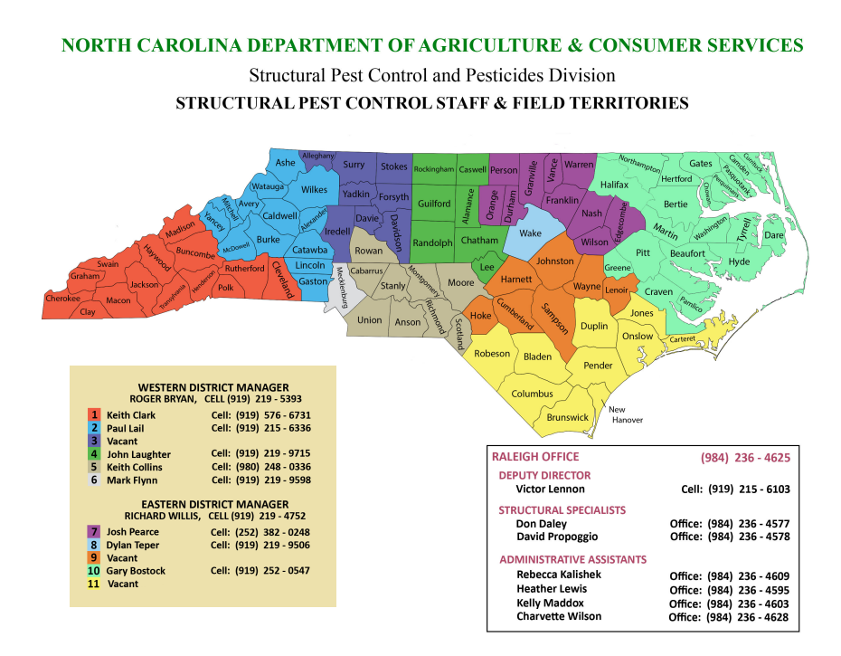
Structural Pest Control Program Staff

Slide 3
Why are we here? EPA required all States who have Cooperative Agreements to revise their respective C&T Plans-beginning in 2017
States worked with Region 4 EPA staff and legal staff out of Atlanta on initial revisions to C&T Plans before sending to EPA headquarters.
In North Carolina we began meeting with the N.C. Pest Management Association to review proposed revisions and eventually presented to the Structural Pest Control Committee for discussion & approval.
Revised C&T Plan was eventually sent to EPA Headquarters staff and legal staff in D.C. for review, dialogue and more revisions.

Slide 4
Our Division received final approval from EPA headquarters for N.C. C&T Plan in July 2023! I. C&T Plan approval: 2023 II. Rules Review Process: 2024 - 2025 III. Implementation: We are here! - 2025
Thanks to the dedicated effort of our Division’s C&T and Enforcement Team, EPA Region 4 staff and valuable input from NCPMA & guidance from the N.C. Structural Pest Control Committee.

Slide 5
Timeline of Rules Revisions Implementation & Enforcement in North Carolina
Rules Revisions effective (published) date of February 1, 2025.
Outreach & notification to PMP’s via NCDA&CS SPC Program web site and emails in March 2025 and renewal insert with Rules Revisions in April - May 2025.
Training workshops in 7 locations throughout N.C. in May 2025: Wilmington, Dallas, Morganton, Greenville, Fayetteville, Raleigh (virtual also), and Greensboro.
Enforcement of Rules Revisions will begin on July 1, 2025.

Slide 6
Revised C&T Plan for N.C.-Structural Pest Control - Rules Implications - Supervision & Training Requirements
The overall Rules regarding the supervision of “non-certified” applicators (i.e. RTs) are changing, however since our N.C. Rules already require non-certified applicators to become RTs (Registered Technicians) through the RTTP (RT Training Program), some training elements are already in place.
Several of the upcoming changes/requirements will be completed “behind the scenes” by the Division staff so the overall impact to PMP’s day-to-day operations will be minimal.
There will be additional training requirements for RTs, revisions of Certified Applicator Exams, record-keeping requirements, and a one-time training requirement for current CA’s and Licensees.

Slide 7
Nine Structural Pest Control Rules were revised:
Rule .0101: General Duties
Rule .0302: Application for License & Cards-Examination
Rule .0309: Recertification
Rule .0313: Registered Technician’s ID Cards/Training Materials
Rule .0327: Licenses and Cards Not Issued to Persons Under 18
Rule .0604: Wood-Destroying Organisms Records
Rule .0703: Written Records of Household Pest Control
Rule .0803: Written Records of Fumigation
Rule .0902: Financial Responsibility

Slide 8
Rule .0101 General Duties (b) - Applicable to both Licensees and Certified Applicators
Before any RT may use any pesticide under the “direct supervision” of licensee or CA, Licensee or CA must ensure that RT has completed 1) the RTTP Rule.0313; (2) that RT has been instructed within the last 12 months in the safe operation of any equipment used for mixing, loading, transferring, or applying pesticides; and 3) that the RT is 18 years old.
RT must always have access to applicable product labeling.
Also, RT must be provided with proper PPE required by labeling, and ensure PPE is being worn and used correctly for its intended purposes through training, documentation, or supervision.

Slide 9
Rule .0101 General Duties (b) - Applicable to both Licensees & Certified Applicators (continued)
Licensee or CA must provide to RT through training, tools necessary to analyze a site prior to pesticide application being made and understanding when it is necessary to postpone an application until contacting Licensee or CA for input.
Examples of site-specific training: Pest ID, damage assessment, construction types, control/management options, and other factors such as surface/ground water, runoff potential, soil type, weather forecast, endangered species, drift, flowering plants, etc.
Licensee or CA must be physically present at the use site when required by product labeling
Licensee or CA must ensure through training, documentation, or inspections that before each day of use, pesticide application equipment is in proper operating condition as intended by manufacturer. Example template for equipment checklist will be available on our website, and you should design yours to reflect all application equipment that your RT uses each day. You may also add your company logo.

Slide 10
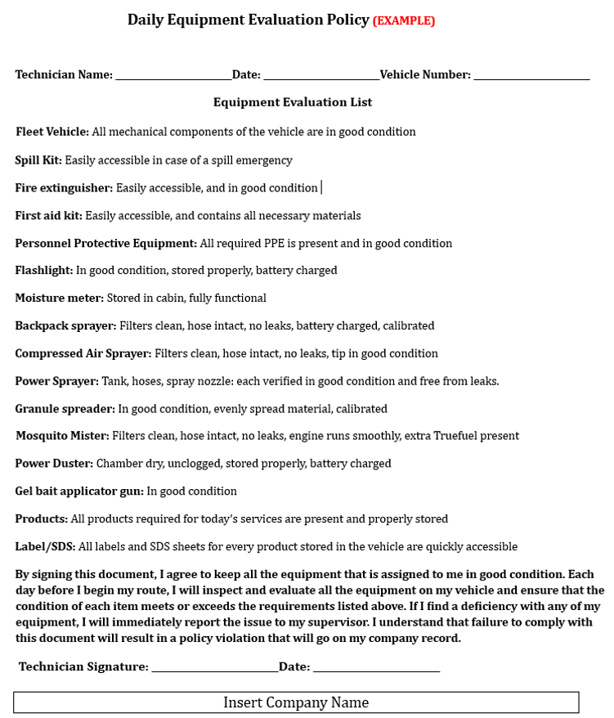

Slide 11
Rule .0101(b) - Applicable to both Licensees & Certified Applicators: Supervision of RT’s - Training Requirements (continued)
RTTP training must be completed prior to anyone being able to make a pesticide application.
RTs will be required to attend annual training in addition to their initial Registered Technician Training Program (RTTP)/RT School training.
Annual RT training will soon be made available on our web site - Pesticide Educational Resources Collaborative (PERC) Training for “non-certified applicators”. This national training video will be edited for N.C. Structural Pest Control non-certified applicators. A certificate of completion will be available. Training must be conducted/monitored by a: licensee, CA, or designated trainer of in-house RT Schools. (see Rule .0313(g)(1)and (2))
There is a RT eligibility record-keeping requirement. However, since the SPC Section currently maintains attendance records & issues a Certificate of Completion for RT Schools and also for RT Equivalent training, then this requirement is already being met. However, you need to keep copies of ALL RT training records and make sure they are readily available for NCDA&CS inspections.

Slide 12
Rule .0302 - Application for Licenses & Cards: Examinations
Unauthorized assistance while taking exams is now indicated as “anyone who is not employed by the Division” and “any outside assistance that has not been previously approved by the Division”. Anyone using unauthorized assistance while taking an exam will be not be allowed to take a re-examination for a period of at least 6 months. (same as old Rule). Authorized assistance (approved by the Division)during exams now includes: translation services, interpretation services, or other needs required by ADA.
FIFRA requirement standards for Certified Applicators now included for all three phases - P, W, & F as to what knowledge must be demonstrated. CA Exams are currently being reviewed and will be revised to meet this requirement.
License Exams are not required to be revised.

Slide 13
Rule .0309 - Recertification
Outdated information removed from this Rule, but CCU requirements remain the same.
PMP can still re-examine between Jan.1 - June 30th of the last year of their 5-year recertification period instead of meeting recertification requirements through CCUs.
*NOTE - Beginning July 1, 2025, All Licensees and CA’s will have to complete a one-time training before the expiration of their 5-year recertification period. This is not a Rule requirement, but an EPA requirement in our N.C. Certification & Training Plan for Licensees & CA’s who tested under the old C&T Plan.
We will provide guidance on our web site as to how to access this training. More than likely, a presentation will be made available on our web site along with a certificate of completion.
PLEASE STAY TUNED & visit our web site for information in the near future!

Slide 14
Rule .0313 - Registered Technician ID Card/Training Materials
References that requirements of Rule .0101(b)(4)(B) must be met before applying for issuance or renewal of RT Card which is: Complete all requirements of Rule .0313 RT Rule, RT must be instructed in safe operation of all equipment used for mixing, loading, transferring or applying pesticides (annual RT training video) and RT must be 18 years old.
Now includes annual training requirement and criteria for trainer: must be a Licensee, CA, or approved designated trainer for In-house RT Schools.

Slide 15
Revised Rule .0327 - Licenses Issued To Persons Under 18
This Rule has been revised to the following: “No license certificate or certified applicator’s identification card or registered technician’s identification card shall be issued to any person who is less than 18 years old.
All RTs will now be required to be at least 18 years of age. Previously this was only a requirement for licensees & CA’s.

Slide 16
Rule .0604 - Wood-Destroying Organisms Records
No major revisions for this Rule
Reference added for FIFRA record-keeping requirements for Licensees & Non-Commercial Certified Applicators- CFR Part 171.303(b)(7)(vi)
Reference added for: RUP’s-as defined in G.S.106-65.24(21) of SPC Law
Reference to NCDA&CS SPC web site link where Pretreatment record form can be found.

Slide 17
Rule .0703 - Written Records of Household Pest Control
No major revisions for this Rule
References added for FIFRA record-keeping requirements CFR Part 171.303(b)(7)(vi) for Licensees and Non-Commercial Certified Applicators.

Slide 18
Rule .0803 - Written Records of Fumigation
Reference to record-keeping requirement of FIFRA 40 CFR Part 171.303(b)(7)(vi)
.0803 (a)(8): Date and Time of fumigation application now required for the record-keeping requirements for fumigations performed by Licensees and Non-Commercial Certified Applicators. (Previously only Date was required)

Slide 19
Rule .0902 - Financial Responsibility
No major revisions to this Rule.
Only some minor language/wording changes.

Slide 20
Final Thoughts & “To-Do” List
All nine Rules with Revisions are easily located on our web site-please visit this web page frequently for any future updates.
We have hard copies and electronic copy (on our web site) of Rules available
Train all appropriate RTs, CAs, and managers on Revisions prior to July 1, 2025.
Annual RT training & one-time training requirement for Licensees & CAs should eventually be available on our web site. Stay tuned……..Keep records of ALL training requirements for Licensees, CAs, & RTs and make sure these records are readily available to present to State Inspectors.
Mark your calendars for future annual training and one-time training requirements to stay in compliance.

Slide 21
Final Thoughts & “To-Do List” (continued):
Contact your area Inspector and/or Field Manager with questions or training needs
Daily equipment checklist is available as hard copy or electronic version—customize to your company’s equipment inventory & review with RT’s so they are aware this is a DAILY requirement before beginning their P.C. or WDO route/workday.
Also emphasize that the checklist is for their “worker protection” safety, environmental protection and reduces company’s liability.
July 1, 2025 is date that Division will begin enforcement, so the next 1-2 months is the time to address any questions and prepare your staff.

Slide 22
THANK YOU FOR YOUR ATTENDANCE! QUESTIONS?
Richard.Willis@ncagr.gov (Eastern N.C. Territory)
Roger.Bryan@ncagr.gov (Western N.C. Territory)
Victor.Lennon@ncagr.gov (Raleigh-headquarters)
Headquarters Phone #: 984-236-4625
www.ncagr.gov/spcap

Slide 23
If you have questions about the new rule changes that have not been addressed already, please email them to:
Don.Daley@ncagr.gov or David.Propoggio@ncagr.gov

