Slide 1
Goal: Reduce Negative Impacts from Forest Threats
Jim Prevette—NCDFR Fire Chief, Fire Control—Program Head
Robert Trickel—NCDFR Pest Control—Program Head

Slide 4
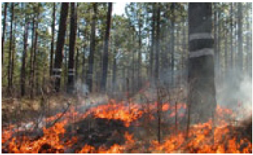
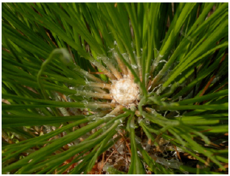
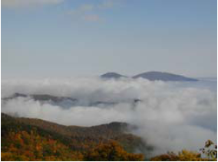
Jim Prevette

Slide 5
Wildfire Issues Focus Areas
Forest health
Population demographics and growth
The wildland-urban interface
Resource capability and availability
Notes:
1. Increased fuel loading in NC forests has greatly influenced the intensity and size of fires. Lack of controlled burning is a primary cause of this increased fuel loading. Pest insects and diseases, natural disasters, and invasive species also have increased fuel loads.
2. As North Carolina continues to transition from a rural and agricultural state to an urban and suburban one, people’s perception of fire and their expectations of fire services have changed. Many people moving to forested areas are coming from metropolitan areas or states where forestland is not as fire-dependent and fire is not as frequent.
3. Many new homes are constructed without any community wildfire planning . This has created neighborhoods with limited accessibility plus flammable building construction and flammable landscaping with no defensible space incorporated.

Slide 6
Key Findings
Fire exclusion contributes to the decline or loss of fire-dependent
ecosystems and species, and creates fuel conditions that produce destructive wildfires.
Population increases in North Carolina's wildland-urban interface areas create significant challenges for firefighters and residents.
Firefighting capacity to rapidly and effectively control wildfires has decreased over the past decade across North Carolina.
The public lacks awareness of wildfire hazards and “firewise” concepts.
Smoke-sensitive areas occur in much of North Carolina. These areas and air quality regulations restrict controlled burning and necessitate coordinated planning at state, regional, and national levels.

Slide 7
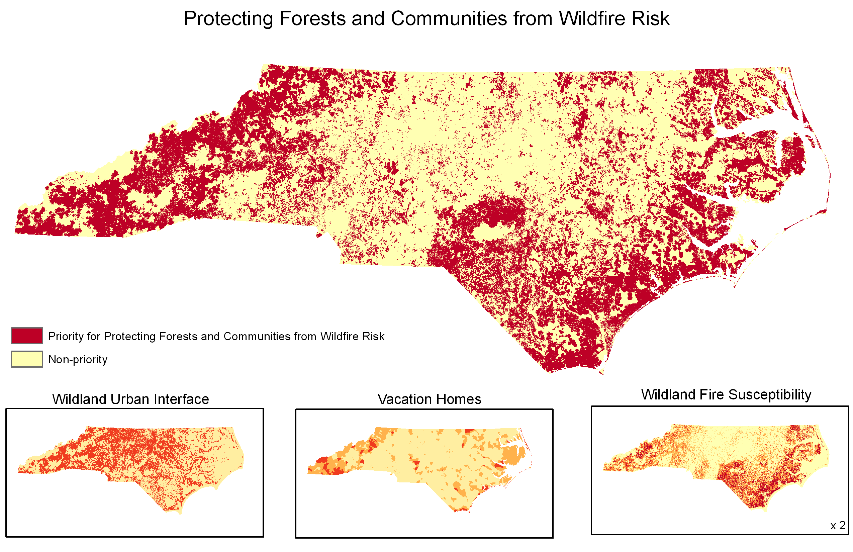

Slide 8
It is crucial that cooperating and assisting agencies form partnerships to:
Identify and mitigate the hazards, risks, and effects from wildfire;
Educate the public to ensure their safety and emergency responder safety;
And continue protecting and enhancing our forest resources.

Slide 9
Robert Trickel

Slide 10
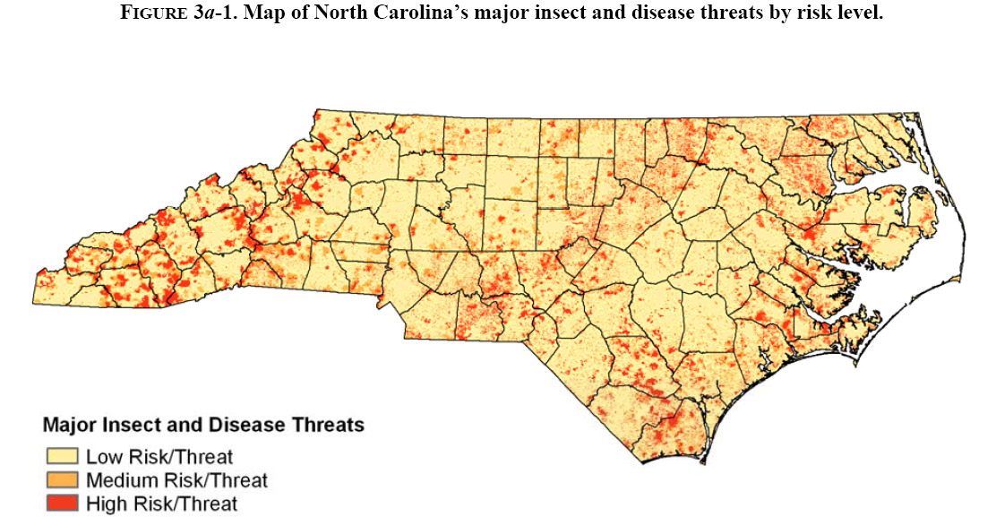

Slide 11
Annosus root rot
Fusiform rust
Southern pine beetle
Balsam woolly adelgid
Hemlock woolly adelgid
Littleleaf disease
Beech bark disease
Gypsy moth
Weeds are not be represented in this format

Slide 12
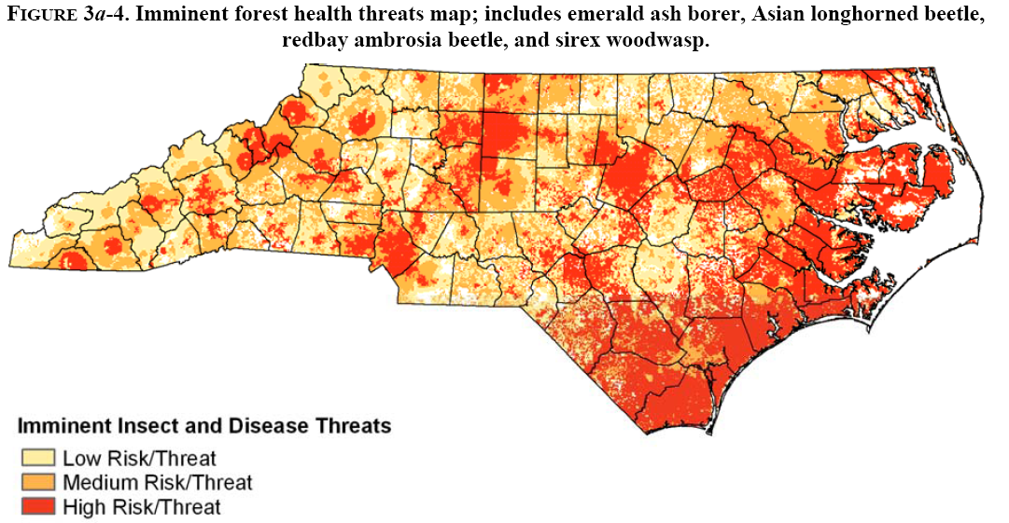

Slide 13
Emerald ash borer
Asian longhorned beetle
Redbay ambrosia beetle
Sirex woodwasp

Slide 14
Also assessed:
Diseases:
Brown spot needle blight
Butternut canker
Oak decline
Dogwood anthracnose
Pitch Canker
Pine Declines (WP and Lob)
Sudden oak death
Non-native Invasive Plants:
Bradford pear
Chinaberry
Cogon Grass
Common reed
English ivy
Garlic mustard
Japanese honeysuckle
Japanese knotweed
Kudzu
Lespediza (various)
Meadowsweet
Mimosa
Miscanthus
Multiflora rose
Oriental bittersweet
Paulownia
Periwinkle
Privets
Stiltgrass
Tree of Heaven
Wisteria (various)
Insects:
Black twig borer
Fall cankerworm
Tent caterpillars (ETC &FTC)
Locust leafminer
Nantucket pine tip moth
Pales/Reproduction weevils
Pine bark adelgid
Ips & black turpentine beetles
Redheaded pine sawflies

Slide 16
Strategy Summary:
Provide necessary training and I&E materials for forest resource professionals to manage threats
Promote use of local firewood
Survey and monitor for, and actively respond to, imminent threats
Promote sound silviculture to prevent, minimize, and mitigate threats

Slide 17
Robert Trickel

Slide 18
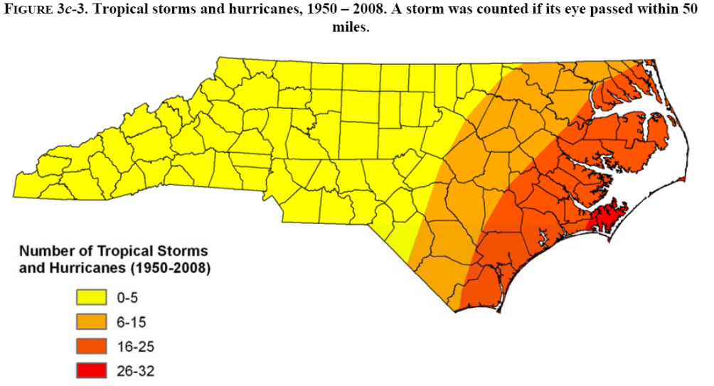
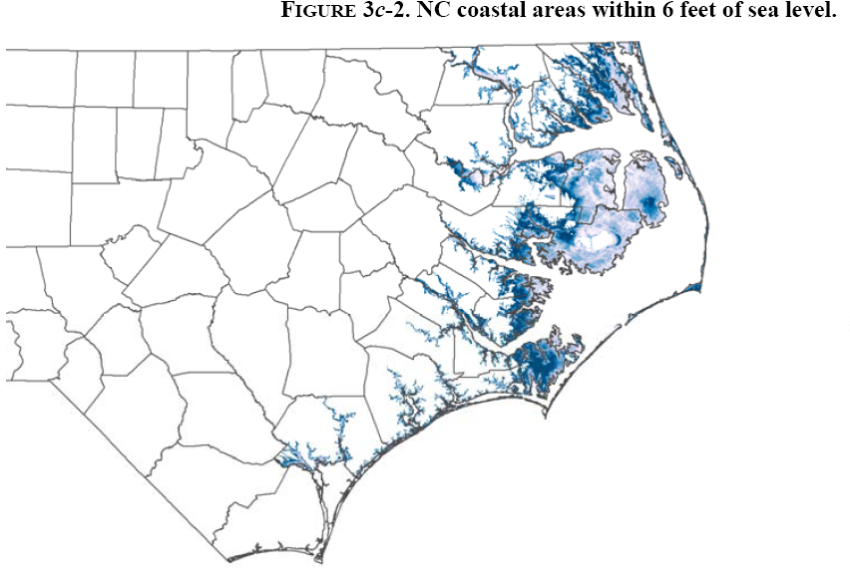
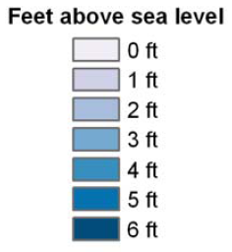
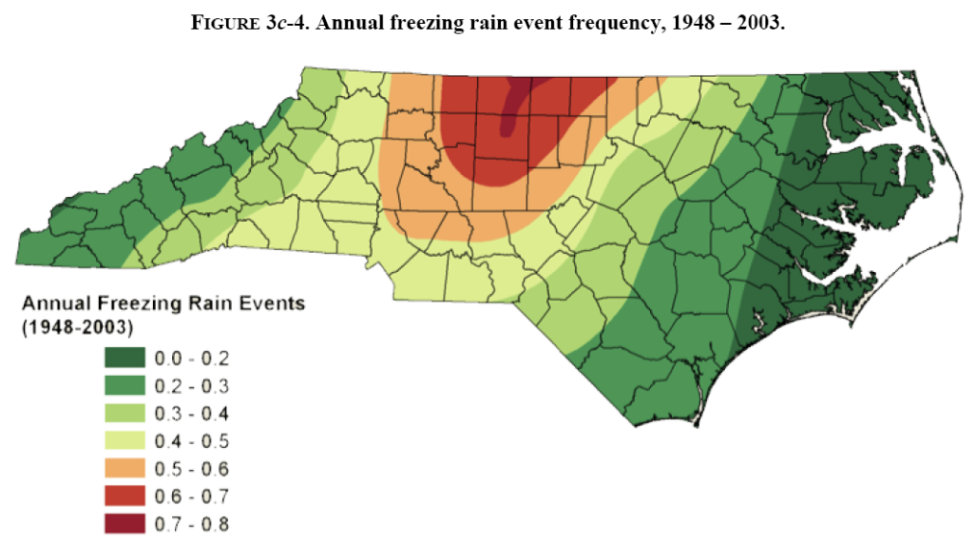

Slide 19
Also assessed:
Air quality
Atmospheric Deposition
Drought

Slide 21
Strategy summary:
Promote research towards better understanding direct impacts to trees from climate change and air quality issues
Develop and promote FM practices to deal with these impacts (esp. sea-level change and saltwater intrusion)
Increase tree planting/silviculture to promote carbon storage
Promote comprehensive and coordinated planning/response to manage forest resources affected by damaging weather events

