Slide 1
Enhance the Benefits and Sustainable Management of Urban Forests
FM Academy Webinar
October 19, 2010
Notes:
Good morning, my name is Alan Moore. I’m the eastern region urban forestry specialist. This presentation will be a tag team effort. I’ll start things off with a brief history, explain what, why and how we developed the urban forestry part of the assessment, give you a few definitions, and present our key findings. Then, my counterpart from the western region of the state, Eric Muecke, will be wrapping up the presentation. He’ll explain each of those key findings a little more and what they mean. And then we’ll entertain any questions you might have from this presentation.

Slide 2
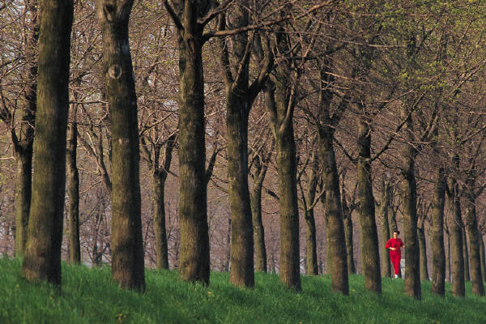
What did the Assessment show about urban forestry in North Carolina?
Main purpose – identify areas where forest loss would impact urban and community forests.
Describe urban forest conditions
Identify benefits and services
Highlight trends and issues of concern
Notes:
We started off with a working group of professionals from across the state. These professionals are experts in the urban environment and were valuable in providing insight on wildlife, development, land-use change and planning and their relationship to urban forestry. Our main purpose was to identify areas where forest loss would have the greatest potential to negatively impact urban and community forests.
We were going to do this by:
First, describing the urban forest conditions in general across the state,
Then, identifying the benefits and services that are derived from the urban forest canopy,
And finally, highlighting the trends and issues of concern within the urban areas.

Slide 3
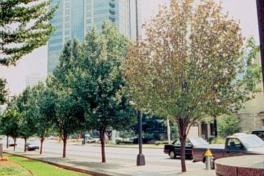
What did the Assessment show about urban forestry in North Carolina?
Issue 1: Changing land use patterns threaten our urban forests.
Issue 2: Natural catastrophic events threaten our urban forests.
Issue 3: The rise in greenhouse gases impacts our urban forests.
Issue 4: Urban forests are underutilized in energy conservation.
Issue 5: Too few urban forest management programs are proactive.
Notes:
There were 5 issues that our working group determined are affecting the urban forests across our state the most. The full version of each issue statement is in the assessment, but they can each be summed up into these brief one line statements – land use changes and natural catastrophic events threaten our urban forests, greenhouse gases affect our urban forests, urban forests are underutilized, and there is not enough proactive management of our urban forests.

Slide 4
Definitions and Assumptions
Urban forest – the system of trees, and associated natural resources within city jurisdictional limits, and the surrounding area where the urban fringe is expanding into the rural landscape
Healthy urban forest – an actively managed forest, able to withstand change, and consisting of an interconnected network of green space that conserves the natural ecosystem values and function
Priority areas – relative designation given to areas as values of different components are summed
Notes:
Before going further, I want to define a few terms and let you know the assumptions that were used.
The urban forest is not just the trees within the city limits. In doing the analysis, we looked at not only the trees in cities and towns, but also other natural resources in the cities and the trees and natural resources in areas surrounding the cities. On the next slide I’ll show you on a map what areas were included, but wanted you first to have an understanding of what we were looking at when we say urban forest.
[Click] Next, a healthy urban forest is that system of trees and associated natural resources that is actively managed to maximize the benefits that can be derived. This touches on the trends we were trying to identify. Are the urban forests across the state becoming more healthy through proper management or are they being left out and neglected?
[Click] And then, priority areas. This is a term you’ll probably hear many times. What it describes is that while all areas are important and deserve attention, some areas have more challenges or needs to developing a healthy urban forest.

Slide 5
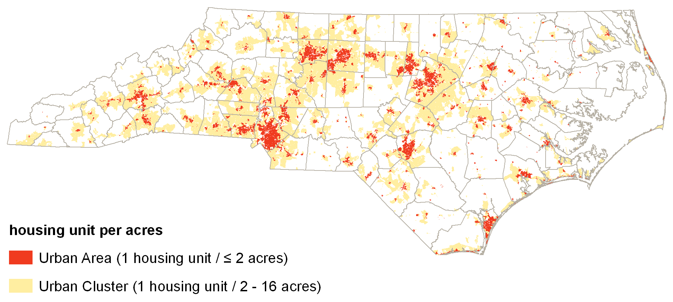
Definitions and Assumptions
Notes:
Like I said before, we looked at all areas across the state when doing our analysis, but limited the analysis to those areas that currently have or are projected to have by the year 2030, housing densities of 1 housing unit per 16 or less acres. What that means is that we looked at areas across the state that show up on this map as either red or yellow. The areas of white, we didn’t include in the analysis.

Slide 6
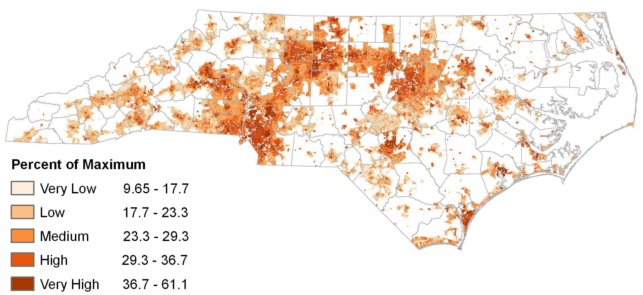
Key Findings
Using trees to improve air quality in the Piedmont Crescent is a priority
Trees planted to reduce energy use is a priority in densely populated areas
In the next 20 years cities will lose about 6% of their current forestland
Natural disasters impact urban forests most in north central and southeast
Only ⅓ of cities have at least 1 of 4 parts to urban forestry management
Notes:
After identifying the 5 issues, 2 slides ago, we then used the magic of GIS to determine the priority areas for urban forestry. That’s kind of the simple explanation, but truly we used spatial analysis tools within ArcView to determine trends and find out the areas and places of most concern. For all of the issues we used a weighted overlay analysis. Meaning that we assigned a weight to each layer, be it canopy cover, natural disaster events, etc. and then used ArcView to determine a value for each pixel.
From what we saw in the analysis, we determined these 5 key findings. The full text of each finding is available within the assessment document, but these are one line statements that sum them up.
And now Eric will explain each of the key findings and what they mean.

Slide 7
Key Findings to Enhance the Benefits and Sustainable Management of Urban Forests
Urban areas within the Piedmont Crescent are high-priority areas for tree conservation and planting efforts to improve local air quality.
Reduce the impacts of land-use change and urbanization on forested landscapes in and around urban areas.
Facilitate strategic planting and maintenance of community trees for public benefit.
Notes:
Thank you Alan.
After identifying our key findings, we then identified objectives to have a positive effect on those findings.
Our first key finding is that we need to focus on tree conservation and planting to improve local air quality. The highest priority area is the Piedmont Crescent that runs from Charlotte in the south, follows the hwy 85 corridor, includes Winston-Salem/Greensboro/High Point and currently ends in Raleigh. (click)
We need to work with communities in this area of intense development to identify the forest resources that improve the air quality to be sure that they are not impacted by land-use changes. (click)
Much of the Piedmont Crescent already has problems with air quality. Studies have shown that local plantings help filter the air of pollutants and particulates. Strategic plantings, specifically directed at improving air quality, can be an effective tool. (click)

Slide 8
Key Findings to Enhance the Benefits and Sustainable Management of Urban Forests
Communities of all sizes and in all regions of North Carolina could reduce energy consumption with strategic tree planting efforts; the more densely populated areas are higher priority areas.
Facilitate strategic planting and maintenance of community trees for public benefit.
Notes:
Any community, or any homeowner for that matter, can utilize trees to reduce energy consumption. (click)
The National Arbor Day Foundation has indicated that windbreaks, planted on the north side of a building, can reduce heating costs by up to 20%. Shade trees planted on the west side can reduce summer cooling costs 15 – 35%. Even shading the air conditioner unit itself can reduce AC costs by up to 10%.
A recent news report from Environment NC indicates that Germany is the largest producer of solar energy. That same report indicates that North Carolina, with 4 hours of peak sun per day, could double the production Germany.
This is why strategic planting is important. (click)

Slide 9
Key Findings to Enhance the Benefits and Sustainable Management of Urban Forests
North Carolina municipalities are predicted to lose approximately 6 percent of their current forestland between 2010 and 2030. A higher number of mountain communities will lose forestland; the greatest amount of change will occur in the piedmont.
Reduce the impacts of land-use change and urbanization on forested landscapes in and around urban areas.
Encourage policies and guidelines that sustain urban and community forests for the public’s benefit.
Notes:
Our third key finding indicates that we are losing forestland. This should come as no surprise. That data that we worked with indicated a 6% loss of forestland, in our urban areas, over the next 20 years. Individual community canopy studies by the USFS indicate that the percent of loss is actually somewhere between 20 and 40% over the next 20 years. One reason for this is that we need a better way to identify the urban forest canopy at the state scale. Our current data is just not as precise as needed. (click)
Again, we have to work with communities to reduce the impacts of land-use change. (click)
We also need to encourage communities to develop policies and guidelines. This includes things like preserving and maintaining green space and green infrastructure through planning and “smart growth.” (click)

Slide 10
Key Findings to Enhance the Benefits and Sustainable Management of Urban Forests
Natural disasters have the greatest impact on urban forests within the northern counties of the North Carolina piedmont and the southern counties of the North Carolina coastal plain.
Facilitate strategic planting and maintenance of community trees for public benefit.
Assist communities with establishing and managing their urban forests.
Notes:
Natural disasters can include things such as hurricanes, tornadoes, storms, ice and snow. These incidents can happen throughout the state, but have typically impacted the Northern Piedmont and the Southern Coastal Plain with a greater frequency and ferocity. (click)
Communities need to address the maintenance of the urban forest. This includes:
Selecting good stock of long-lived, well-structured, storm tolerant trees for planting
Proper pruning – including young tree training and cycle pruning of the tree population
Identifying/monitoring risk trees
A tree removal program
These activities can reduce the impact of storms on the urban forest and the effect on our communities. (click)
This can help a “reactive” community take the steps to proactively managing their urban forest resource.

Slide 11
Key Findings to Enhance the Benefits and Sustainable Management of Urban Forests
Only one out of every three communities has at least one of the four performance measures that lead to an active urban forestry management program.
Advocacy Group (Tree Board)
Public Tree Ordinance
Professional Staff
Management Plan
One – 70 (≈11%)
Two – 66 (≈10%)
Three – 38 (≈6%)
Four – 36 (≈5.5%)
Notes:
Finally, few communities meet the USFS standards of a “managing program.”
The USFS identifies a managing program as one that has an advocacy group or tree board, has a public tree ordinance that authorizes the management of street trees and trees on public property, professional staff (forester, arborist), and has a management plan for the urban forest. (click)
Of the 655 census designated places in NC, only 210 communities have met at least one of these standards.
1-70; 2-66; 3-38; 4-36 (click)

Slide 12
Key Findings to Enhance the Benefits and Sustainable Management of Urban Forests
Only one out of every three communities has at least one of the four performance measures that lead to an active urban forestry management program.
Assist communities with establishing and managing their urban forests.
Encourage policies and guidelines that sustain urban and community forests for the public’s benefit.
Notes:
This is why it is so important to assist communities in managing their urban forest resource. (click)
That management has to be based on good policies and guidelines with an emphasis on the benefits that the urban forest provides the public. (click)

Slide 13
Urban Forestry Priorities
Notes:
As a review, these are the areas where we have to place a priority on managing the resources of the urban forest for the benefit of the public. Our activities can then work toward the goal, which is to enhance the benefits and sustainable management of urban forests.
As a final note… The state of North Carolina is one of the fastest growing states in the nation. 80% of the national population resides in an area that is designated as “urban.” We need to be sure that the forest resource in these urban areas is managed for the benefit of all.
With that, I would like to thank you on behalf of Alan, the urban forestry work group, and the rest of the Urban and Community Forestry program; and remember, we are here to assist you with the needs of your service area. (click)

Slide 14
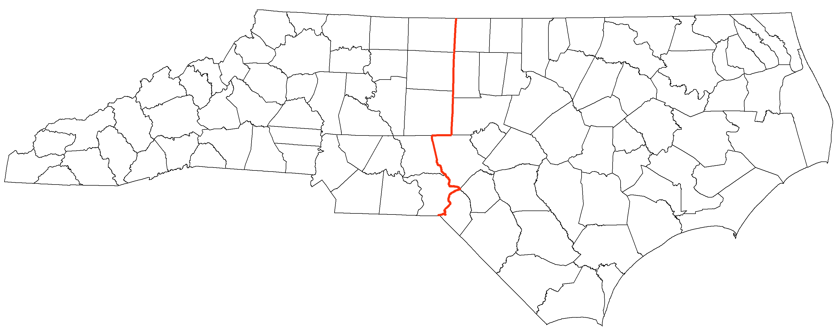
Questions?
Western Region Urban Forestry Specialist
Eric Muecke
(828) 438-3793 x 205
Eric.Muecke@ncdenr.gov
Eastern Region Urban Forestry Specialist
Alan Moore
(919) 857-4841
Alan.Moore@ncdenr.gov

