Slide 1












  North Carolina’s Forest Resources Assessment
  A statewide analysis of the past, current and projected future
  conditions of North Carolina’s forest resources
  2010
GOAL 6
Manage, conserve, restore, and enhance forestlands important to current and future supplies of clean water for economic, social, and ecological uses.
Assessment Chapter 4f: page 187 -- 197

Slide 2

USFS – NASF Guidance
Goal 6
“Assessments should identify watersheds where continued forest conservation and management is important to the future supply of clean municipal drinking water, or where restoration or protection activities will improve or restore a critical water source.”

Slide 3
Key Findings
Goal 6
NC’s surface water supply watersheds are 60% forested.
Groundwater wellhead protection areas are 36% forested.
  So What? Forests and forest management practices play a vital role in sustaining clean, abundant, and affordable supplies of drinking water.
Approximately two-thirds of the subwatersheds in NC have less than 70% forest or natural land cover.
  So What? Research shows when a watershed’s land cover falls below this threshold percentage, a significant reduction of water quality results.
CONCLUSION: Based upon the relatively rapid expansion of urbanizing areas, an emerging opportunity exists to re-evaluate and transform the role that forest management can serve in those subwatersheds that are located across urban, suburban, and rural transition areas.

Slide 4
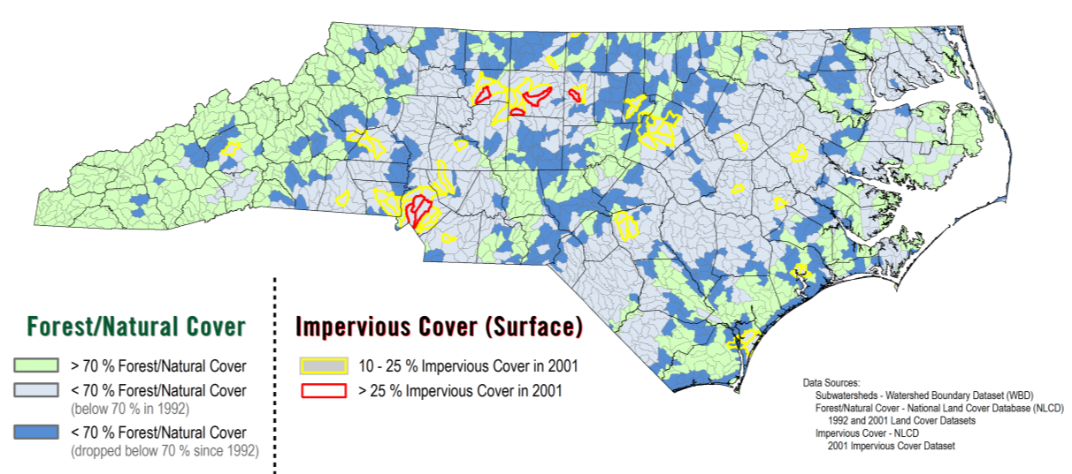
Watershed Conditions
Goal 6
Figure 4f-5, page 191

Slide 5
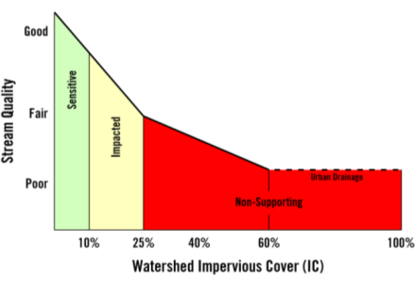
Watershed Conditions
Goal 6
Another way to illustrate the same concept...

Slide 6
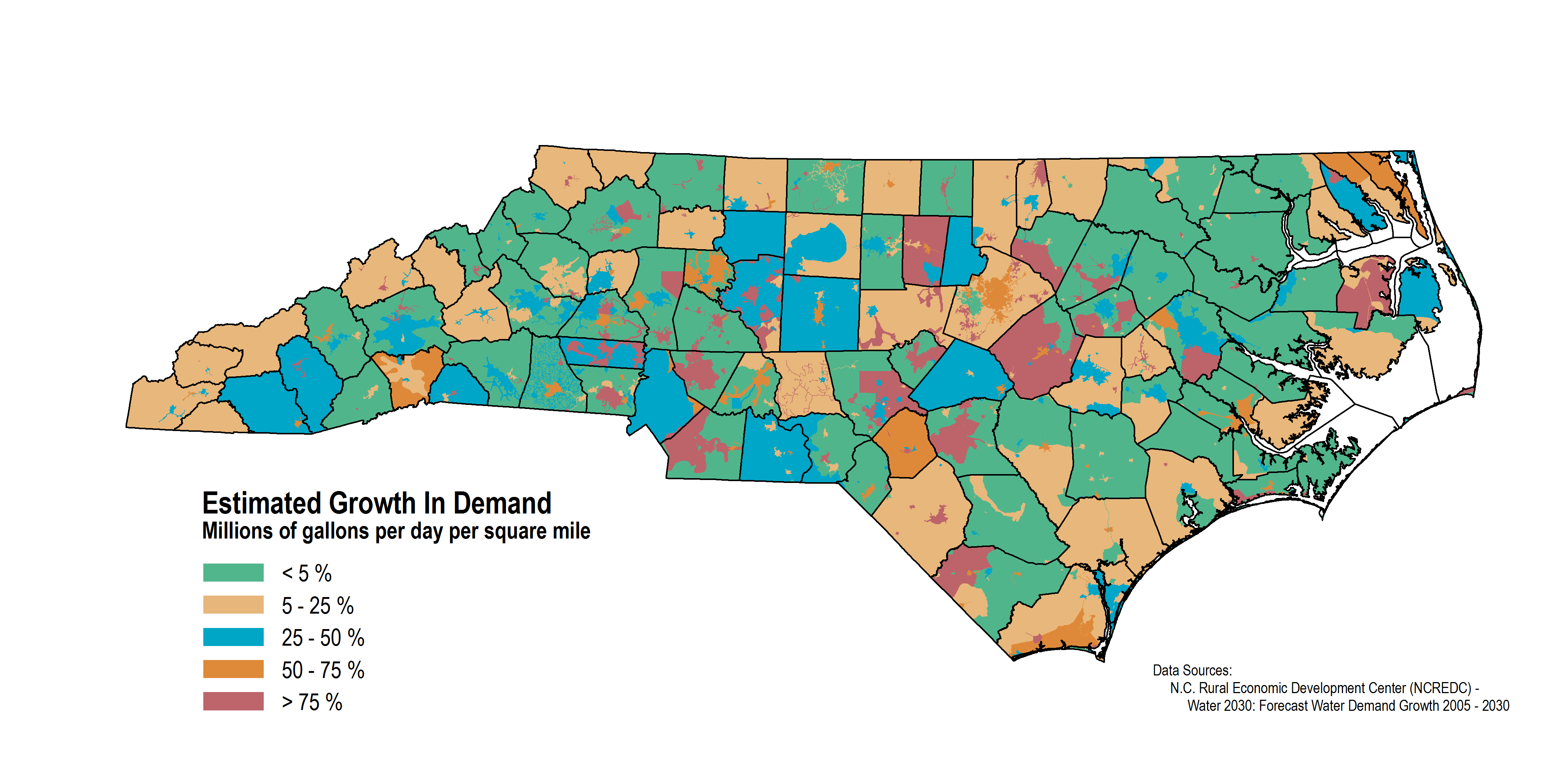
Water Supply & Demand
Goal 6

Slide 7
Priority Watershed Analysis
Goal 6
NC Conservation Planning Tool – Water Services Assessment
NCREDC – Forecasted Water Demand Growth
Southern Forest Lands Assessment (SFLA) – forestland layer
NC Source Water Assessment and Protection Areas
Southern Forest Lands Assessment (SFLA) – development layer

Slide 8
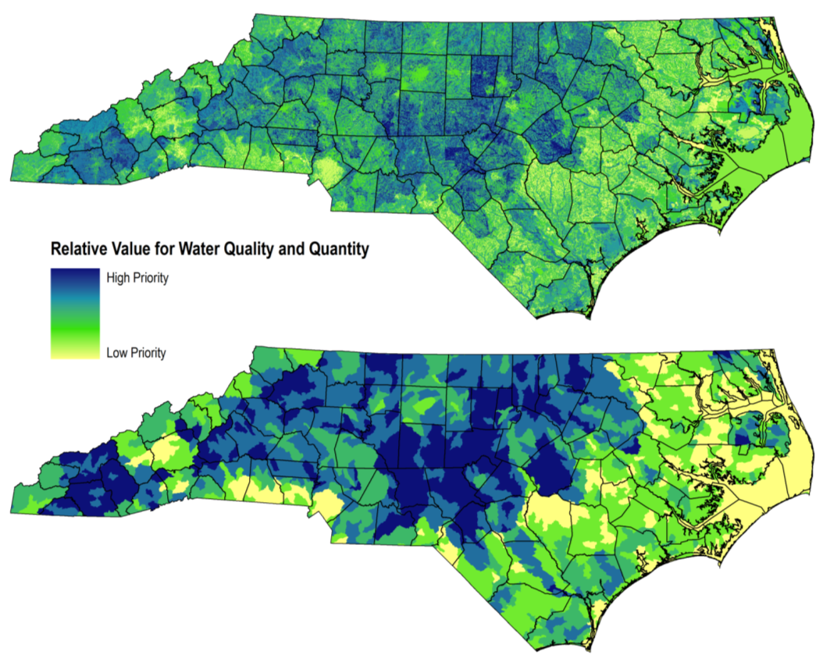
Priority Watersheds
Goal 6

Slide 9
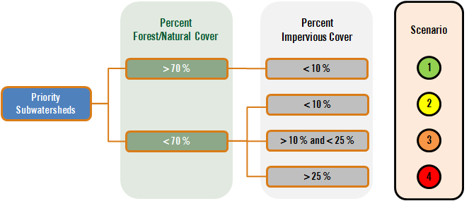
Forest Watershed Scenarios
Goal 6

Slide 10
What do we propose to do?
Goal 6
Ch.5d, Goal 6 Objectives & Strategies: pg 332 – 338
GOAL 6 – Manage, conserve, restore, and enhance forestlands important to current and future supplies of clean water for economic, social, and ecological uses.
Objective 6.1. – Increase implementation of forestry BMPs and compliance with water-quality regulations.
Objective 6.2. – Retain or increase the area of forestland within priority watersheds.
Objective 6.3. – Conduct education and outreach on the relationships between forests and water resources.
Objective 6.4. – Offer landowners technical assistance that incorporates water-resource management with forest management.

